Slide 1
The Whats and Whys of Tracing
OpenTelemetry FTW
Dave McAllister

Slide 2
Senior Technical Evangelist
Dave McAllister
Day 115
Notes:
A Million Points of Data
Married (so I have a witness that I can’t read minds)
10 years as a soccer referee (I’m used to people disagreeing with me)
Owned by 3 cats (I’m trained in being ignored)

Slide 3
Data is the driving factor for Observability
Notes:
But what if you never got all the data?
You never got all the data
You missed ephemeral data
Your data showed you something that you couldn’t drill into
You only saw the good stuff (or the bad stuff)

Slide 4
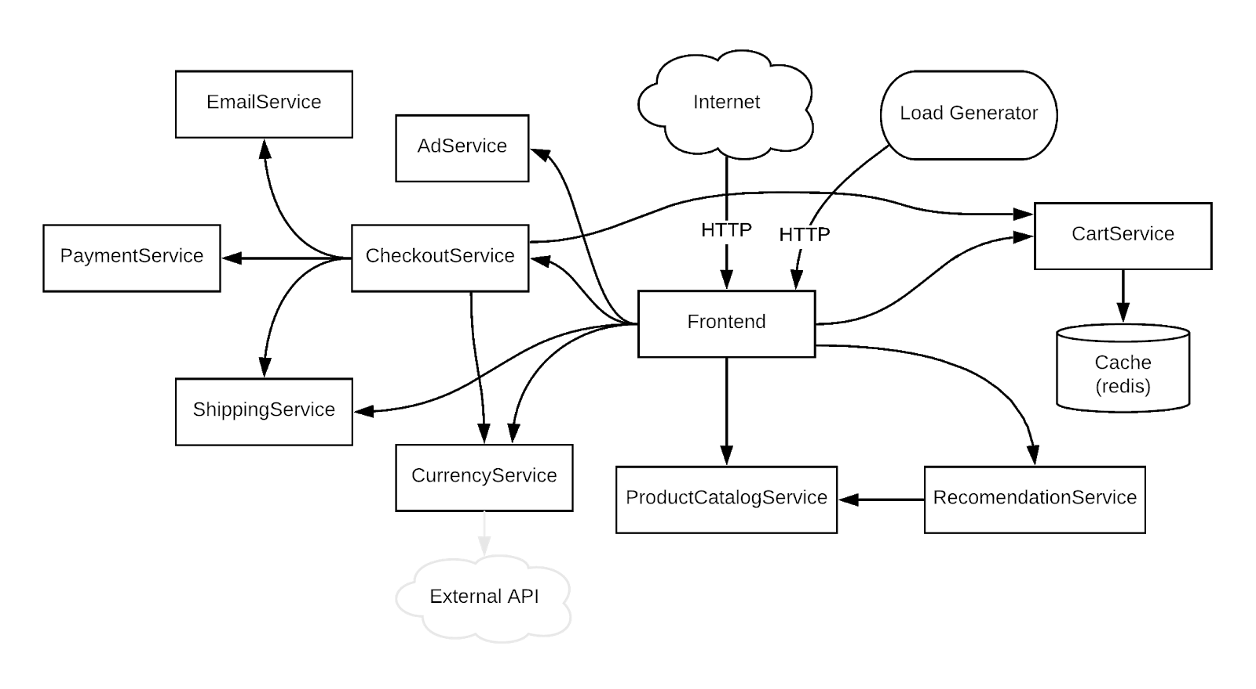
EXAMPLE MICROSERVICE ARCHITECTURE

Slide 5
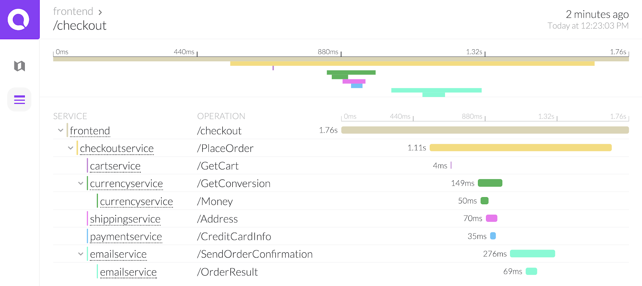
DISTRIBUTED TRACE VISUALIZATION

Slide 6
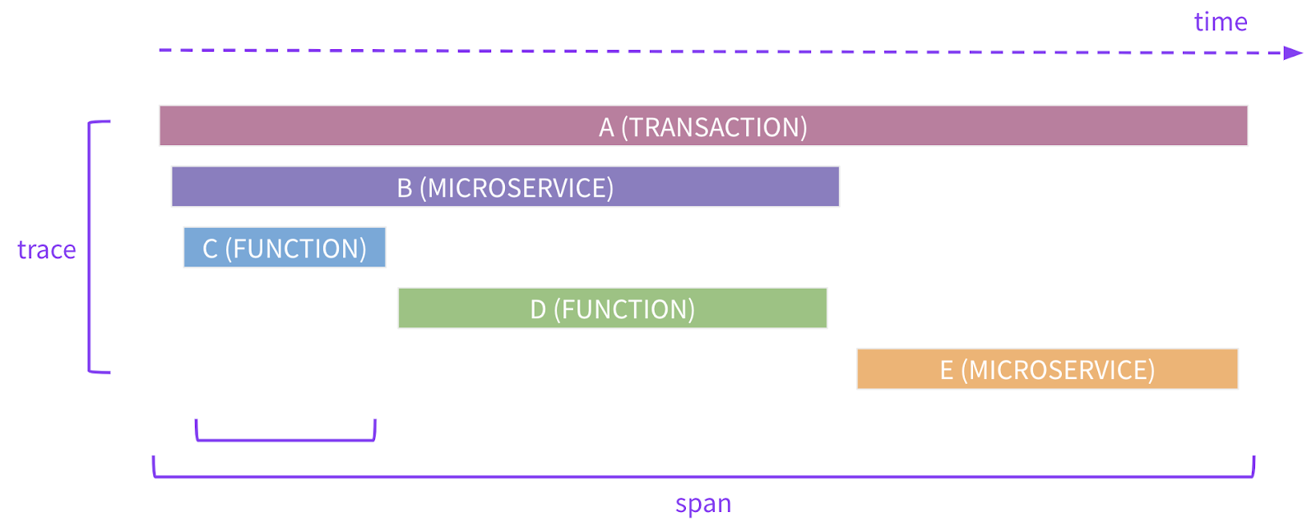
DISTRIBUTED TRACE DETAILS

Slide 7
METRICS IN MICROSERVICE ARCHITECTURE
Code push 5x num requests
CPU at 100% for > 5 minutes

Slide 8
LOGS IN MICROSERVICE ARCHITECTURE
Increase in HTTP 503

Slide 9
“Observability is not the microscope. It’s the clarity of the slide under the microscope.”
Baron Schwartz

Slide 10
Data Collection
Standards-based agents, cloud-integration
Automated code instrumentation
Support for developer frameworks
Any code, any time
No cardinality limits

Slide 11
What is OpenTelemetry?
+
=
OpenCensus
OpenTelemetry: the next major version of both OpenTracing and OpenCensus

Slide 12
Cloud Native Telemetry
Telemetry “verticals”
 | Tracing | Metrics | Logs, etc
Instrumentation APIs
Canonical implementations
Data infrastructure
Interop formats
foreach(language)
foreach(language)
Telemetry “layers”
collectors, sidecars, etc
w3c trace-context, wire formats for trace data, metrics, logs, etc

Slide 13
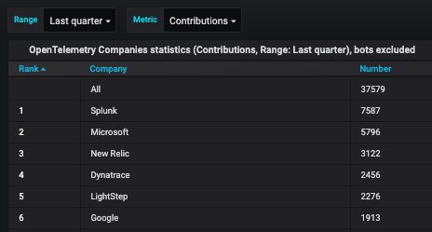
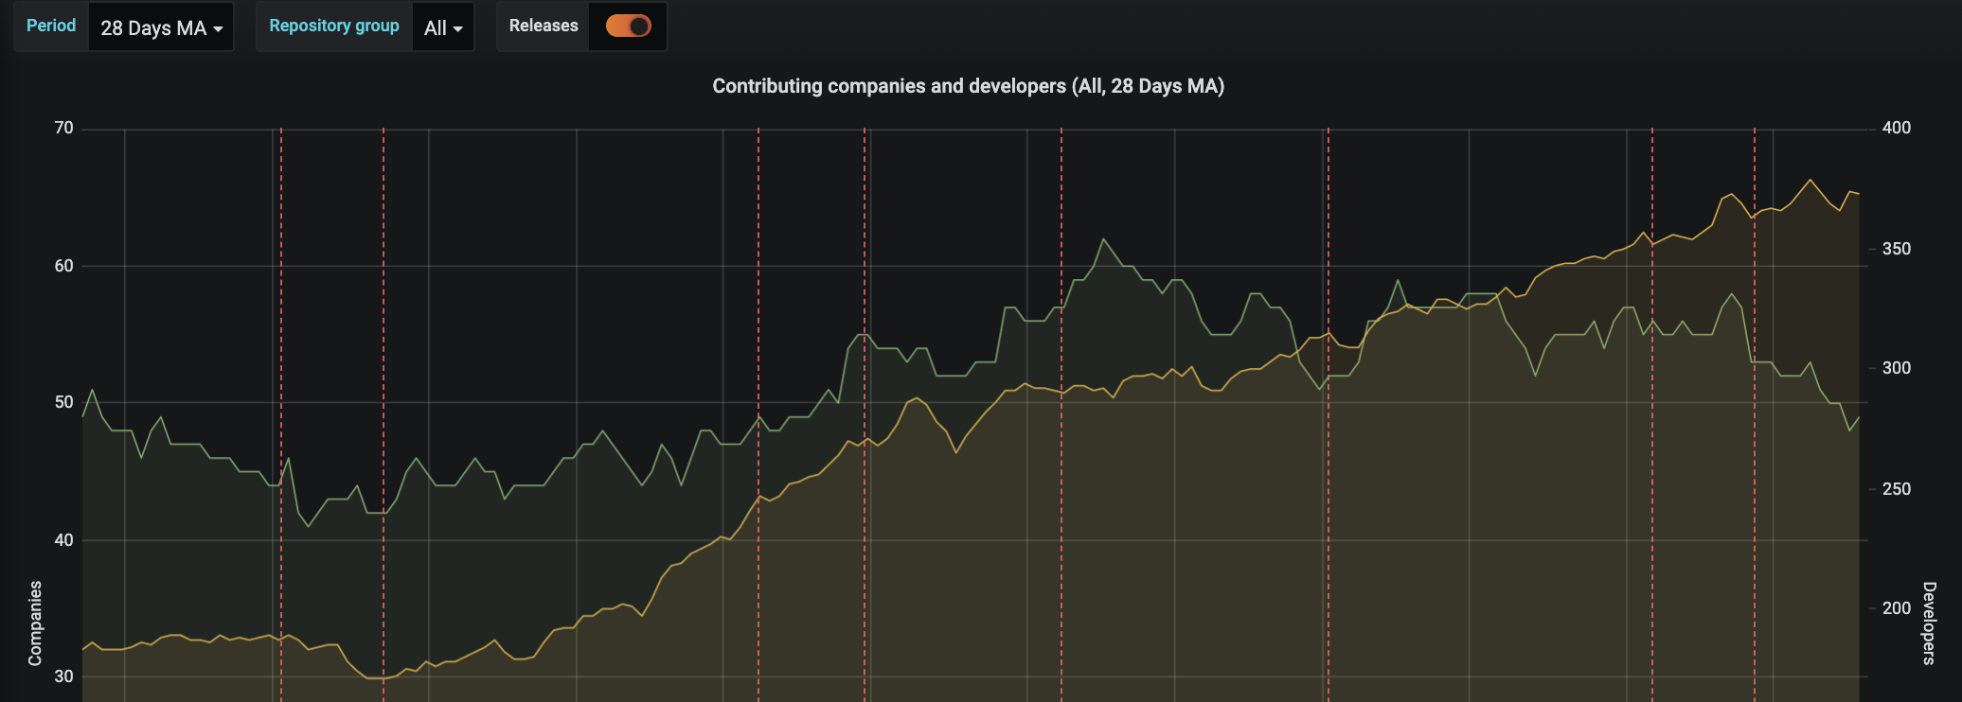
Project Stats
CNCF DevStats
General: 149 companies
Contributors: 660+ unique contributors and 60K+ contributions
Community Stats
Cloud Providers: Azure and GCP
Users (and contributors): Mailchimp, Postmates, Shopify, Zillow
CNCF Project Collaboration
Fluentbit: Potential log agent for OpenTelemetry
Jaeger: Plan to leverage client libraries and collector (collector already announced)

Slide 14
is the second most active
project in CNCF today!
(per CNCF DevStats)

Slide 15
Why do you want to trace?

Slide 16
What problems are you trying to solve?
A tiny subset of answers*
- Performance issues
- Mean time to resolution and detection is too high
- Metrics and logs are missing valuable context.
- More data types can provide better answers

Slide 17
Gaps in current observability method
A tiny subset of answers*
Difficult to correlate observed behavior with what is operating.
Difficult to collect data in different formats
No (observable) gaps and want to try something new

Slide 18
Goals of tracing
Questions to ask yourself and of your organization
Which teams/components would benefit the most?
How much resources are available to this effort?
What is the short term goal and long term goal?
If already in use, how is adoption? What are possible roadblocks to higher adoption?
Why tracing now?

Slide 19
Architecture

Slide 20
Components
Specifications
API
SDK
Data
Collector
Vendor-agnostic way to receive, process, and export data
Default way to collect instrumented apps
Can be deployed as an agent or service
Client Libraries
Vendor-agnostic app instrumentation
Support for traces and metrics
Automatic trace instrumentation
Incubating: Logging
Status = Beta for Traces + Metrics:
Collector
Erlang
Go
Java (including auto instrumentation)
Javascript (including web)
Python (auto instrumentation planned)
Coming soon:
.NET (auto instrumentation planned)
Ruby (auto instrumentation planned)

Slide 21
Reference Architecture: OpenTelemetry
Host
Application
Back-end 1
Host
Application
Otel Library
Otel Library
Otel Collector (Service)
Otel Collector (Agent)
Back-end 2
Otel Collector (Agent)
Metrics
Traces + Metrics

Slide 22
Specifications

Slide 23
Tracing Basics
Context: W3C trace-context, B3, etc.
Tracer: get context
Spans: “call” in a trace
Kind: client/server, producer/consumer, internal
Attributes: key/value pairs; tags; metadata
Events: named strings
Links: useful for batch operations
Sampler: always, probabilistic, etc.
Span processor: simple, batch, etc.
Exporter: OTLP, Jaeger, Prometheus, etc.
Notes:
Chris

Slide 24
Tracing and Semantic Conventions
In OpenTelemetry, spans can be created freely and it’s up to the implementor to annotate them with attributes specific to the represented operation.
Some span operations represent calls that use well-known protocols like HTTP or database calls. It is important to unify attribution.
HTTP: http.method, http.status_code
Database: db.type, db.instance, db.statement
Messaging: messaging.system, messaging.destination
FaaS: faas.trigger

Slide 25
Metrics Basics
Context: span and correlation
Meter: used to record a measurement
Raw Measurement
Measure: name, description, unit of values
Measurement: single value of a measure
Metric: a measurement
Kind: counter, measure, observer
Label: key/value pair; tag; metadata
Aggregation
Time

Slide 26
Resource SDK + Semantic Conventions
A Resource is an immutable representation of the entity producing telemetry.
All of these
Environment: Attributes defining a running environment (e.g. cloud)
Compute instance: Attributes defining a computing instance (e.g. host)
Deployment service: Attributes defining a deployment service (e.g. k8s).
Compute unit: Attributes defining a compute unit (e.g. container, process)
Notes:
For example, a process producing telemetry that is running in a container on Kubernetes has a Pod name, it is in a namespace and possibly is part of a Deployment.

Slide 27
OpenTelemetry and Logs (Incubating!)
The Log Data Model Specification : https://github.com/open-telemetry/oteps/blob/master/text/logs/0097-log-data-model.md#motivation
Designed to map existing log formats and be semantically meaningful
Mapping between log formats should be possible
Three sorts of logs and events
System Formats
Third-party applications
First-party applications
Notes:
It should be possible to unambiguously map existing log formats to this Data Model. Translating log data from an arbitrary log format to this Data Model and back should ideally result in identical data.
Translating log data from an arbitrary log format A to this Data Model and then translating from the Data Model to another log format B ideally must result in a meaningful translation of log data that is no worse than a reasonable direct translation from log format A to log format B.
System Formats. These are logs and events generated by the operating system and over which we have no control - we cannot change the format or affect what information is included
Third-party Applications. These are generated by third-party applications. We may have certain control over what information is included, e.g. customize the format.
First-party Applications. These are applications that we develop and we have some control over how the logs and events are generated and what information we include in the logs.

Slide 28
OpenTelemetry and Logs
Two Field Kinds:
Named top-level fields
Fields stored in key/value pairs
Field Name | Description
Timestamp | Time when the event occurred.
TraceId | Request trace id.
SpanId | Request span id.
TraceFlags | W3C trace flag.
SeverityText | The severity text (also known as log level).
SeverityNumber | Numerical value of the severity.
Name | Short event identifier.
Body | The body of the log record.
Resource | Describes the source of the log.
Attributes | Additional information about the event.
Notes:
Top level fields. Think of these as fields that are mandatory (or frequently present) in well-known formats, like timestamp
AND where the semantics is the same for all log and event formats, thus can be mapped directly
This gives us the ability to efficiently represent those fields.
Key /value pairs gives us the flexibility to represent less-frequent data, both less-common standardized inputs as well as arbitrary custom data

Slide 29
Observability drives Evidence-based Debugging
Debugging for complex systems is iterative
Start with a high-level metric
Drill down and detangle based on fine-grained data/observations
Make the right deductions based on the evidence

Slide 30
Collector

Slide 31
Objectives
The OpenTelemetry Collector offers a vendor-agnostic implementation on how to receive, process, and export telemetry data in a seamless way.
Usable: Reasonable default configuration, supports popular protocols, runs and collects out of the box.
Performant: Highly performant under varying loads and configurations.
Observable: An exemplar of an observable service.
Extensible: Customizable without touching the core code.
Unified: Single codebase, deployable as an agent or collector with support for traces, metrics, and logs (future).
Notes:
Top level fields. Think of these as fields that are mandatory (or frequently present) in well-known formats, like timestamp
AND where the semantics is the same for all log and event formats, thus can be mapped directly
This gives us the ability to efficiently represent those fields.
Key /value pairs gives us the flexibility to represent less-frequent data, both less-common standardized inputs as well as arbitrary custom data

Slide 32
But Why?
Offload responsibility from the application
Compression
Encryption
Retry
Tagging / Redaction
Vendor-specific exporting
Time-to-value
Language-agnostic; makes changes easier
Set it and forget it; instrumentation that is ready for the Collector
Vendor-agnostic and easily extensible

Slide 33
Architecture
Otel Collector
Extensions: health, pprof, zpages
OTLP
OTLP
Batch
...
Queued Retry
Jaeger
Processors
Jaeger
Receivers
Exporters
Batch
...
Queued Retry
Prometheus
Prometheus
Processors

Slide 34
Getting Started: Traces (Automatic)
java -javaagent:path/to/opentelemetry-auto-<version>.jar \
-Dota.exporter.jar=path/to/opentelemetry-auto-exporters-otlp-<version>.jar \
-Dota.exporter.otlp.endpoint=localhost:55680 \
-Dota.exporter.otlp.service.name=shopping \
-jar myapp.jar
Instruments known libraries with no code (only runtime) changes
Adheres to semantic conventions
Configurable via environment and/or runtime variables
Can co-exist with manual instrumentation
WARNING: Do not use two different auto-instrumentation solutions on the same service.

Slide 35
Roadmap
Rest of client libraries to beta ASAP
Move to GA later this year for traces and metrics
Tracing auto instrumentation for all languages
Add initial log support (goal of beta later this year)
Improve documentation
Increase adoption; get case studies
Make getting started really easy

Slide 36
Problem solving
Imagine being paged
What questions do you ask yourself when you are being paged?
How do you filter out noise?
How do you determine what isn’t causing an issue?
How do you determine impact?

Slide 37
A span for everything or bare minimum
It depends
Remember why you want to trace
Rule of thumb: Start with service boundaries and 3rd party calls
Iterative process
There is information overload
Make it easy for teams to get tracing (for free or almost free)

Slide 38
Next Steps
Join the conversation: https://gitter.im/open-telemetry/community
Join a SIG: https://github.com/open-telemetry/community#special-interest-groups
Submit a PR (consider good-first-issue and help-wanted labels)

