Slide 1
Developer Friendly Platforms
With Kubernetes & Infrastructure as Code

Slide 2
$(whoami)
Staff Software Engineer
@Pulumi - https://pulumi.com
Blog
https://www.leebriggs.co.uk
GitHub
https://github.com/jaxxstorm
Twitter
https://twitter.com/briggsl
Notes:
Quick introduction - Lee Briggs
I occasionally write on my blog, and occasionally post on twitter

Slide 3
What we’ll cover today
Platforms
We’ll talk about what a “platform” might look like, and why you might want to build one at your organization
IaC
We’ll introduce Infrastructure as Code in the context of a platform, and explore some of the gaps and problems with existing tooling
Developer Friendly
We’ll talk about what it means to be developer friendly and bring the previous two topics
Notes:
Let’s first look at what we’re going to cover today
We’ll discuss the boom of “platforms” and why you might choose to build one
Some infrastructure as code considerations
Talk about what it takes to define a platform or IaC that’s developer friendly

Slide 4
Infrastructure Platforms
What are they, and might you need one?

Slide 5
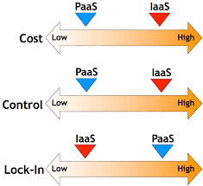
IaaS vs PaaS
Two widely used acronyms
Which is right for you?
Notes:
IaaS gives you control
Flexibility
IaaS means your interface is the infrastructure from the ground up
You define the database schema, the operating system etc
It’s a high level of control, with a high level of operational cost
Not everyone has that level of knowledge
PaaS removes your need to manage infrastructure. The data layer and infrastructure is defined for you.
This is easier to manage

Slide 6
Building a Platform
Public platforms are opinionated
You have to follow defined model and workflows
Your business logic - your way
Tailor your platform to suit your needs
Notes:
The problem with public PaaS is they’re opnionated
If you have legacy apps, you need to do a lot of work to fit the peg into the hole
New changes in our infrastructure has made it easier than ever to build a platform
You can build a platform that fits your application and business logic

Slide 7
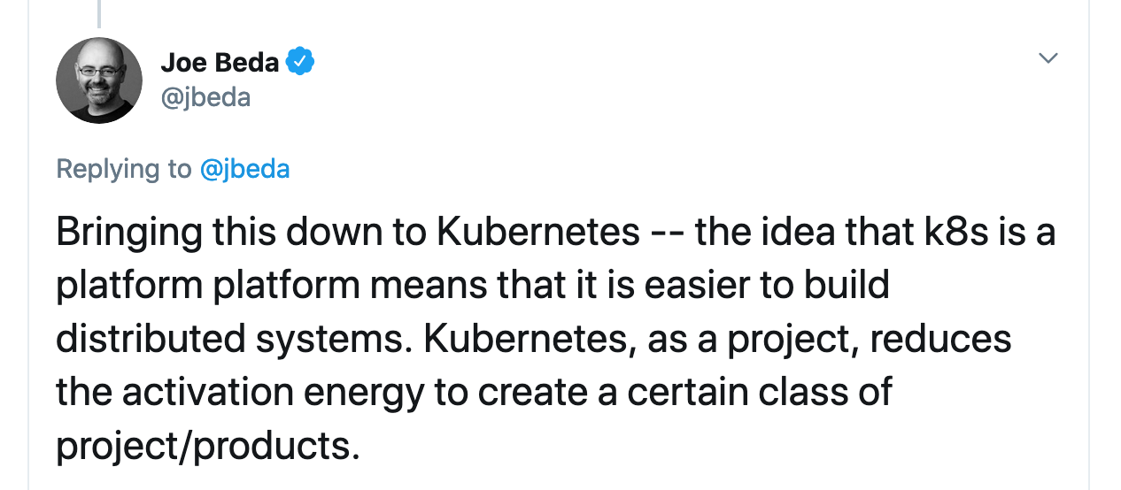
Kubernetes: The platform platform
Kubernetes makes it easier to build platforms for your business
Defines low-level primitives and APIs that make it easy to build on
Notes:
Kubernetes is the platform platform
It defines the APIs, primitives and resources needed to make easy for you to build a platform with much less effort than before

Slide 8
Infrastructure as Code
What is it, and why do you need it?

Slide 9
In a nutshell
“Infrastructure as code is the practice of managing and provisioning computer systems and services through machine readable definitions rather than interactive configuration tools”
Notes:
For those not familiar with the the term, what exactly does IaC mean?
This is my definition, slightly changed from the wikipedia definition

Slide 10
Why?
Auditing
Peer review
Consistency & Repeatability
Efficiency
Notes:
If you’re using the AWS console or the Kubernetes dashboard to deploy your resources, that’s not IaC
How do you know who deployed something? What if you want to do it again?
Clicking through a UI is slow, hard to repeat and hard to verify if you did what you intended

Slide 11
Configuration v Languages
Almost all IaC tools define infrastructure using configuration languages
JSON
YAML
Programming languages have control flow, conditionals but extra work needed for idempotence.
Notes:
Many IaC tools map the publicly available API to a configuration language
This usually works for small implementations, but once you scale past single instances, you need some kind of control flow in your tool. Many of the available tools work around this by using templating languages
This is limiting and most importantly, for many people it’s hard to understand!
Using a programming language means you get control flow built in, but how do you use desired state with that? Programming languages are rarely concerned with desired state, and require a lot of additional work and conditionals to get that effect

Slide 12
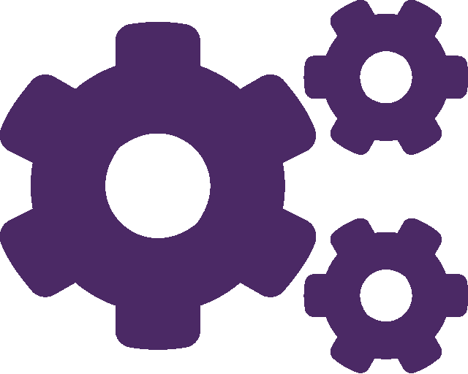
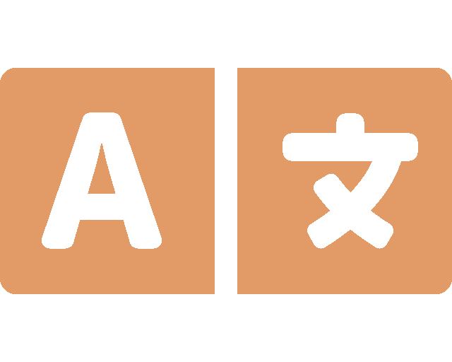
What is Pulumi?
Modern Infrastructure as Code
Any Cloud, Any Cloud Architecture
Familiar Programming Languages and Tools
For the Entire Cloud Engineering Organization
OPEN SOURCE
SAAS FOR TEAMS AND ENTERPRISES
Notes:
This is where Pulumi comes in!

Slide 13
Supported Languages
JavaScript
TypeScript
Python
Go
F#
C#

Slide 14
Developer Friendly Platforms
Bringing platforms & IaC togerher

Slide 15
Communication
Developers appreciate APIs
Machine readable language
Developers appreciate SDKs
Developer readable language

Slide 16
Tooling
Package management
Use the native installations methods developers are familar with
Development Environment
Use your familiar IDE
IntelliSense
Languages
Use the language that’s right for you
Use Pulumi’s powerful features to pass properties between languages

Slide 17
Demo time!

Slide 18
ComponentResources
“Packageable” resources delivered directly to your users
Grab them directly from your languages’ package manager
Mix & Match cloud resources & Kubernetes workloads
Deliver production ready applications with cloud backed services

Slide 19
Stack References
Export the important properties from your infrastructure stacks
Build infrastructure in the language you feel comfortable with
Infrastructure in Python
Application in Go
Database in C#
Expose only the properties others need

Slide 20
Kube2Pulumi
Convert complex, K8s YAML manifests to any languages
Convert to a language developers know
Enable their learning and understanding
Remove the need for templating languages

Slide 21
Automation API
Ship your automation interface in familiar terms
Build CLI tools that abstract complexity from users
Build GUI tools that guide your users
Infrastructure + Complex workflows

