Slide 1
A full application environment
for every PR
Notes:
Title:
ephemeral.run: A full application environment for every PR–before you merge to main!
Abstract :
How do you give Product managers an early view of new features before your changes are merged into main? How can your quality team run regression tests on a full, live environment, before merging into main? And how do you do these easily, quickly, and cheaply?
In this webinar, OpenGov and InfraCloud present “ephemeral.run” a system that enables a large team of developers to test their full stacks seamlessly within a GitHub pull-request native workflow. Ephemeral environments, but on steroids, build on the capabilities of Skaffold, Helm, and Github actions. Join us to hear about choices we made and what the future looks like at www.ephemeral.run!

Slide 2
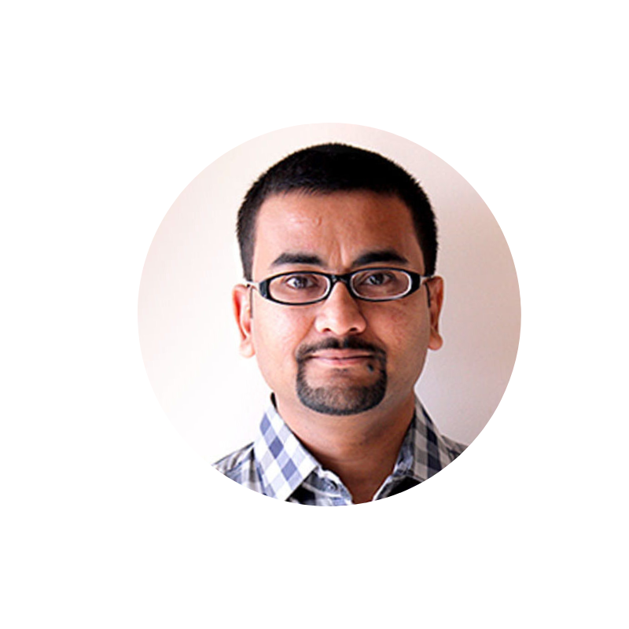
Vishal Biyani
CTO
InfraCloud
Jono Spiro
Ops Team
OpenGov

Slide 3
Agenda
Problem Statement 5 Minutes
Solution Overview 5 Minutes
Demo 15 Minutes
Numbers 5 Minutes
Roadmap Items
5 Minutes
Notes:
I'll give you a moment to review the agenda. There will be lots of time for questions during the demo and at the end!

Slide 4
Who needs an ephemeral environment?
Notes:
Who needs an ephemeral environment?
An ephemeral environment is one which is brought up as quickly as it can be destroyed and are purpose-built for development and testing. They're usually miniature versions of integration or production.
As a developer or quality engineer, you want to be able to spin up a whole environment on Kubernetes, run all your tests, and be sure your code is golden before merging to the main branch, or going to production. As the operations team, you want to provide your organization with cost-effective, easy-to-manage, right-sized, micro-environments.
There are many use cases for ephemeral environments:
Mixed local to remote development and debugging with personal environments, one per branch
Integration, regression, automation, and manual testing
Early feedback from design and product teams
Running your CI tests inside real-ish systems instead of mocks
Let's talk about the development lifecycle, and then we'll go over the criteria by which we select a technology to build ephemeral environments.

Slide 5
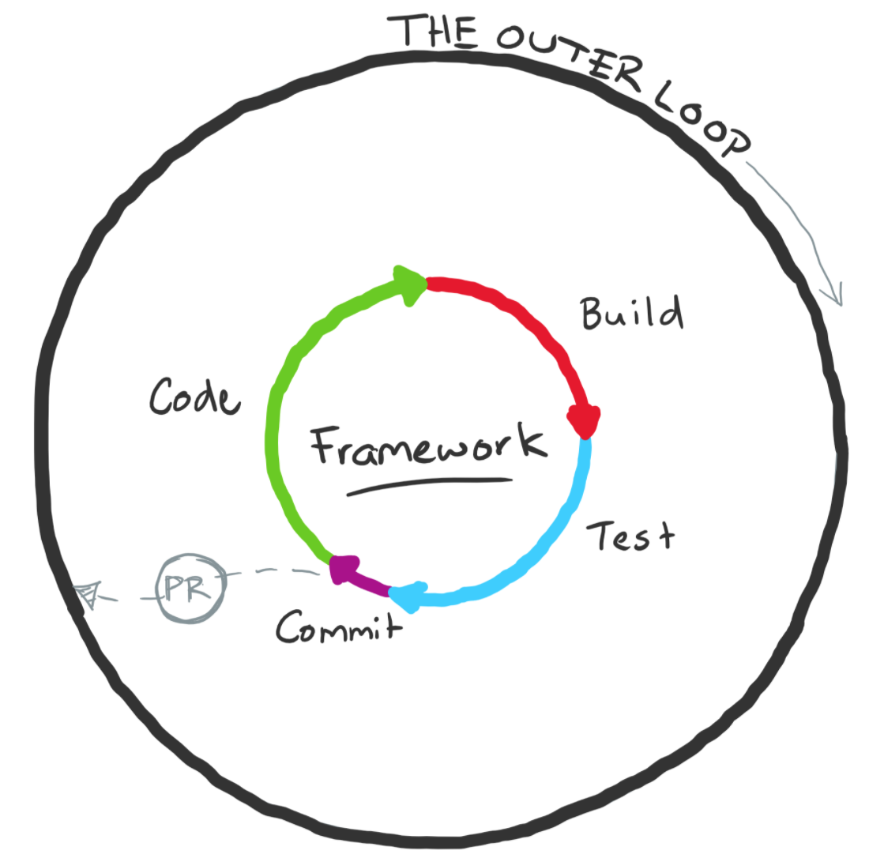
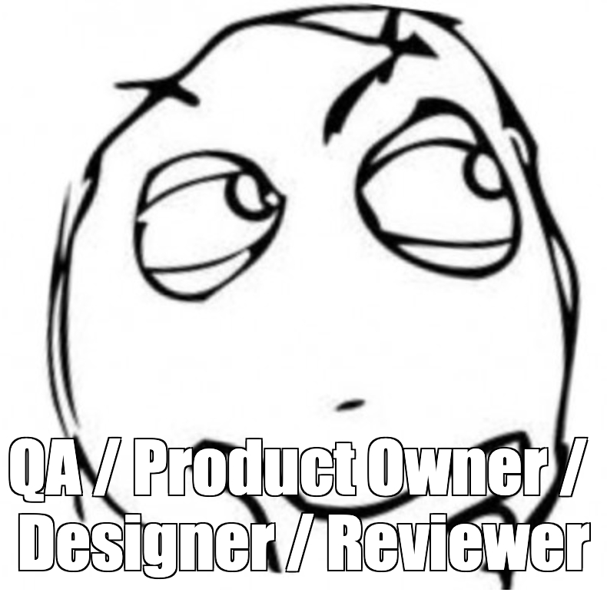
Inner/Outer Loop of Development
Wish I could try out this feature right now...
Wish I could test this feature with a full stack before PR...
Image Source : https://mitchdenny.com/the-inner-loop/
Notes:
Developers spend most of their lives within the inner loop of development: Make a change, build, deploy, test, repeat. We want this loop to be as fast as possible, spending most of our time iterating, not waiting. Our tests should be as realistic and close to production as possible, so that after we commit, merge, and release, we don't have to come back and fix issues that were missed during development.
In the inner loop we use IDEs and text editors, debuggers, unit tests–but there aren't as many solutions to testing our changes as we'd like, and every team and company has different needs. We tend to hack things together that aren't reflective of production, just enough to load localhost:8080 and get our work done: e.g. Docker Compose, a Makefile, or complex runners in our IDEs.
Our support teams of QA, Product, Design, and our peers excitedly and nervously wait for us to come up for air in the outer loop, ready to test new code, and get it to production as quickly and defect-free as possible. Every defect is another iteration of the inner loop–we want to avoid these context switches as much as possible.
And while bugs are inevitable, when we discover them is in our control. The worst case is for a customer to report a defect, so we want to left-shift the "when" as much as possible: fail fast and fail early. At the extreme left, developers often pair up to catch issues as they're created.
What we need are production-reflective development and testing environments that are fast, easy, and useful, as early as possible.

Slide 6
Evaluation criteria for an
ephemeral environment
Cost Per Environment
User Experience
Complexity & Team Maturity
Quality Experience
Product Experience
Notes:
Now that we know what we want, how do we pick a technology?
Cost: Can your company (afford to) stand up an entire cluster for each engineer? That may not be too hard, if you can afford it. But it's either very hard, and/or you absolutely cannot afford it, so you need a simplification.
User experience: Is the solution convenient? While Minikube is cheap and somewhat convenient, it has no ability to branch your infrastructure like you wish it could if it worked like git. You can't test new helm charts without impacting/compromising other work you're doing. You can't reset --hard and start over quickly if you mess it up. You can't switch branches and easily redeploy the changes. You probably don't even have a powerful enough laptop to run your cluster and your developer tools.
Complexity/team maturity: Does everyone on your team understand kubectl? Can they use Minikube? Maybe your developers do, but probably not well enough to stand up everything. And in any given solution, is your Ops team matured and experienced enough to manage ephemeral or shared environments?
Quality experience: Is the solution reflective of production–can you certify a release with it? What data is it seeded with? Is it repeatable, and can your team bring it up without knowing how it's built? Faking Kubernetes with pure container solutions like Docker Compose/Swarm or Ansible/Chef isn't real enough.
Product experience: Can you share new features with the design or product teams, or prospective customers, before the code is merged and released?
Most, if not all, existing solutions don't stack up well in all of these areas. That's our challenge. So what are our options?

Slide 7
Since everything in K8s
must be nautically themed...
Notes:
Since everything in K8s must be nautically themed...

Slide 8
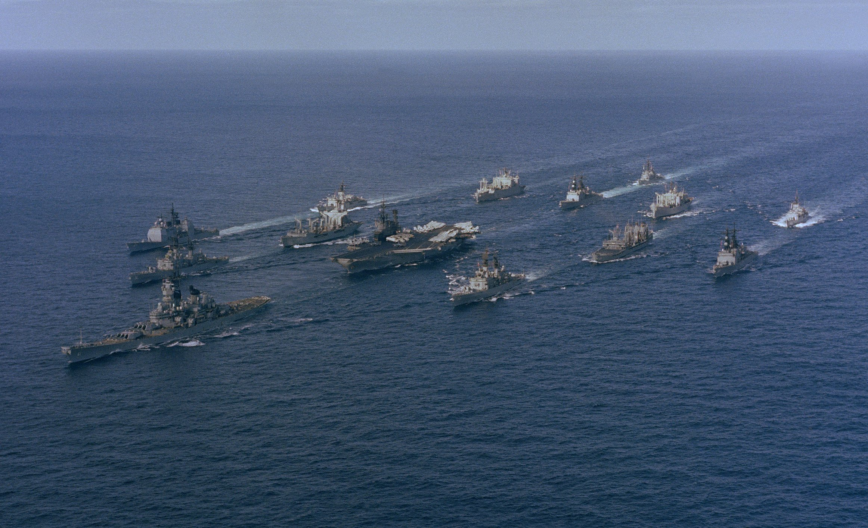
Production
is a battle group
Notes:
Production is a battle group: A massive, impossibly expensive fleet of services, requiring full-time, highly-trained operational crews. They're deployed in a protected, secret, or otherwise inconvenient location, and the fleet composition and course are decided months or years ahead, and cannot change easily.
As the most interesting man in the world once said: I don't always test my code, but when I do, I do it in production.
Let's… let's not do that anymore.

Slide 9
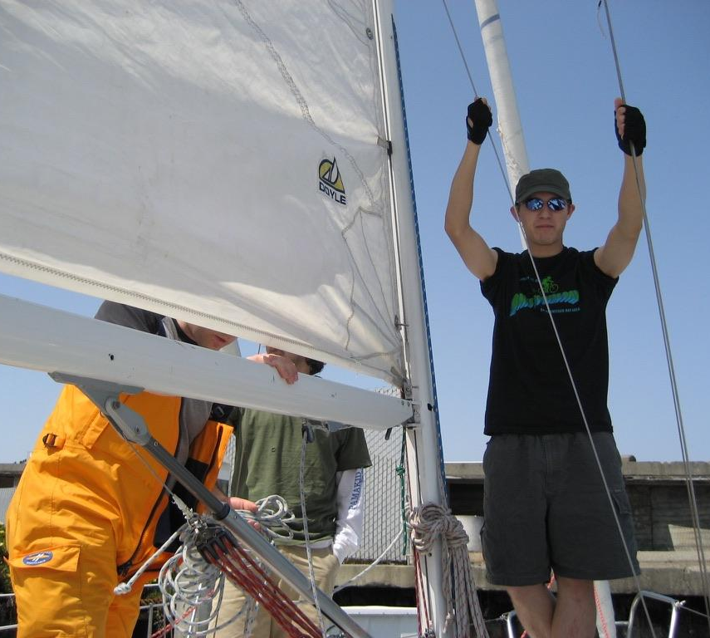
Existing solutions
are sailing vessels
Notes:
Existing solutions are sailing vessels: for instance, Skaffold, Garden, and Microsoft Draft.
They're bespoke and don't tend to share reusable parts or designs with each other, nor your production fleet. They're difficult to build, expensive to maintain, slow to turn, and require extensive training and manual operation to be proficient at running them.
I've been on many, and while they share the principles of wind, tiller, and sail, many if not most of the other design features are unique to each.

Slide 10
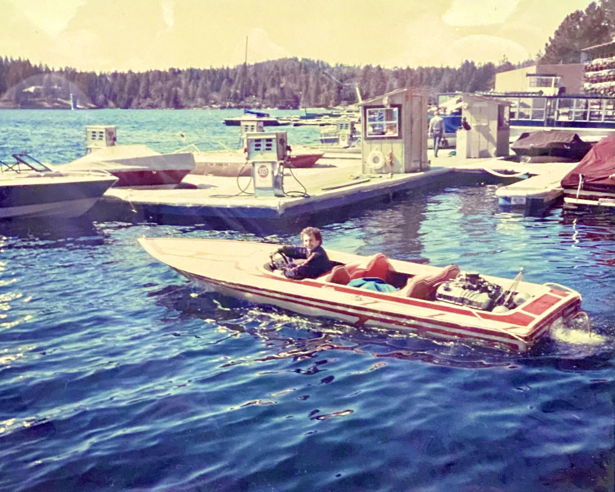
Where we're going,
we want speedboats
Notes:
Where we're going... we want speedboats.
Speedboats are generally cheap (by comparison) or rentable by the hour, so everyone can share a small fleet or have their own. They're fast to deploy, change directions quickly, and require almost no training or skill to operate (if you've ever played Grand Theft Auto, at least).
And yet, they operate on the same principles as our battleship: Fuel, engine, and propeller.
So they're actually reflective of production–unlike, say, a sailing simulation running in Docker, or a book on how to sail, written by Chef Ansible.
---
And yeah, I grew up bouncing around in the back of this one. It was loud, wet, and I cried every time, but I loved it (or so my dad tells me).
ephemeral.run is our speedboat, and Vishal will now share how we designed and built it.

Slide 11
Solution Overview

Slide 12
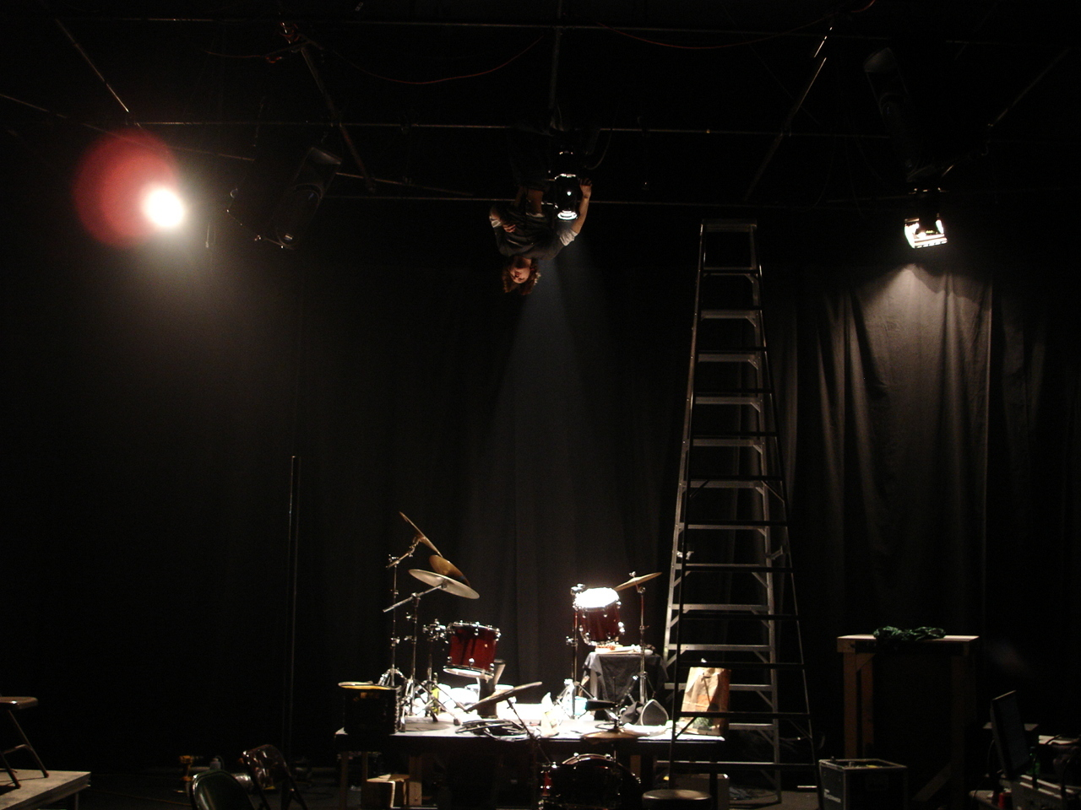
It’s not just skaffolding

Slide 13
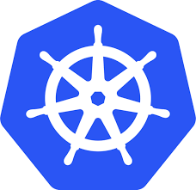
Solution Overview
Platform Tools
Kubernetes Cluster
AWS Certificate Manager
Dev1
namespace-dev1-ephemeral
Route 53
$ ephemeral run
S3 Buckets
$ ephemeral dev
App1
App2
App3
Postgres
namespace-PR-ephemeral
$ ephemeral run
App1
App2
App3
Postgres
Supporting Tools
Okta
Dev Orchestrator
Cluster Manager
Skaffold
Cleanup Controller (https://github.com/hjacobs/kube-janitor)
Cluster Autoscaler (https://github.com/kubernetes/autoscaler/tree/master/cluster-autoscaler)
DockerHub
Helm
Spot Instance Manager (https://github.com/aws/aws-node-termination-handler)
BotKube
(https://www.botkube.io/ )
SumoLogic
Terraform
Notes:
Overall solution diagram. Spend very less time here, just giving high level overview. Subsequent slides should dive deeper into each component.

Slide 14
Solution Overview
Inner Loop
Platform Tools
Kubernetes Cluster
AWS Certificate Manager
Dev1
namespace-dev1-ephemeral
Route 53
$ ephemeral run
S3 Buckets
$ ephemeral dev
App1
App2
App3
Postgres
namespace-PR-ephemeral
$ skaffold run
App1
App2
App3
Postgres
Supporting Tools
Okta
Dev Orchestrator
Cluster Manager
Skaffold
Cleanup Controller (https://github.com/hjacobs/kube-janitor)
Cluster Autoscaler (https://github.com/kubernetes/autoscaler/tree/master/cluster-autoscaler)
DockerHub
Helm
Spot Instance Manager (https://github.com/aws/aws-node-termination-handler)
BotKube
(https://www.botkube.io/ )
SumoLogic
Terraform
Notes:
As a developer - the development happens in your IDE but you want to validate things beyond just the changes you made. Inner loop is typically useful to validate your changes with other components and ensure it works well in integrated form too. While traditionally inner loop has been either ad hoc or heavily custom scripted, with ephemeral run you can use same platform to test effectively for inner loop of development too. Apart from creating a namespace and deploying entire stack, you can also test with real integrations suchh as Route53 or S3 bucket or an external SaaS logging platform too! The components involved are primarily Skaffold and Helm and ephemeral platform to enable dynamic provisioning and integrating etc.
Basic Flow - Inner Loop. Here, Developer runs skaffold dev / run on his local machine. This triggers building the images for required services and a deployment to remote AWS cluster in a dedicated namespace. Key components involved here are Skaffold, Helm Charts for deployments, K8s Cluster, DockerHub as image repository, AWS Certificate Manager, Route 53 and NGINX ingress controller for being able to access the environment. S3 buckets as needed by the application.

Slide 15
Solution Overview
Outer Loop
Platform Tools
Kubernetes Cluster
AWS Certificate Manager
Dev1
namespace-dev1-ephemeral
Route 53
$ skaffold run
S3 Buckets
$ skaffold dev
App1
App2
App3
Postgres
namespace-PR-ephemeral
$ ephemeral run
App1
App2
App3
Postgres
Supporting Tools
Okta
Dev Orchestrator
Cluster Manager
Skaffold
Cleanup Controller (https://github.com/hjacobs/kube-janitor)
Cluster Autoscaler (https://github.com/kubernetes/autoscaler/tree/master/cluster-autoscaler)
DockerHub
Helm
Spot Instance Manager (https://github.com/aws/aws-node-termination-handler)
BotKube
(https://www.botkube.io/ )
SumoLogic
Terraform
Notes:
Once you have developed and tested your changes as an engineer, you raise a PR and once it is merged, it is tested along with changes from other developers too potentially. This delays feedback loop but also some time is spent in analyzing which changes caused which issue etc. Would it not be wonderful that right after you raise a PR - you can deploy changes with rest of the services and create a unique URL for QA team or product team to use for validation. With outer loop of development, you can raise a PR and simply apply a label to create an entire stack. The Github action along with Skaffold and Helm talk to ephemeral run and provision a full stack for you!
Basic Flow - Outer Loop. Not much different from the inner loop - just that the environment deployment gets triggered from GitHub Action instead of from developer machine. Relies on the images being built by the CI tool before the deploy action is triggered.

Slide 16
Solution Overview
Cost Control
Platform Tools
Kubernetes Cluster
AWS Certificate Manager
TTL on ephemeral Environments
No environment runs beyond a set time to live.
Set auto-scaling with
min and max limits
Auto scaling upper limits ensure cost is not blown out of budget. And cluster is downsized when not in use.
Dev1
namespace-dev1-ephemeral
Route 53
$ skaffold run
S3 Buckets
$ skaffold dev
App1
App2
App3
Postgres
Using AWS Spot Instances.
Spot Instance Manager handles spot instance termination for workloads.
namespace-PR-ephemeral
$ skaffold run
App1
App2
App3
Postgres
Supporting Tools
Okta
Dev Orchestrator
Cluster Manager
Skaffold
Cleanup Controller (https://github.com/hjacobs/kube-janitor)
Cluster Autoscaler (https://github.com/kubernetes/autoscaler/tree/master/cluster-autoscaler)
DockerHub
Helm
Spot Instance Manager (https://github.com/aws/aws-node-termination-handler)
BotKube
(https://www.botkube.io/ )
SumoLogic
Terraform
Notes:
Now when you provision stack for every engineer, you need to be cognizant of the costs involved. We use a three fold strategy for optimizing the costs of infrastructure.
The instances used for deploying ephemeral environments are all on spot instances which are auto scaled. As you will see in demo, we have no instance when we start and as soon as we raise a PR, a instance is provisioned and used.
Ephmeral run also provides a TTL policy engine and some preset policies so that environments are cleaned up after certain durtion.
Lastly - Auto scaler ensures that only the minimum needed instances are used for the application workload.
Cost Concern with the ephemeral environments. Speak about the three main components that help keep cost in control.
Also mention sharing single cluster across environments and control plane - saves significant cost.

Slide 17
Solution Overview
Monitoring
Platform Tools
Kubernetes Cluster
AWS Certificate Manager
Dev1
Integrate external monitoring / log aggregation tools
Integrate your existing / third party monitoring or log aggregation tools.
Route 53
namespace-dev1-ephemeral
$ skaffold run
S3 Buckets
$ skaffold dev
App1
App2
App3
Postgres
namespace-PR-ephemeral
$ skaffold run
BotKube - Chat with your cluster
Monitor activities like new ephemeral environment creation / deletion from Slack / Microsoft Teams / Mattermost
App1
App2
App3
Postgres
Supporting Tools
Okta
Dev Orchestrator
Cluster Manager
Skaffold
Cleanup Controller (https://github.com/hjacobs/kube-janitor)
Cluster Autoscaler (https://github.com/kubernetes/autoscaler/tree/master/cluster-autoscaler)
DockerHub
Helm
Spot Instance Manager (https://github.com/aws/aws-node-termination-handler)
BotKube
(https://www.botkube.io/ )
SumoLogic
Terraform
Notes:
Another aspect which is crucial for ephemeral environments is the integration with external systems such as a SaaS logging platform. Developers often tets this in not an efficient or not close to production manner which leads to bugs later.
You also want to monitor your ephemeral environments and BotKube configured with cluster notifies respective teams of the creation/deletion of the respective environments.
Monitoring and log aggregation. BotKube to monitor activities around the ephemeral environments. We can integrate any third party tools as needed. This is mainly managed at the cluster level or through the code for your apps.

Slide 18
Repo
Structure
front-end Service Repo
github.com/OpenGov/front-end
On Code Change
Build Docker Image
When tagged for deploy
Dispatch Event to ephemeral.run repo
ephemeral.run Repo
github.com/OpenGov/ephemeral.run
For every deploy request
Update values.yaml with image
Deploy to Cluster
Communicate details back to dispatching repo via Github Bot
Ephemeral AutoScaled TTLed Instance
namespace-dev1-ephemeral
FrontEnd
Backend
Backend
DB
ephemeral.run (On Demand)
Notes:
Finally let me explain a bit of repo structure we are going to use in demo today. So we have a front end repo which houses UI for SockShop. In backend there are a bunch of services such as product, catalog, checkout etc. We are only going to change the front end repo for our demo today. As soon as we change code and raise a PR, the build kicks off which builds and pushes a Docker image. Once that is done, we instruct Ephemeral run using a GitHub label to deploy the entire stack. The platform takes the changed FE service and stable backend services and deploys to a new namespace.

Slide 19
Demo
Notes:
Demonstrate the workflow. Primarily focus on the PR Workflow. Mention that environments can also be created from command line on a developer machine using images built by them.
Show architecture overview of the service and the two repos (front-end and ephemeral.run)
Have a second environment already running and load the site for everyone to see (Gaurav can do this ahead of time)
Create a PR with a change, and wait for the build to complete, THEN add the label
Explain why we wait for the build to complete, and show the details of the comments
Show ephemeral demo slack channel showing the new namespace was created
Show the namespaces and services of both environments
Note nodes may be autoscaling
Show the result and highlight the change in the middle of the page
Show or talk about updating the PR workflow (make another change and re-deploy, time-depending)
Destroy the new environment and show the namespace is gone
…
At the very end, show that the first environment TTLd

Slide 20
Numbers

Slide 21
Numbers
(>_<)
In 2020, engineers started an average of four legacy Chef environments per month.
These were limited, unreliable, took hours to start, and were not representative of production.
Legacy environments cost $150/day/env, and thousands per month in fixed costs.
Notes:
In 2020, OpenGov engineers started an average of only one legacy environment per week using Chef, despite there being over a hundred engineers across teams. Most changes could only be tested post-merge in our integration clusters due to the inherent complexity of our polyglot microservices architecture.
These were not containerized, limited to only a few of OpenGov's core services, and none of our new application suites. They were unreliable, took hours to start, and were in no way representative of production (now that we're on Kubernetes).
At $150/env/day, and thousands of dollars in fixed costs, legacy environments were extremely costly to run in control plane, compute, and snapshots.
As of the day we launched ephemeral.run at OpenGov, no one ever again started a legacy environment.

Slide 22
Numbers
(^_^)
10x usage: Engineers started 50 environments with ephemeral.run in the first month.
10x faster: Environments start in ~15 minutes, and can be updated in five minutes.
10x cheaper: $15/day/env (billed by the minute) and $200/month in fixed costs.
Priceless: New defects discovered immediately, and for the first time, pre-merge.
Notes:
In contrast with the 1 environment per week per hundred person ratio before, we saw 50 ephemeral.run environments started in the first month by one team of a dozen people. Nearly 10x increase in usage overnight.
In contrast with the limited legacy environments, ephemeral.run starts many database types with seeded data and migrations, and dozens of services, comprising most of OpenGov's core platform and Budgeting and Planning suite. And they start in minutes, not hours. It's easy to imagine running hundreds of environments each month once our entire organization and all services are on board.
In contrast with the thousands of dollars we spent before, at $200 fixed control plane costs, and only $15/env/day, these are dirt cheap to run compared with the cost of people. They pay for themselves quickly. We haven't even begun to optimize our tooling – not cost, nor performance – and yet our metrics are are generally 10x better out of the gate.
The greatest value is that these environments are representative of production and can be used for development, debugging, and many types of testing before hitting the merge button. Our teams started finding defects almost immediately and fixing them before they even made it to integration. We're planning to expand our usage of ephemeral.run for local development, remote debugging, load testing, automated verification in CI, and even testing hotfixes in an ephemeral copy of production.

Slide 23
Roadmap Items
Join the Project!
A generic, fork-friendly framework with simplified configuration DSL/templates
A loving and proactive @runbot (like GitHub's @dependabot)
Suspend/Resume Compute
Dynamic TTLs on cluster resources
Local-to-remote telepresence
CI integration
Smarter Pod scheduling to optimize autoscaling
BotKube integration and ChatOps
Centralized Control Plane with UI
Usage reporting and analytics
Budgeting policies
Notes:
To give you an idea of where we think this tool will take us, these are the most requested features that have the broadest appeal.
A generic, fork-friendly framework with simplified configuration DSL/templates – Skaffold is powerful but verbose and easy to miswire. Not everyone needs that flexibility. We want you to be able to get started with a lightweight configuration enumerating all of your services.
A loving and proactive @runbot – like GitHub's @dependabot, we want you to interact with ephemeral.run using a chat bot instead of labels. This gives us a lot richer experience for the user.
Suspend/Resume Compute: To save cost and avoid the dreaded TTL, we'd like to scale down environment's compute indefinitely while retaining data.
Dynamic TTLs on cluster resources allos different environments to live for different lengths of time. This is especially important for global teams handing environments off to each other for testing.
Local-to-remote telepresence connects a locally running service in an IDE to a remote cluster for debugging and development of your new service.
CI Integration could wait for CI to finish building your PR and its images before starting your environment (today there is a race condition when the environment is starting), or it could let you launch and manage an environment from a CI pipeline like Jenkins.
Smarter Pod scheduling helps us run the fewest number of nodes required, scheduling with MostRequestedPriority, for example, or other affinity tricks. The default spread behavior may keep many nodes scaled up for only one environment, increasing cost per environment. Ideally all environments would fit on a single node, or as close to a multiple as possible with high utilization per node.
BotKube integration and ChatOps would let you interact with your environments and the control plane from team chat.
Centralized Control Plane UI pulls together all the configuration and monitoring to make things easier for your operations team.
Similarly, Usage reporting and analytics help make the case for adding more nodes to the cluster as teams adopt ephemeral.run
And finally, budgeting policies would dynamically control the number of simultaneously supported environments and autoscaling groups based on cost spent and cost budgeted, rather than keeping those static, and resetting each month.
There's something here for everyone. So Vishal, how do people join us?

Slide 24
Resources
Project and Reference Implementation
Fork us to try it, ⭐️ us for updates, and open an issue or PR to join us!
ephemeral.run (or github.com/OpenGov/ephemeral.run)
Follow our other projects on GitHub
@infracloudio – @vishal-biyani
@OpenGov – @jspiro
Discover what we're building with all this technology
infracloud.io
opengov.com
Work with us!
https://jobs.cncf.io/employers/406951-infracloud-technologies

Slide 25
Q&A

Slide 26
Thank You!

