Slide 1
The Truth About the Service Mesh Data Plane
Denis Jannot
Director of Field Engineering - EMEA
Notes:
Slide for each UI

Slide 2
About me
Denis Jannot
Director of Field Engineering - EMEA @ Solo
@djannot
denis.jannot@solo.io
http://www.recorditblog.com
denisjannot

Slide 3
From Monolith to Service Mesh

Slide 4
From Monolith to Microservices
MONOLITH
MICROSERVICES

Slide 5
Kubernetes became the most popular platform
MONOLITH
MICROSERVICES

Slide 6
How do you expose your apps ? The Ingress way
Ingress
Kubernetes
Service
Pods
TLS
Basic routing
MICROSERVICES

Slide 7
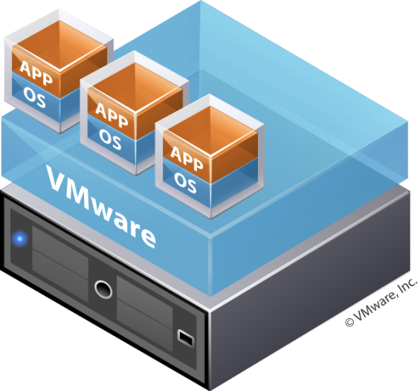
API Gateways
API
GATEWAY
Connect
Secure
Control
Observe
MICROSERVICES

Slide 8
Service to Service communication requirements
Identity Management
Encryption
Certificate Management
Traffic Management
Health check
Access Control
Telemetry
...

Slide 9
Service to Service communications
Encryption
Encryption
Kubernetes
Service
Traffic management
Health check
Third Party
Access control
Identity
Management
Certificate management
Telemetry

Slide 10
Service to Service communications
Encryption
Encryption
Traffic management
Third Party
Access control
API
GATEWAY
Telemetry
Identity
Management
Certificate management
Health check
MICROSERVICES

Slide 11
Service to Service communications
Encryption
Encryption
Traffic management
Third Party
Access control
API
GATEWAY
Telemetry
Identity
Management
Certificate management
Health check
MICROSERVICES

Slide 12
Service to Service communications
Encryption
Identity Management
Telemetry
Control
Plane
Access control
Certificate management
Traffic management
Health check
Data Plane
SERVICE MESH

Slide 13
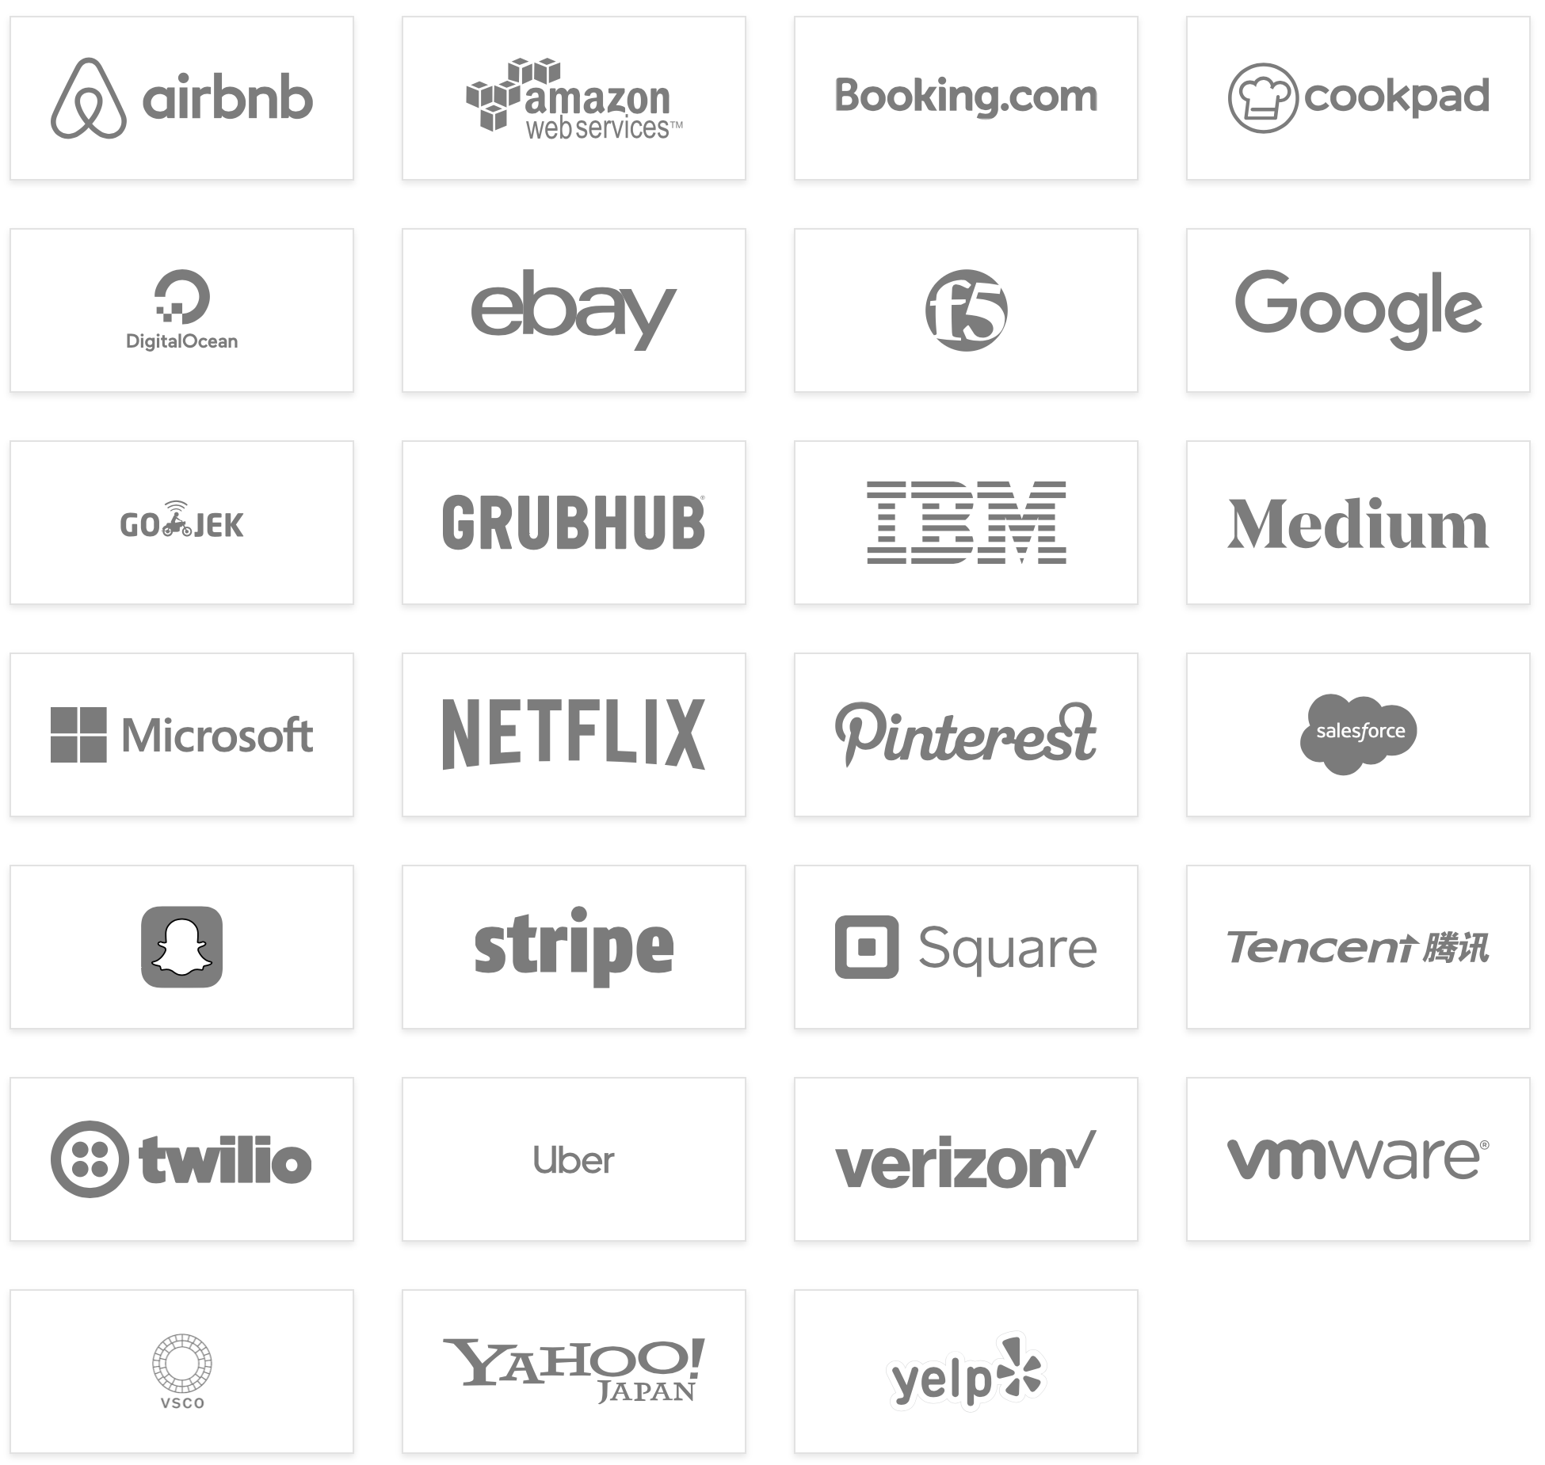
Why Envoy Proxy for Service Mesh Data Plane
Neutral Foundation (CNCF)
Large, diverse, vibrant community
Built ground up for dynamic services environment
Dynamic configuration, driven by API
Highly extensible
L7 filters (HTTP/1, HTTP/2, gRPC, redis, mysql, Kafka, etc)
Deep signals telemetry out of the box
Versatile deployment options

Slide 14
Common challenges with Service Mesh

Slide 15
Adoption challenges
Which one to choose ?
Who's going to support it ?
Fitting with existing services (sidecar lifecycle, race conditions, etc)
Non container environments / hybrid env ?
No good way to manage multiple clusters

Slide 16
Multicluster Service Mesh
EDGE
GATEWAY
EDGE
GATEWAY
SERVICE MESH
SERVICE MESH

Slide 17
Multicluster Service Mesh challenges
You need Federated Trust and Identity
You need to allow communications between clusters
You need to manage access control globally
You need to define a Disaster Recovery strategy
You need to secure the Edge as well
All of the above is highly complex

Slide 18
Service Mesh Hub
Manage your service mesh deployments across multiple clusters and multiple meshes

Slide 19
Service Mesh Hub is simplifying everything
MULTI-CLUSTER STATE
MESH
TRAFFIC
TARGET
CREATE CUSTOM RESOURCES
CLUSTER
istiod
WORKLOAD
MESH DISCOVERY
DISCOVER &
WATCH MESH,
PODS, SERVICES
TRAFFIC
POLICY
MESH NETWORKING
CLUSTER
istiod
WATCH
ACCESS
POLICY
VIRTUAL
MESH
CLUSTER
istiod
ISSUED CERTIFICATE
CREATE POLICIES
SIGN CERTS

Slide 20
Multi-cluster Traffic
CLUSTER
CLUSTER
PRODUCTPAGE
PRODUCTPAGE
INGRESS
GATEWAY
INGRESS
GATEWAY
DETAILS
v1
v1
REVIEWS
REVIEWS
DETAILS
v2
v2
v3
istiod
istiod
RATINGS
RATINGS
CLUSTER

Slide 21
Traffic Policy
CLUSTER 1
apiVersion: networking.smh.solo.io/v1alpha2
kind: TrafficPolicy
metadata:
namespace: service-mesh-hub
name: simple
spec:
destinationSelector:
- kubeServiceRefs:
services:
- clusterName: kind2
name: reviews
namespace: default
trafficShift:
destinations:
- kubeService:
clusterName: kind3
name: reviews
namespace: default
subset:
version: v3
weight: 75
- kubeService:
clusterName: kind2
name: reviews
namespace: default
subset:
version: v1
weight: 15
- kubeService:
clusterName: kind2
name: reviews
namespace: default
subset:
version: v2
weight: 10
Notes:
This simple TrafficPolicy creates all the objects described in the 2 next slides

Slide 22
Demo
Service Mesh Hub

Slide 23
CLUSTER 2
CLUSTER 2
CLUSTER 2
apiVersion: networking.istio.io/v1beta1
kind: VirtualService
metadata:
labels:
cluster.multicluster.solo.io: kind2
owner.networking.smh.solo.io: service-mesh-hub
name: reviews
namespace: default
spec:
hosts:
- reviews.default.svc.cluster.local
http:
- route:
- destination:
host: reviews.default.svc.kind3.global
subset: version-v3
weight: 75
- destination:
host: reviews.default.svc.cluster.local
subset: version-v1
weight: 15
- destination:
host: reviews.default.svc.cluster.local
subset: version-v2
weight: 10
apiVersion: networking.istio.io/v1beta1
kind: DestinationRule
metadata:
labels:
cluster.multicluster.solo.io: kind2
owner.networking.smh.solo.io: service-mesh-hub
name: reviews.default.svc.kind3.global
namespace: istio-system
spec:
host: reviews.default.svc.kind3.global
subsets:
- labels:
cluster: kind3
name: version-v3
- labels:
cluster: kind3
name: version-v1
- labels:
cluster: kind3
name: version-v2
trafficPolicy:
tls:
mode: ISTIO_MUTUAL
apiVersion: networking.istio.io/v1beta1
kind: ServiceEntry
metadata:
labels:
cluster.multicluster.solo.io: kind2
owner.networking.smh.solo.io: service-mesh-hub
name: reviews.default.svc.kind3.global
namespace: istio-system
spec:
addresses:
- 253.124.25.94
endpoints:
- address: 172.18.0.230
labels:
cluster: kind3
ports:
http: 15443
hosts:
- reviews.default.svc.kind3.global
location: MESH_INTERNAL
ports:
- name: http
number: 9080
protocol: TCP
resolution: DNS
Notes:
A VirtualService has been created to route 75% of the traffic to the subset version-v3 of the host reviews.default.svc.kind3.global.
A DestinationRule has been created for this host and define the subset version-v3 with the label cluster: kind3.
A ServiceEntry has been created for this host and associate this label with the endpoint corresponding to the Istio Ingress Gateway of the second cluster.

Slide 24
CLUSTER 3
CLUSTER 3
CLUSTER 3
apiVersion: v1
kind: Service
metadata:
labels:
app: reviews
service: reviews
name: reviews
namespace: default
spec:
clusterIP: 10.97.193.52
ports:
- name: http
port: 9080
protocol: TCP
targetPort: 9080
selector:
app: reviews
sessionAffinity: None
type: ClusterIP
status:
loadBalancer: {}
apiVersion: networking.istio.io/v1alpha3
kind: EnvoyFilter
metadata:
labels:
cluster.multicluster.solo.io: kind3
owner.networking.smh.solo.io: service-mesh-hub
name: virtual-mesh.service-mesh-hub
namespace: istio-system
spec:
configPatches:
- applyTo: NETWORK_FILTER
match:
context: GATEWAY
listener:
filterChain:
filter:
name: envoy.filters.network.sni_cluster
portNumber: 15443
patch:
operation: INSERT_AFTER
value:
name: envoy.filters.network.tcp_cluster_rewrite
typed_config:
'@type': type.googleapis.com/istio.envoy.config.filter.network.tcp_cluster_rewrite.v2alpha1.TcpClusterRewrite
cluster_pattern: \.kind3.global$
cluster_replacement: .cluster.local
workloadSelector:
labels:
istio: ingressgateway
apiVersion: networking.istio.io/v1beta1
kind: DestinationRule
metadata:
labels:
cluster.multicluster.solo.io: kind3
owner.networking.smh.solo.io: service-mesh-hub
name: reviews
namespace: default
spec:
host: reviews.default.svc.cluster.local
subsets:
- labels:
version: v3
name: version-v3
- labels:
version: v1
name: version-v1
- labels:
version: v2
name: version-v2
trafficPolicy:
tls:
mode: ISTIO_MUTUAL
CLUSTER 3
apiVersion: v1
kind: Pod
metadata:
labels:
app: reviews
istio.io/rev: default
pod-template-hash: d978546db
security.istio.io/tlsMode: istio
service.istio.io/canonical-name: reviews
service.istio.io/canonical-revision: v3
version: v3
name: reviews-v3-d978546db-dj59b
namespace: default
spec:
...
Notes:
An EnvoyFilter has been created to replace the suffix .kind3.global by cluster.local when requests arrive in the Istio Ingress Gateway.
A DestinationRule has been created for the same host (but with the .cluster.local suffix) and define the subset version-v3 with the label version: v3.
The traffic is routed to the Pods of the corresponding service that have this label.

Slide 25
Service to Service Failover
CLUSTER
CLUSTER
PRODUCTPAGE
PRODUCTPAGE
INGRESS
GATEWAY
INGRESS
GATEWAY
DETAILS
v1
v1
REVIEWS
REVIEWS
DETAILS
v2
v2
v3
istiod
istiod
RATINGS
RATINGS
CLUSTER

Slide 26
What’s next ?

Slide 27
Web Assembly
Customize Envoy Proxy with WebAssembly

Slide 28
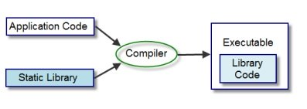
Extending Envoy Proxy - Adding Custom Filters
THE OLD WAY:
Write filter in C++
Statically link it to Envoy (requires compiling Envoy)
Ship and deploy new version of Envoy

Slide 29
Extending Envoy Proxy - Adding Custom Filters
THE OLD WAY:
Write filter in C++
Statically link it to Envoy (requires compiling Envoy)
Ship and deploy new version of Envoy

Slide 30
Introducing WebAssembly Hub and wasme
Build, Deploy, and Publish
Write filter in any language
Compile to .wasm module
Dynamically load in Envoy Proxy during runtime
Publish and share filters
With or without Service Mesh

Slide 31
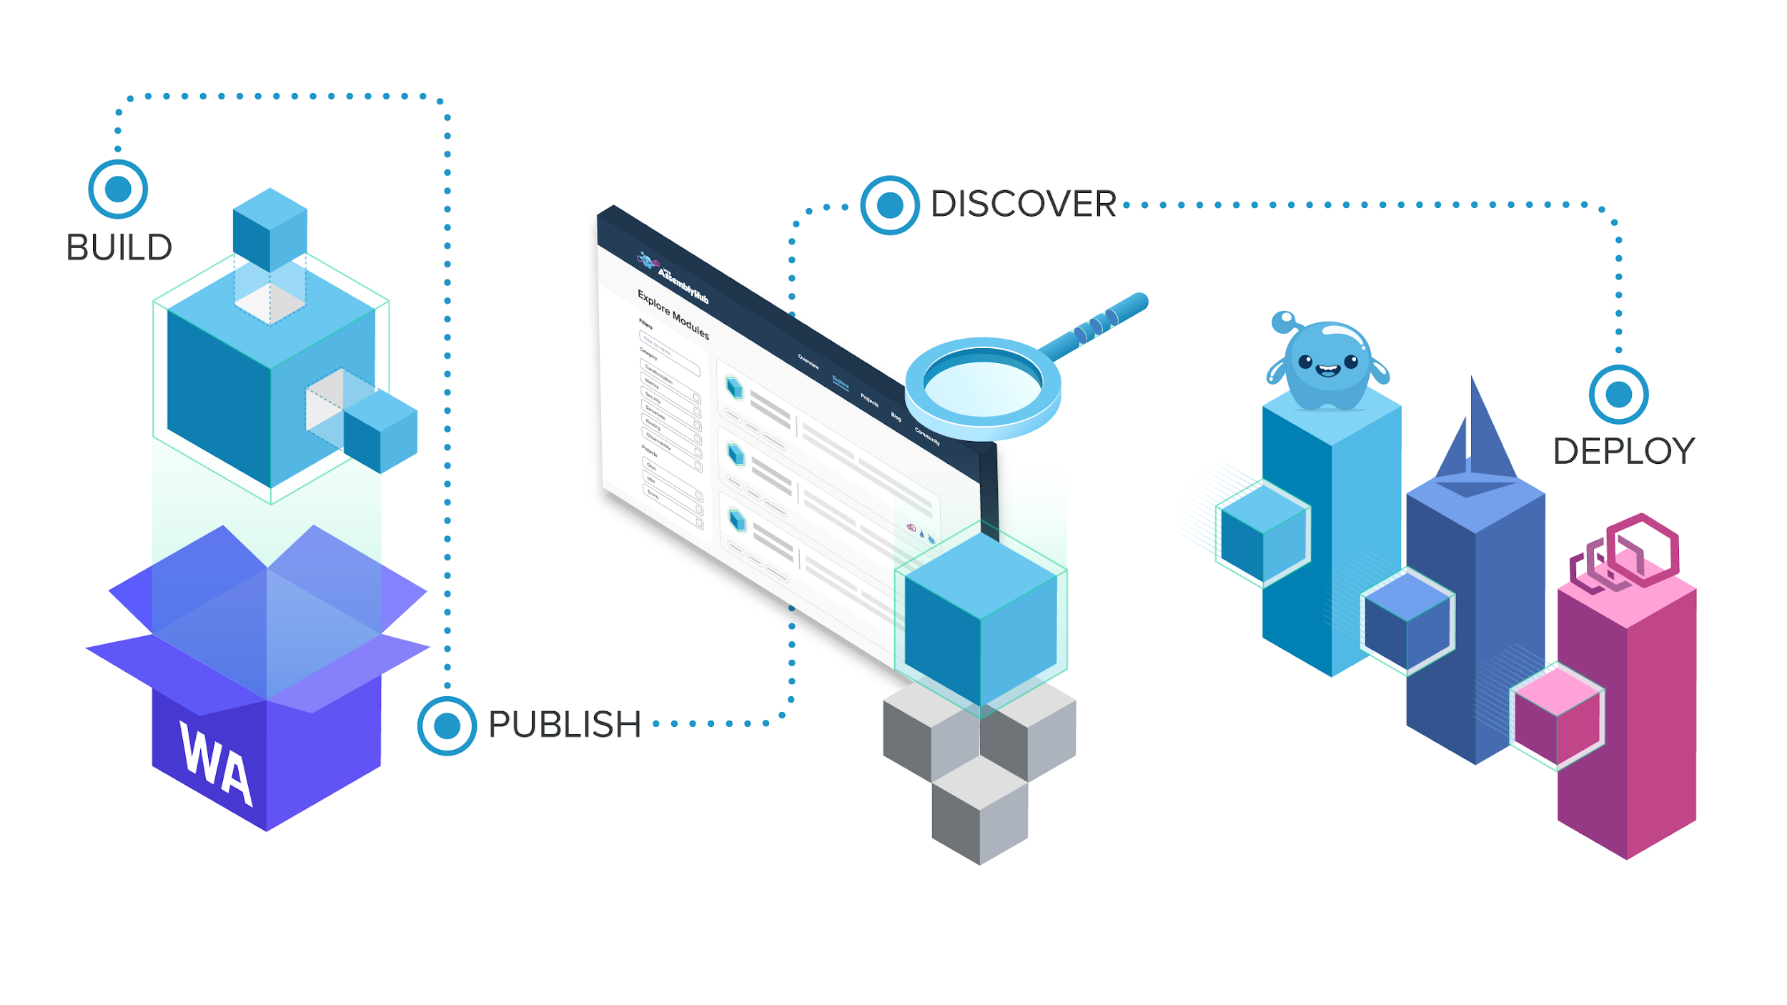
https://webassemblyhub.io

Slide 32
Demo
Web Assembly

Slide 33
Current state of WASM in Envoy
https://www.solo.io/blog/the-state-of-webassembly-in-envoy-proxy/
https://github.com/envoyproxy/envoy/pull/12546
https://www.youtube.com/watch?v=8fty-sqFyoY

Slide 34
Thank you !

