Slide 1
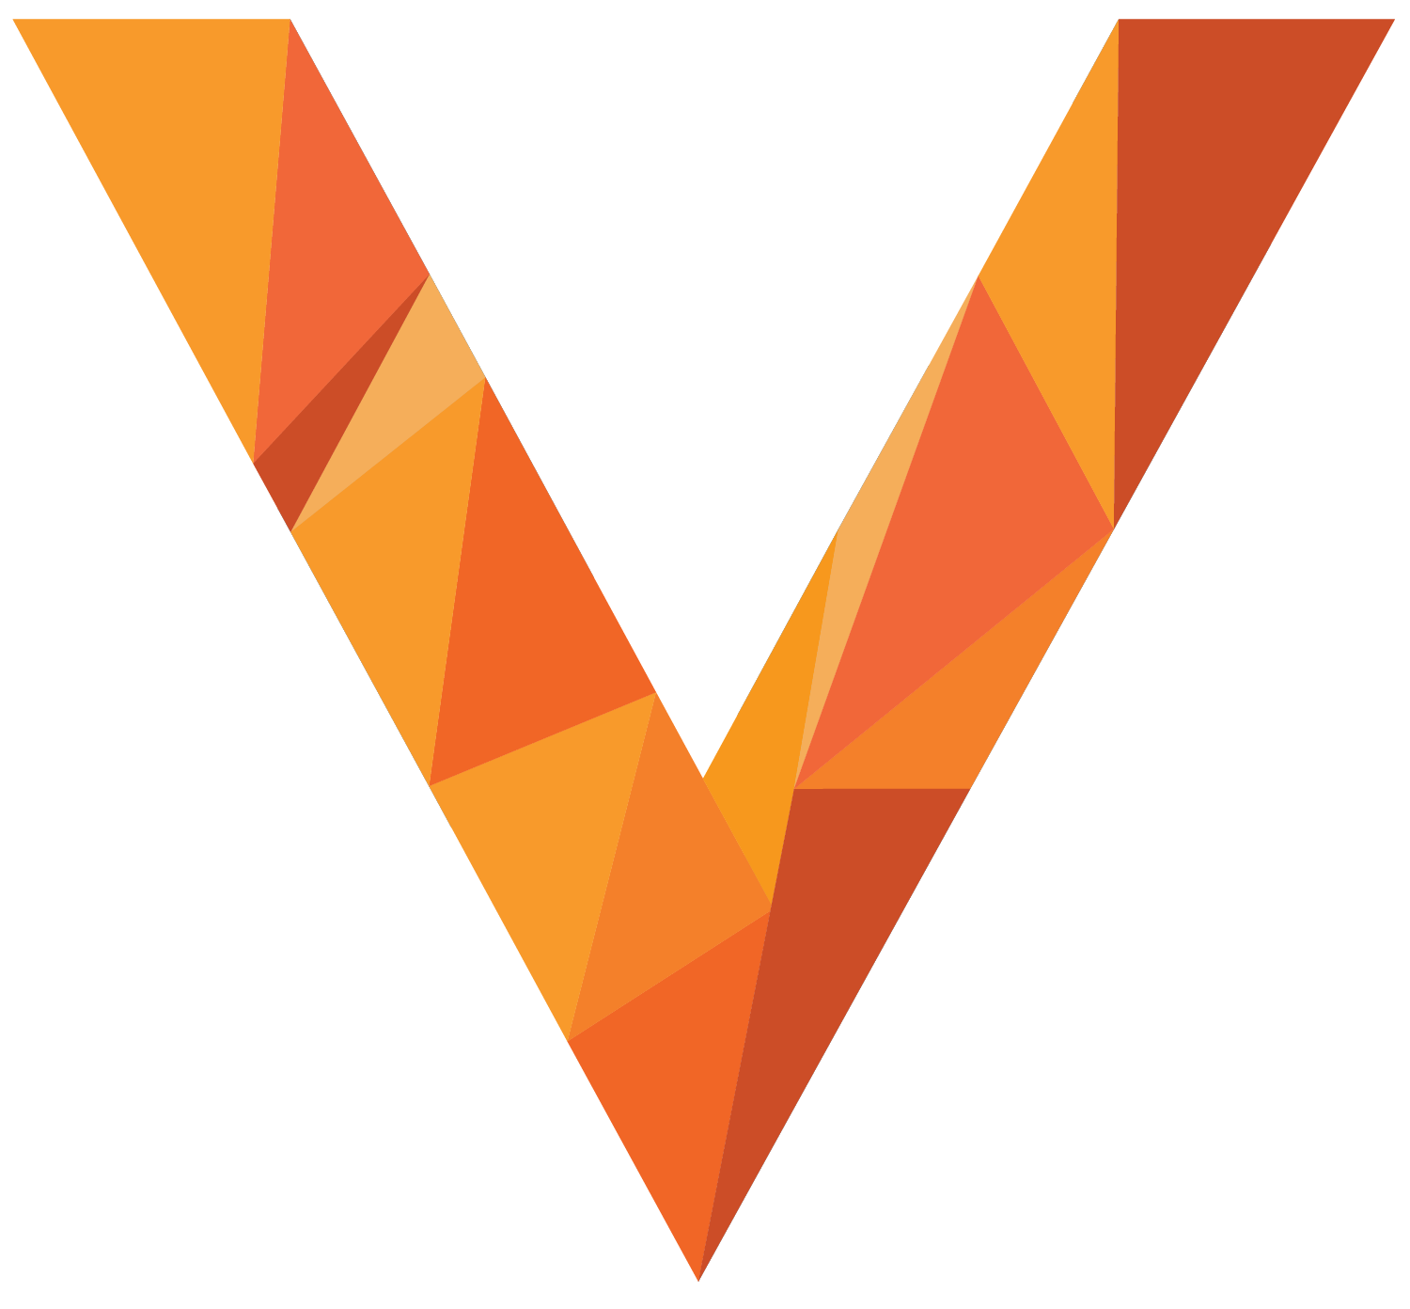
Vitess Transactional Microservices
Dan Kozlowski
PlanetScale

Slide 2
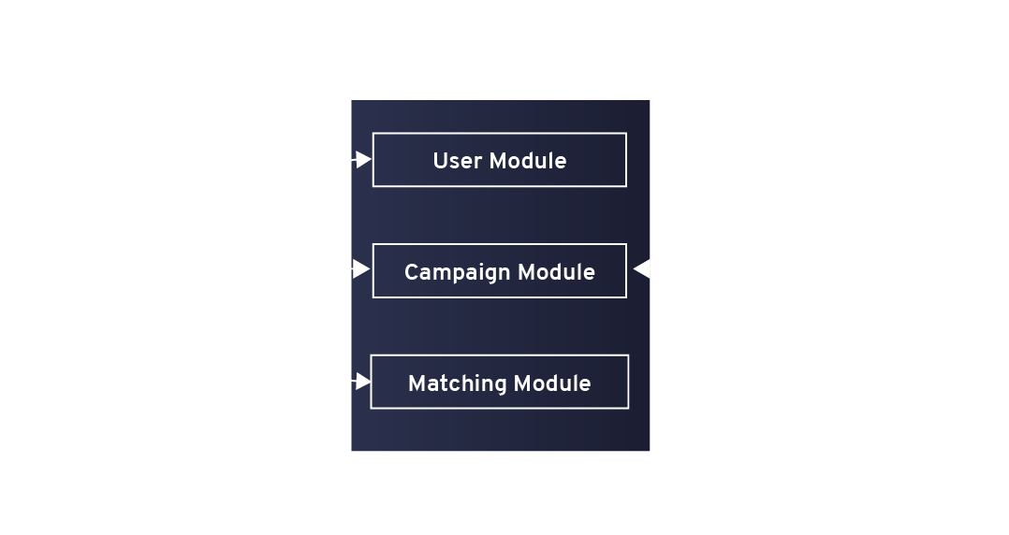
Traditional Monolithic Architecture
Database
Client

Slide 3
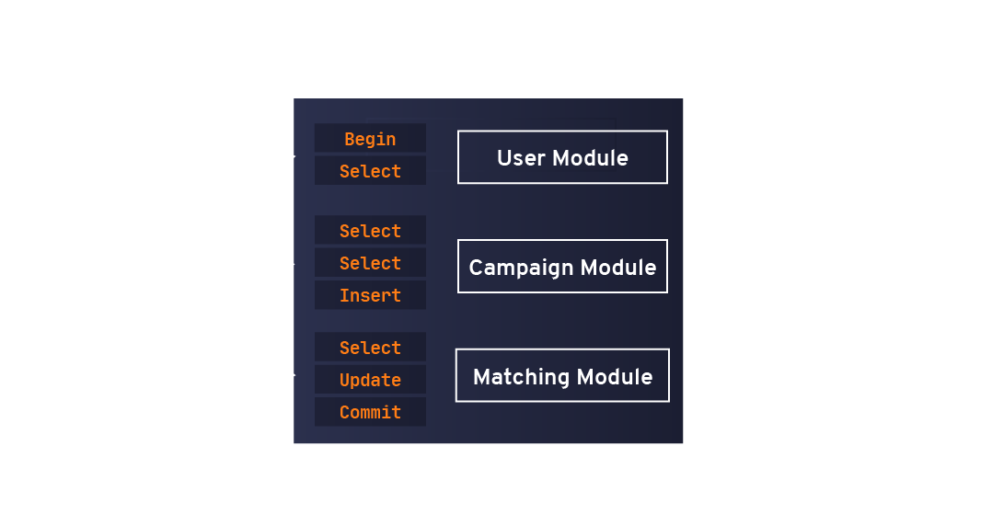
Traditional Transaction Architecture
Client
Database

Slide 4
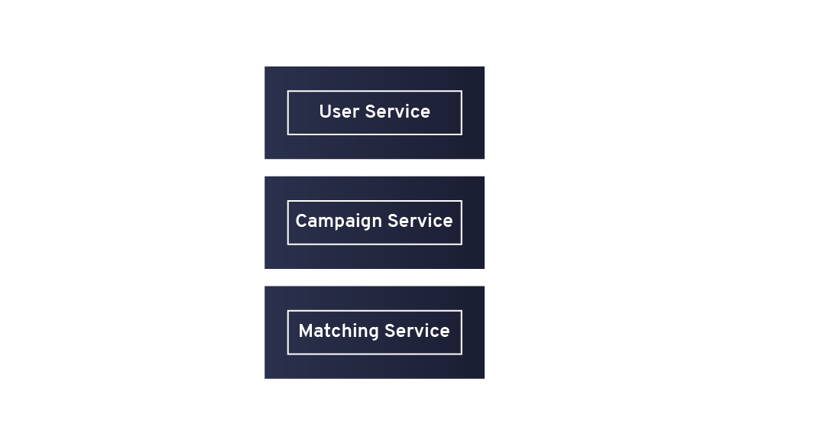
Traditional Micro-Service Architecture
Notes:
Well Understood patern, Solves many operational concerns with

Slide 5
Transactions With Microservices

Slide 6
Why Not Micro-Service Architecture
Notes:
Services now have a shared dependency ( single point of failure )
Services still can’t coordinate transactions without outside service
Version Dependencies if not using service api
Still can’t do transactions

Slide 7
Explicit State Management
Database Connection
TCP Connection to Client
Notes:
If your application has complex interactions you will have to have some kind of transaction logic built into your service.
I.e. Show me my balance before I withdraw money.
Show me available inventory before I make a purchase

Slide 8
Enter Vitess

Slide 9
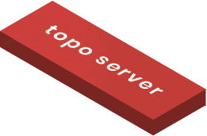
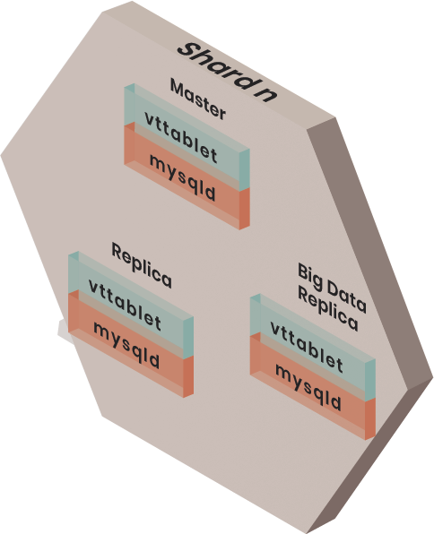
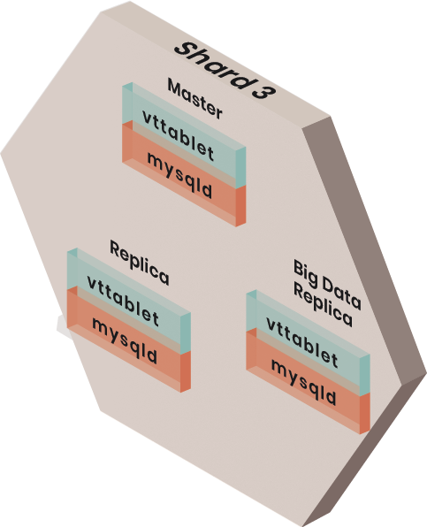
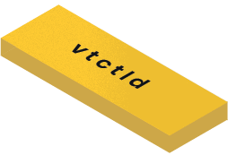
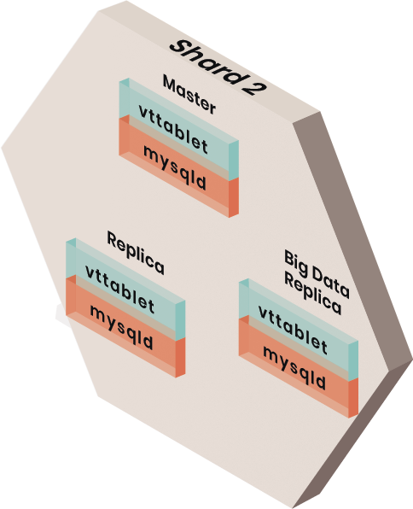
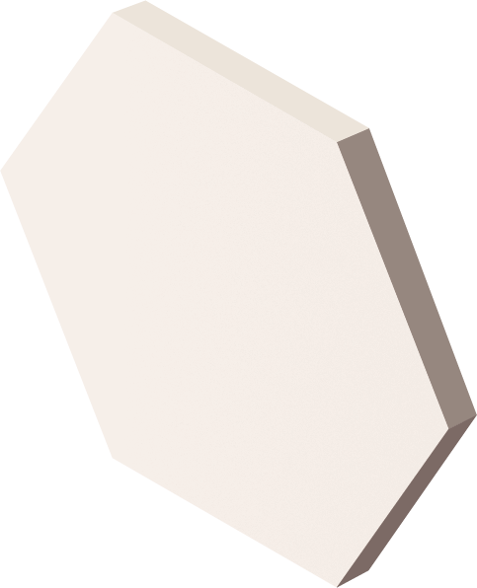
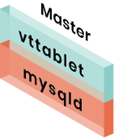
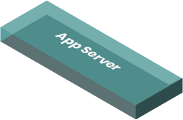
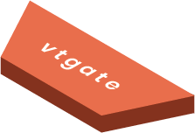
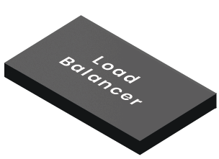
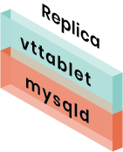
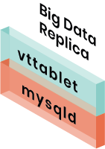
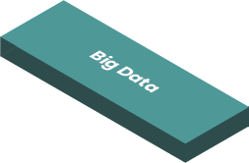
Architecture

Slide 10
gRPC Endpoint
// ExecuteRequest is the payload to Execute.
message ExecuteRequest {
vtrpc.CallerID caller_id = 1;
Session session = 2;
query.BoundQuery query = 3;
}
// ExecuteResponse is the returned value from Execute.
message ExecuteResponse {
vtrpc.RPCError error = 1;
Session session = 2;
query.QueryResult result = 3;
}
Notes:
Your Database becomes and External Service using gRPC with all the built in functionality.

Slide 11
gRPC Endpoint
// Session objects are exchanged like cookies through various
// calls to VTGate. The behavior differs between V2 & V3 APIs.
// V3 APIs are Execute, ExecuteBatch and StreamExecute. All
// other APIs are V2. For the V3 APIs, the session
// must be sent with every call to Execute or ExecuteBatch.
// For the V2 APIs, Begin does not accept a session. It instead
// returns a brand new one with in_transaction set to true.
// After a call to Commit or Rollback, the session can be
// discarded. If you're not in a transaction, Session is
// an optional parameter for the V2 APIs.
message Session {
…
}
Notes:
Your Database becomes and External Service using gRPC with all the built in functionality.

Slide 12
Vitess Micro-Service Architecture

Slide 13
But,
My Application is a Monolith and we are moving to Microservices!
Notes:
You can, you just need to build out CQRS or Saga for all your applications.

Slide 14
But,
If you use the same database you will not have independent services!
Notes:
Vitess lets you pass the session around so you can read the DB for your service and use the API for other services, all while keeping the same transaction

Slide 15
But,
We could do the same thing with CQRS or Saga!
Notes:
You can, you just need to build out CQRS or Saga for all your applications.

Slide 16
?
Notes:
Questions ?

Slide 17
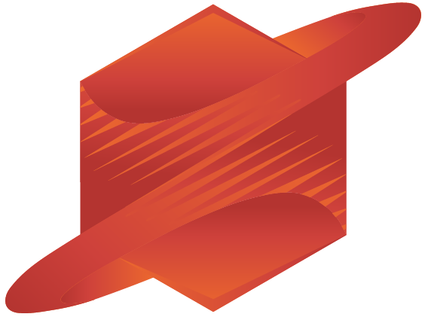
Daniel Kozlowski
@MinisterOfEng
PlanetScale
Maintainer, Vitess
https://vitess.io/slack

