Slide 1
Production Gitops In Practice
Rick Spencer, InfluxData
Notes:
jsonnet snippet
How we collect metrics
Telegraf to get data
Added as sidecar containers to infrastructure and InfluxDB application
Application / system specific metrics - i.e. Redis (Telegraf built-in plugin)
Prometheus scaping from Telegraf
We’re also moving to a telegraf operator that we’re building - because
Adding telegraf to tens of deployments / statefulsets is not easy (even with jsonnet)
Managing secrets for sending data to specific targets is / was manual
Want to make it easier to gather all metrics for others
Istio
Error rates
Latency

Slide 2
InfluxData Overview

Slide 3
INFLUXDB: THE OPEN SOURCE TIME SERIES DATABASE
Providing real-time visibility into stacks, sensors and systems

Slide 4
Open Source

Slide 5
InfluxDB Cloud
(Cloud 2.0)

Slide 6
InfluxDB 2.0 Cloud in Production

Slide 7
2.0 Cloud Platform
SaaS data platform, but data has gravity
Multi Cloud (AWS, GCP, Azure)
Multi Region
Private Instances
Kubernetes as cloud abstraction layer

Slide 8
Signifiers of Gitops
Developers get code into production by landing it in the main branch, automation takes care of the rest
Infrastructure as code is delivered in a similar manner to application code
Testing in Production
Notes:
GitOps is a way to do Kubernetes cluster management and application delivery. It works by using Git as a single source of truth for declarative infrastructure and applications. With Git at the center of your delivery pipelines, developers can make pull requests to accelerate and simplify application deployments and operations tasks to Kubernetes. (Weave)

Slide 9
Diagrams
All models are wrong, but some are useful

Slide 10
Code
Master
CI
Development
Config
AWS
GCP
Azure
Staging
Tools
Argo
Internal Production
AWS
GCP
Azure
AWS
GCP
Azure
AWS
GCP
Azure
External Production

Slide 11
Code
Master
CI
Development
Config
AWS
GCP
Azure
Staging
Tools
Argo
Internal Production
AWS
GCP
Azure
AWS
GCP
Azure
AWS
GCP
Azure
External Production

Slide 12
Code
Master
CI
Development
Config
AWS
GCP
Azure
Staging
Tools
Argo
Internal Production
AWS
GCP
Azure
AWS
GCP
Azure
AWS
GCP
Azure
External Production
Notes:
Not clear that we get value out of acceptance, and many people think this is an anti-pattern. I think we may end up dedicating these clusters just to testing
By contrast, our Internal Production cluster has been very useful

Slide 13
Code
Master
CI
Development
Config
AWS
GCP
Azure
Staging
Tools
Argo
Internal Production
AWS
GCP
Azure
AWS
GCP
Azure
AWS
GCP
Azure
External Production
Notes:
We rolled out without any automated feedback loop, relying on our CI, and everything was fine

Slide 14
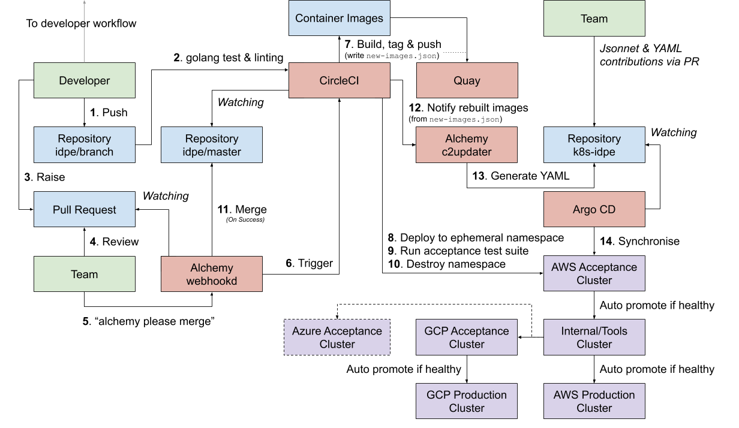
Notes:
Even this is a simplification
We’ll skip over CI, because that is a whole talk itself

Slide 15
Observed Benefits
Dramatic decrease in time working on release process
Fewer and less severe incidents due to more frequent and smaller releases as well as reduction in potential for human error
Easy to add more regions
Consistency between all production environments (and master) makes everything easier

Slide 16
How we Implement Gitops
Engineering Management View

Slide 17
Required Elements
CI to build artifacts (containers) and run tests (unit and integration)
A way to represent infrastructure as code (jsonnet)
A way to deploy K8s configuration (ArgoCD)
Fast deployments pipeline
Feature flagging (ConfigCat)
Production metrics and reliable alerts

Slide 18
Optional Components
Automated feedback loop (tests and metrics)
Pipeline for high level operations (Argo Workflow)
Canary deployments
External availability validation
Testing or acceptance environments *

Slide 19
Jsonnet - example
serviceA.jsonnet
serviceA-aws-prod.jsonnet
Output YAML file
{
service: { /* ... */ },
deployment: {
local labels = { component: 'serviceA' },
apiVersion: 'apps/v1',
kind: 'Deployment',
metadata: {
labels: labels,
name: 'serviceA',
},
spec: {
replicas: 1,
selector: {
matchLabels: labels,
},
template: {
spec: {
containers: [ /* ... */ ],
},
}
}
}
}
local serviceA =
import './serviceA.jsonnet’;
// extend serviceA with instance
// specific settings
serviceA {
deployment+: {
spec+: {
replicas: 4,
serviceAccountName: 'serviceA-account',
resources: {
requests: { memory: '2G' },
limits: { memory: '4G' },
}
}
}
}
apiVersion: apps/v1
kind: Deployment
metadata:
labels:
component: serviceA
name: serviceA
spec:
replicas: 4
resources:
limits:
memory: 4G
requests:
memory: 2G
selector:
matchLabels:
component: serviceA
serviceAccountName: serviceA-account
template:
spec:
containers:
...
---
apiVersion: v1
kind: Service
...

Slide 20
Availability: Super Smooth Deploys
The Challenge
Customers expect very high availability for their API calls (99.999% succeed)
Deployments cause pods to restart, frequent deployments cause frequent restarts
Our Solution
Custom controller code to ensure proper ordering of restarts
“Be one with the retries”

Slide 21
Metrics

Slide 22
How we gather metrics
Telegraf
Agent for collecting metrics & writing them to InfluxDB or other outputs
Open source project that can be run everywhere
Written entirely in Go - single binary, no external dependencies
We run it as a sidecar
Different types of metrics
Application specific metrics - Redis, Etcd, Nginx, Zookeeper
Custom metrics - sending data to Telegraf from services directly
Istio and other services - with Telegraf Prometheus Input Plugin

Slide 23
Putting Metrics to Work
Alert on urgent issues
Alert on leading indicators
Dashboards for overall system health
Dashboards for troubleshooting
Dashboards for feature flags

Slide 24
Alerts (and Dashboards)

Slide 25
Alerts
Kubernetes Health
Application Health
Deadman Alerts
Externally Running Availability Tests

Slide 26
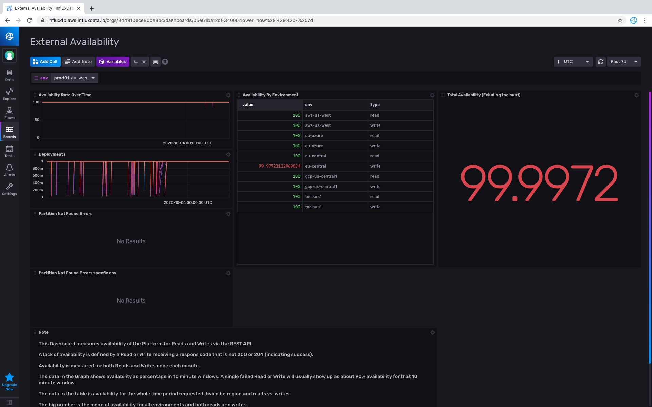
A moderate number of deploys for the week
2 503s from the write API

Slide 27
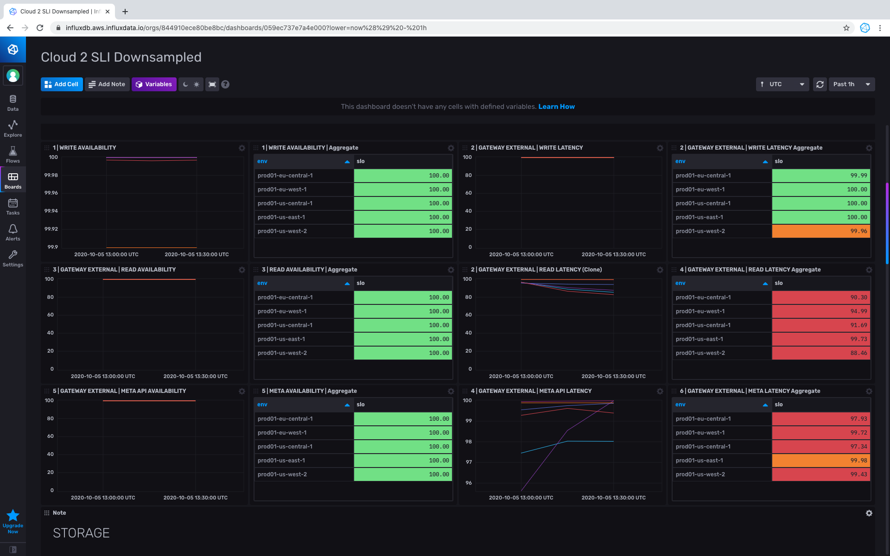
This is the column that matters

Slide 28
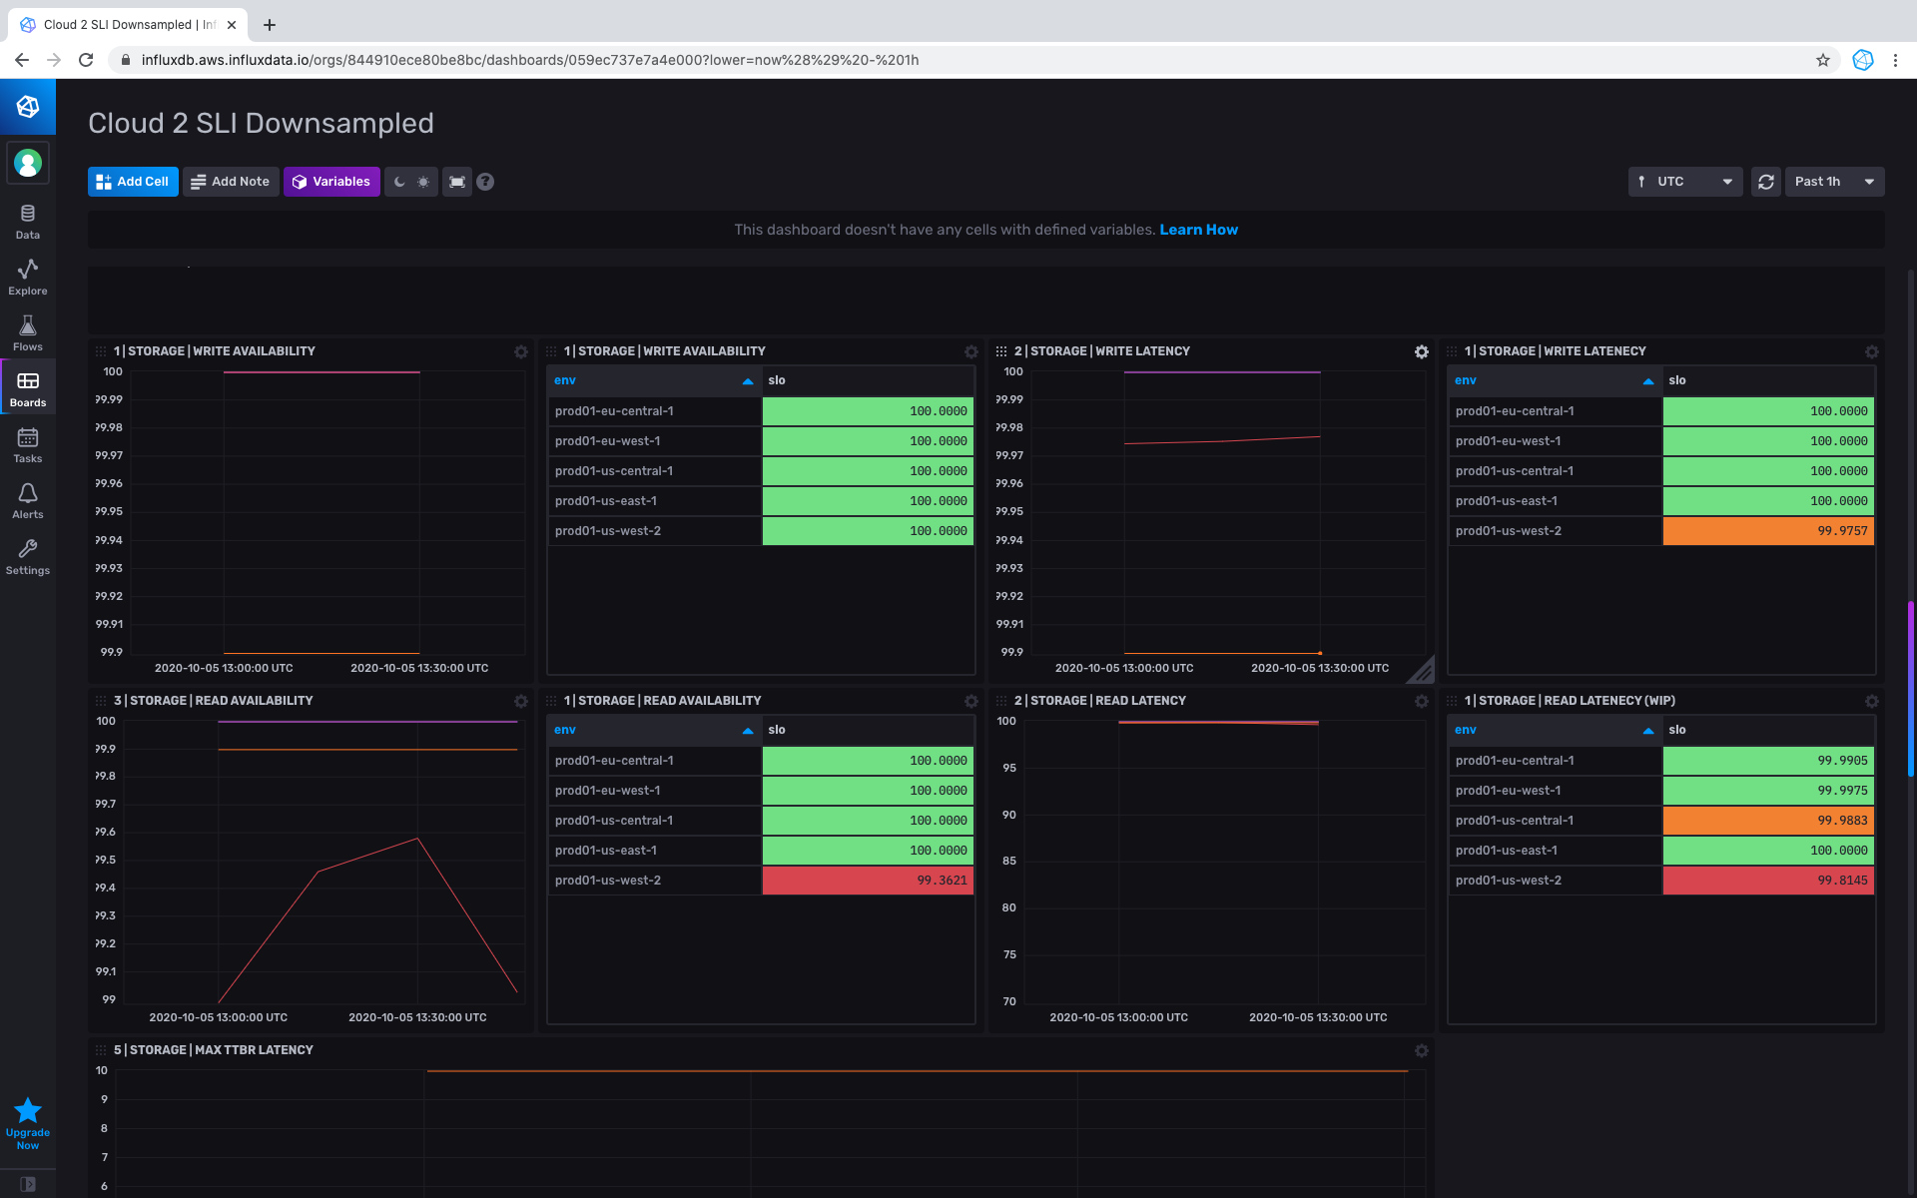
Only a 1 hour view
Potential problem in production?

Slide 29
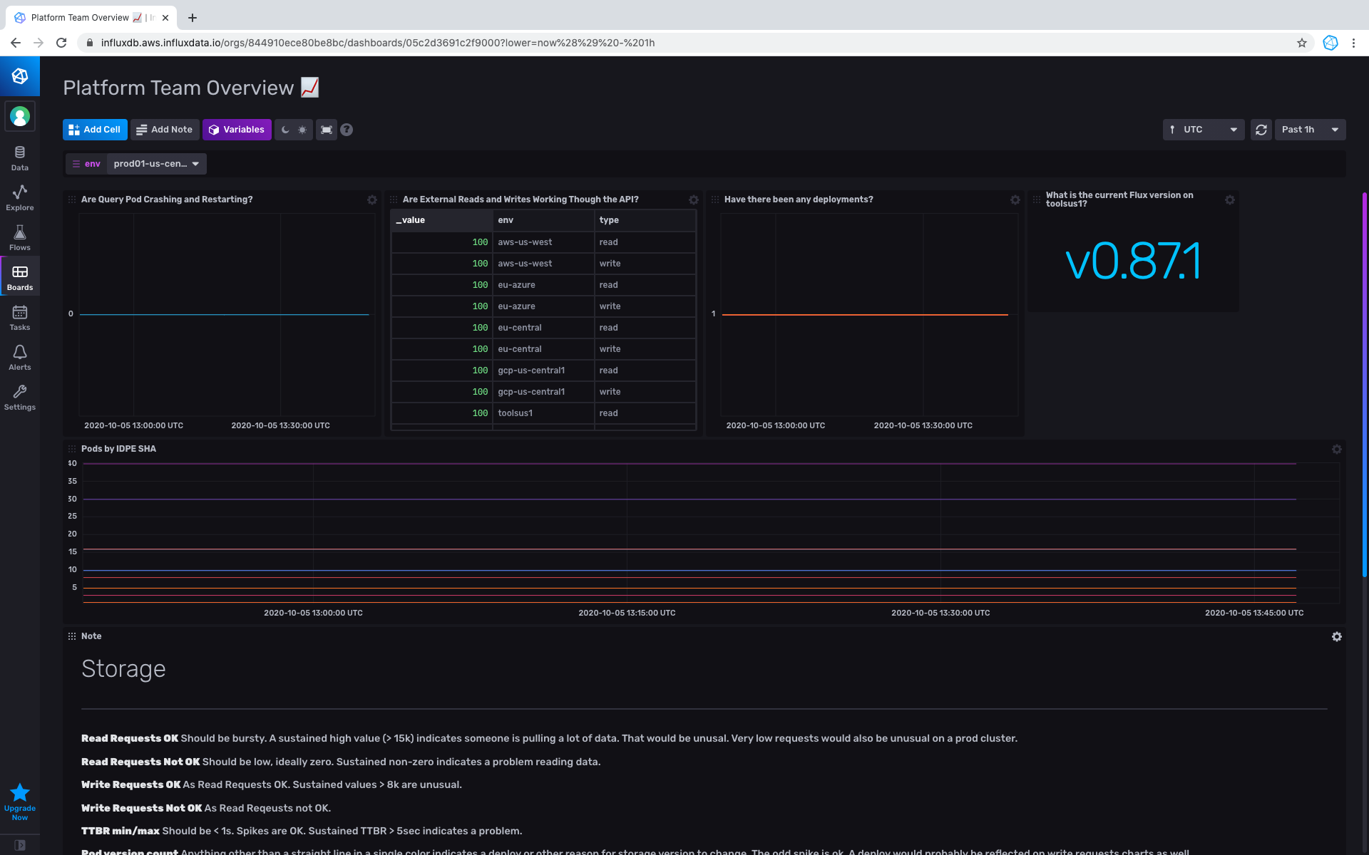

Slide 30
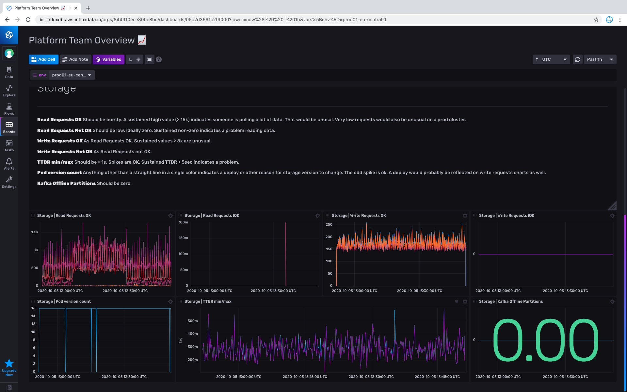

Slide 31
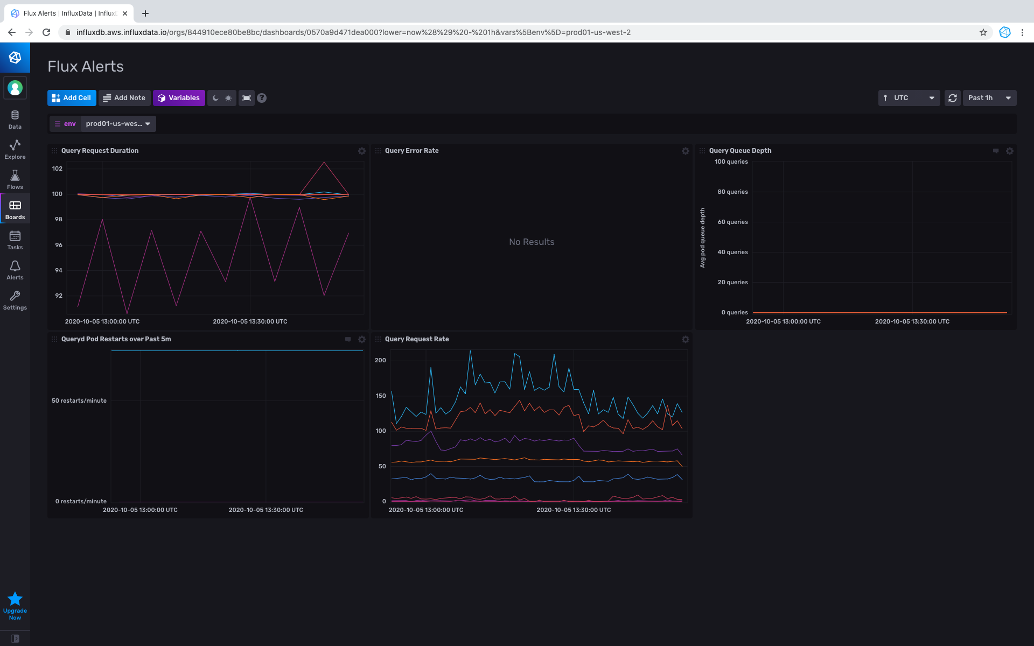

Slide 32
Organizational Challenges
Change of mindset from releases to Continuous Delivery
Rolling out breaking changes incrementally
Overcoming fear of breaking production

Slide 33
Our Next Steps
Feed metrics into automated feedback loop to gate promotion
Testing health *during a deploy*
Gather more metrics around GitOps processes
Game days
Canary

