Slide 1
The evolution of Ingress through the Gateway API
Bowei Du <bowei@google.com>
Kaslin Fields <kaslin@google.com>
Notes:
45 minutes for presentation
15 demo
======
30 minute presentation
10-15 minutes for questions.

Slide 2
Kaslin Fields <kaslin@google.com>
Bowei Du <bowei@google.com>
Notes:
Hi, my name is Kaslin ...
Hi, my name is Bowei …
Good morning, today we will be talking about the evolution of K8s L4 + L7 APIs.
This is a K8S SIG-NETWORK subproject
Contact information and how to contribute.
We are currently very excited to be close to an Alpha very of the API.
Please come check out our meetings, they will be listed on the community page.

Slide 3
Evolving Landscape
self-service, single role
Transparent “Proxies”
sidecars,
kube-proxy...
👩‍💻
👨‍💻
Cloud LBs
GCP, AWS,
Azure, ...
Middle
Proxies
nginx, envoy,
haproxy, ...
👩‍🔧
👨‍🔧
👷
👷‍♀️
👨‍💻
👩‍💻
split permissions, many roles
Notes:
Giving some context on what is driving the API evolution.
Two observations:
Early resources design were “self-service” oriented:
Few tenants
Empowered dev owns whole deployment
Now, we have:
Multiple team/roles interactions
Potentially multiple co-existing implementations
L4/L7 LB landscape is also changing
Convergence in feature sets over time
But there will be areas where features are will never converge

Slide 4
Goals
Better model the personas and roles involved with services and load-balancing.
Support modern load-balancing features while maintaining portability (or maybe “predictability”)
Have standard mechanisms for extension for API growth / implementation / vendor-specific behaviors.
Notes:
These are the goals for the evolution of the APIs, three main goals:
(read slides)

Slide 5
Goals (and how to get there)
Better model the personas and roles involved with services and load-balancing. | → | Resource model + RBAC
Support modern load-balancing features while maintaining portability (or maybe “predictability”) | → | Levels of support, specification and conformance
Have standard mechanisms for extension for API growth / implementation / vendor-specific behaviors. | → | Resource model, polymorphism-like
Notes:
And here is how those goals will translate concretely in the proposals.
Create a resource model that can integrate well with RBAC to express different personas and roles.
Explicitly handle portability and different levels of support. This is similar to the work in the overall SIG-ARCH conformance around “conformance profiles”
Create places for extension points for attaching in custom types/attributes.

Slide 6
Modeling: Services
Services V+1
(Headless)
A Service resource describes many things:
Method of exposure (ClusterIP, NodePort, LoadBalancer)
Grouping of Backends (i.e. selector)
Attributes (ExternalTrafficPolicy, SessionAffinity, …)
Evolving and extending the resource becomes harder and harder due to interactions between fields…
ClusterIP
NodePort
LoadBalancer
Service hierarchy
Notes:
Taking a look at the existing Kubernetes service, we find that it is really an intersection of several different “concerns”:
Method of exposure -- how do clients access the service?
A method of grouping for the backends
Place to decorate attributes about the Service (e.g. how to handle traffic)
We are finding that mixing all of these concerns becomes harder and harder to get right in the same resource.

Slide 7
Personas and Roles
👷👷‍♀️ | Infrastructure Provider | Provides the infrastructure for cluster creation, e.g. cloud provider, internal PaaS team.
👨‍🔧👩‍🔧 | Cluster Operator / NetOps / SRE | Manages the cluster overall once its created. Responsible for overall policies, e.g. which services expose to Internet.
👨‍💻👩‍💻 | Application Developer | Builds the services and applications and defines traffic routing, services.
Notes:
Taking a look at the personas that we are encountering in Kubernetes:
(read slide)

Slide 8
Designing for RBAC
USER
ROLE
Alice can act as a Cluster Operator with permission to Update the configuration of a Gateway
VERB
RESOURCE
Notes:
This is a single slide refresher on how RBAC permissions work in K8S (or in general).
RBAC concerns the relationation of “users”, “roles”, “verbs” and “resources”.
Users belong to roles.
Roles have permissions to act via a set of verbs on a set of resources.
(read slide).
K8S APIs mostly have the same set of Verbs (i.e. the RESTful CRUD).
In designing APIs, we will be focused on:
1) different kinds of roles (i.e. personas)
2) dividing up the resources so roles can be given different kinds of access.

Slide 9
Modeling roles: Ingress
IngressClass
Ingress is a self-service model.
IngressClass is created by the infrastructure provider
Application developer manages Ingress + Service; Ingress limited to simple L7 descriptions.
Ingress
Service
Notes:
So let’s take a look at the existing Ingress resource:
(read slide)

Slide 10
Modeling roles: Gateway
Services V+1
GatewayClass
Idea: Decouple along role, concept axes:
Roles:
👷‍♀️ Infrastructure Provider (GatewayClass)
👨‍🔧 Cluster Operator / NetOps (Gateway)
👩‍💻 Application Developer (Routes and Services)
Concepts:
Exposure and access (Gateway)
Routing, protocol specific attributes (Routes)
Grouping, selection (Service)
Gateway
*Route
Service
Notes:
The new API
Gateway is a different decomposition that tries to split the different concerns we talked about above w/ Services and address the different roles.
Roles are (read slide)
Separate concepts (read slide)

Slide 11
API schema
👨‍💻
GatewayClass
HTTPRoute
foo.example.com -> foo
foo Service
👷‍♀️
HTTPRoute
bar.example.com -> bar
baz.example.com -> baz
bar Service
👨‍🔧
Gateway
baz Service
👩‍💻
Notes:
This is an example of how the personas and roles map to the different resources.
IaaS provider creates a set of GatewayClasses in the cluster that define what kind of LBs are available (think cloud provider).
SRE control actual deployments Gateways
Application developer builds the routes + services.

Slide 12
Portability vs predictability
Implementation-Specific API
Core
MUST be supported.
Extended
Feature by feature.
MAYBE supported, but MUST be portable.
Part of API schema.
Implementation-specific
No guarantee for portability, No k8s API schema.
Extended API
100% portable IF supported
Core API
100% portable
Notes:
Now let’s talk about portability.
In the Venn diagram at the beginning of the talk, we expect most functionality to converge, but there will remain pieces that don’t.
We should just make this fact explicit in the API.
Ingress was too lowest common denominator.
Instead, we split the functionality into “Core”, “Extended” and “Implementation-Specific”.
Core MUST be supported by all implementations (just like the old Ingress API)
Extended is supported on a feature by feature basis, but MUST be portable, i.e. behave the same IF it is supported.
It also appears in the API schema...
Implementation-specific has no guarantee

Slide 13
Portability vs predictability
Implementation-Specific API
Enforcement by conformance tests
Extended feature definition requires self-contained conformance
Require all extended features be checkable statically
Extended API
100% portable IF supported
Core API
100% portable
Notes:
How will get do this?
(read slide)

Slide 14
Extensibility
kind: Gateway
listeners:
- routes:
- resource: httproute
- resource: myroute
...
Polymorphic object references:
Gateways can refer to different kinds of Routes: {HTTP, TCP, UDP, SNI} Route
Route to backends also polymorphic (not just to Services)
Use of Custom Resources (CRs) for extension.
kind: HTTPRoute
spec:
...
kind: TCPRoute
spec:
...
kind: MyRoute
spec:
...
Notes:
Finally, let’s talk about extensibility.
We will try to tackle this in a couple of ways:
Use polymorphic references whenever possible. The example on the right shows a list of route references that can target several different kinds of resources.
We will fully leverage CRDs for defining resources.

Slide 15
A taste of the API 🍲
Notes:
transition to bowei@
Ok, let’s go through an example to give a flavor for the kinds of workflows we wish to enable with this API.

Slide 16
User story
👷‍♀️ Alice the IaaS provider
👨‍🔧 Bob the SRE
👩‍💻 Carol the application developer

Slide 17
User story: Alice the IaaS 👷‍♀️
Alice the IaaS provider offers two flavors of load-balancers:
external: Public access to the Internet
internal: Internal to the VPC
kind: GatewayClass
meta:
name: external
spec:
controller: alice.io/gw-ctrl
...
kind: GatewayClass
meta:
name: internal
spec:
controller: alice.io/gw-ctrl
...

Slide 18
User story: Bob the SRE 👨‍🔧
Bob wants:
Only certain namespaces can deploy external LBs (namespaces with label internet:external)
Anyone can deploy an internal LB
Anyone can deploy a in-cluster proxy for testing (Bob installs an acme.io/proxy)
☝
kind: GatewayClass
meta:
name: external
spec:
controller: alice.io/gw-ctrl
allowedGatewayNamespaces:
matchLabels:
internet: external
kind: GatewayClass
meta:
name: internal
spec:
controller: alice.io/gw-ctrl
# Default allows all ns
kind: GatewayClass
meta:
name: test
spec:
controller: acme.io/proxy
# Default allows all ns

Slide 19
User story: Carol the dev 👩‍💻
Creates Routes and Services to describe her applications: “store”, “checkout”
kind: HTTPRoute
meta:
name: store
spec:
hostnames: [“store.acme.io”]
rules:
- match:
- path: { value: “/” }
forwardTo:
targetRef:
name: store
- match:
- path: { value: “/search” }
forwardTo:
targetRef:
name: search
kind: Service
meta:
name: store
...
kind: HTTPRoute
meta:
name: checkout
spec:
hostnames: [“checkout.acme.io”]
rules:
- match:
- headers:
type: Exact
values: {“canary”: “y”}
forwardTo:
targetRef:
name: checkout-canary
...
kind: Service
meta:
name: checkout
...
kind: Service
meta:
name: search
☝
namespace: carol

Slide 20
User story: Carol the dev 👩‍💻
To test out her applications, she creates a Gateway of class “test” in her namespace:
kind: Gateway
meta:
name: test-gw
spec:
gatewayClassName: test
listeners:
- protocol: HTTP # take defaults
routes:
resource: httproutes
routeNamespaces:
onlySameNamespace: true
kind: HTTPRoute
meta:
name: checkout
kind: Service
meta:
name: checkout
kind: HTTPRoute
meta:
name: store
kind: Service
meta:
name: store
kind: Service
meta:
name: search
namespace: carol

Slide 21
User story: Carol the dev 👩‍💻
A Gateway is a “request” for an LB. It may be underspecified and the controller for the class will fill in the blanks:
kind: Gateway
meta:
name: test-gw
spec:
gatewayClassName: test
listeners:
- protocol: HTTP # take defaults
routes:
resource: httproutes
routeNamespaces:
onlySameNamespace: true
kind: HTTPRoute
meta:
name: checkout
kind: Service
meta:
name: checkout
☝
kind: HTTPRoute
meta:
name: store
kind: Service
meta:
name: store
kind: Service
meta:
name: search
namespace: carol

Slide 22
User story: Carol the dev 👩‍💻
A Gateway serves Routes. Carol uses the simplest configuration which is to pick up routes in her own namespace:
kind: Gateway
meta:
name: test-gw
spec:
gatewayClassName: test
listeners:
- protocol: HTTP # take defaults
routes:
resource: httproutes
routeNamespaces:
onlySameNamespace: true
kind: HTTPRoute
meta:
name: checkout
kind: Service
meta:
name: checkout
kind: HTTPRoute
meta:
name: store
kind: Service
meta:
name: store
☝
kind: Service
meta:
name: search
namespace: carol

Slide 23
User story: Carol the dev 👩‍💻
Creating the Gateway wires up the app(s) and the acme.io/proxy starts serving traffic:
kind: GatewayClass
meta:
name: test
spec:
controller: acme.io/proxy
kind: Gateway
meta:
name: test-gw
…
spec:
gatewayClassName: test
…
status:
addresses:
- value: “10.1.2.3”
kind: HTTPRoute
meta:
name: checkout
kind: Service
meta:
name: checkout
kind: HTTPRoute
meta:
name: store
kind: Service
meta:
name: store
kind: Service
meta:
name: search
namespace: carol
carol@acme$ curl -H store.acme.io http://10.1.2.3 Hello, world! ....

Slide 24
User story: Carol the dev 👩‍💻
Carol is cannot use the external class and serve production traffic - she isn’t allowed:
kind: GatewayClass
meta:
name: external
spec:
controller: alice.io/gw-ctrl
allowedGatewayNamespaces:
matchLabels:
internet: external
kind: Gateway
meta:
name: bad-gw
…
spec:
gatewayClassName: external
…
status:
conditions:
… NamespaceForbidden
kind: Service
meta:
name: checkout
kind: HTTPRoute
meta:
name: checkout
kind: Service
meta:
name: store
kind: HTTPRoute
meta:
name: store
kind: Service
meta:
name: search
namespace: carol

Slide 25
User story: Bob the SRE 👨‍🔧
Bob, who manages external Gateways for the cluster, can reference Carol’s Routes and put them into production:
kind: GatewayClass
meta:
name: external
spec:
controller: alice.io/gw-ctrl
allowedGatewayNamespaces:
matchLabels:
internet: external
kind: Gateway
meta:
name: prod-gw
…
spec:
gatewayClassName: external
listeners: ...
routes:
routeSelector:
matchLabels:
dev:carol
kind: HTTPRoute
meta:
name: checkout
kind: Service
meta:
name: checkout
☝
kind: HTTPRoute
meta:
name: store
kind: Service
meta:
name: store
kind: Service
meta:
name: search
namespace: bob
namespace: carol

Slide 26
User story: Carol the dev 👩‍💻
Carol also needs to allow her Route to the prod Gateway - otherwise anyone with a Gateway can start serving traffic (default is to allow in the same namespace):
kind: GatewayClass
meta:
name: external
spec:
controller: alice.io/gw-ctrl
allowedGatewayNamespaces:
matchLabels:
internet: external
kind: Gateway
meta:
name: prod-gw
…
spec:
gatewayClassName: external
listeners: ...
routes:
routeSelector:
matchLabels:
dev:carol
kind: HTTPRoute
meta:
name: checkout
spec:
gateways:
allow: All
kind: Service
meta:
name: checkout
☝
kind: HTTPRoute
meta:
name: store
kind: Service
meta:
name: store
kind: Service
meta:
name: search
namespace: bob
namespace: carol
carol@acme$ curl -H http://store.acme.io Hello, world! ...

Slide 27
User story: recap
GatewayClass: Supports multiple classes of load-balancing, reflecting capabilities of the IaaS or deployed infrastructure
Gateway: defines how your app is exposed (e.g. VIP:port, what kind of proxy used)
Route: defines the routing of your app for a given protocol
Service: defines your Backends (grouping)

Slide 28
User story: recap
Supports multiple classes of load-balancing, reflecting capabilities of the IaaS or deployed infrastructure.
Access to GatewayClasses is controlled.
Gateways can reference and aggregate cross namespace Routes. Access is controlled using handshake between Gateway and Route 🤝

Slide 29
Conflicts
Merging Routes into Gateways can result in conflicts (same host, same path)...

Slide 30
Conflicts principles
Do no harm
Don’t break things that are working
Drop as little traffic as possible
Be consistent
Provide a consistent behavior when conflicts occur (A then B ≡ B then A)
Prefer more specific matches to less specific ones
Decide using stable properties: creation timestamp, canonical order <namespace, name>
Be clear
Make it clear which configuration has been chosen
Communicate conflicts via object status

Slide 31
Extension points
GatewayClass parameters for overall LB configuration.
Gateway.Listeners have an ExtensionRef to customize Listener properties
Routes
Custom filters via ExtensionRef
Backends can be more than Services
Feedback needed!

Slide 32
What in the Alpha?
Services V+1
Basic applications, data types:
GatewayClass, Gateway
{HTTP, TCP, UDP, SNI} Route
TLS (HTTPS, TLS)
Implementations:
Merging style (multiple Gateways hosted on in-cluster proxy)
Provisioning/Cloud (Gateways mapped to externally managed resources)
What remains to be done:
Feedback (users, users, users)!
Conformance tests
Delegation within Routes
→ Gain confidence towards Beta

Slide 33
Demo:
https://bit.ly/2RY9Xzr
Notes:
https://github.com/GoogleCloudPlatform/gke-networking-recipes/tree/master/gateway

Slide 34
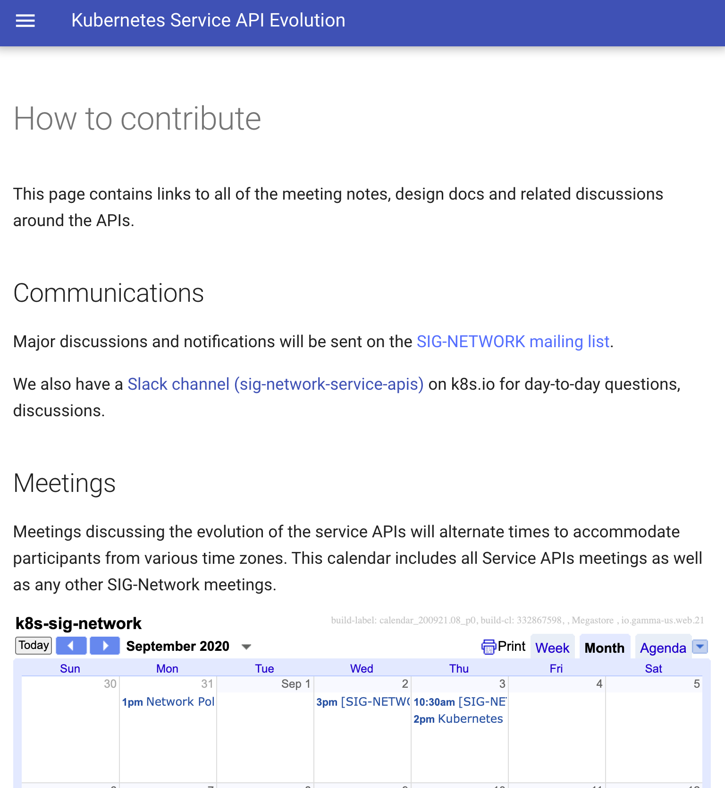
Thanks for coming!
Kubernetes SIG-NETWORK subproject
Project homepage github/kubernetes-sigs/service-apis
How to contribute kubernetes-sigs.github.io/service-apis/community/
Meetings Wednesday, Thursdays
Alternating times AM/PM Pacific, check calendar, meeting code: “77777”
Notes:
Thank you for coming to our session.
We are a Kubernetes SIG-NETWORK subproject
Here is our project homepage
Please

Slide 35
Fin

Slide 36
References
https://www.youtube.com/watch?v=Ne9UJL6irXY (very old)
Kubecon San Diego 2019 - Evolving the Kubernetes Ingress APIs to GA and Beyond [PUBLIC]
Virtual KubeCon EU 2020: SIG-Network Intro and DeepDive
https://github.com/kubernetes-sigs/service-apis

