Slide 1
The CNCF End User Technology Radar, September 2020: Observability
Cheryl Hung, VP Ecosystem, @oicheryl
September 11th, 2020

Slide 2
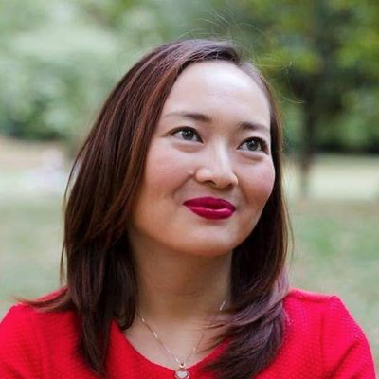
Cheryl Hung, VP Ecosystem
My mission is to make end users successful and productive with cloud native technologies such as Kubernetes and Prometheus.
Find me at oicheryl.com or @oicheryl on Twitter.
Notes:
5500 members

Slide 3
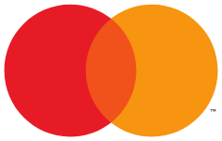
The CNCF End User Community
Plus 12 non-public members

Slide 4
September 2020 Radar Team

Slide 5
September 2020 Radar Team

Slide 6
September 2020 Radar Team

Slide 7
September 2020 Radar Team

Slide 8
September 2020 Radar Team

Slide 9
The Radar

Slide 10
What is a Technology Radar?
Each technology radar is accompanied by themes, which are interesting or surprising patterns.

Slide 11
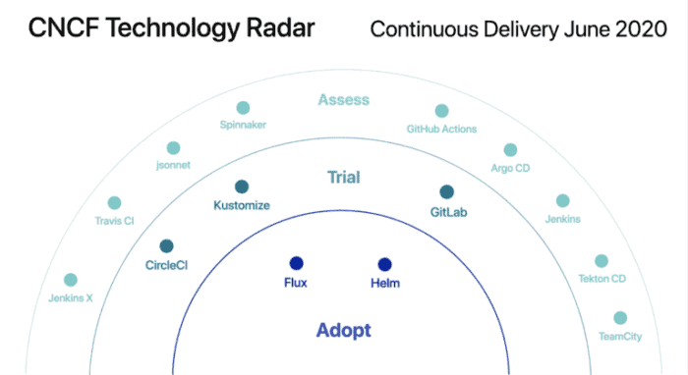
Each CNCF Tech Radar is on a different use case, published quarterly

Slide 12
Radar Team: Why did you choose Observability for the topic of this radar?
Notes:
Marcin
What would you have guessed?

Slide 13
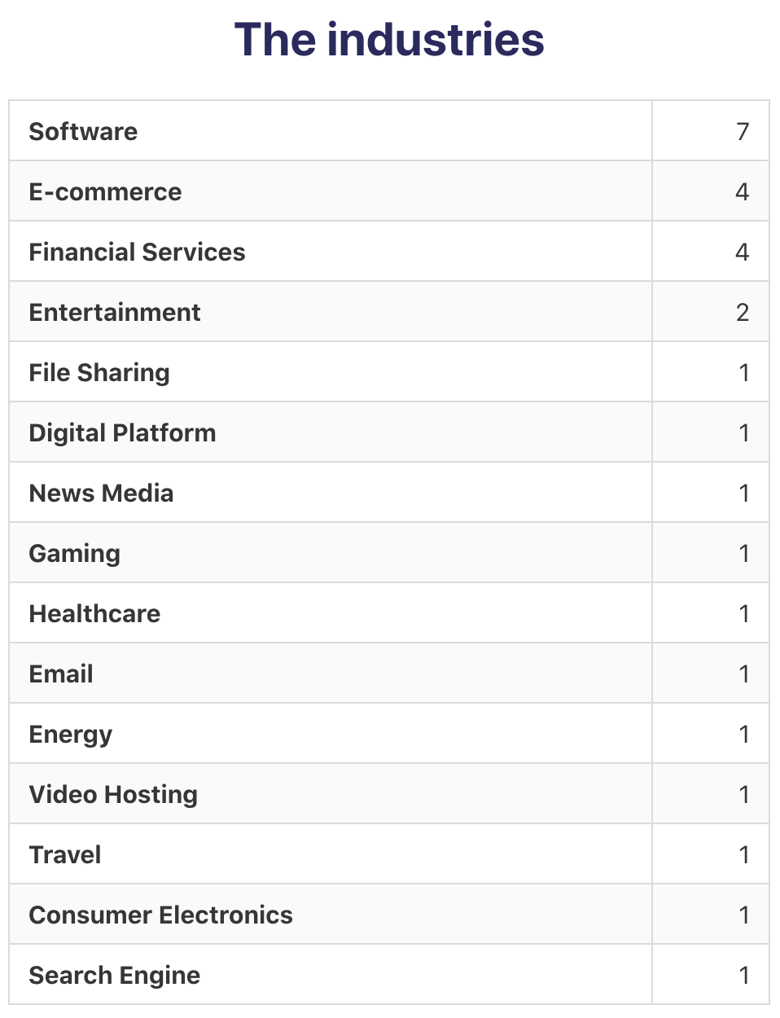
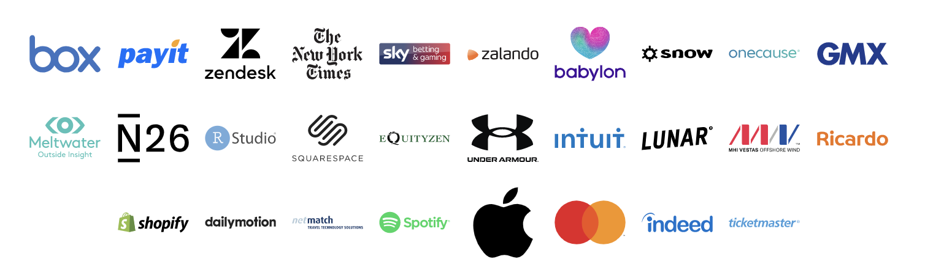
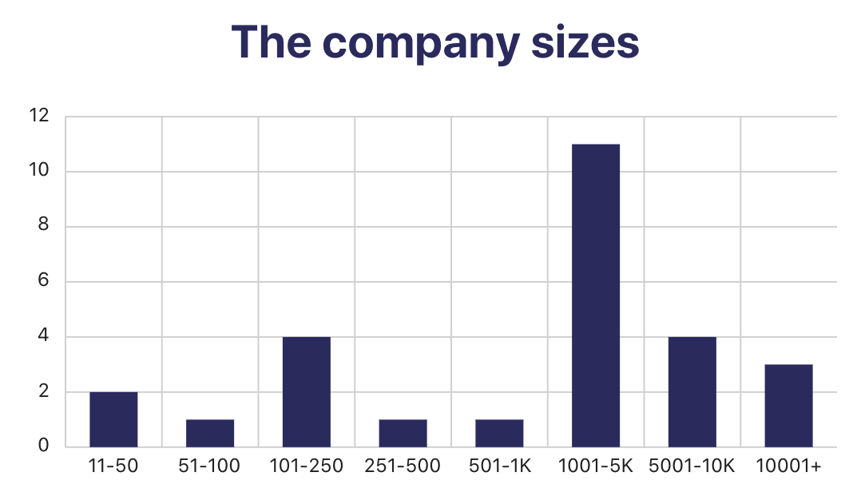
283 votes from 32 companies

Slide 14
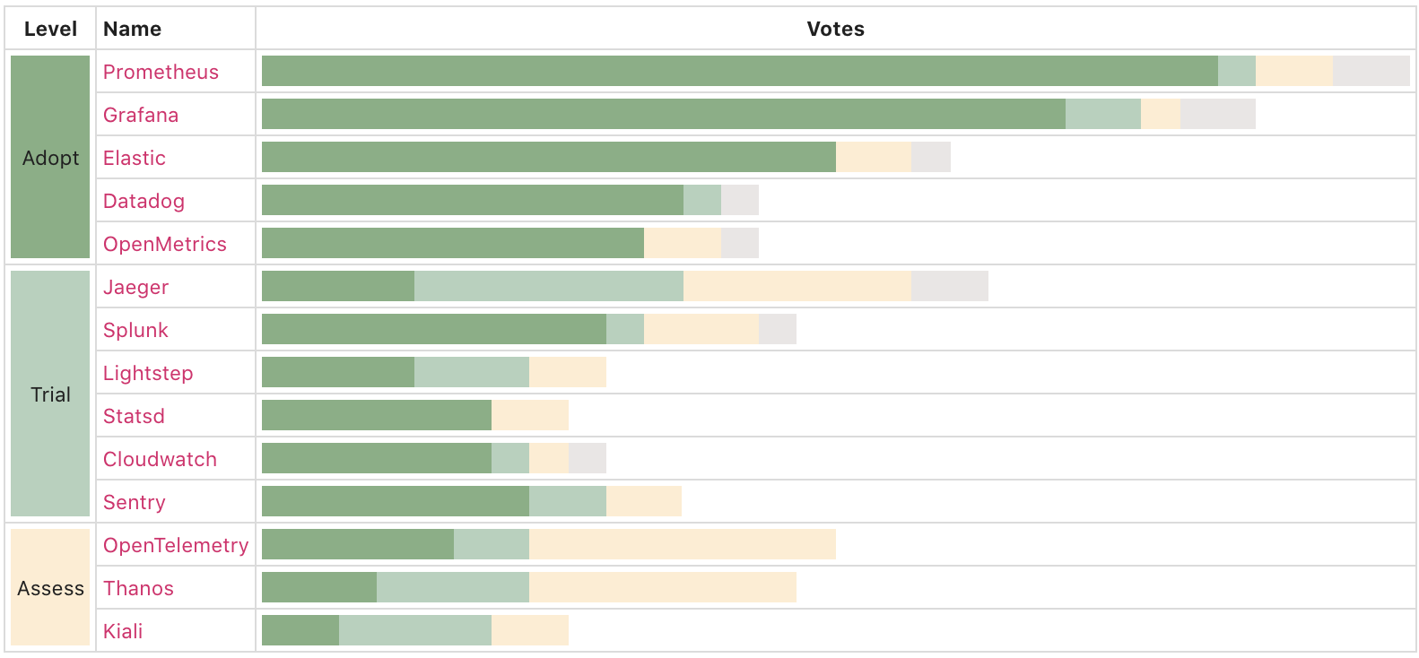
283 votes from 32 companies

Slide 15
283 votes from 32 companies

Slide 16
283 votes from 32 companies

Slide 17
Radar Team: What interesting themes did you see?

Slide 18
Radar Team: What interesting themes did you see?
1. The most commonly adopted tools are open source.
Notes:
Marcin

Slide 19
Radar Team: What interesting themes did you see?
1. The most commonly adopted tools are open source.
2. There’s no consolidation in the observability space.

Slide 20
Radar Team: What interesting themes did you see?
1. The most commonly adopted tools are open source.
2. There’s no consolidation in the observability space.
3. Prometheus and Grafana are frequently used together.

Slide 21
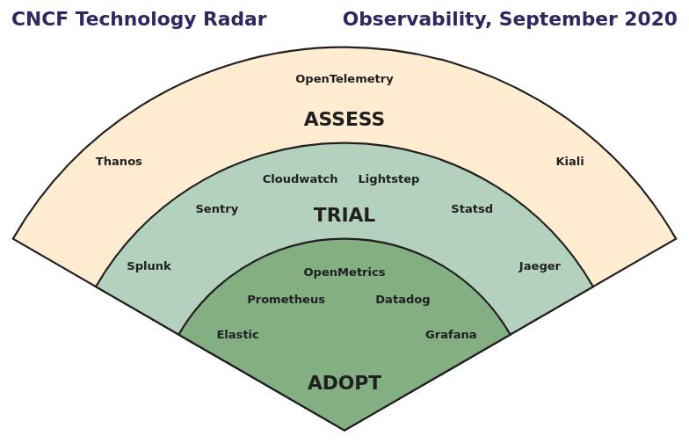
The final Radar
1. The most commonly adopted tools are open source.
2. There’s no consolidation in the observability space.
3. Prometheus and Grafana are frequently used together.

Slide 22
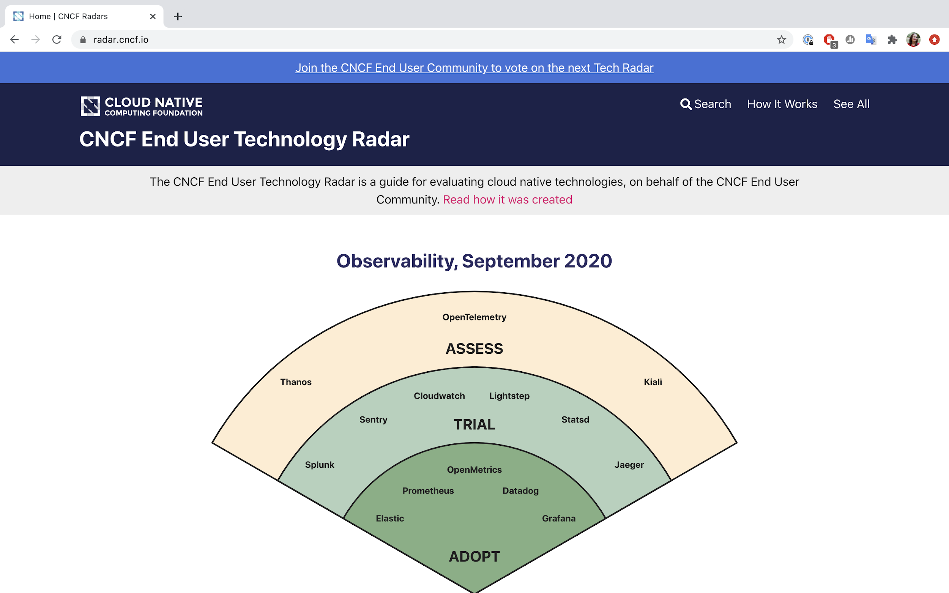
New!
radar.cncf.io

Slide 23
How to get involved
🗳️
Vote on the next topic at cncf.io/tech-radar

Slide 24
How to get involved
🗳️
Vote on the next topic at cncf.io/tech-radar
🙌
To contribute to future radars, join cncf.io/people/end-user-community/

Slide 25
How to get involved
🗳️
Vote on the next topic at cncf.io/tech-radar
🙌
To contribute to future radars, join cncf.io/people/end-user-community/
🤔
Send feedback to info@cncf.io

Slide 26
Questions?

Slide 27
Thank you!
chung@linuxfoundation.org

