Slide 2
About me
CEO @ Stakater
Container platform evangelist & fullstack developer & architect and instructor (13+)
Explore our open source contributions in Kubernetes ecosystem: https://github.com/stakater

Slide 3
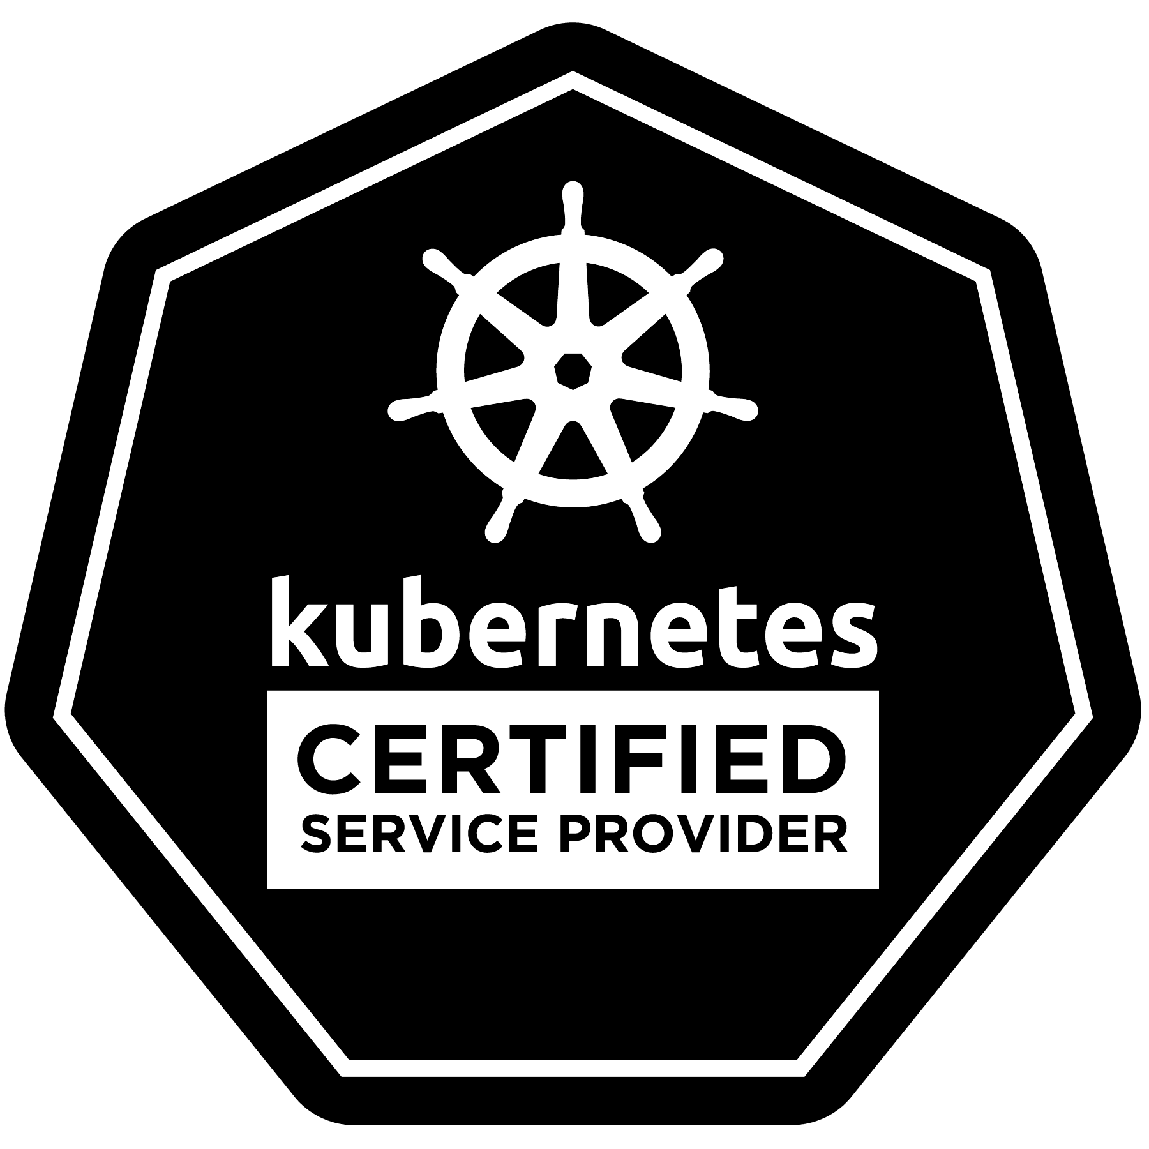
Stakater is a Kubernetes experts company enabling enterprises to realize the full potential of Kubernetes and its ecosystem, by assisting their journey from Strategy to Development and Operations.

Slide 4
TODAY’S CHALLENGES FOR HIGH AVAILABILITY (HA) AND DISASTER RECOVERY (DR)

Slide 5
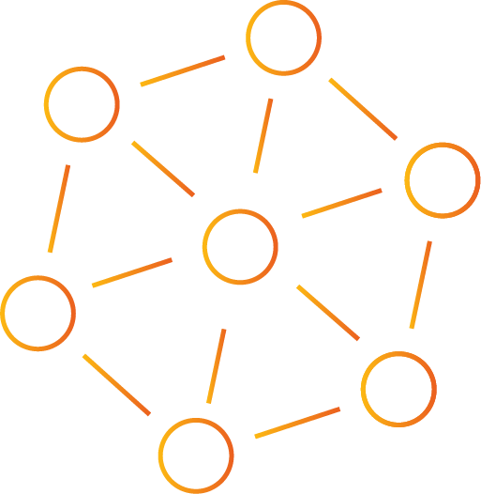
TODAY CIO’s REQUIRE MORE
REQUIREMENTS
No outages
React quickly to demand
Provide service 24 x 7 x 365
IMPLEMENTATION
DevOps, CI/CD
Rolling upgrades
Redundancy
HA architectures
HA operational processes
CONTINUOUS
SERVICE
DELIVERY

Slide 6
What is Business Continuity ?
Business Continuity is having a strategy to deal with major disruptions and disasters.
Backup
Copying your data to another environment or location
Disaster Recovery
Providing you with an environment that is capable of sustaining your business

Slide 7
Why is Business Continuity important ?
24 / 7 Availability
Competitive Advantage
Malware Protection & Security
Reputation & Revenue

Slide 8
CHALLENGES
Efficiency
Complexity
Cost

Slide 9
INTRODUCTION TO HIGH AVAILABILITY (HA)
Single site application (Traditional)
No disaster recovery
DR application (Traditional)
Failover to a secondary site
Multi site application (Cloud-native)
Deploy across multiple sites
Disaster recovery is built-in Simply re-scale
Recommended three sites vs two
Internet
Data Center
A
Data Center
B
Kubernetes
(cluster A)
Kubernetes
(cluster A)
App 1
App 2
App 1
App 2

Slide 10
WHAT EVERYONE WANTS?

Slide 11
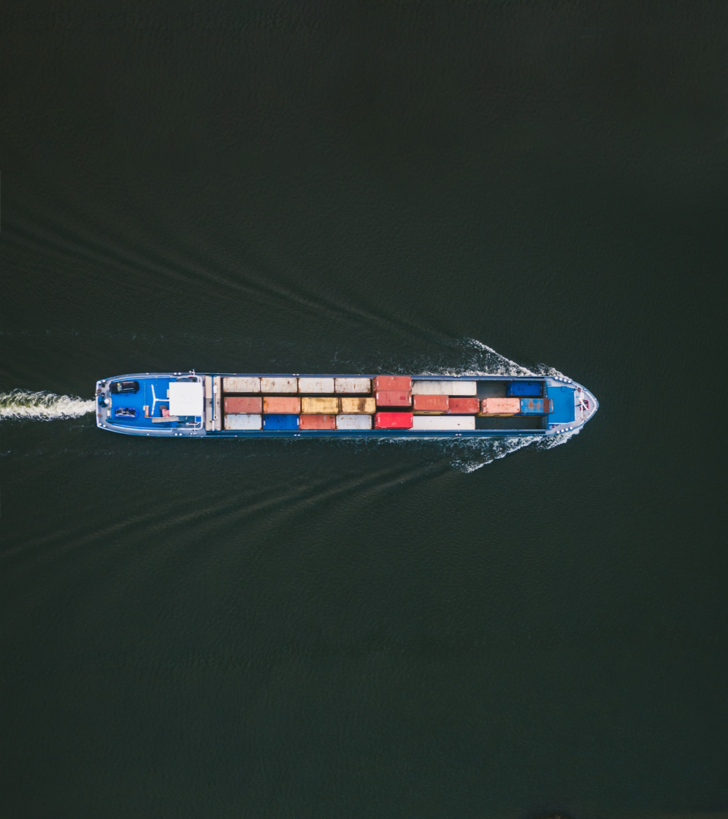
Expectation from our IT infrastructure
Availability and uptime for our apps

Slide 13
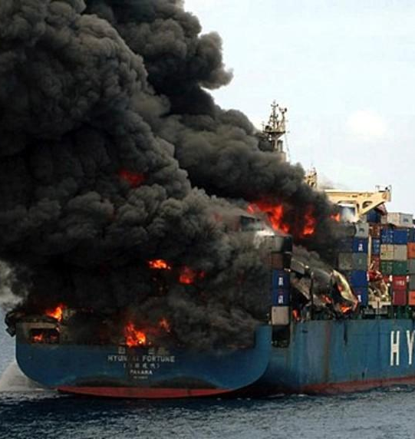
But eventually, something may go wrong

Slide 15
Time for...
Disaster Recovery

Slide 16
Disaster Recovery Metrics
Recovery Point Objective (RPO)
Recovery Time Objective (RTO)
RPO
Disaster
RTO
Data Loss
Down-time

Slide 17
PRE-CONTAINER ERA

Slide 18
Pre-Container ecosystem
Strong relation between applications deployed on specific servers
Disaster Recovery
Regular backups server including software and configuration on the server
Restore backup on new working server

Slide 19
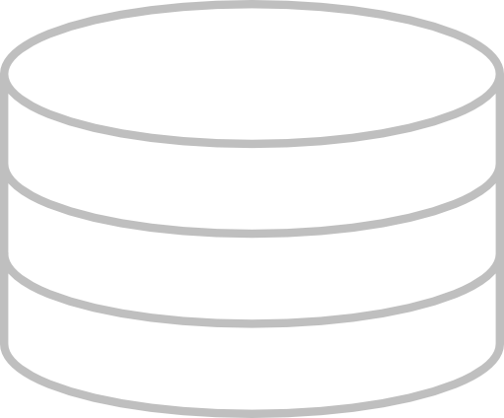
TRADITIONAL DR APPROACHES
Active Data Center
Standby Data Center
Active Data Center
Standby Data Center
A
A
A
A
Periodic
Backups
Batch or
Continuous
Replication
Full Read/Write
Idle and Offline
Full Read/Write
Idle and Offline
COLD STANDBY
WARM STANDBY
Application and data unavailable until standby is brought online
Data loss highly likely

Slide 20
TRADITIONAL DR APPROACHES
Active Data Center
Standby Data Center
Active Data Center
Standby Data Center
A
A
A
A
Continuous
Replication
Continuous
Replication
Full Read/Write
Active and Offline
Full Read/Write
Online, Read-Only
HOT STANDBY
HOT STANDBY, READ REPLICAS
Standby available for immediate use in case of active data center failure
Failure or read-only data processing utilization in standby data center

Slide 21
TRADITIONAL DR APPROACHES
Data Center #1
Data Center #2
A
A
Additional Technology
Configuration
Coordination
Complicated & difficult
Real-time Data Integration and Replication
Availability and Disaster Recovery
Process Availability and Scalability
Process Availability and Scalability
Disk Replication
ACTIVE - ACTIVE

Slide 22
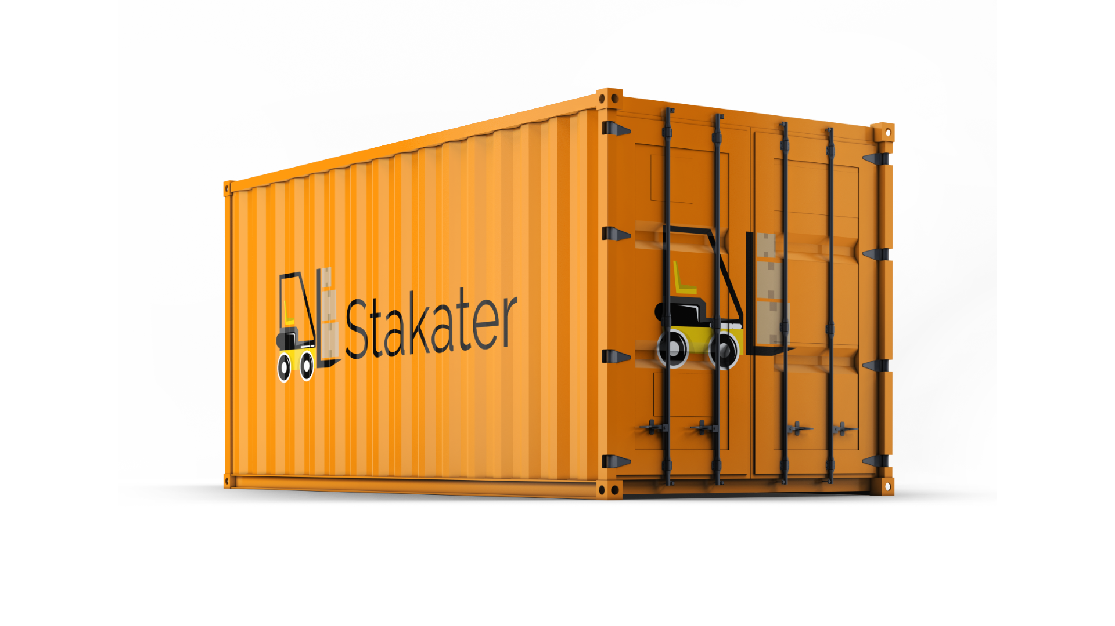
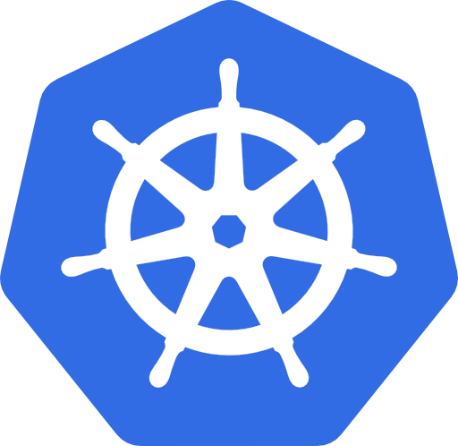
CONTAINER ERA

Slide 23
Kubernetes ecosystem
Application not deployed on any fixed server
Could be scheduled on any of the worker nodes
master
kube-controller- manager
kube-controller- manager
kube-controller- manager
kube-apiserver
node
node
node
etcd
kubelet
kubelet
kubelet
kube-scheduler
kube-scheduler
kube-scheduler
kube-proxy
kube-proxy
kube-proxy

Slide 24
Kubernetes Backup & Recovery

Slide 25
WHY BACKUP
Natural or man-made disasters
Human error
Hackers, Malware
Legal standards or compliance regulations

Slide 26
WHAT TO BACKUP
Namespaces
Container Images
Deployment Configurations
Access Controls
Certificates
Persistent Volumes

Slide 27
Analysis
Stateful Components
Stateless Components

Slide 28
Stateful components
ETCD
Kubernetes cluster state (kubernetes API objects)
Application configurations
Persistent Volumes
Application persistent data (e.g. database, message queue, etc.)

Slide 29
Stateless components
Rest of Kubernetes control plane
Kubernetes worker node components

Slide 30
ETCD
What is ETCD?
How to backup ETCD?
How to restore ETCD?

Slide 31
What is etcd?
key value store used as Kubernetes’ backing store
consistent and highly available
stores all cluster state and data
all kubernetes objects in the cluster

Slide 32
How to backup etcd?
Option # 1: Take snapshot of the storage volume
Option # 2: Use built-in snapshot feature of etcd
Option # 3: Backup the kubernetes objects/resources

Slide 33
Restore etcd
etcd can be restored from snapshots
recover data of a failed cluster.

Slide 34
Persistent Volumes
CSI Volumes
Non CSI Volumes

Slide 35
CSI VOLUMES

Slide 36
Backup (CSI Volumes)
Create Volume snapshot from Persistent Volumes
Considerations
Some CSI drivers may not have implemented the volume snapshot functionality.
apiVersion: snapshot.storage.k8s.io/v1beta1
kind: VolumeSnapshot
metadata:
name: new-snapshot-test
spec:
volumeSnapshotClassName: csi-hostpath-snapclass
source:
persistentVolumeClaimName: pvc-test
$ kubectl create -f your_snapshot_file.yaml

Slide 37
Restore (CSI Volumes)
Provision a new volume using snapshot
apiVersion: v1
kind: PersistentVolumeClaim
metadata:
name: restore-pvc
spec:
storageClassName: csi-hostpath-sc
dataSource:
name: new-snapshot-test
kind: VolumeSnapshot
apiGroup: snapshot.storage.k8s.io
accessModes:
- ReadWriteOnce
resources:
requests:
storage: 10Gi

Slide 38
NON-CSI VOLUMES

Slide 39
Backup and Restore (non-CSI Volumes)
Open source solutions such as:
VMware Velero (formerly Heptio Ark)
Rook
etc.

Slide 40
RESTORE K8S PLATFORM OPERATIONS

Slide 41
Restore Platform Operations
5 strategies:
Platform backup/restore
Restore VMs from a snapshot
Failover to another cluster
Failover to other site (multi-site)
Re-Build from scratch (GitOps)

Slide 42
Option # 1 - Platform Backup/Restore

Slide 43
Replication repository
Application
Backup
PV1
PV2
Restore
Internal images
Source cluster
Target cluster
Application
Backup tool
Application
Backup tool
PV1
PV2
PV1
PV2
Internal images
Internal images

Slide 44
Option # 2 - Restore VMs from a snapshot

Slide 45
Snapshot
Restore
Source VM

Slide 46
Option # 3 - Failover to another cluster

Slide 47
What is Failover
In case of failure of one cluster, use a failover cluster
Both clusters are near identical
Infrastructure identical
Stateless applications identical
Configuration and secrets possibly different
Clusters can be kept in sync with parallel CI/CD

Slide 48
Active
Standby
PVCs
PVCs
Data Center
Data Center

Slide 49
Option # 4 - Failover to other site (multi-site)

Slide 50
Active
Standby
PVCs
PVCs
Data Center 1
Data Center 2

Slide 51
Option # 5 - Rebuild from scratch (GitOps)

Slide 52
What is GitOps
Git as a single source of truth for declarative infrastructure
Entire system is described declaratively. State is maintained and versioned.
Self-healing agents can ensure any manual or erroneous changes are automatically corrected.
Observable changes via Git Diffs
Changes are approved and applied with Git operations
Easy rollbacks via Git revert/rollback/fork

Slide 53
Everything as Code
Infrastructure
Cloud configurations
VM configurations
Kubernetes cluster set up
Deployments
Tools
Applications
Configuration

Slide 54
Cloud Infrastructure as Code
CI/CD Pipeline
Cloud
Compute
STEP # 1
Storage
Security
...

Slide 55
Kubernetes Cluster as Code
CI/CD Pipeline
K8s on Cloud
master
STEP # 2
node
node
node

Slide 56
Tools as Code
CI/CD Pipeline
K8s on Cloud
STEP # 3
Prometheus
Nexus
kibana
Fluentd

Slide 57
Applications as Code
CI/CD Pipeline
K8s & Cloud
STEP # 4
Configmap
Secrets
Ingress
Service
...
…
...
frontend
backend
…
...
api

Slide 58
Summary

Slide 59
CONSIDERATIONS
Plan ahead
Create backup and recovery procedures to best meet your specific requirements
Test and rehearse failure + recovery scenarios in non-production environment
Chaos Engineering tools
Consider failures on every layer of infrastructure and kubernetes
Master (single and multiple)
Worker
Storage

Slide 60
Thank you!
hello@stakater.com
www.stakater.com
github.com/stakater
medium.com/stakater
youtube.com/channel/UCl9t7syUHPc2XXnuOiimZbg
linkedin.com/company/stakater

