Slide 1
Cloud Native Development in AWS with Container and Serverless
使用容器和无服务器在 AWS 中进行云原生开发
Pahud Hsieh
Specialist Solutions Architect, Serverless
Aug 22, 2019

Slide 2
A little bit about Myself
Joined AWS in 2016
Focus on Serverless and Containers
Public Speaker in AWS Global Summits, KubeCon and communities
Serverless Specialist SA since 2019 Feb
Father of a 5-year-old daughter
Road trip lover

Slide 3
Agenda
What's New in Kubernetes on AWS
eksctl – A CLI for Amazon EKS
AWS CDK with Kubernetes
Service Mesh in AWS
Kubernetes Ingress and Load Balancing in AWS
Building Kubernetes in AWS China Regions
Hybrid Serverless and Container in AWS
Kubernetes Global Distributions in AWS

Slide 5
51%
of Kubernetes workloads run on AWS today —CNCF survey

Slide 6
AMAZON ELASTIC KUBERNETES SERVICE
(EKS)

Slide 7
We started in us-east-1 and us-west-2 and soon after…
Released VPC CNI 1.0
HIPAA Support
Released our build scripts on Github
Released VPC CNI 1.1
Enabled GPU support
Support for API Aggregation
Support for HPA
Support for eu-west-1
CLI support for writing the kubeconfig
Support for Admission Controllers
Released VPC CNI 1.2
Allow for additional VPC CIDR ranges
Support for us-east-2

Slide 8
We started in us-east-1 and us-west-2 and soon after…
Official support for ALB Ingress
Container Market Place
AW Cloud Map integrations
Support for AWS App Mesh
Support for eu-central-1, ap-southeast-1, ap-southeast-2, ap-northeast-1
Support for ap-northeast-2
ADDED AN SLA… IN LESS THAN A YEAR!

Slide 9
We started in us-east-1 and us-west-2 and soon after…
Achieved ISO and PCI compliance
Support for ap-south-1, eu-west-2, eu-west-3
Released VPC CNI 1.3
Added a new QuickStart
Allowed private API Endpoints
Launched an App Mesh controller at GA
Public Preview for Windows nodes
Deep Learning container launch
Added 1.12 with a new cluster update api

Slide 10
We started in us-east-1 and us-west-2 and soon after…
Released CSI Drivers for FSx and EFS
Support for getting control plane logs
Public Preview of A1 instances
Released a Machine Learning Benchmark tool
Support for Public IPs in Cluster VPCs
Support for the public preview of CloudWatch Container Insights

Slide 11
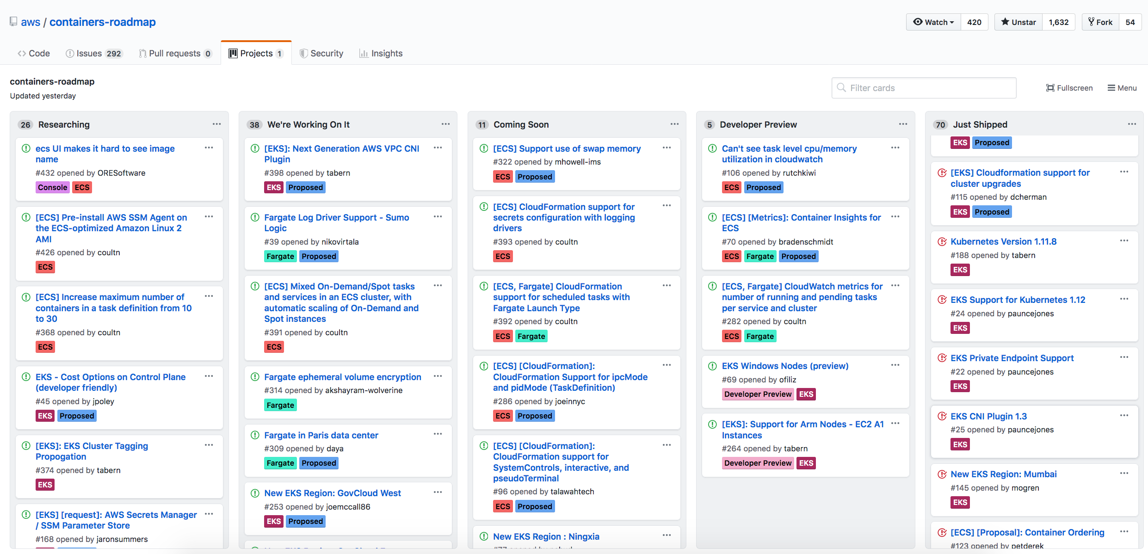
AWS Containers Public Roadmap

Slide 12
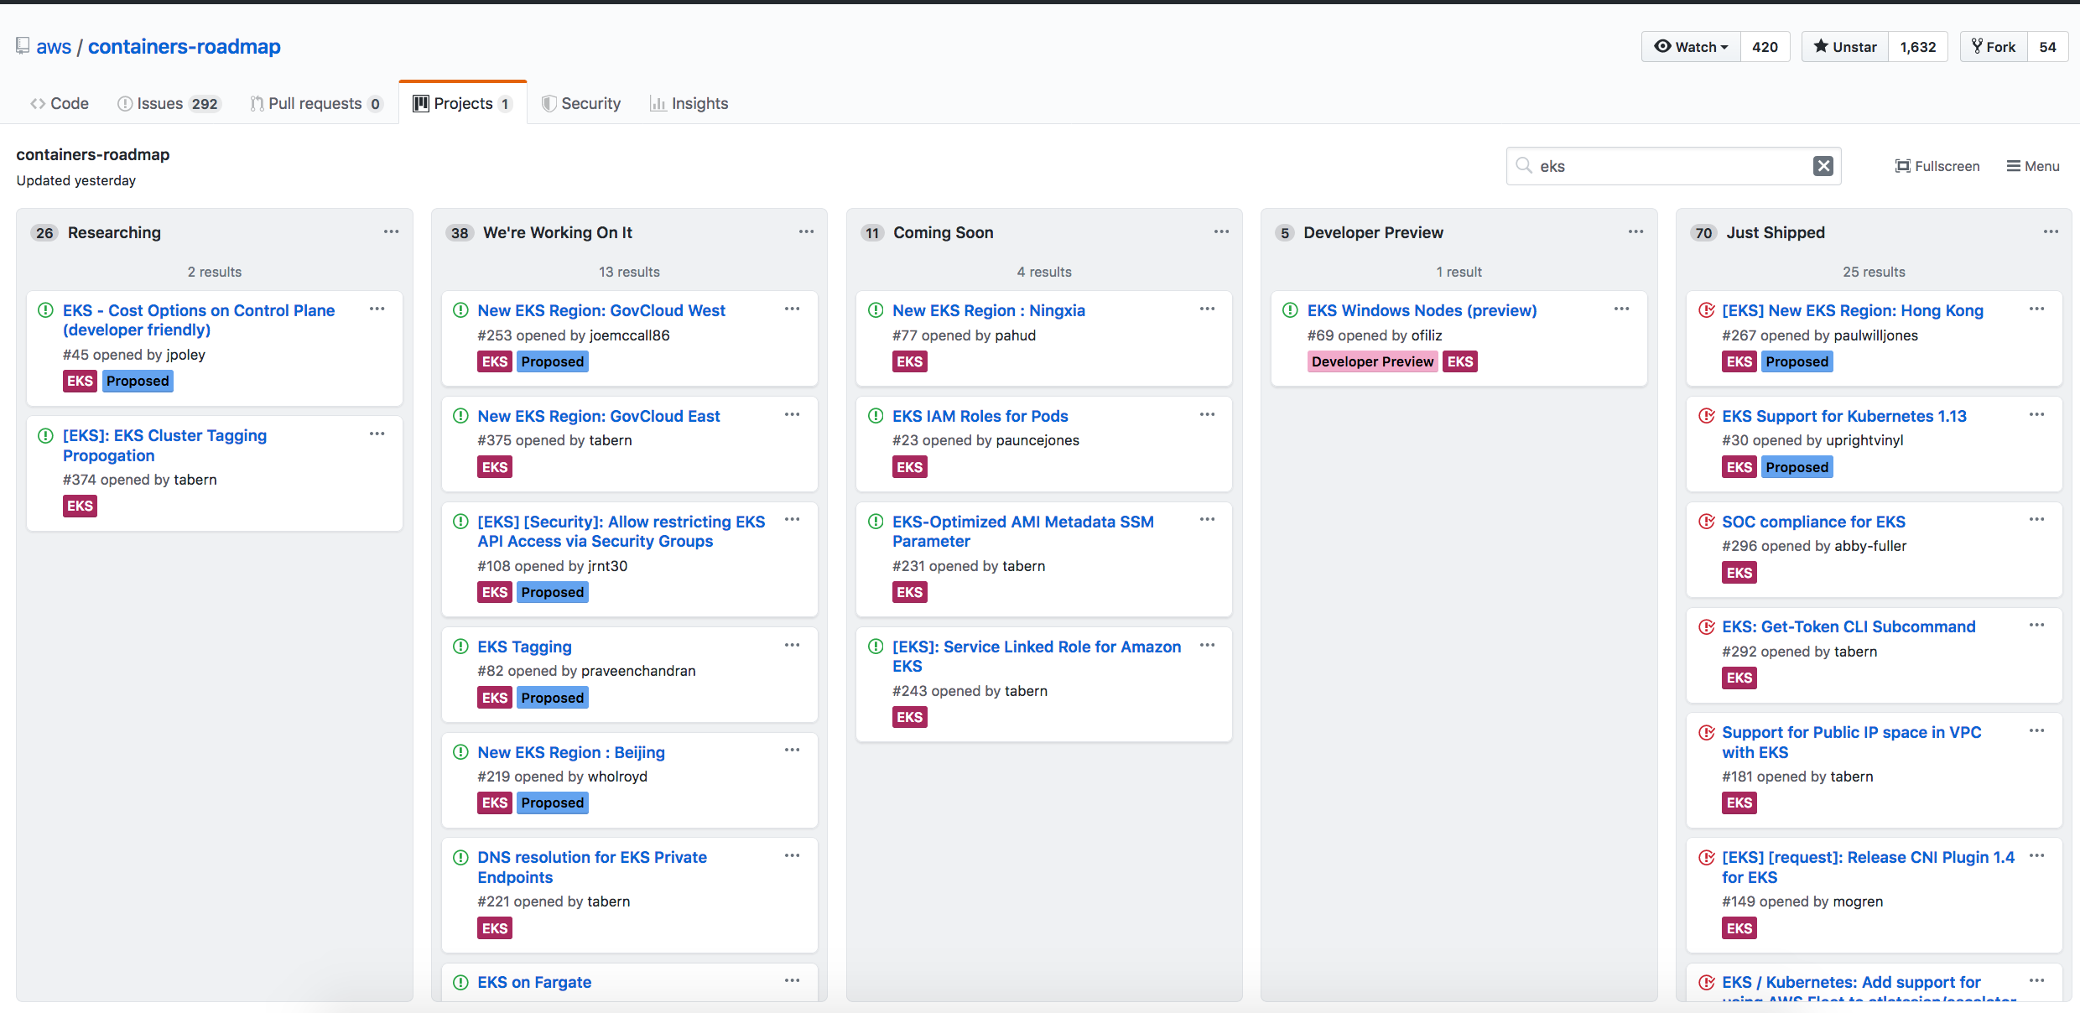
Amazon EKS Public Roadmap

Slide 13
eksctl – The official CLI for Amazon EKS
sponsored by weaveworks
eksctl create cluster
https://eksctl.io

Slide 14
“eksctl is now officially our command line for EKS”
https://aws.amazon.com/blogs/opensource/eksctl-eks-cli/

Slide 15
# customize your cluster
$ eksctl create cluster -f cluster.yaml
# manage nodegroups
$ eksctl create nodegroup --cluster=<clusterName> [--name=<nodegroupName>]
# cluster update
$ eksctl update cluster --name=<clusterName>

Slide 16
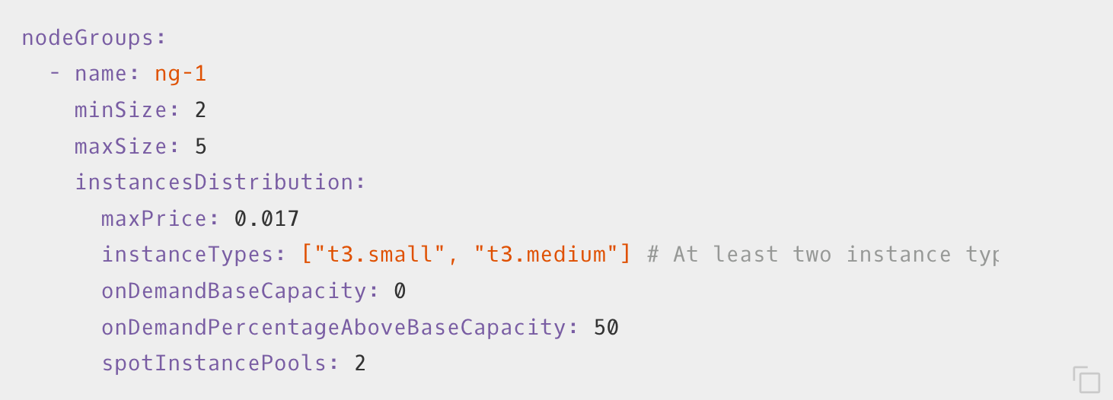
Nodegroup of Mixed Instance Types

Slide 17
Nodegroup of GPU Instances

Slide 18
AWS Cloud Development Kit (AWS CDK)

Slide 19
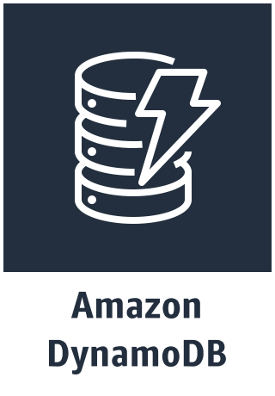
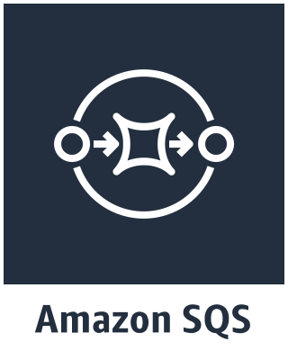
AWS CDK
General Available
AWS CDK application
AWS CloudFormation template
Stack(s)
Construct
Construct
Componentized
High level
DOMs
Declarative
Resources
Scripted
Manual
Low level

Slide 20
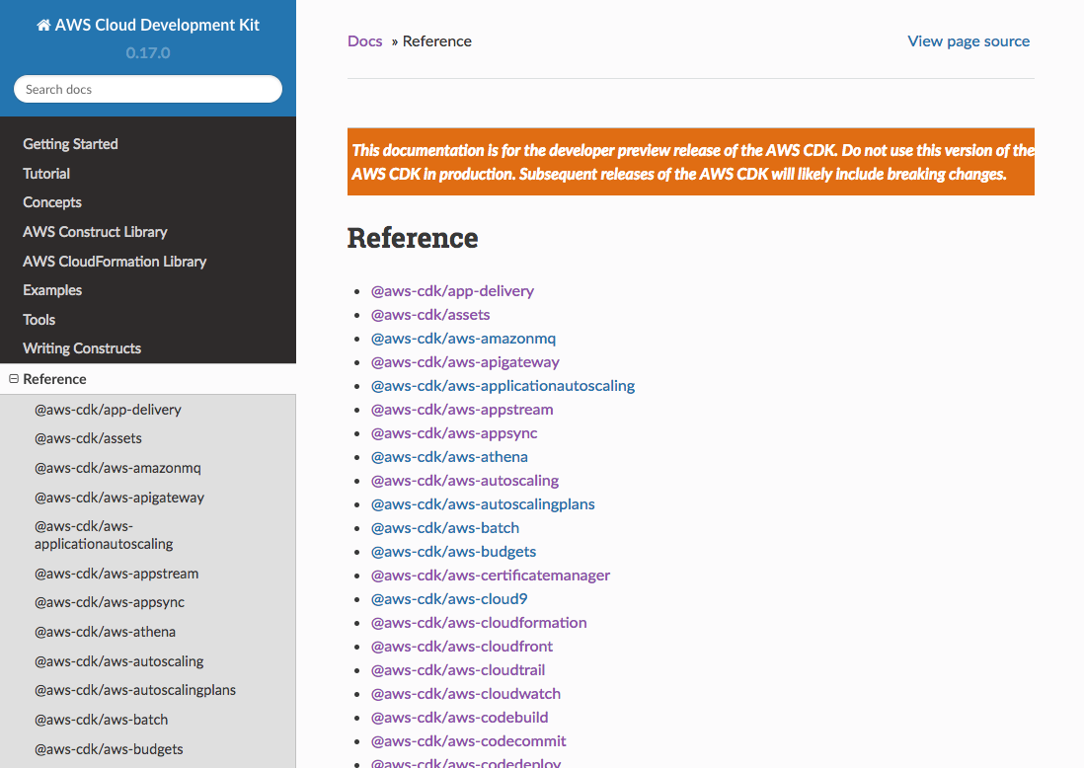
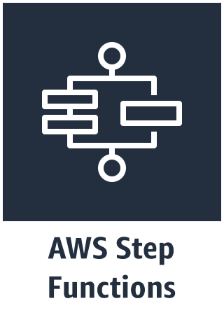
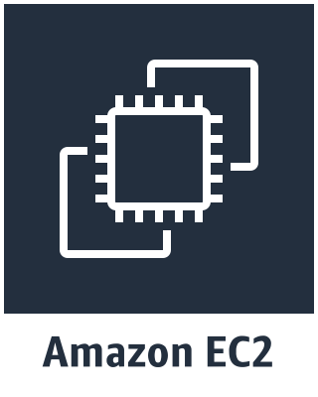
AWS CDK
General Available
AWS Construct Library
Componentized
High level
DOMs
Declarative
Scripted
Manual
Low level

Slide 21
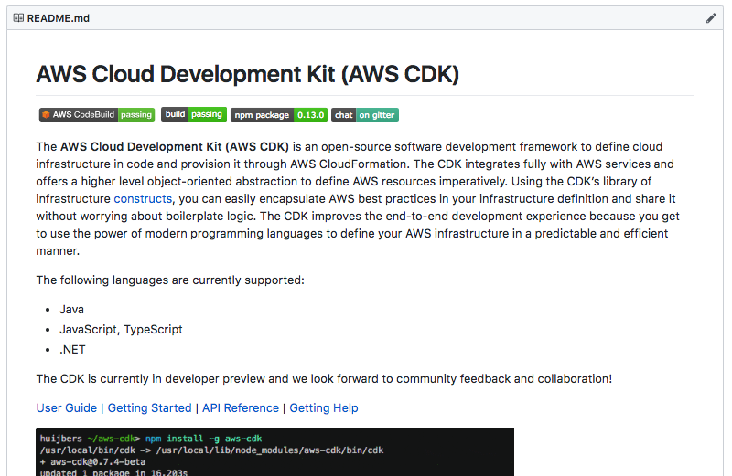
AWS CDK
General Available
Componentized
High level
DOMs
Declarative
Scripted
Manual
Low level

Slide 22
Show me the Code!

Slide 23
new eks.Cluster();
Dedicated VPC with default configurations
Amazon EKS cluster with managed control plane
Required Security Groups and IAM Role
2x m5.large EC2 instances with the latest Amazon EKS-optimized AMI in the nodegroup (just as eksctl)

Slide 24
Show me the IDE!

Slide 25
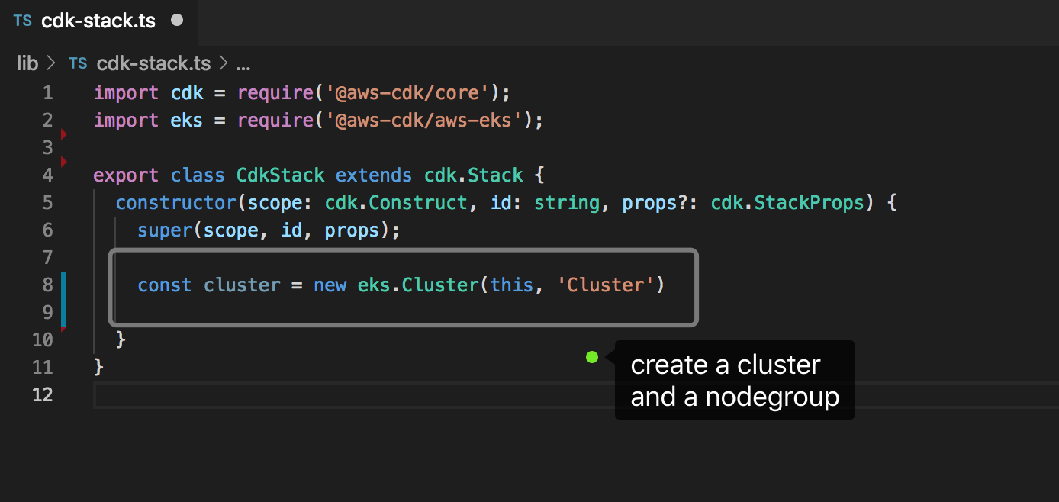

Slide 26
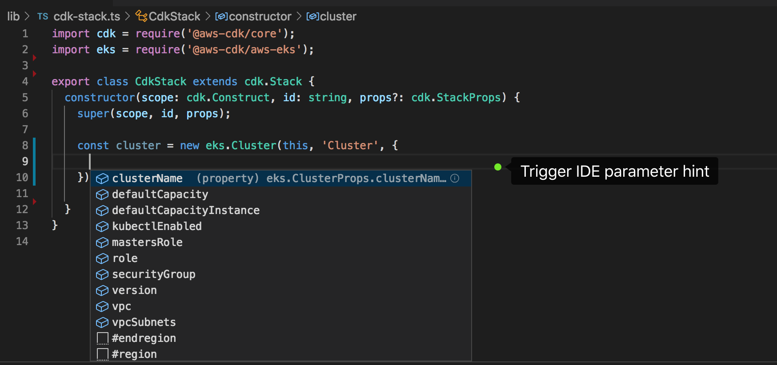

Slide 27
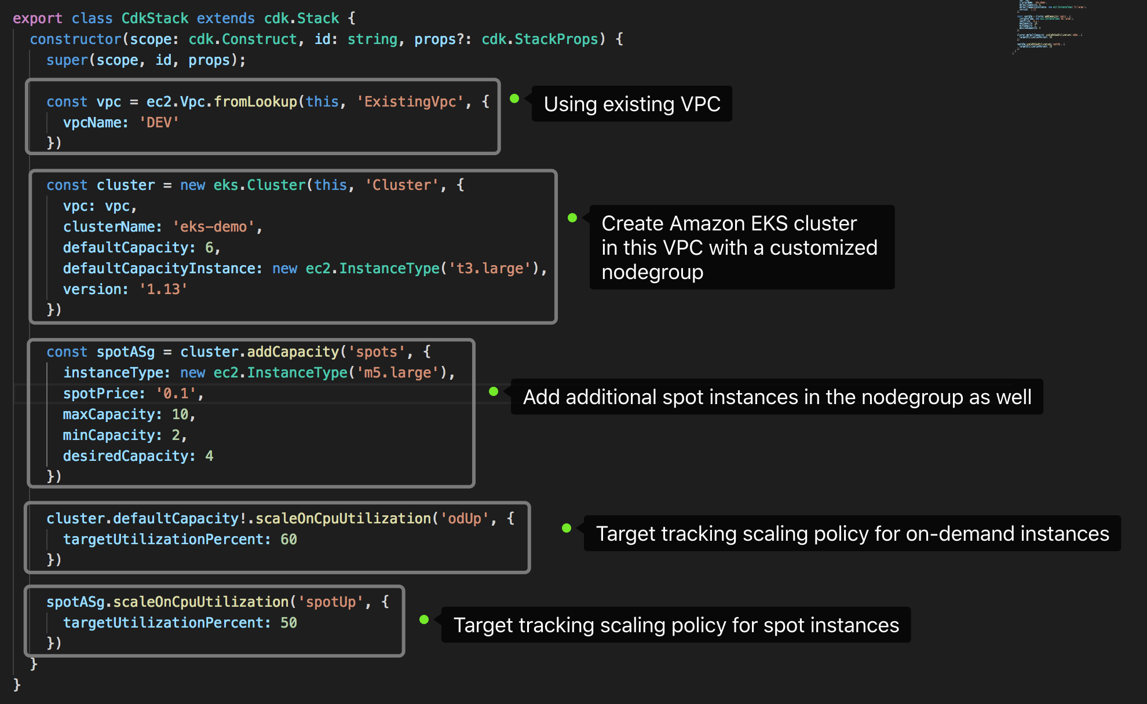

Slide 28
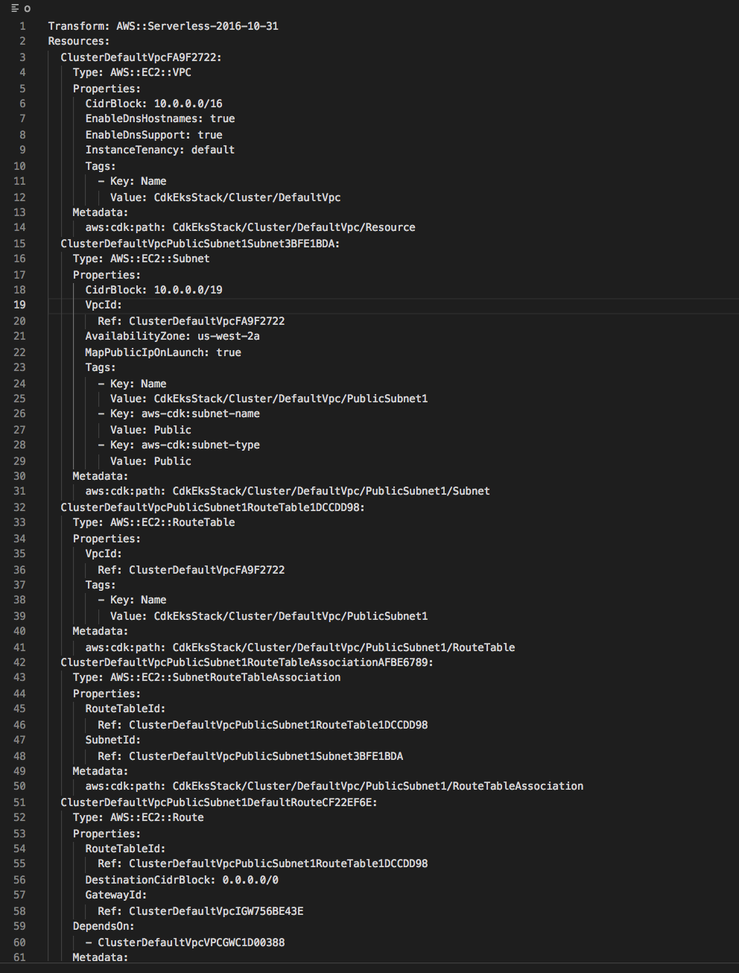
$ cdk synth

Slide 29
$ cdk deploy

Slide 30
Service Mesh in AWS

Slide 31
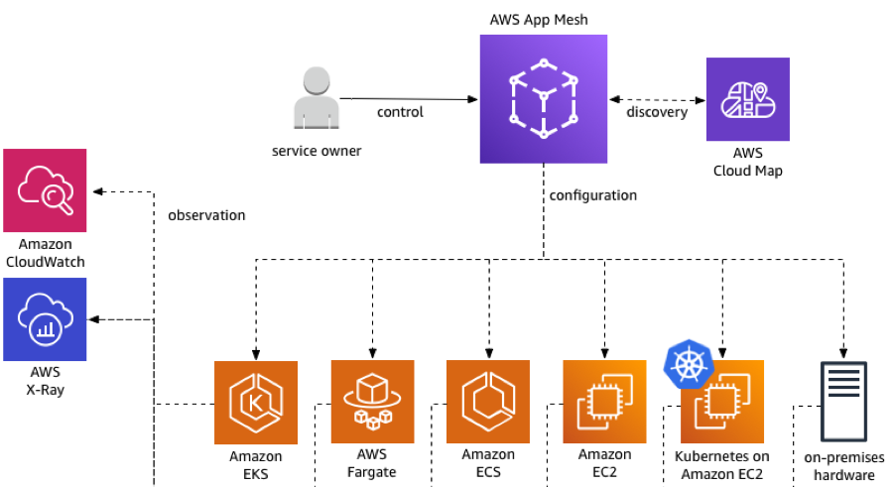
“Our vision for App Mesh is an AWS-native service mesh that integrates equally well with AWS primitives and advanced services.”
Werner Vogels CTO - Amazon.com

Slide 34
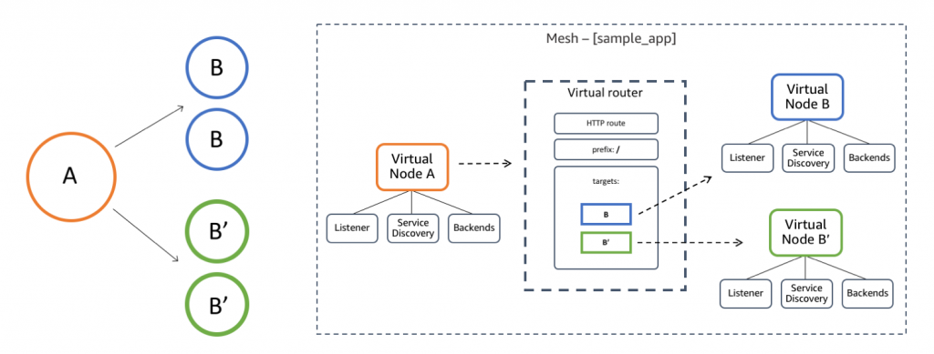
Blue/Green Deployment or Traffic Switching

Slide 35
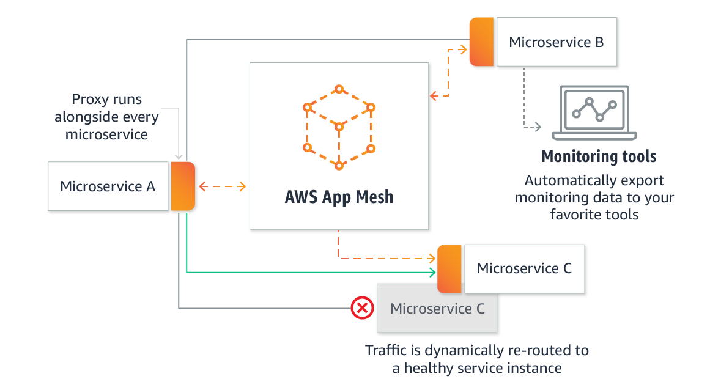

Slide 36
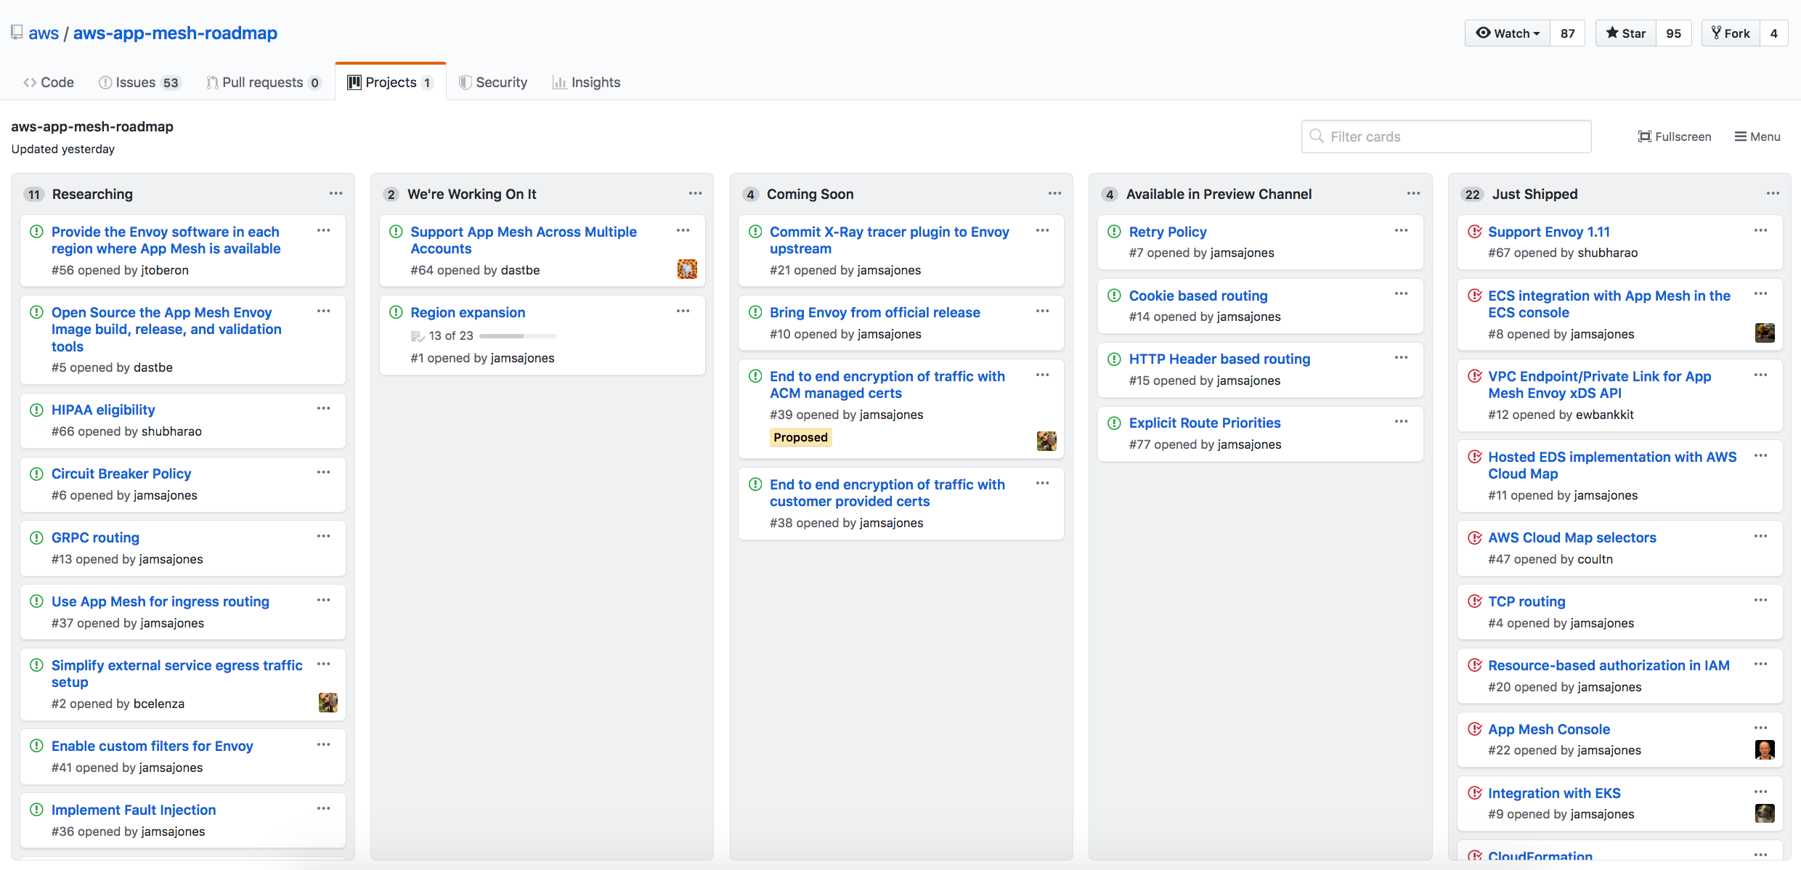
AWS AppMesh Public Roadmap in Github

Slide 37
Kubernetes Ingress in AWS

Slide 38
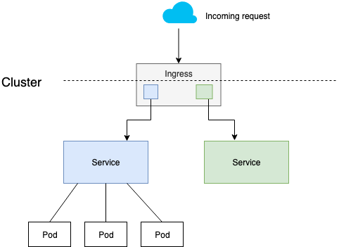
Kubernetes Ingress in AWS
AWS ALB Ingress Controller
Nginx Ingress Controller
HAProxy Ingress Controller
Traefik Ingress Controller
Gloo Ingress Controller

Slide 39
AWS ALB Ingress Controller
Originated by Ticketmaster and CoreOS
Donated to AWS-SIG
Maintained by SIG-AWS Contributors
kubernetes-sigs/aws-alb-ingress-controller
Host mode balancing through nodeports
IP Mode balancing as a container native load balancer
SSL/TLS termination and AWS ACM/WAF integration

Slide 40
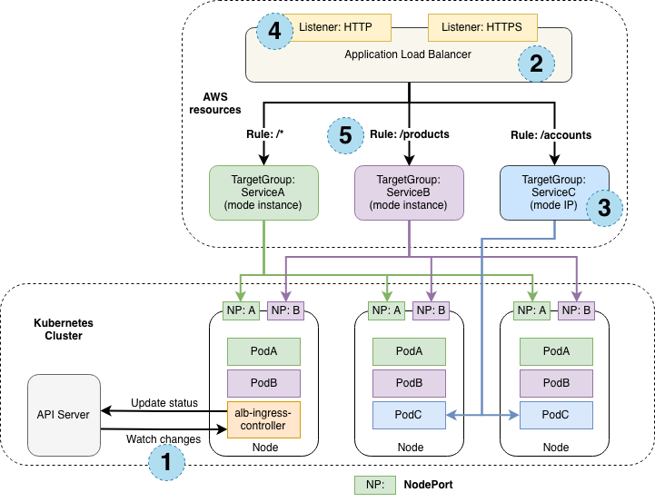
AWS ALB Ingress Controller

Slide 41
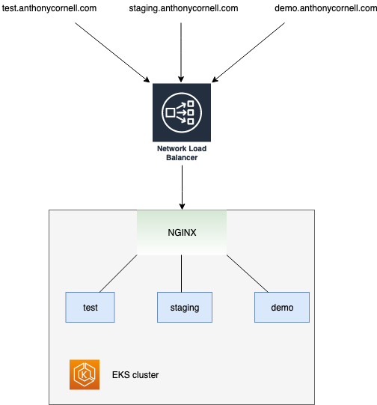
Network Load Balancer with the NGINX Ingress Controller on Amazon EKS
Scale to millions of requests per second
Long-lived TCP connections
Source/remote address preservation
SSL/TLS Termination

Slide 42
Kubernetes in AWS China Regions

Slide 43
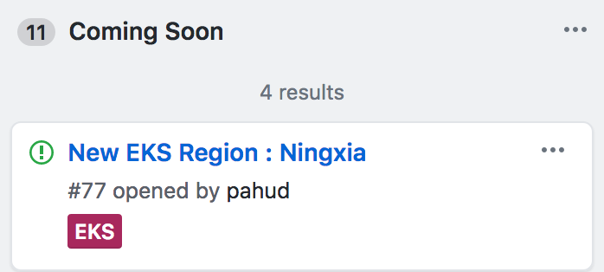
Amazon EKS is Coming to AWS Ningxia Region
https://github.com/aws/containers-roadmap/issues/77

Slide 44
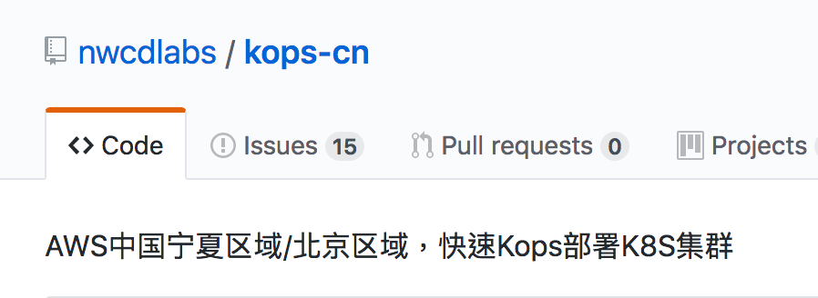
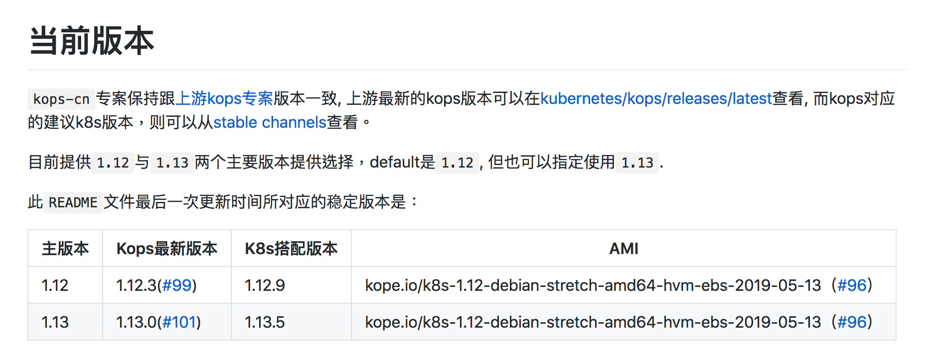

Slide 45
Serverless x Containers in AWS

Slide 46
“Use of serverless technology in Asia has spiked 100% with 29% of respondents using installable software and 21% using a hosted platform.”
https://www.cncf.io/blog/2018/11/13/cncf-survey-china-november-2018/

Slide 47
“For hosted serverless platforms, AWS Lambda is the most popular with 11% of respondents citing usage. “
https://www.cncf.io/blog/2018/11/13/cncf-survey-china-november-2018/

Slide 48
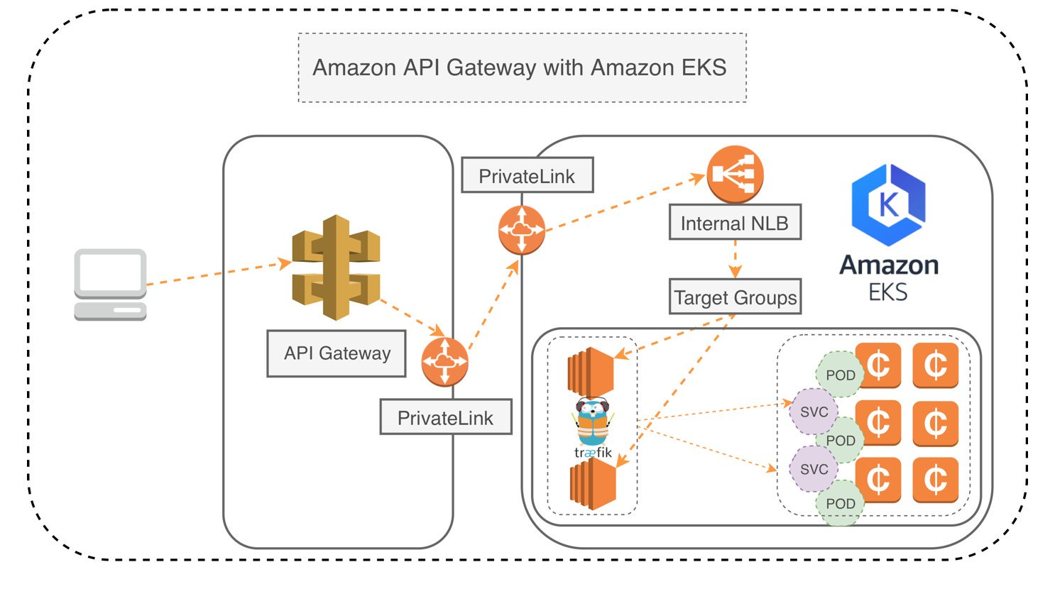
Amazon API Gateway with Amazon EKS

Slide 49
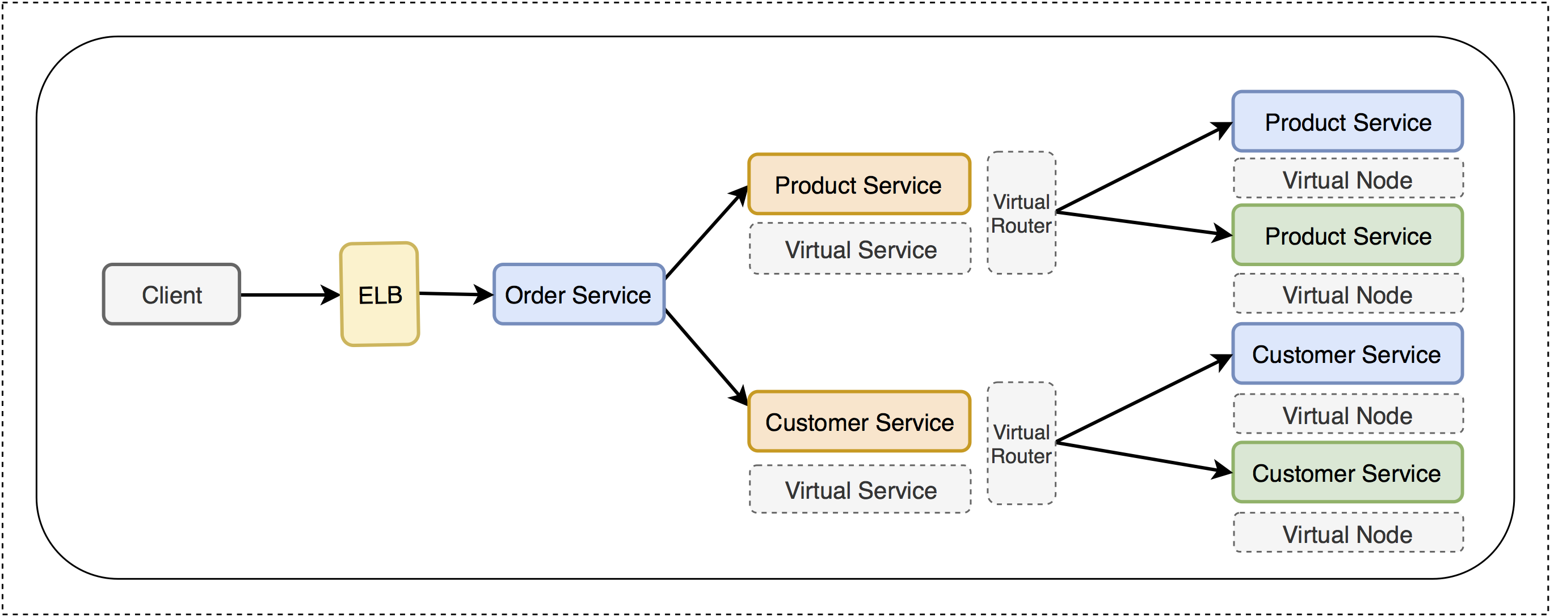
Amazon EKS Canary Deployment with AWS Step Function
https://github.com/aws-samples/eks-canary-deployment-stepfunction

Slide 50
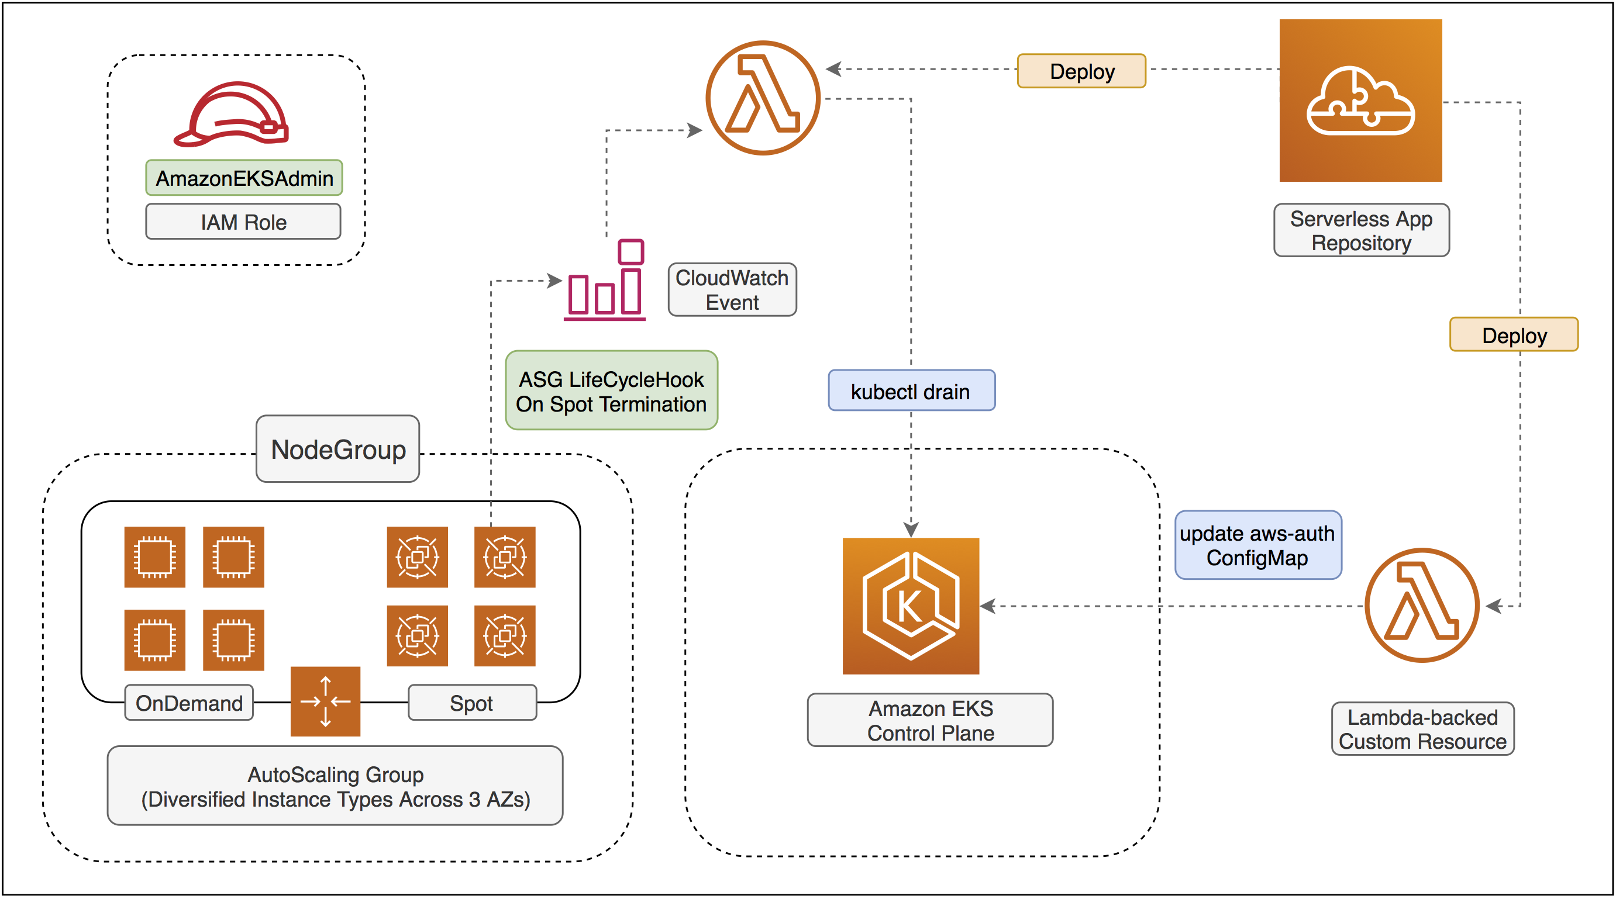
Amazon EKS Reference Architecture with AWS Lambda
https://github.com/aws-samples/amazon-eks-refarch-cloudformation

Slide 51
Distributing to Global

Slide 52
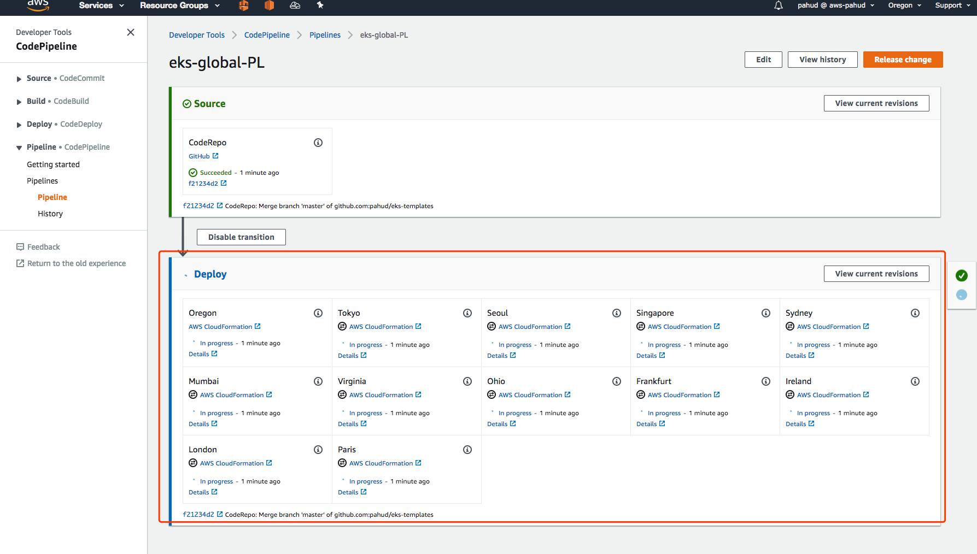
Cross-Regional CodePIpeline for Kubernetes Global Distribution

Slide 53
But, since we have CDK today…

Slide 54
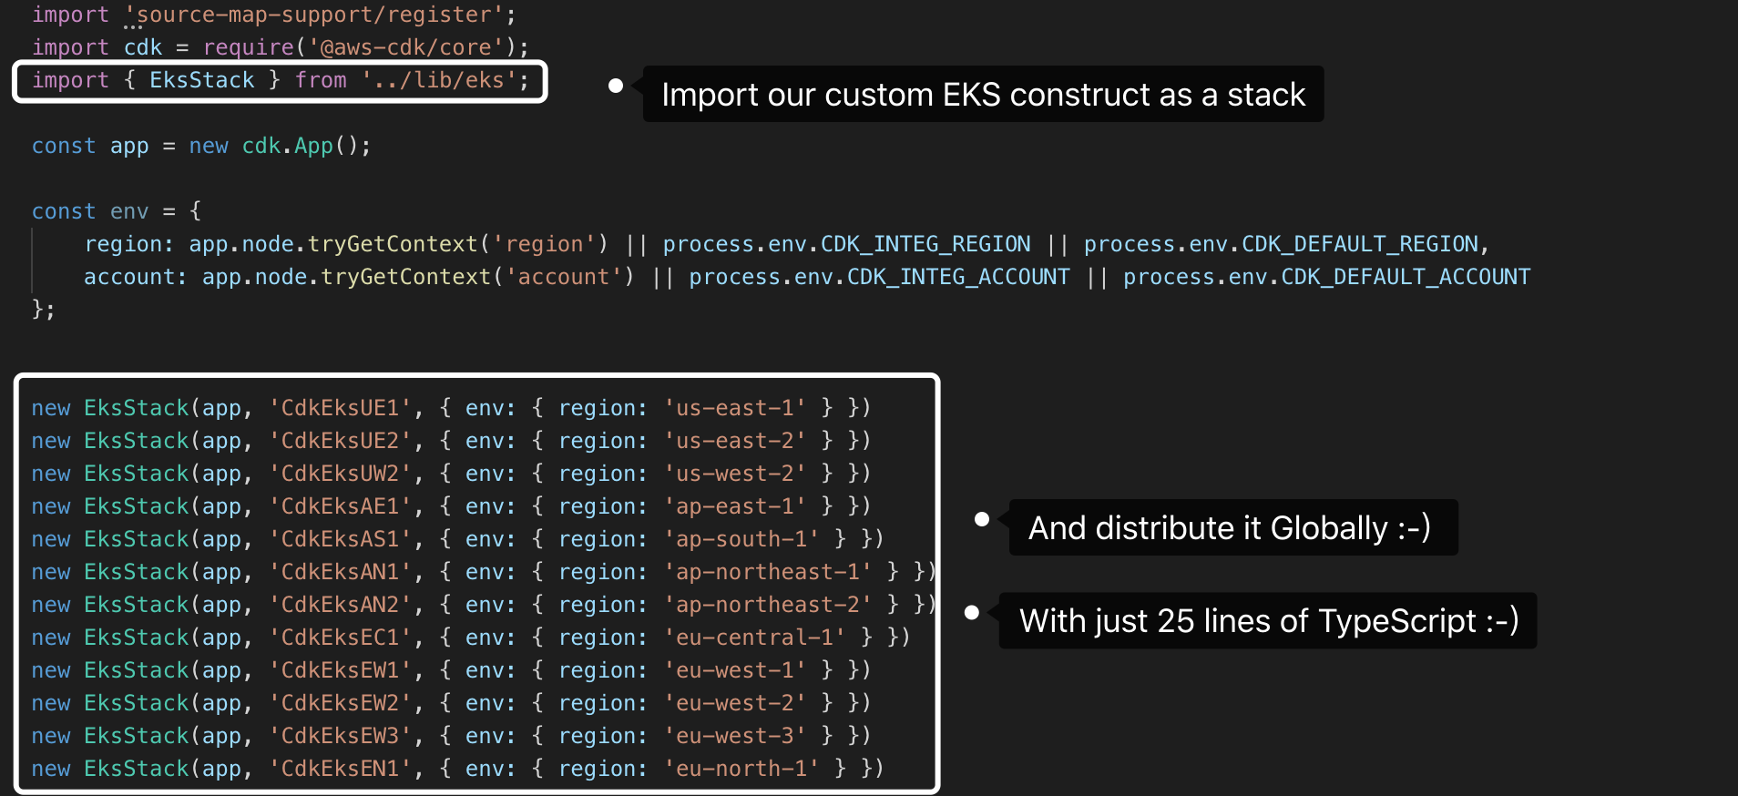

Slide 55
Thank you!
@pahudnet
Pahud Hsieh
@pahud
Specialist SA, Serverless
Amazon Web Services
hunhsieh@amazon.com

