Slide 1
How We Doubled System Read Throughput with Only 26 Lines of Code
Presented by Minghua Tang

Slide 2
About me
Minghua Tang
Interested in databases, storage systems (and Civilization)
R&D, PingCAP
Github ID: @5kbpers

Slide 3
Agenda
What’s TiKV
How Follower Read was built
General use cases
Q&A

Slide 4
Part 1 - What’s TiKV

Slide 5
TiKV is ...
a distributed transactional key-value database originally created by PingCAP as the underlying storage engine for TiDB
based on the design of Google Spanner and HBase, but simpler to manage and without dependencies on any distributed file system
a CNCF incubating project with 7.6 K GitHub Stars and 246 Contributors

Slide 6
TiKV offers ...
Key-Value store
Get(Key)
Put(Key, Value)
Delete(Key)
Scan(StartKey)
Infra build upon TiKV:
TiDB (SQL like), Tedis (Redis like), etc

Slide 7
TiKV offers ...
Key-Value store
Cloud native
You can run TiKV across physical, virtual, container, and cloud environments

Slide 8
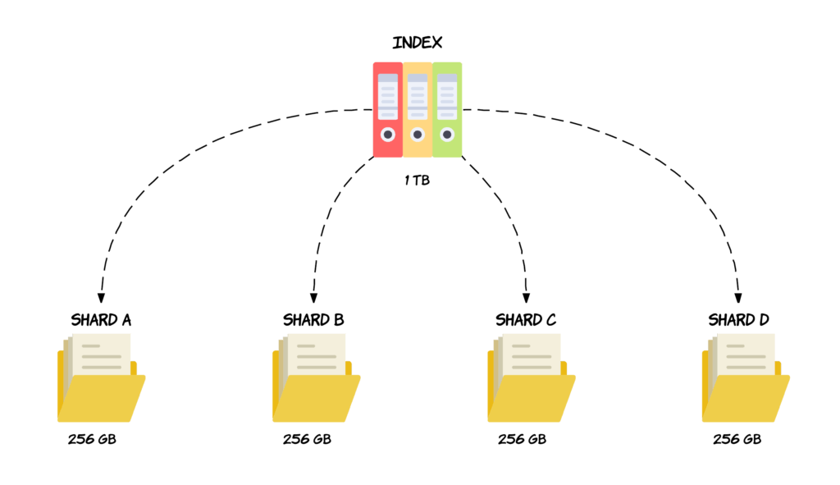
TiKV offers ...
Key-Value store
Cloud native
Horizontal scalability
Deploy more TiKV instances to scale out:
Scale Storage to store petabytes of data
Scale Performance to handle more requests

Slide 9
TiKV offers ...
Key-Value store
Cloud native
Horizontal scalability
High availability
Replicate and store data in multiple distant physical locations to provide redundancy in case of data center failures.
Copy 1
Copy 2
Copy 3

Slide 10
TiKV offers ...
Key-Value store
Cloud native
Horizontal scalability
High availability
Dynamic membership
Grow or shrink TiKV clusters dynamically, without the need for downtime

Slide 11
TiKV offers ...
Key-Value store
Cloud native
Horizontal scalability
High availability
Dynamic membership
Transactional
Provides externally consistent distributed transactions (ACID) to operate over multiple Key-Value pairs.

Slide 12
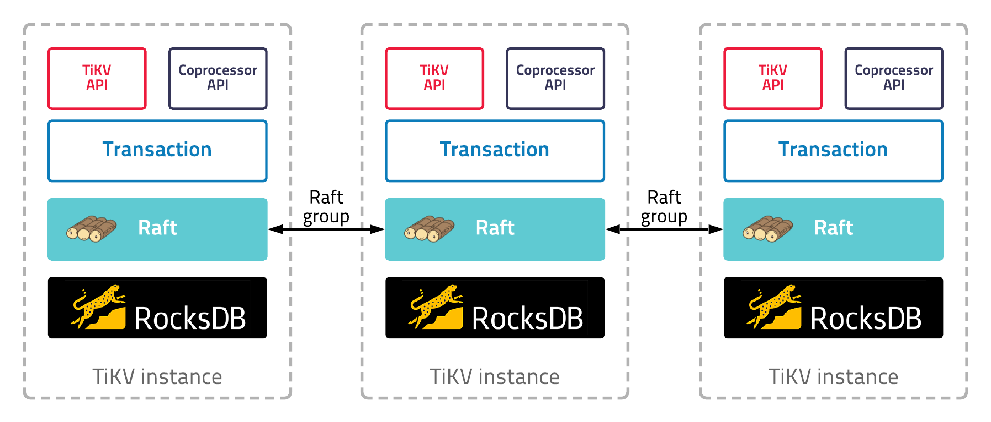
System architecture

Slide 13
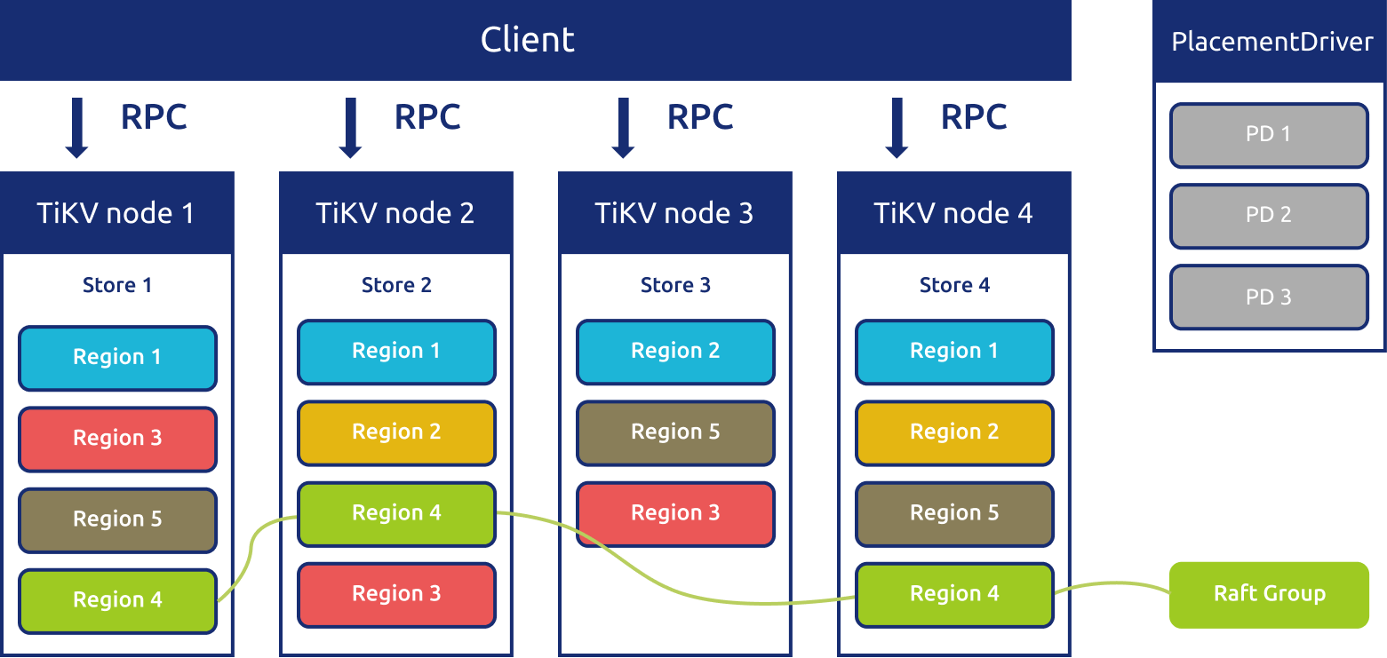
System architecture

Slide 14
TiKV Timeline
Created as the storage layer for TiDB
TiKV 1.0 was released
TiKV was accepted as an Incubating project
April 2016
Aug, 2018
May 2020
April 2015
Oct 2017
May, 2019
TiKV was open sourced
TiKV entered CNCF as a Sandbox project
TiKV 4.0 GA (31 May)

Slide 15
Part 2 - How Follower Read was built

Slide 16
Why Follower Read ?
By default, only the leader in a Region handled heavy workloads
Question: how to reduce the load on the leader and scale out efficiently?
Follower Read: let followers serve read requests

Slide 17
Raft Consensus Algorithm
What is consensus?
Agreement on shared state
Recovers from server failures autonomously
Minority of servers fail: no problem
Majority fail: lose availability, retain consistency
N
N

Slide 18
Server States
Times out
Starts election
Receives votes from majority nodes
Times out
New Election
Starts up
Follower
Candiate
Leader
Discovers
current leader or new term
Discovers node with higer term

Slide 19
Log replication
Client
applied index
2
applied index
1
applied index
1
Leader
Raft
Follower
Raft
Follower
Raft
State
Machine
a = 1
State
Machine
a = 1
State
Machine
a = 1
b = 2
Log
Log
Log
committed index
2
1
a = 1
2
b = 2
committed index
2
1
a = 1
2
b = 2
committed index
1
1
a = 1
Commit: Replicate logs to a majority of replicas. The progress was recorded by committed index (only available on leader)
Apply: Execute commands inside logs in the state machine. The progress was recorded by applied index
Note: follower applied index != leader applied index != leader committed index

Slide 20
Read Index
Client
applied index
2
applied index
1
applied index
1
Leader
Raft
Follower
Raft
Follower
Raft
State
Machine
a = 1
State
Machine
a = 1
State
Machine
a = 1
b = 2
Log
Log
Log
committed index
2
1
a = 1
2
b = 2
committed index
2
1
a = 1
2
b = 2
committed index
1
1
a = 1
Steps:
Follower requests a ReadIndex from leader
Leader reads its committed index and broadcasts a message for confirming its liveness
Leader returns the committed index to follower
Optimazation: Lease Read

Slide 21
Follower Read
Two steps
request leader committed index through ReadIndex
read states locally in state machine of the follower
Exception:
TiKV implements pipelined raft, “apply” is executed asynchronously
leader may apply slower than followers
Then what if follow applied index > leader applied index?
Request 1
Propose
Append
Replicate
Apply
Request 2
Propose
Append
Replicate
Apply
Request 3
Propose
Append
Replicate
Apply

Slide 22
follower applied index > leader applied index
Break linearizability !!!
But snapshot isolation is still ok.
Put a = 1
(log index = 2)
Get a = 1 from follower
Get a = 0 from leader
a = 0
Leader
Follower
committed index = 2
applied index = 1
committed index = 2
applied index = 2

Slide 23
Tranactions in TiKV
Client
Begin
TiKV
Write a = 10 to local buffer
Prewirte a = 10
start ts = 1
Lock
Write
a(1) = 10
Lock
Write
Commit start ts = 1
commit ts = 3
a(1, 3) = 10

Slide 24
Snapshot Isolation ?
Snapshot isolation is still ok.
Prewirte a = 10
start ts = 1
(log index = 2)
Get lock from follower, must retry
Get a = 0 from leader
a = 0
Leader
Follower
committed index = 2
applied index = 1
committed index = 2
applied index = 2

Slide 25
Snapshot Isolation ?
Snapshot isolation is still ok.
Commit start ts =1
commit ts = 3
(log index = 3)
a = 10 was locked
start ts = 1
Get a = 10 from follower
Get lock from leader, must retry
Leader
Follower
committed index = 3
applied index = 2
committed index = 3
applied index = 3

Slide 26
Part 3 - General use cases

Slide 27
General use cases
Note: Generally Follower Read is not helpful for performance
TiDB is a multi Raft service, leaders are balanced on stores

Slide 28
General use cases
Note: Generally Follower Read is not helpful for performance
TiDB is a multi Raft service, leaders are balanced on stores
Use case 1: Build a HTAP system
Performing read on a column store (TiFlash) is much faster than on TiKV

Slide 29
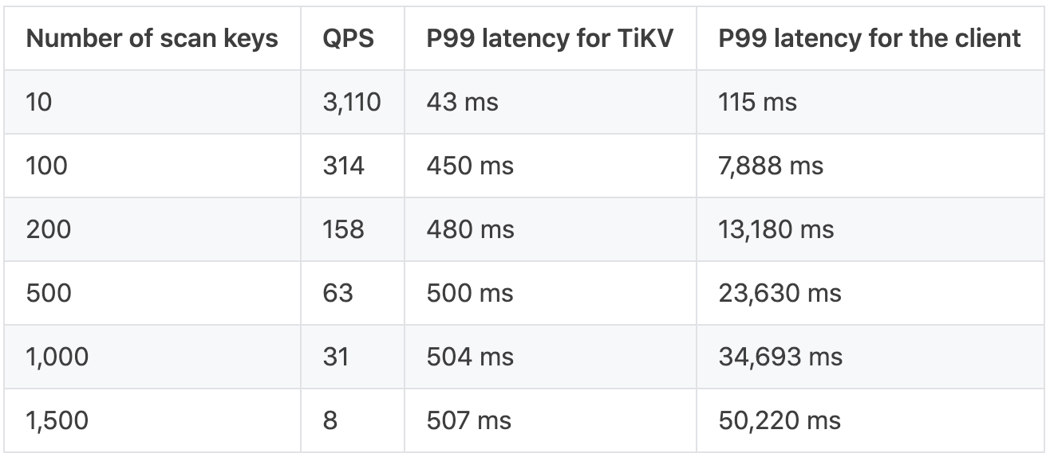
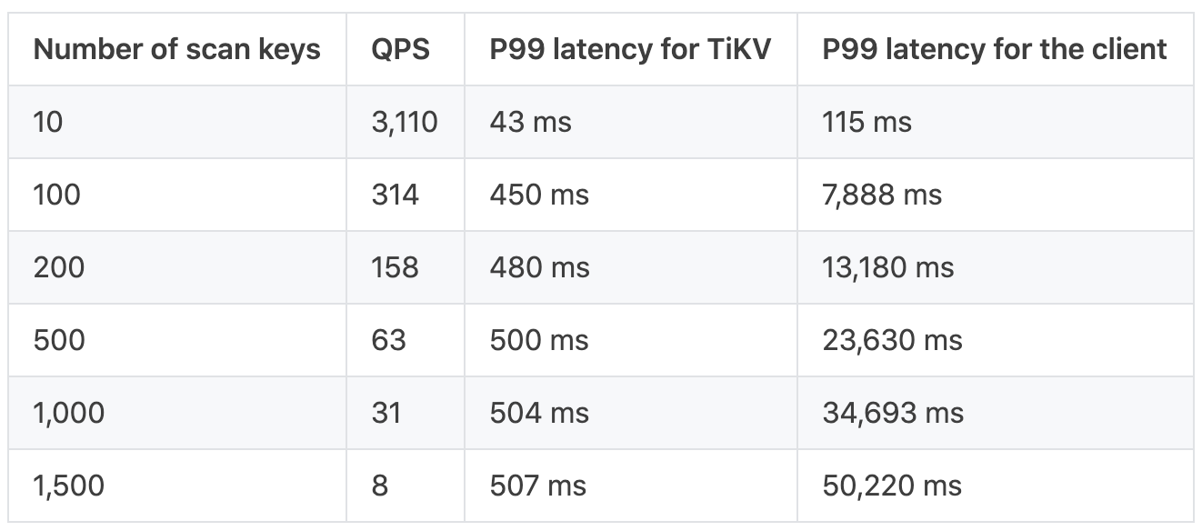
General use cases
Note: Generally Follower Read is not helpful for performance
TiDB is a multi Raft service, leaders are balanced on stores
Use case 1: Build a HTAP system
Performing read on a column store (TiFlash) is much faster than on TiKV
Use case 2: Read cross multiple data centers
Performing read on nearlier data center
Read from leader in another data centor
Read from follower in the same data centor

Slide 30
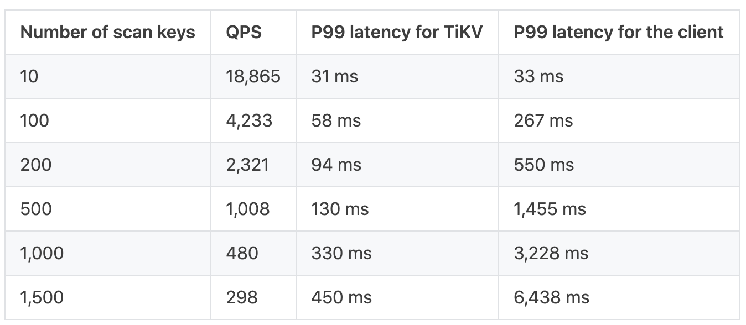
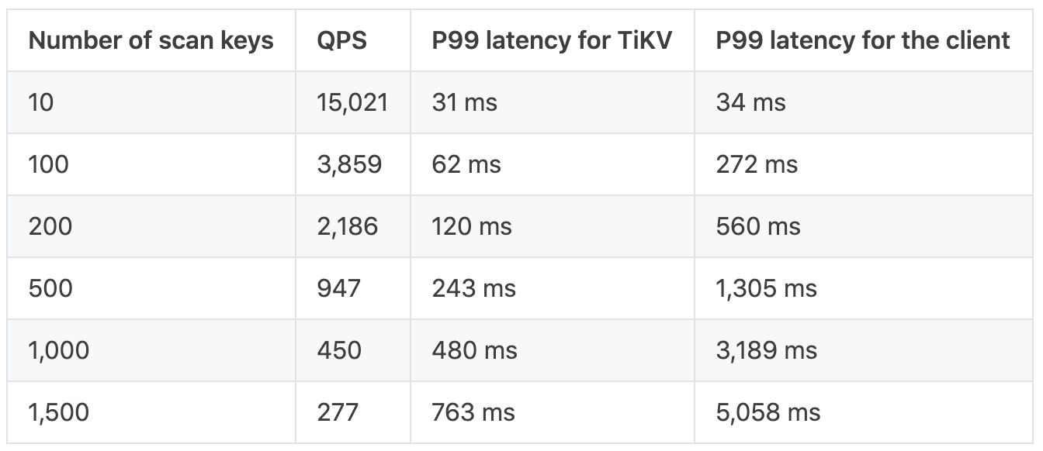
General use cases
Note: Generally Follower Read is not helpful for performance
TiDB is a multi Raft service, leaders are balanced on stores
Use case 1: Build a HTAP system
Performing read on a column store (TiFlash) is much faster than on TiKV
Use case 2: Read cross multiple data centers
Performing read on nearlier data center
Use case 3: Scale out for the read performance
Elastically add a store in which places raft learners for improving read performance
Leader Read
Follower Read

Slide 31
Thanks!

