Slide 1
Take control of your “DevOps Dumping Ground”

Slide 2
Cloud adoption has shifted the center of gravity for automation
Tomorrow
Event-driven orchestration
APIs, services, serverless, K8s, container platforms
Configuration management is a smaller part of the infra stack
Today
Model/task-driven automation
OSs, hardware, apps, VMs, hypervisor
Configuration management is king
On-prem
Cloud
Notes:
Over the past five years, we've been seeing this shift in the centre of gravity for where and how automation happens.
The driver for it is often expressed as the catch-all phrase "moving to cloud", but cloud is often more of a catalyst for change than the mechanism for it.
That is to say, the adoption of cloud centric practices like provisioning through APIs instead of bare metal or moving to containerization to reduce stack dependencies and speed development , are not intrinsically tied to running on AWS or Azure or Google. They might not even leave a VMware stack in the datacentre.
But regardless of how cloud-native hipster you choose to get, those practices DO change the way automation happens, and they require changes in our tools and approaches as well.
Some of the most important changes that we're seeing:
moving from purely model or hybrid model/task automation to automation that responds to external events and integrates with a broader range of event sources.
A move to, as I mentioned a minute ago, managing at arm's length through APIs for everything from provisioning cpu, storage, networking to DNS and load balancing.
And, importantly for Puppet, a shift in how configuration management fits in to the rest of the automation landscape - rather than being the central driver of automation, it's more of a piece in a larger picture that's centered more squarely on application delivery.
So as we've been talking with customers, the community, and the industry over the past few years we've been trying to understand how we can help in this changing world.

Slide 3
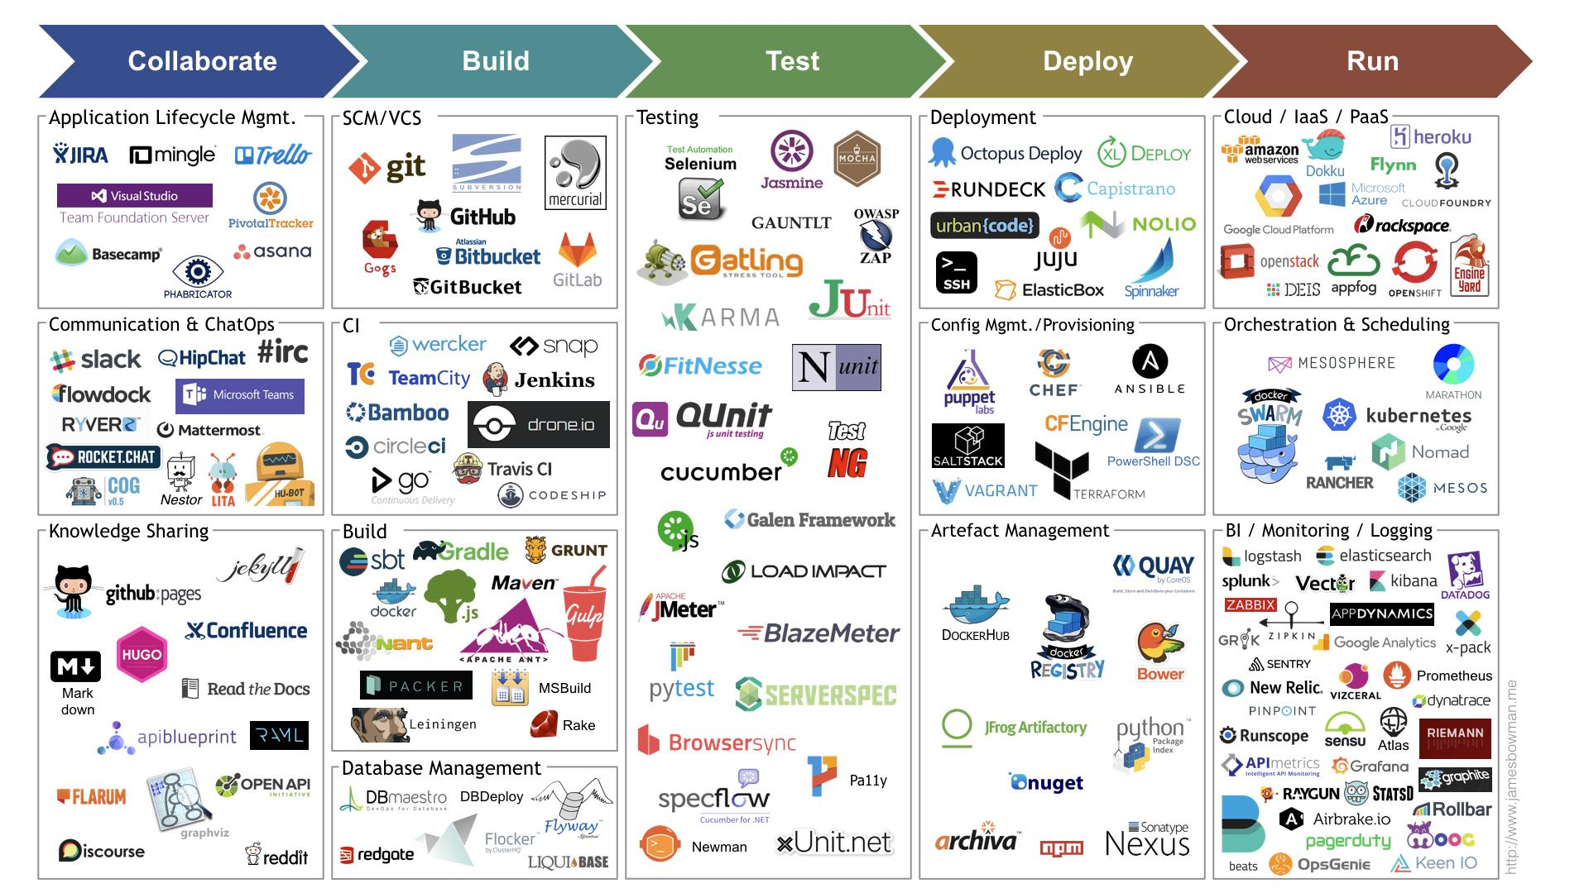
Lesson 1: CD is Hard. Really Hard.
source: jamesbowman.me
Notes:
Lesson 1 - continuous delivery is not a solved problem. it's really hard.
This landscape, from James Bowman, is pretty illustrative of the complexity of the problem. It's even a few years old now and things have gotten more complex, not less. As people started trying to use Nebula for CD it became clear that we both needed a lot of sophisticated features like blue/green and canary deployment strategies. To add these would be a pretty long lead time. Plus it really feels like the market has a long way to go before a fully cloud-based CD system was going to get mass adoption.

Slide 4
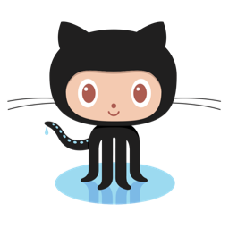
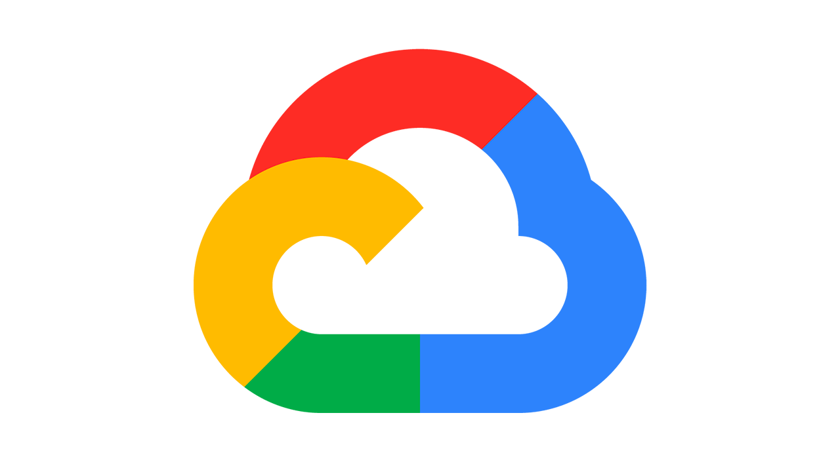
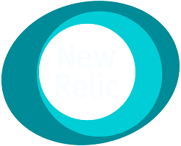
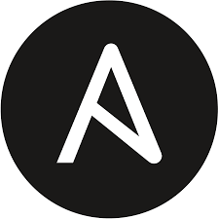
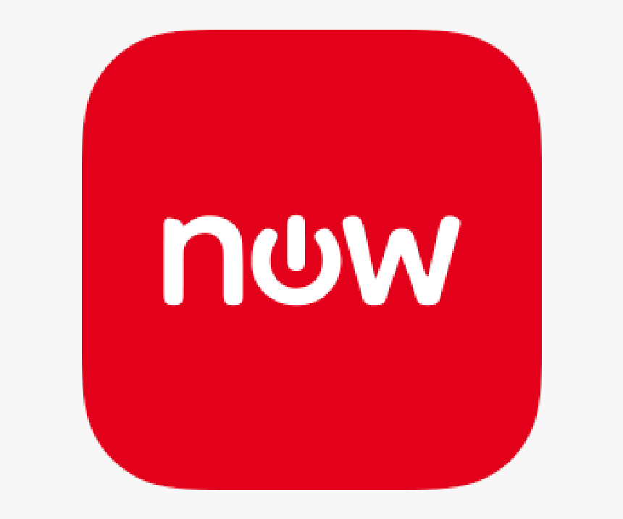
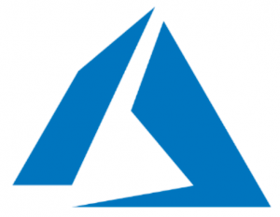
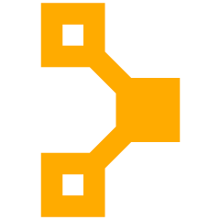
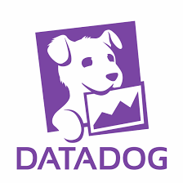
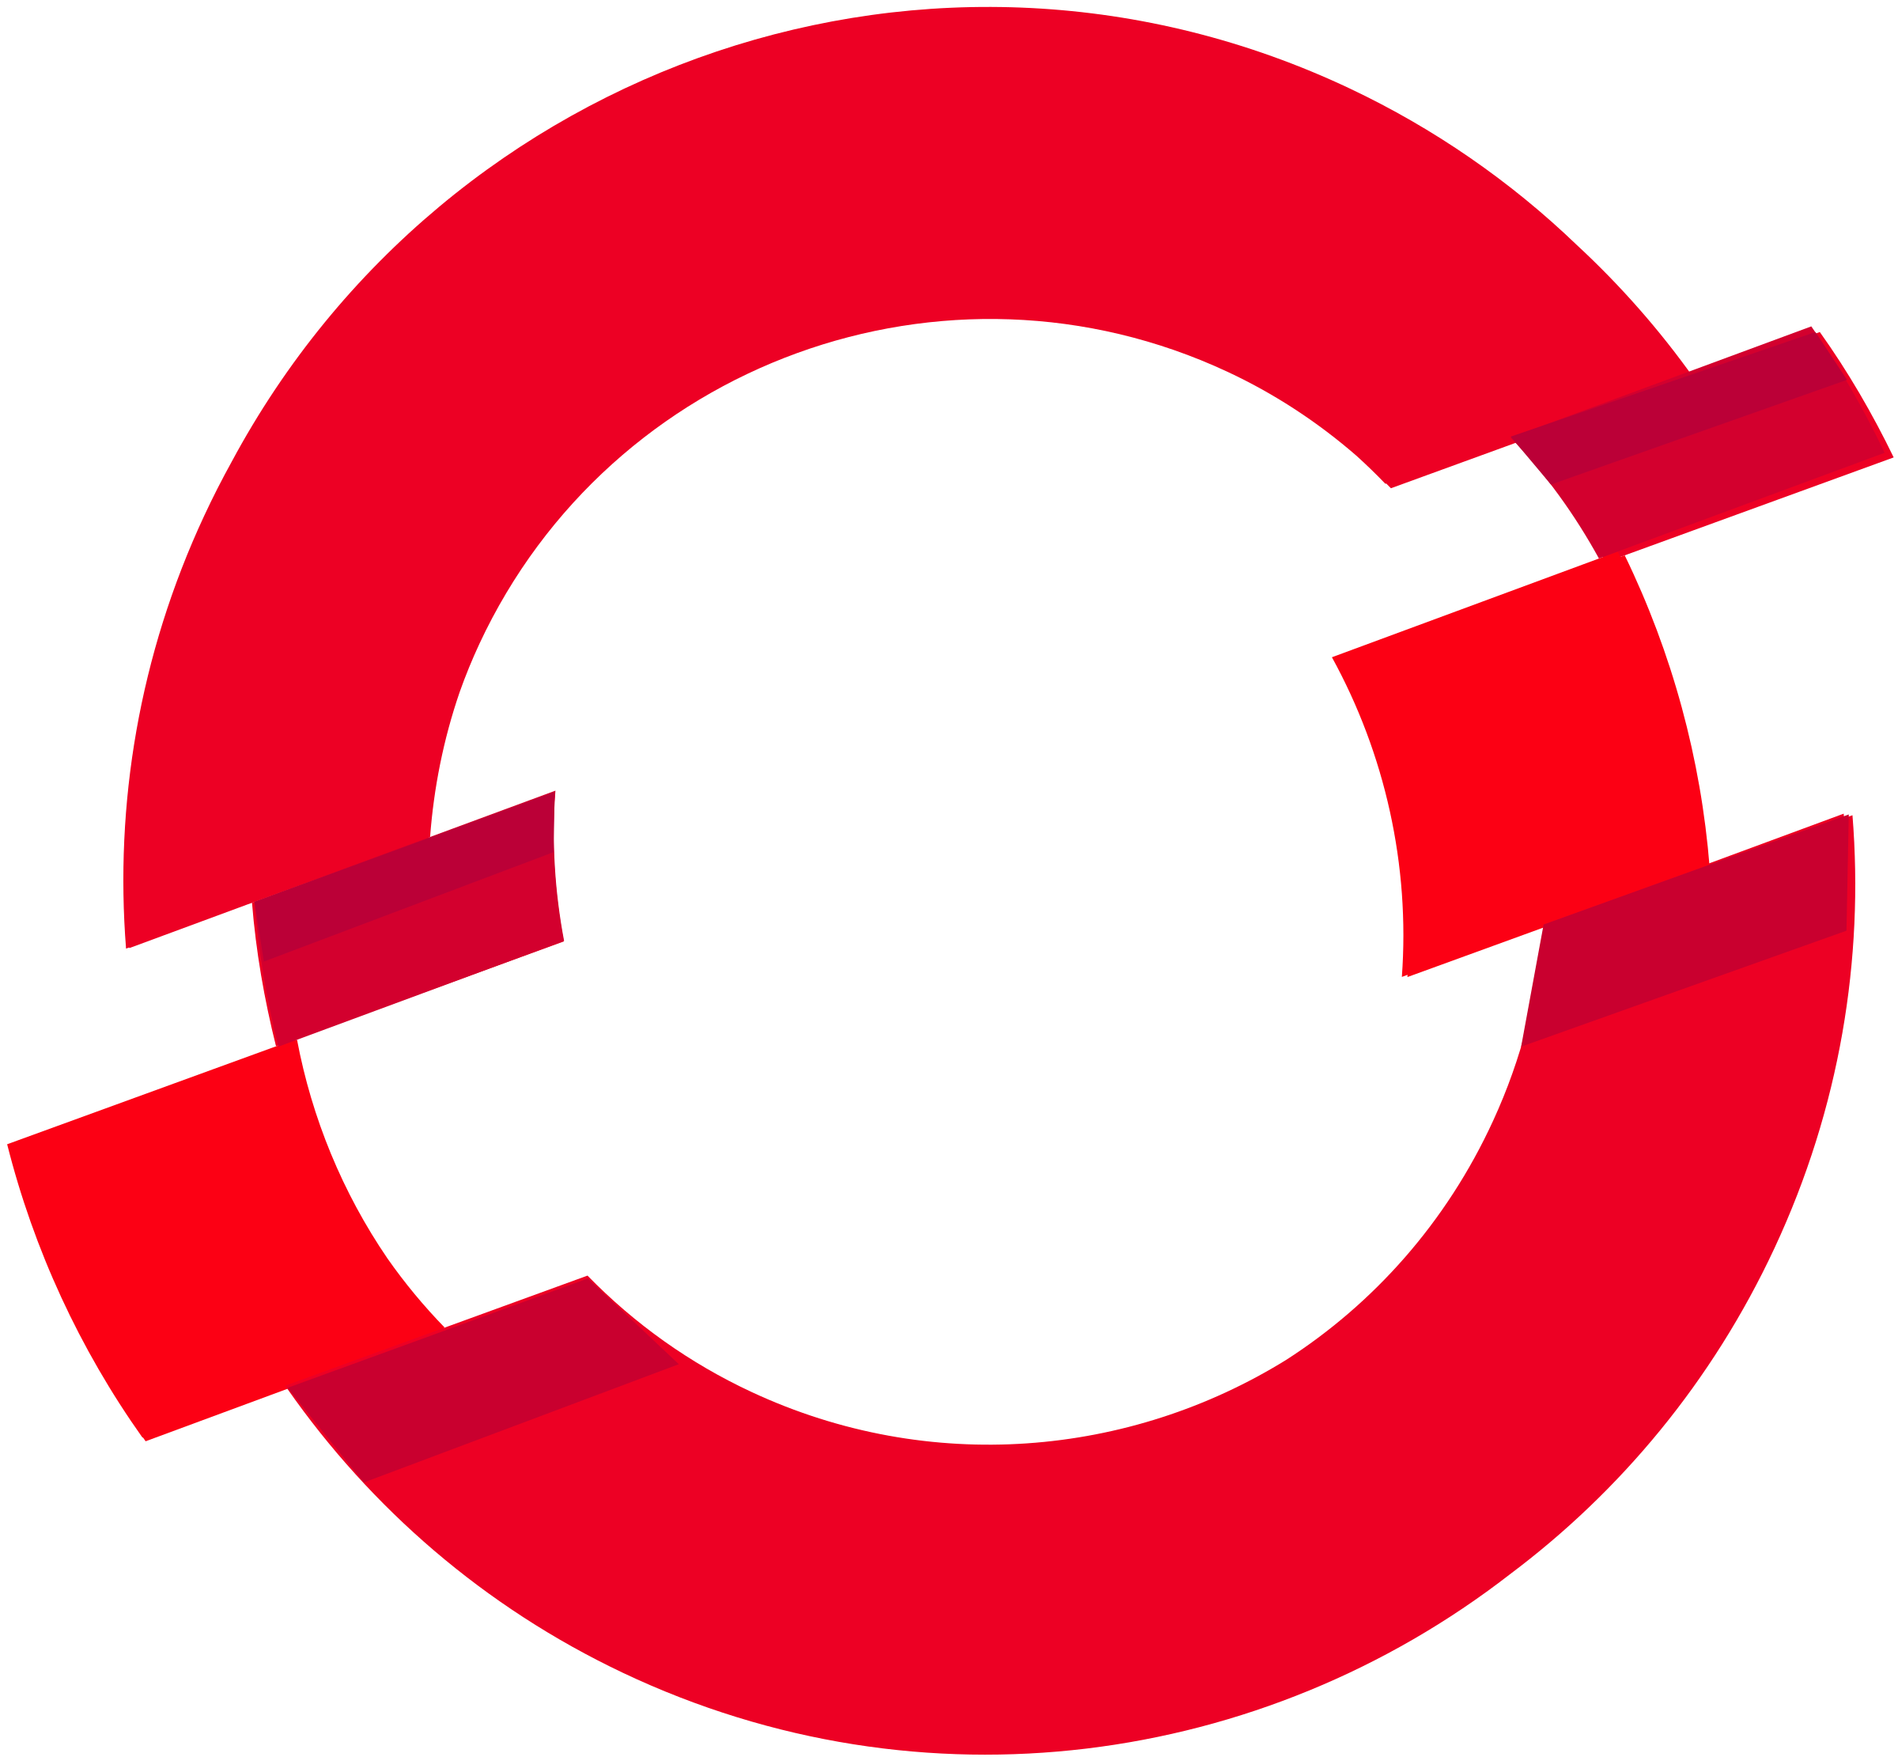
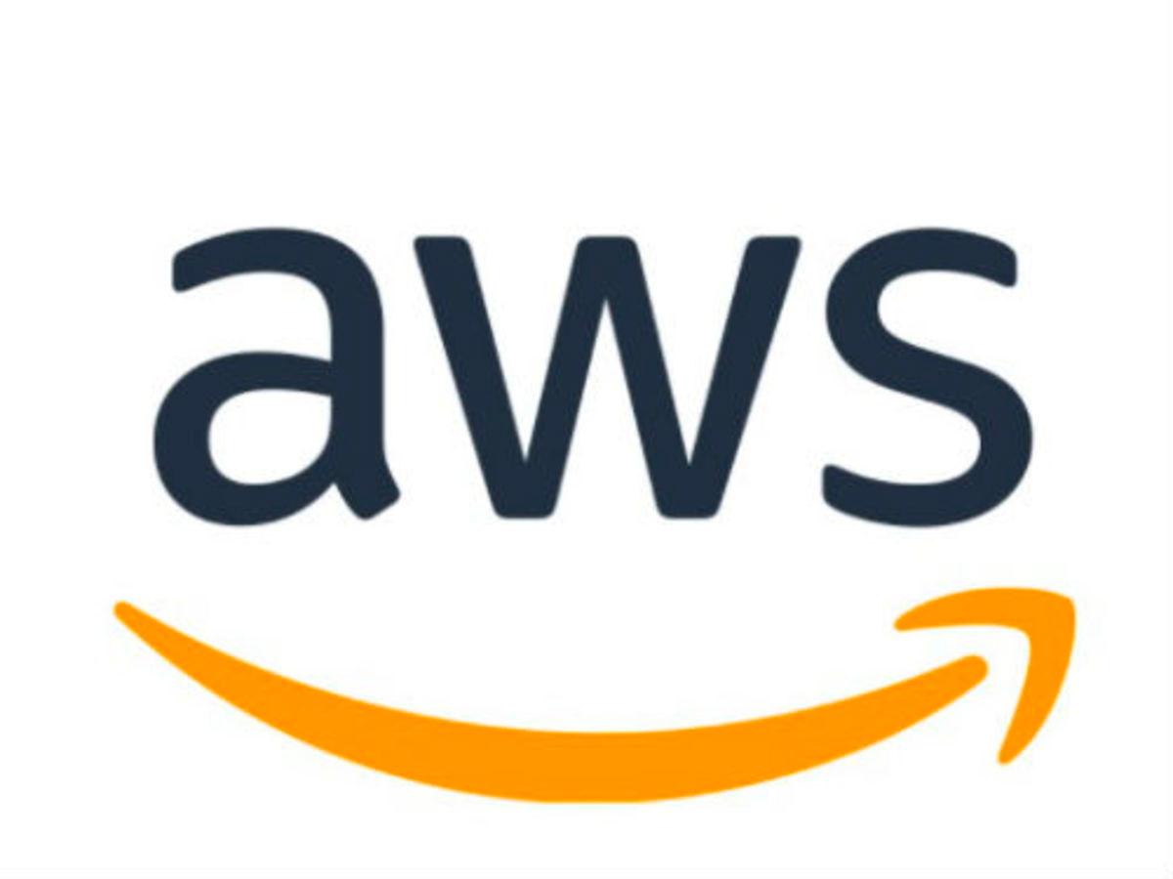
Lesson 2: Events Are Everywhere.
Notes:
Lesson 2 - even a subset of that landscape that's in use at a single organization can be pretty complicated. And increasingly, the tools talk to each other through APIs - generating and consuming events. The emerging practice of gitops is a great example of this - a new container version shows up in a registry, a tool like Argo or Weaveworks Flux gets a notification that it's there, the tool generates a pull request against a repo containing production configuration, and if the CI tests hooked into the repo pass, it'll get merged and deployed automatically. That's great at a certain level and has tons of benefits, but it's also insanely complicated!
And that's just one event-based workflow. When we look at modern ops teams there might be 10 to 20 of these processes going on in a given day.

Slide 5
Lesson 3: 'Ware The DevOps Dumping Ground
source: tirefi.re
Notes:
To make this better, some devs try to create their own one-off automation tools or integration hubs, usually per team or per project. Examples include:
Using Lambda and writing functions for EC2 management tasks
Running scheduled jobs for EBS cleanup
Repurposing a CI/CD tool like Jenkins for incident response workflows
But this "dumping ground" current approach is Inefficient, expensive and risky
Inefficient because work is done as one offs that last forever, no reusability or repeatability
Expensive because spending time building tools and integrations isn't directly delivering customer value
Risky because sidestepping governance to get stuff done can lead to exposure and failures

Slide 6
Listen to events from the services that you already use
Orchestrate actions across downstream tools and services
Cloud events
K8s
Triggers
Incidents
Serverless
Secrets
Tickets
Cloud storage
Workflows
Git events
CI/CD Tools
Monitoring
AI/ML/data
Config Mgmt
Notes:
All of these conversations and iterations brought us to the idea that's behind Relay.
The toolchain really is complicated, and a lot of the automation is about what Deepak described as digital duct tape. Like there could be a killer process for provisioning new LBs but the point where it ends, someone tends to have to pick up manually and carry it forward to, say, close the ticket that started the request.
So we think there's some value in being able to link together those incoming actions with some intelligent decision making that can respond automatically. The response takes the form of a workflow that can be the duct tape but with bells on - maybe bulletproof duct tape? gotta think about that metaphor - having secure access to API keys, an audit log of what happened when it ran, and nice Puppet style properties like being a code description that's testable, manageable with Git, and reusable across an organization and across the wider ecosystem.

Slide 7
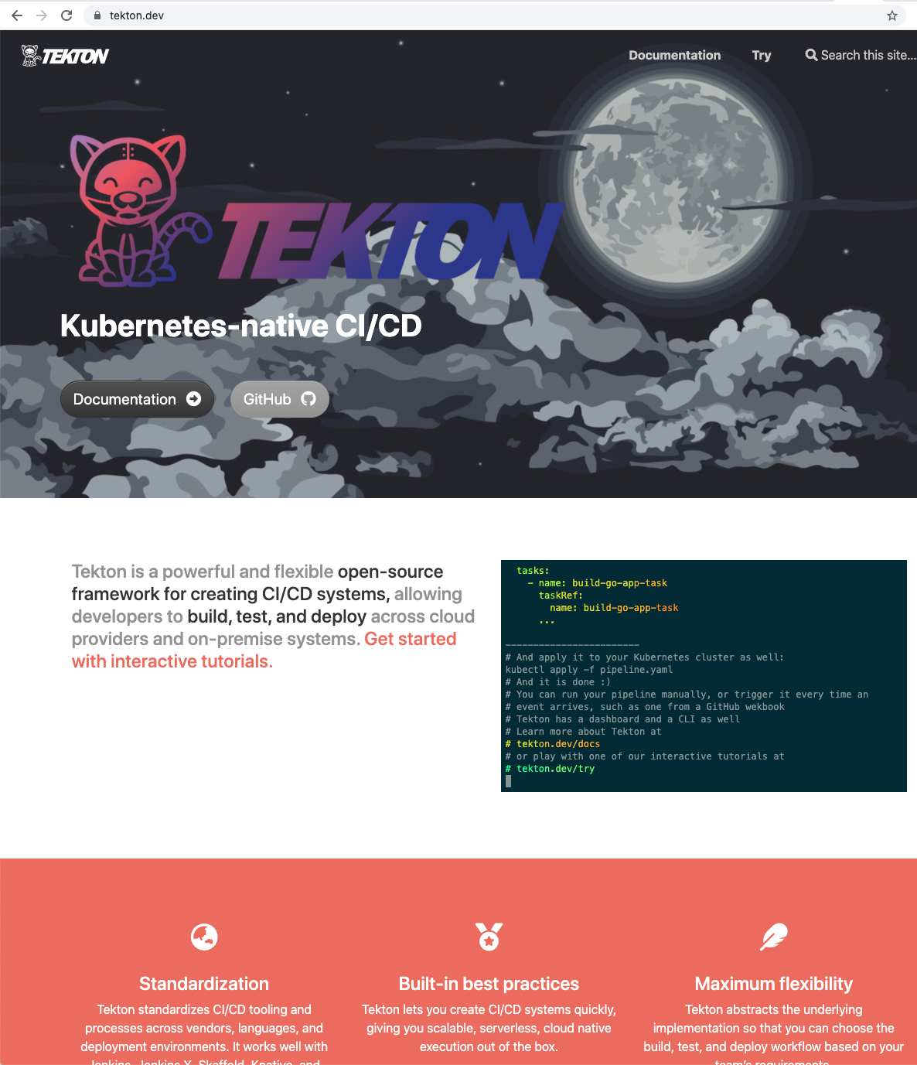
Tekton
Kubernetes-native CI/CD
Powerful, open-source workflow engine
Tasks are individual, containerized steps
Pipelines stitch together tasks into a workflow
Tekton pipelines help us build and traverse a graph of the Actions and Queries that make up the workflows for Relay!
🔗 tekton.dev
Notes:
What tekton is
What tekton does:
Relay then uses Tekton pipelines to build and traverse a graph of the Actions and Queries that make up the workflow itself: each step is a container execution, that can be an off the shelf container to run scripts or talk to remote APIs, or one that's built with the Relay tooling layer to access and modify the state that's passed around through the workflow's life cycle.

Slide 8
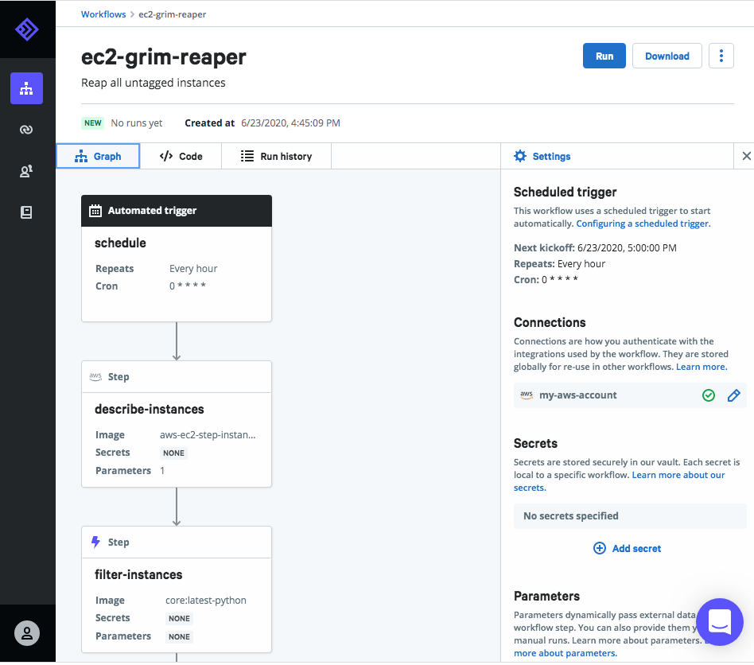
Relay Taxonomy
Trigger steps are based on cloud events, git events, monitoring alerts, tickets, and incidents – like a Splunk alert, a Cloudwatch alert, a GitHub PR being merged, etc.
Action steps are reusable, modular, and composable--things like destroying old EC2 instances, provisioning environments with Terraform, or clearing unattached EBS volumes.
Query steps let you break out of a workflow to wait for an external process like manual approval or a callback from another system.
Notes:
Great, so how does it work?
The system is built on top of Tekton. The fundamental building block is a STEP, of which we have three types.
Trigger steps run containers on GKE to respond to incoming events, which can extract values from the incoming events to fill out the workflow Parameters.
Relay then uses Tekton pipelines to build and traverse a graph of the Actions and Queries that make up the workflow itself: each step is a container execution, that can be an off the shelf container to run scripts or talk to remote APIs, or one that's built with the Relay tooling layer to access and modify the state that's passed around through the workflow's life cycle.
We've also got support for Query steps, which can be used for things like manual approval or to pause workflow execution until some external callback happens.
This workflow visualization shows a few of these in action through the web app. This EC2 Reaper workflow is based on an internal Puppet tool that our SRE team uses to traverse the EC2 accounts for instances that aren't tagged with cost center properly and terminates the rogue ones.

Slide 9
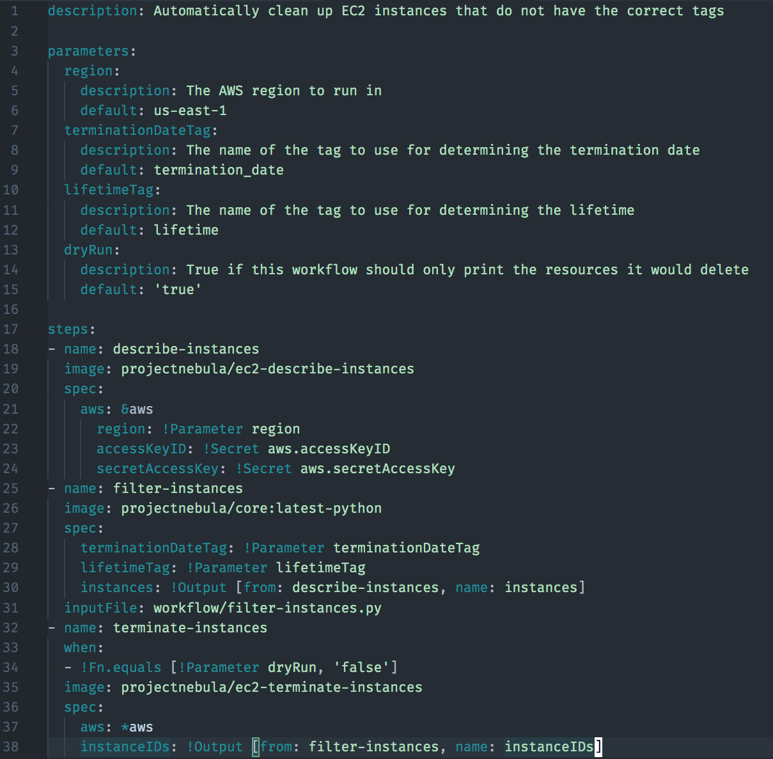
Workflows-as-Code YAML
Parameters prompt the user for data input at runtime to customize the behaviour of the workflow. Values can be supplied interactively, via API, or on CLI.
Secrets are stored securely server-side using Hashicorp Vault, referenced in a workflow using the "!Secret" tag.
Output tags enable data from previous steps to be used by ones that come later.
Notes:
This is the code that underpins the graph visualization from the previous slide. It's a pretty straightfoward YAML dialect, because that's the lingua franca of cloud tech these days. lingua franca a phrase from a dead middle eastern pidgin language that means literally the "Language the Franks speak" and metaphorically means the lowest common denominator of communication - so it's pretty apt for YAML.
Our YAML has some special top level keys for PARAMETERS, to be filled in or left to defaults if unspecifiied like on lines 4 through 15
We have some tags that use the exclamation point Tag notation to access those parameters and Secrets that are stored on the service as on lines 22 through 24
and there's the ability to pass data between steps using the !output tag as on lines 30 and 38.
One neat thing from an authoring standpoint is that this workflow format is defined in a json schema file, so it was easy to set up the vscode yaml plugin from Red Hat to do realtime validation and syntax completion for it. It really speeds up the development process.

Slide 10
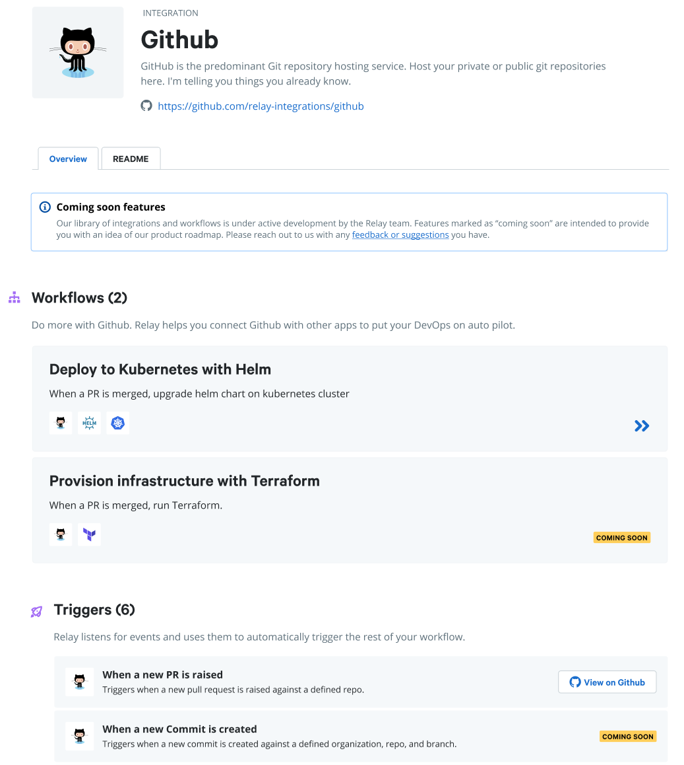
Open-source
Integration Ecosystem
A library of useful integrations that cover the most common use cases and external services with sample workflows and well-documented steps that let you remix and combine however you want.
Low-friction interoperability if you have existing containers that you want to use in Relay workflows, they can drop right in alongside purpose-built integrations.
Easy step authoring if you've built something that other people might find useful or want to contribute to existing steps
github.com/relay-integrations
Notes:
Of course none of this really matters if you can't DO things with it. It's really important that we have a rich library of useful integrations that do what you want. So we're working both internally and with partners and friends to make sure the major use cases are supported out of the box. The integrations have a specific format, similar to modules on the puppet forge, that can contain a variety of elements like workflows or any of the three kinds of steps I mentioned a minute ago.
If you're already using some kind of containerized workflow, you can bring your own existing containers - as long as we can talk to the registry to pull them down and execute as a pod, we can make use of them. Many of the examples we've been working with use the upstream containers like vanilla ubuntu or terraform.
And if you're building something that you want to be part of the ecosystem, we're trying to build a really great authoring experience for steps. Still working through the details, but we're looking at things like being able to run steps locally without having to submit them to the service for debugging and having the service build and push the containers on demand.

Slide 11
DEMO

Slide 12
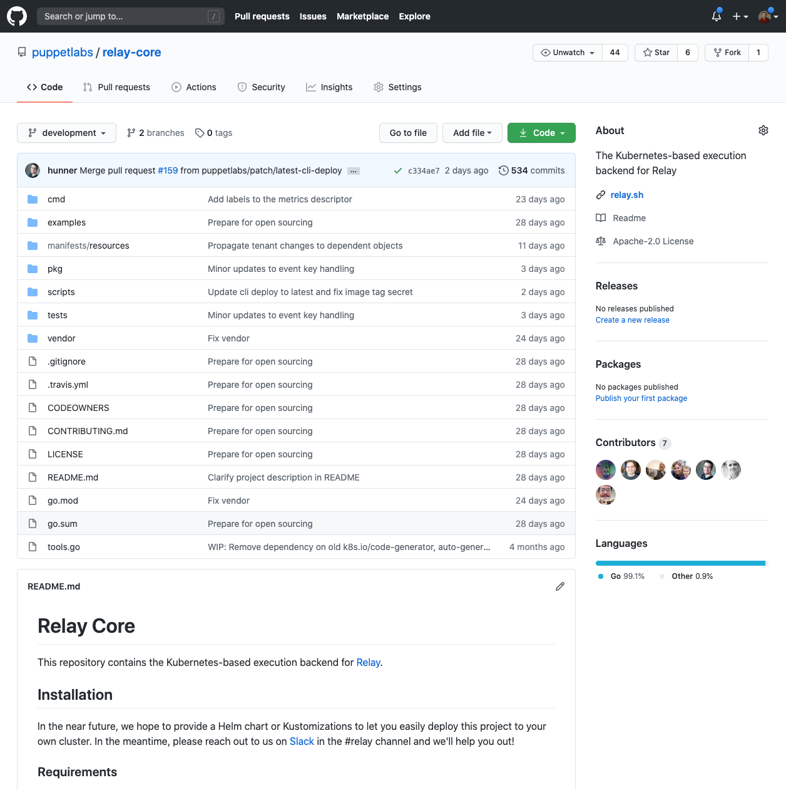
puppetlabs/relay-core
Kubernetes-based execution backend for running workflows on top of Tekton.

Slide 13
Available now!
Sign up at https://relay.sh/ !
Join us in Slack for Q&A: #relay channel
Check out our Github Repos: Integrations: github.com/relay-integrations
Relay core: github.com/puppetlabs/relay-core
Thank you!
Melissa Sussmann | melissa.sussmann@puppet.com
Kenaz Kwa | kenaz@puppet.com
Notes:
I'd love to hear your feedback and talk more about use cases, how the tech stack works, and what you can do with it.
So sign up for the list to be notified of updates.
And if you're really fired up about it and want to dig in immediately, we're in the #relay channel in puppet community slack.

