Slide 1
The Open Source
Observability Playbook
Hen Peretz - Head of Solutions Engineering @epsagon

Slide 2
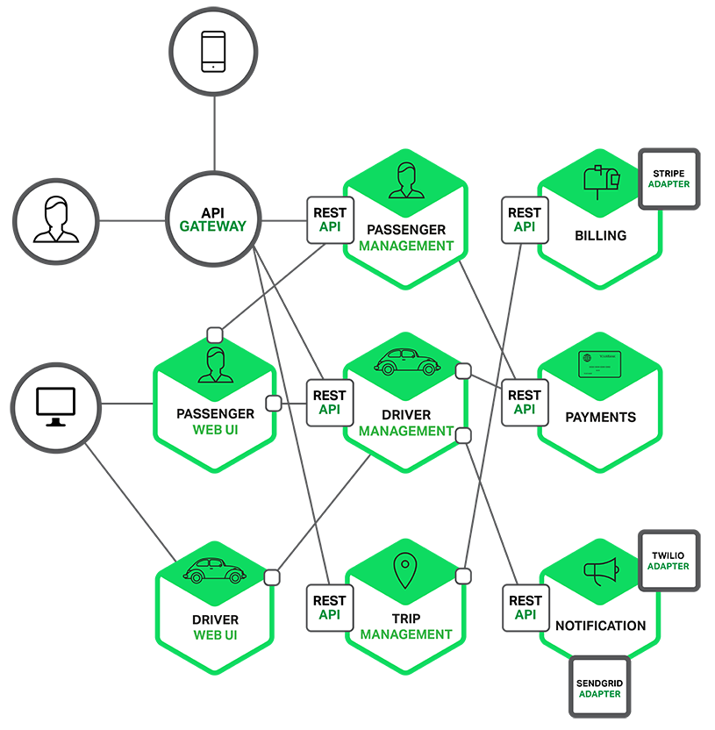
What We’ll Discuss Today
Old-School Observability methods
How to achieve observability
Logging, monitoring best practices
Open-source monitoring landscape

Slide 3
Why Monitoring?
Make sure our business works

Slide 4
What Should We Monitor?
4 golden signals from SRE book by Google:
Latency
Traffic
Errors
Saturation

Slide 5
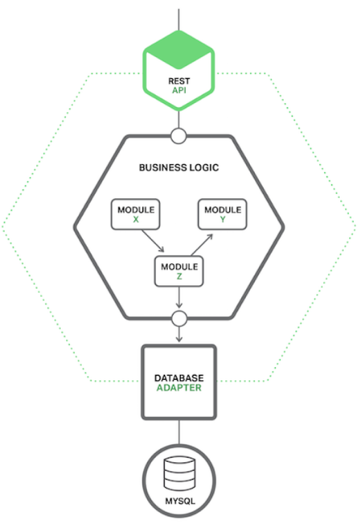
Old-School Monitoring
Agent based
Collects only host data
Collects only metrics

Slide 6
Old-School Troubleshooting
We need more debug data logs

Slide 7
Old-School Logging
Agent based
Dumps locally or remotely
Collects only logged data

Slide 8
Fast Forward into the Future

Slide 9
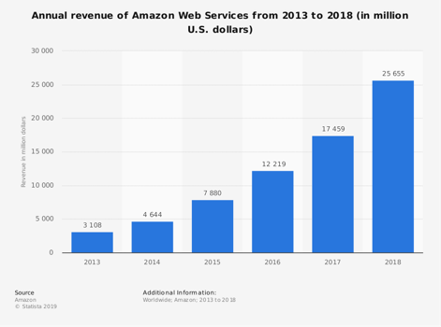
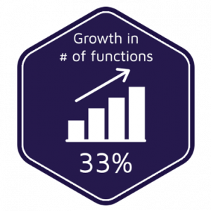
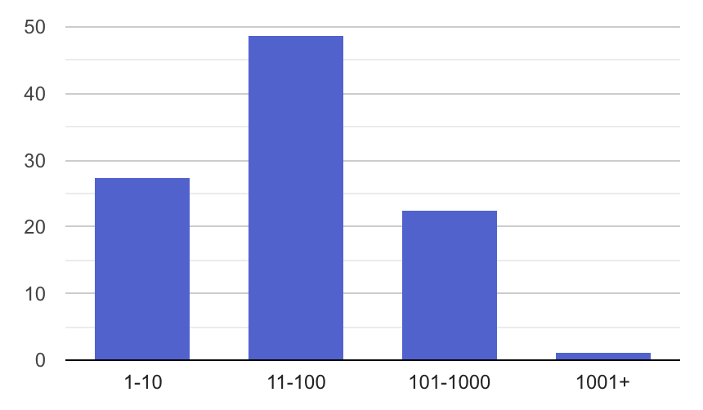
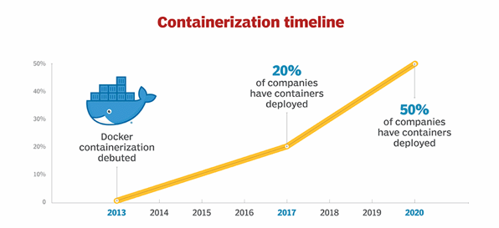
New Era for Applications: Cloud + Microservices
AWS Lambda adoption

Slide 10
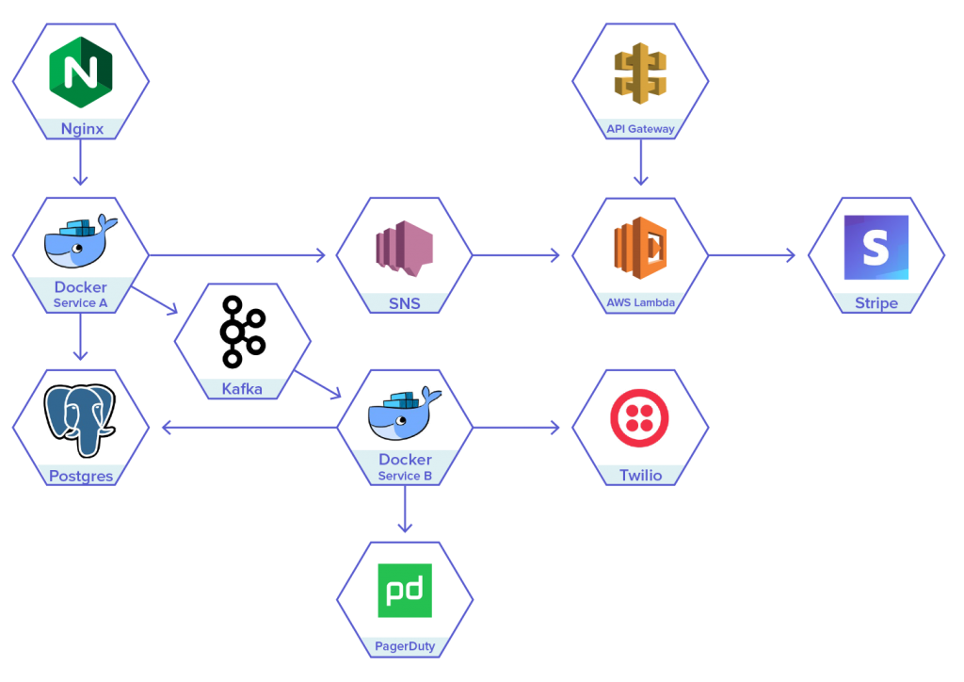
The Rise of Microservices in the Cloud
Host-based Monolithic
Host-based Distributed
Abstracted-host Highly Distributed
Extremely hard to monitor and troubleshoot

Slide 11
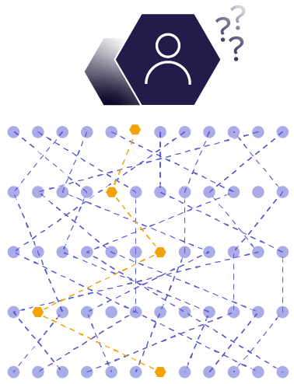
Challenges for Engineering and DevOps
Troubleshooting Are basic logs and metrics the right tool for highly distributed applications?
Monitoring “Is my application working properly”?
Development I’m not sure what’s currently running in production. How can I build new services?

Slide 12
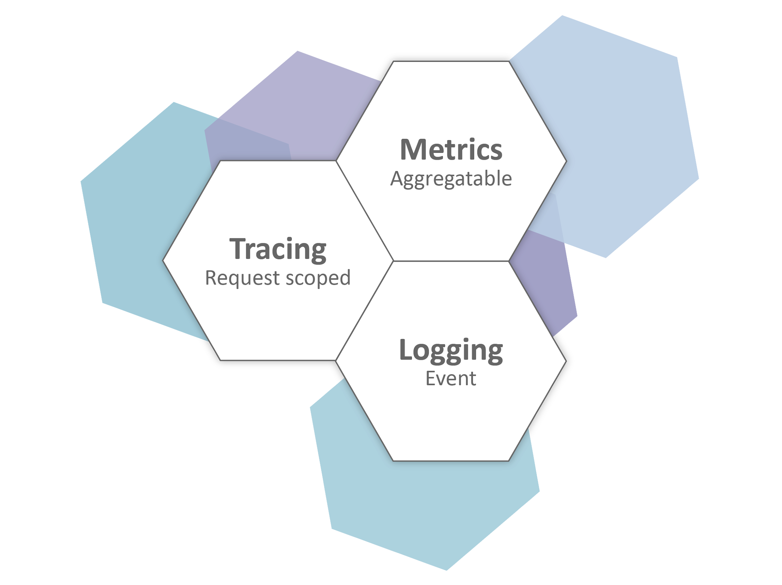
The Three Pillars of Observability
Combining metrics, logs, and traces for observability is the only way to understand complex environments
Metrics tell us the “what”
Logs tell us the “why”
Traces tell us the “where”

Slide 13
Logging Best Practices
Print out JSONed logs with metadata
(service name, stage, etc.)
Automate the process of logging
Index the fields you’re are using

Slide 14
Logging Best Practices - Setup

Slide 15
Logging Best Practices
Demo

Slide 16
Monitoring Best Practices
Aggregate all metrics into a unified dashboard
Define your critical metrics (thresholds)
Use custom business metrics

Slide 17
Monitoring Best Practices
Monitor application metrics:
Avg. duration of calls to an HTTP API
Minimum number of calls to a message queue
Number of 500/400 errors

Slide 18
Monitoring Best Practices
Demo

Slide 19
Something Is Still Missing
How do we correlate between metrics and logs
How do we correlate between data in different services

Slide 20
Distributed Tracing DIY

Slide 21
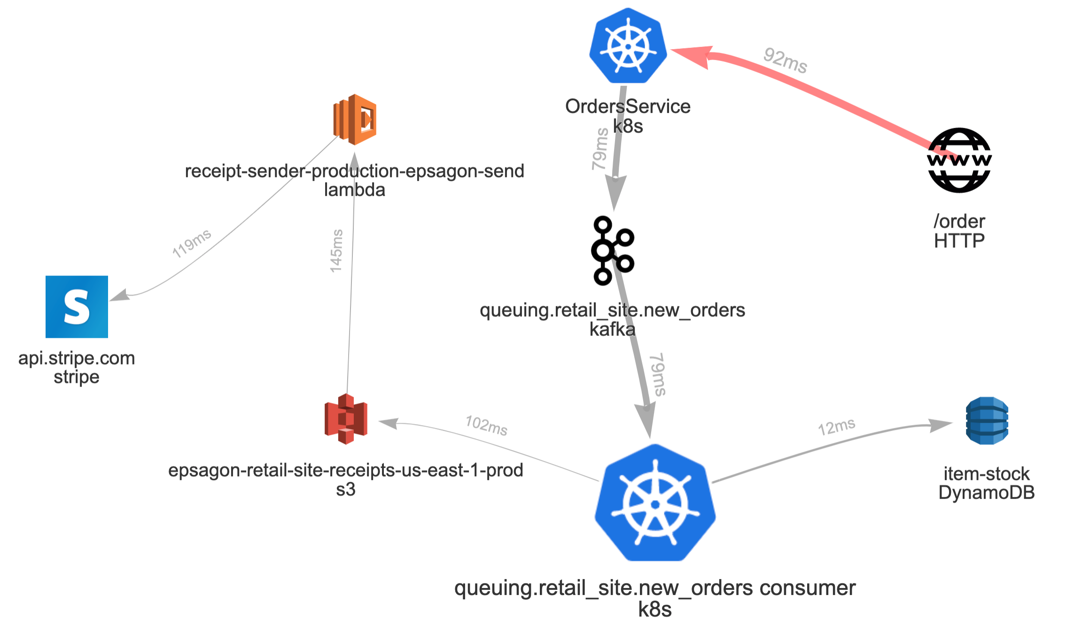
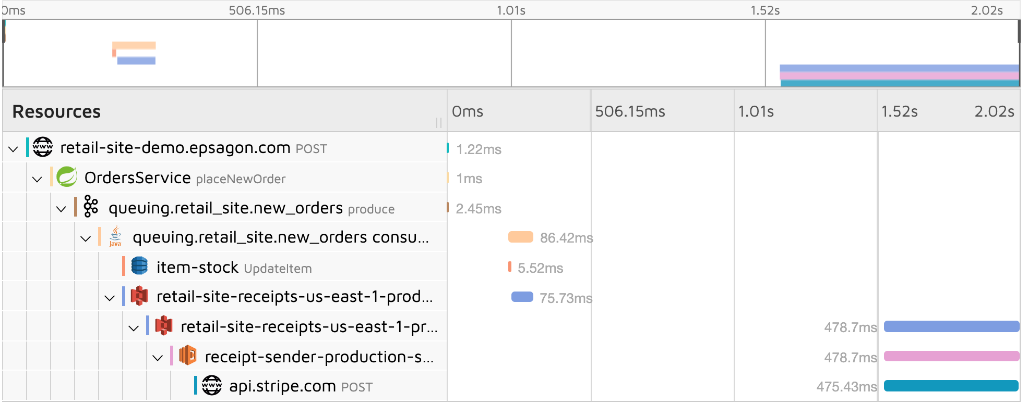
Why Distributed Tracing Is Critical Today
The Only Way to Understand Cloud-Native Workloads
A trace tells the story of a transaction or workflow as it propagates through a distributed system
Due to high complexity and the need for manual instrumentation, distributed tracing remained an approach viable only for very tech savvy companies

Slide 22
Distributed Tracing Landscape
Generating Traces
Ingestion and visualization
+
=

Slide 23
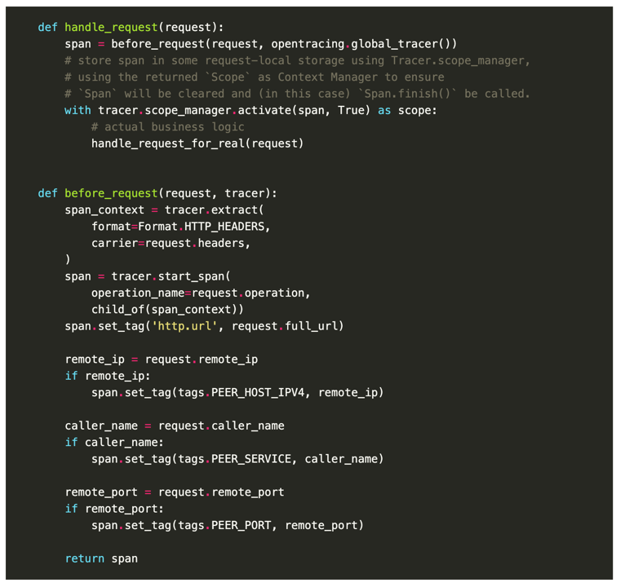
Distributed Tracing DIY - Generating Traces
Instrument every call
(AWS-SDK, http, postgres, Flask, …)
A span for every request and response
Add context to every span
Inject and Extract IDs in relevant calls

Slide 24
Distributed Tracing DIY
Demo

Slide 25
Distributed Tracing DIY - Ingestion & Visualization
Ingestion according to our scale (millions? billions?)
Index context and tags for easy search
Visualize traces (timeline, graph)
Set alerts

Slide 26
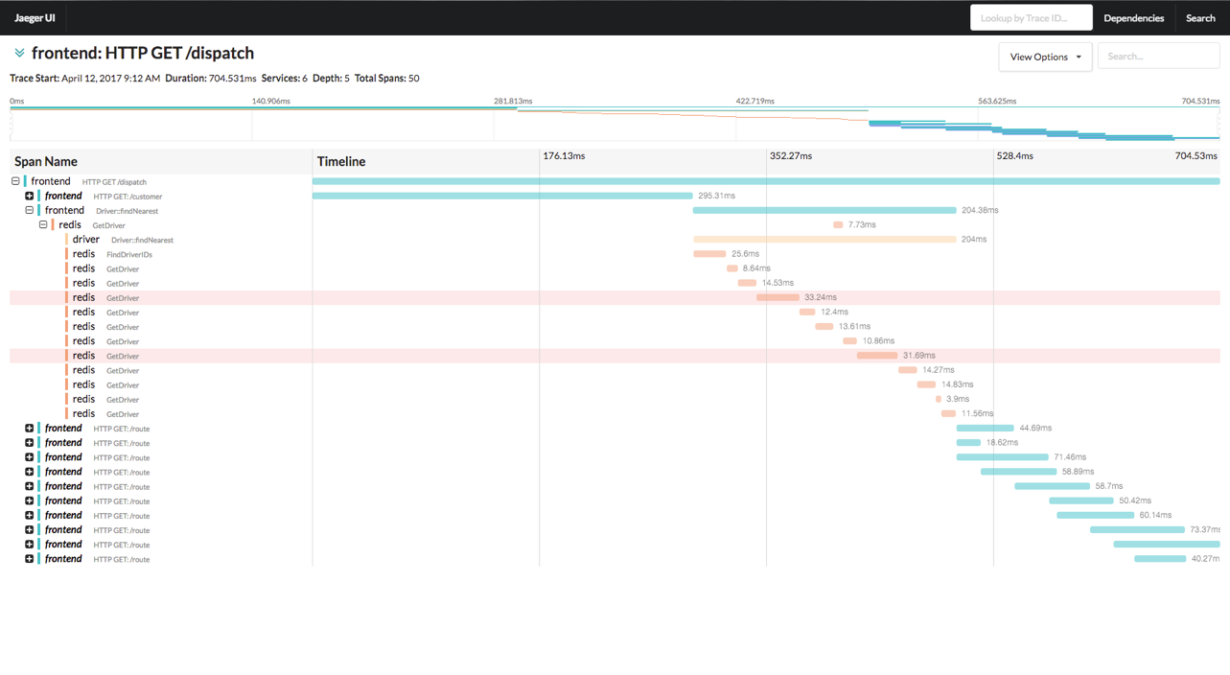
Distributed Tracing DIY - Ingestion & Visualization

Slide 27
Tagging Traces
Adding tags for search and aggregations:
Identifiers – user ID, customer ID, device ID
Flow control – event type, business logic
Business metrics – items in cart, minutes watched

Slide 28
Tracing with payload
Search an event according to:
HTTP headers or body - IDs
Key or query in SQL/NoSQL
Response payload from HTTP call

Slide 29
Tracing As a Glue
Trace Logs
Trace Environment

Slide 30
Best Practices for
Observability

Slide 31
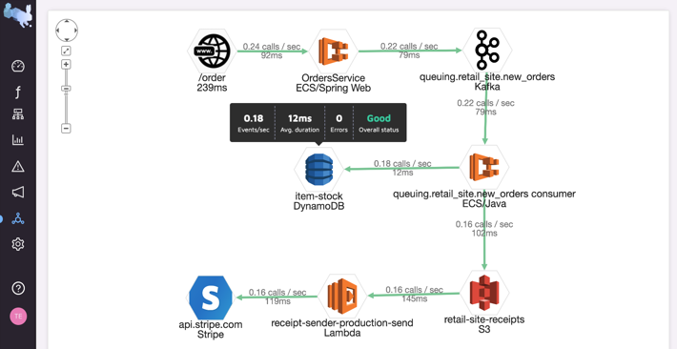
Best Practices for Observability
Automated setup and zero maintenance
Support any environment
(K8s, Serverless, ECS, AKS, On Prem)
Connects every request
in a transaction
Search and analyze your data
Helps to quickly pinpoint problems

Slide 32
Summary
Modern applications requires more than just monitoring
Distributed tracing becomes a crucial component in such environments
Stop implementing your own solutions unless needed

Slide 33
Q&A

