Slide 1
Advancing image security and compliance through Container Image Encryption!
Brandon Lum, IBM

Slide 2
Contents
Container Image Security
OCI Container Image Encryption
End-to-end demo, build, distribute, run!
Advanced Compliance usecase: Geo-fencing

Slide 3
Container Image Security
Build
Distribute
Run
Developer
DevOps, CI/CD
Build

Slide 4
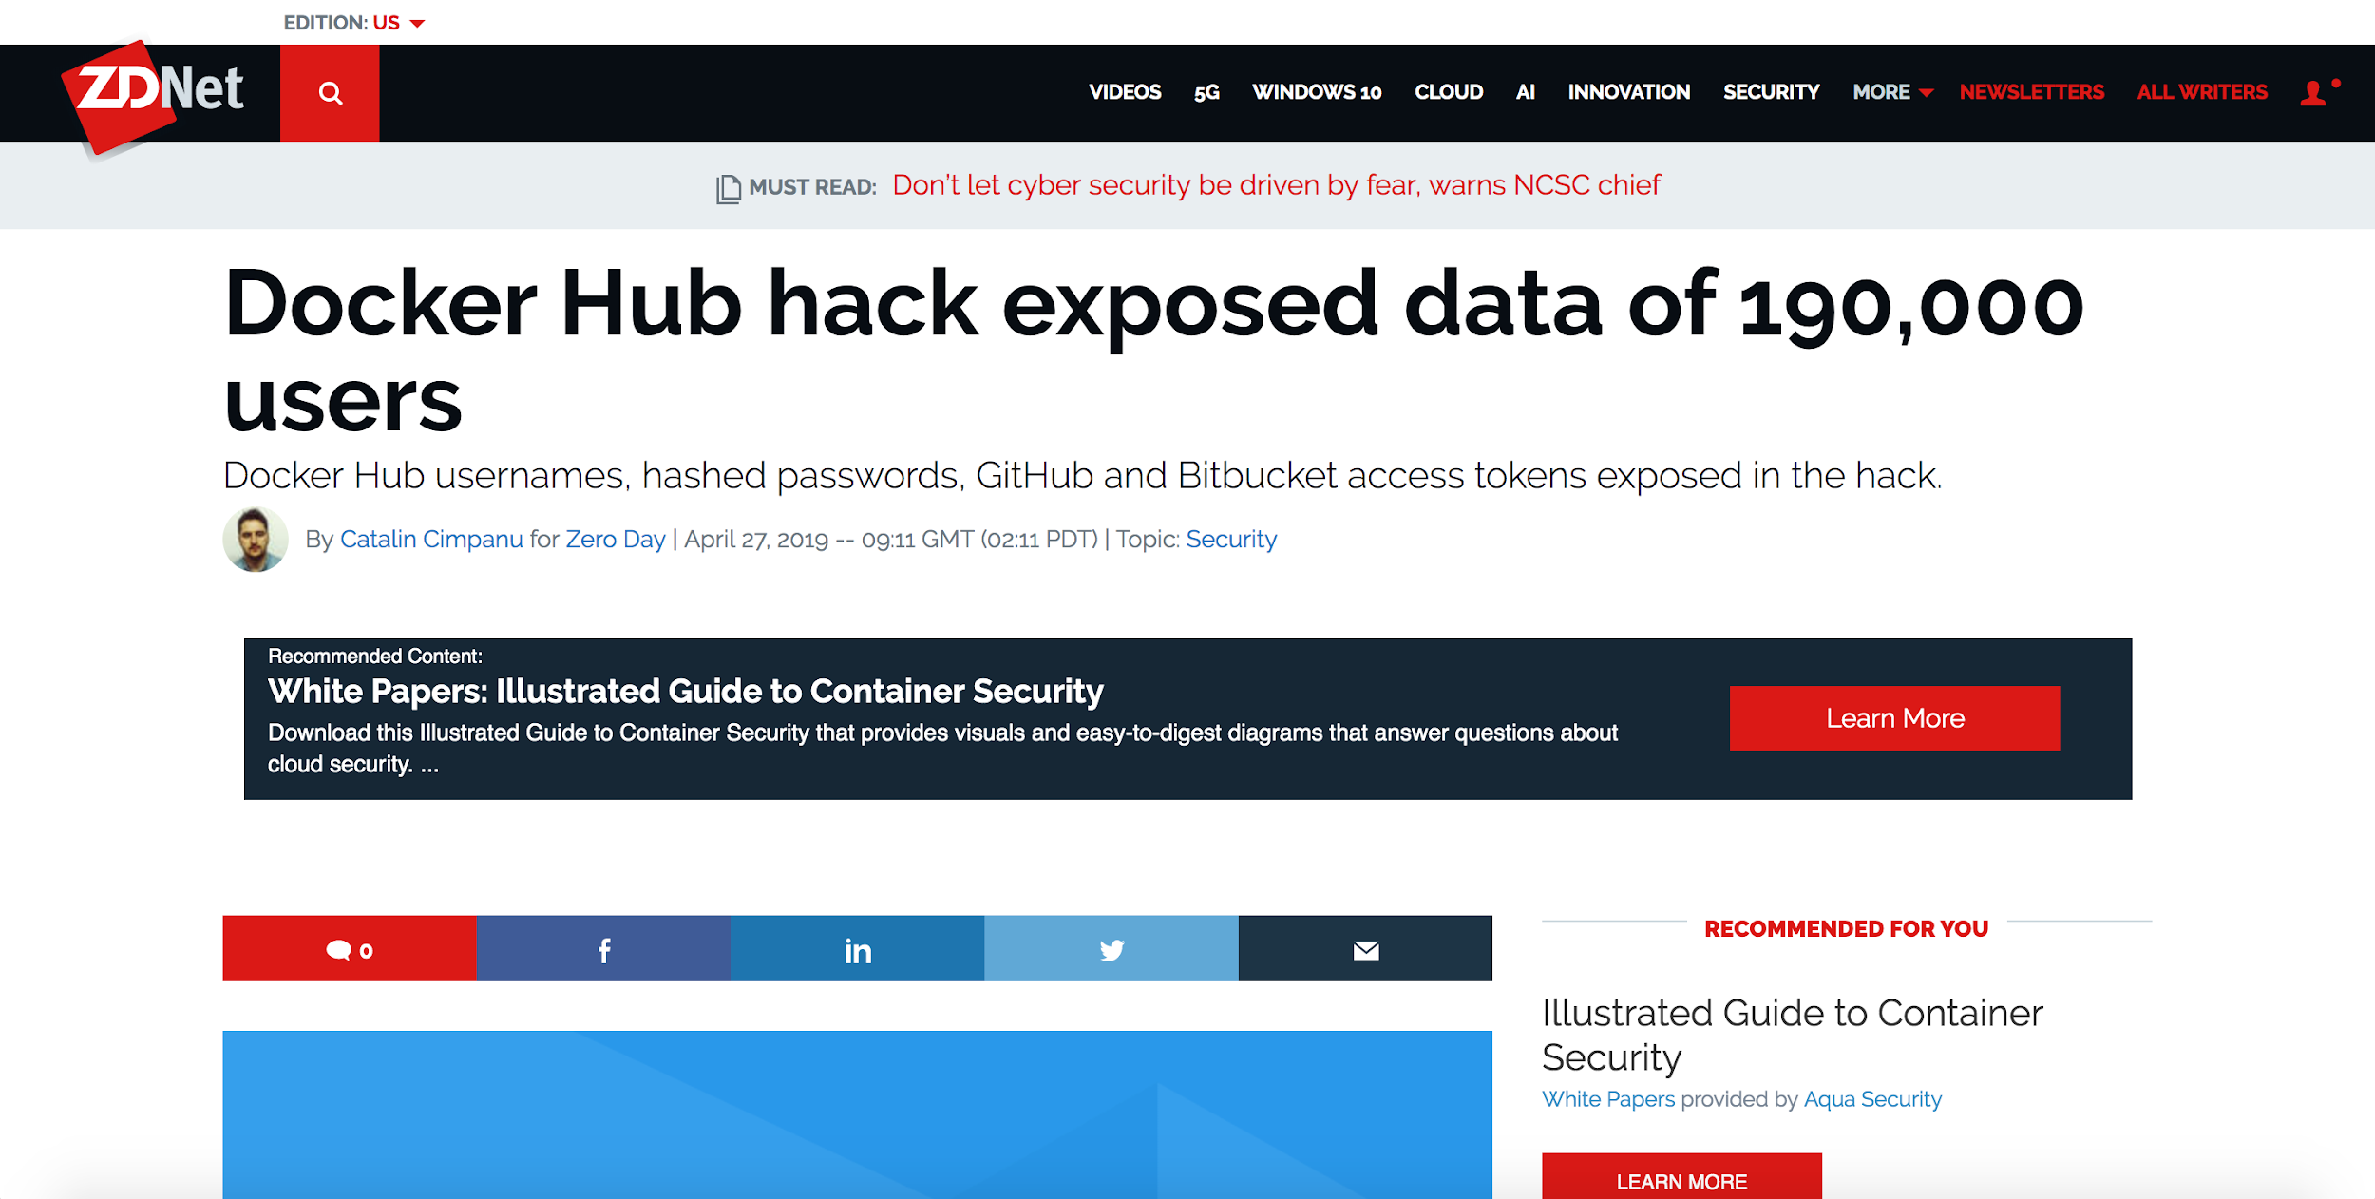

Slide 5
Container Image Security
Build
Distribute
Run
Developer
DevOps, CI/CD
Build
Registries and Cloud may be compromised/untrusted
Compliance perspective: some of these services in between are not auditable

Slide 6
What does this mean for your images?
RedHat Signing
Image Signing will ensure the integrity of your deployment images! Technologies: Docker Content Trust (DCT) or RedHat Simple Signing
But…
Private Images’ sensitive content will be exposed!

Slide 7
Container Image Encryption
Build
Encrypt
Run
Build as normal
Encrypt
Push
Encrypted image stored
Cannot be read
Pull
Decrypt
Run

Slide 8
Benefits?
Image Confidentiality & Deprivileged Registry
Execution Boundary Control “If my code is running, I know it’s in my cluster”
Encrypted Containers Images + Key management could provide guarantees about where an image can run.
i.e. Image X can only run in the EU nodes.

Slide 9
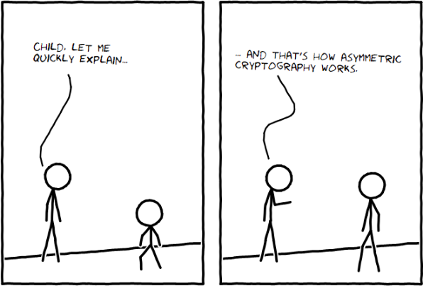
Encryption Primer
https://www.outsystems.com/blog/posts/how-to-teach-child-about-asymmetric-cryptography/

Slide 10
Encryption Primer - Assym Enc.
This is a secret message.
903nsvlvn391xkshu9282jks910alfde=
903nsvlvn391xkshu9282jks910alfde=
This is a secret message.
Each user has a Public-Private key pair, where Public Key is not secret, can be published.

Slide 11
Bob
Alice
sends an encrypted image to
1
Alice creates an RSA private/public keypair, publishing her public key
openssl genrsa -out alicePrivate.pem 2048
openssl rsa -in alicePrivate.pem –pubout ...
2
Alice
Bob encrypts his image and pushes it to the registry
buildah push --encryption- alicePublic.pem ...
Bob
3
Alice pulls and decrypts the image with her private key

Slide 12
Simple Encrypt/Decrypt Demo

Slide 13
OCI Spec Details

Slide 14
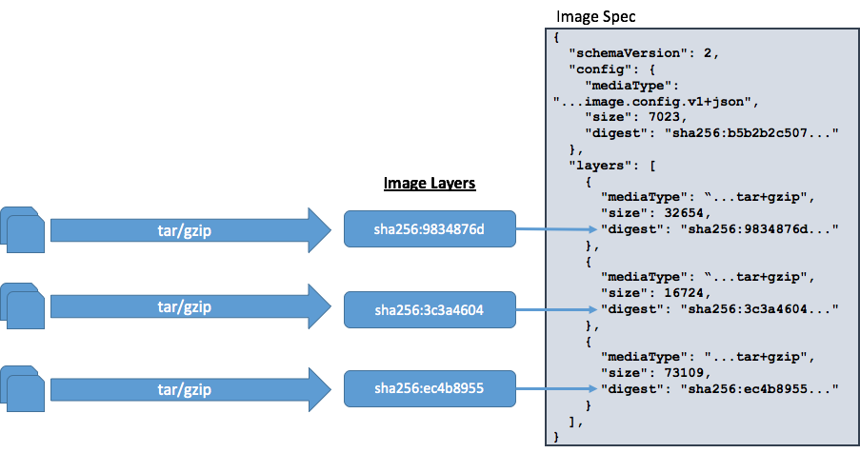
OCI Spec

Slide 15
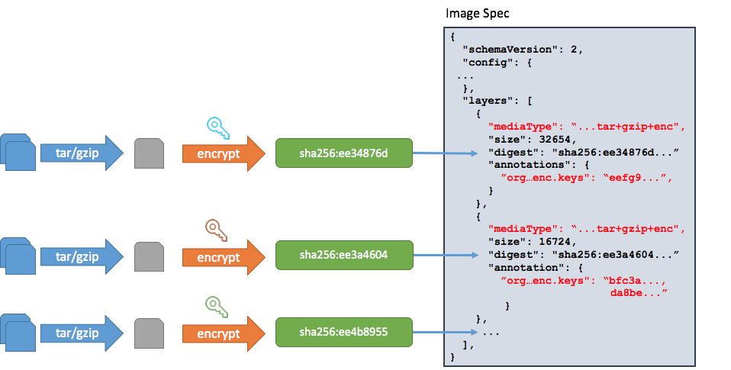
OCI Spec +encrypted
*+enc = +encrypted abbreviated
*org…enc.keys annotations represent encryption metadata

Slide 16
Container Encryption Features
Secret Algorithms
Encrypt on layers means images can still benefit from deduplication of non-sensitive layers
Encrypt once for multiple recipients. Registry deduplication on large encrypted data blob.
node/python/nginx
ubuntu:16.04
Small and not part of blob hash
Push
Enc. Layer
For Alice
For Brandon
For Justin
Image Registry
1GB
<1KB
<1KB
<1KB
@lumjjb, @justincormack

Slide 17
Bob
Alice
sends an encrypted image to
Bob
Alice

Slide 18
I want to run these images on my Kubernetes cluster!
Bob
Alice
sends an encrypted image to
Bob
Alice

Slide 19
Bob
Alice
sends an encrypted image to
1
Alice creates an RSA private/public keypair, publishing her public key
openssl genrsa -out alicePrivate.pem 2048
openssl rsa -in alicePrivate.pem –pubout ...
2
Alice
Bob encrypts his image and pushes it to the registry
buildah push --encryption- alicePublic.pem ...
Alice’s k8s cluster
Bob
3
Alice pulls and decrypts the image with her private key

Slide 20
Adding Decryption to K8s Nodes
Alice configures the nodes in the Kubernetes cluster with the private key for decryption
The encrypted image is pulled from the registry and decrypted with the private key provided
How is decryption done in k8s?
Decryption is done when image is pulled by the container runtime, i.e. containerd/cri-o
Configuration is on the node level
Runtime
Key Location
cri-o
/etc/crio/keys
containerd
<set in config.toml>

Slide 21
Cluster Decryption Demo

Slide 22
Adding Decryption to K8s Nodes
Put Key
Alice

Slide 23
Adding Decryption to K8s Nodes
Key release ONLY if cluster is authorized
Alice
Decryption keys can be protected behind cluster authorization
Proof stemming from cluster CA
Proof stemming from hardware root of trust attestation

Slide 24
Geofencing Execution
Encrypt Image with EU Public key
Cryptographic Binding
EU
EU
Get EU Public Key
EU
US
Private Key release ONLY if cluster is authorized

Slide 25
Summary
Encrypted Container Images can be used for confidentiality of images
With key management, can create geofencing based policies
Encrypted Container Images is supported today in: - Runtimes: Containerd, Cri-o - Build Tools: Buildah, Skopeo - Registries: Docker Distribution
Call for contribution! - Build Tools: kaniko, docker CLI - Registries: Quay

Slide 26
Encryption Primer
https://www.outsystems.com/blog/posts/how-to-teach-child-about-asymmetric-cryptography/

Slide 27
Encryption Primer - Assym Enc.
This is a secret message.
903nsvlvn391xkshu9282jks910alfde=
903nsvlvn391xkshu9282jks910alfde=
This is a secret message.
Addresses key sharing: Each user has a Public-Private key pair, where Public Key is not secret, can be published.
Slow

Slide 28
Encryption Primer - Symm Enc.
This is a secret message.
903nsvlvn391xkshu9282jks910alfde=
903nsvlvn391xkshu9282jks910alfde=
This is a secret message.
Fast, good for large data
Key needs to be securely shared somehow

Slide 29
Encrypt and distribution flow
docker build --encrypt --keys Alice.pub ...
Bob
Alice
Image

Slide 30
Encrypt and distribution flow
docker build --encrypt --keys Alice.pub ...
Bob
Alice
Image
Generate Sym. Key
Enc. Image

Slide 31
Encrypt and distribution flow
docker build --encrypt --keys Alice.pub ...
Bob
Alice
Image
Generate Sym. Key
Enc. Image
Wrap sym. key with public key of Alice to create a Wrapped Key.
For Alice (Wrapped Key)

Slide 32
Encrypt and distribution flow
docker build --encrypt --keys Alice.pub ...
Bob
Alice
Image
Generate Sym. Key
Enc. Image
docker push
Wrap sym. key with public key of Alice to create a Wrapped Key.
Image Registry
For Alice (Wrapped Key)

Slide 33
Encrypt and distribution flow
ctr-enc image encrypt --recipient Alice.pub ...
Bob
Alice
Image
Generate Sym. Key
Enc. Image
docker push
Wrap sym. key with public key of Alice to create a Wrapped Key.
Image Registry
For Alice (Wrapped Key)

Slide 34
Encrypt and distribution flow
docker build --encrypt --keys Alice.pub ...
Unwrap wrapped key with private key of Alice to get the sym. key.
Bob
Alice
For Alice (Wrapped Key)
Image
Generate Sym. Key
Enc. Image
Wrap sym. key with public key of Alice to create a Wrapped Key.
Enc. Image
Image
Image Registry
For Alice (Wrapped Key)

Slide 35
Bob
Bob’s k8s Cluster
Bob configures the nodes in the Kubernetes cluster with the private key for decryption
The encrypted image is pulled from the registry and decrypted with the private key provided
Bob creates an RSA private/public keypair for the cluster
openssl genrsa -out clusterPriv.pem 2048
openssl rsa -in clusterPriv.pem –pubout ...
Bob
Bob encrypts his image and pushes it to the registry
buildah push --encryption- clusterPub.pem ...
Bob

Slide 36
Bob
Bob’s k8s Cluster
Bob creates an RSA private/public keypair for the cluster
openssl genrsa -out clusterPriv.pem 2048
openssl rsa -in clusterPriv.pem –pubout ...
Bob
Bob encrypts his image and pushes it to the registry
buildah push --encryption- clusterPub.pem ...
Bob configures the nodes in the Kubernetes cluster with the private key for decryption
The encrypted image is pulled from the registry and decrypted with the private key provided
Bob

