Slide 1
Stay On Top Of Ongoing Kubernetes Security Hygiene
Zohar Kaufman
Ariel Shuper
July 2020

Slide 2
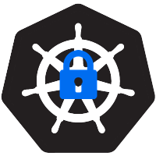
Discussion Points
Vulnerabilities Scan: A new approach
Advanced Runtime Risks Detection: CD pipelines
Pods Deployments: The Good, The Complex and The Intuitive way
Network policies: There’s a Life Outside the Cluster
Kubernetes Master node Security: Really?
Wrap Up + Shareables
Q&A

Slide 3
Vulnerabilities Scan:
A new approach

Slide 4
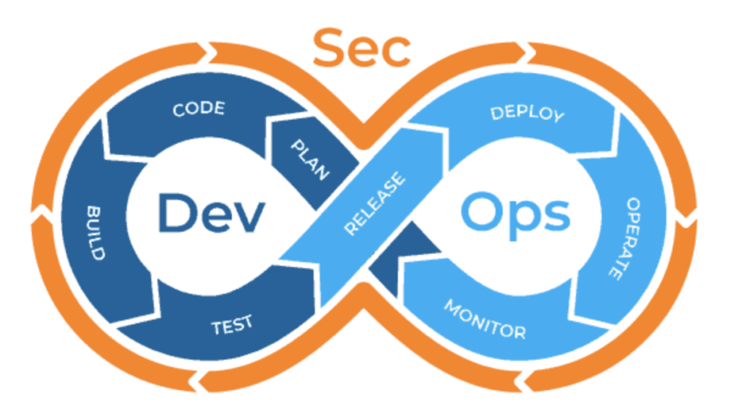
Classical Image Scan
Scan in registry or with a pipeline job
Risks are detected in advanced
Developers can fix/replace quicker and more efficiently
DevSecOps do not need to communicate to developers that they shouldn’t use certain images
Preventing vulnerable pods from being deployed

Slide 5
The Challenges of the Classical Approach
Require preliminary integrations
External repositories & Sidecars
Inefficient process
New Vulnerabilities can be found after deployment
The Kubernetes Infrastructure may be vulnerable too

Slide 6
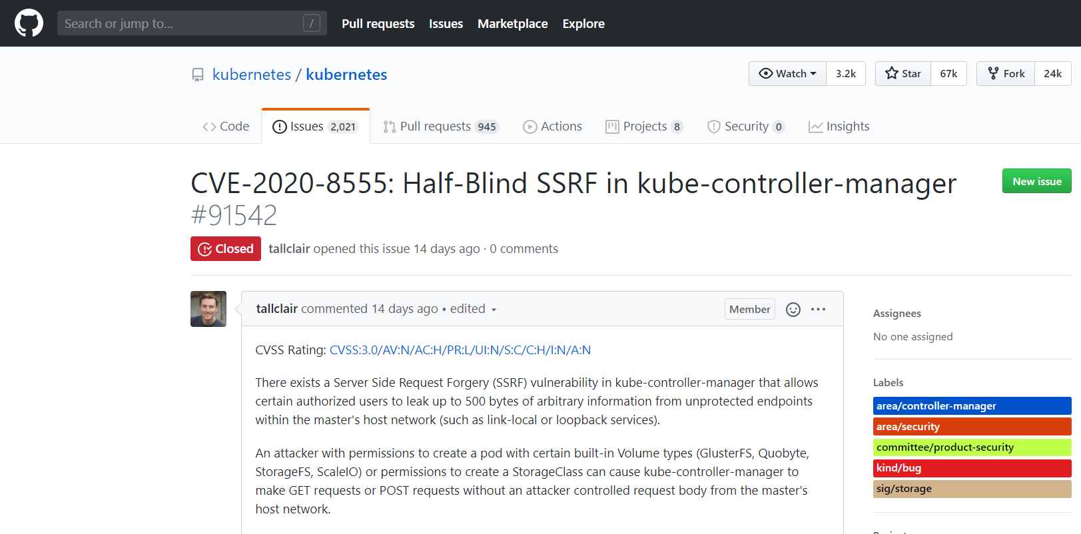
A New Approach is Required
2 new vulnerabilities were discovered in Kubernetes on June 1st
CVE-2020-10749 (container networking plugins)
CVE-2020-8555 (kube-controller-manager)
Constant monitoring of Kubernetes clusters is critical

Slide 7
Introducing Kubei, an Open Source Runtime Scanner
Scan all runtime images, whether coming from CI/CD or not
Detect malicious pods and provide an extra layer of security to your cluster
Scan public images you use that are not hosted in your registry
Gain visibility into Kubernetes elements which suffer from occasional vulnerabilities
Get accurate, real-time status of your cluster’s health

Slide 8
How Kubei Works
No need for registry or CI/CD integration
Kubei runs inside the cluster and provides real-time assessment of deployed containers’ vulnerabilities
Distributes the load
Generates a report that will show the exact location of the pods, their risks, and the relevant packages to be patched

Slide 9
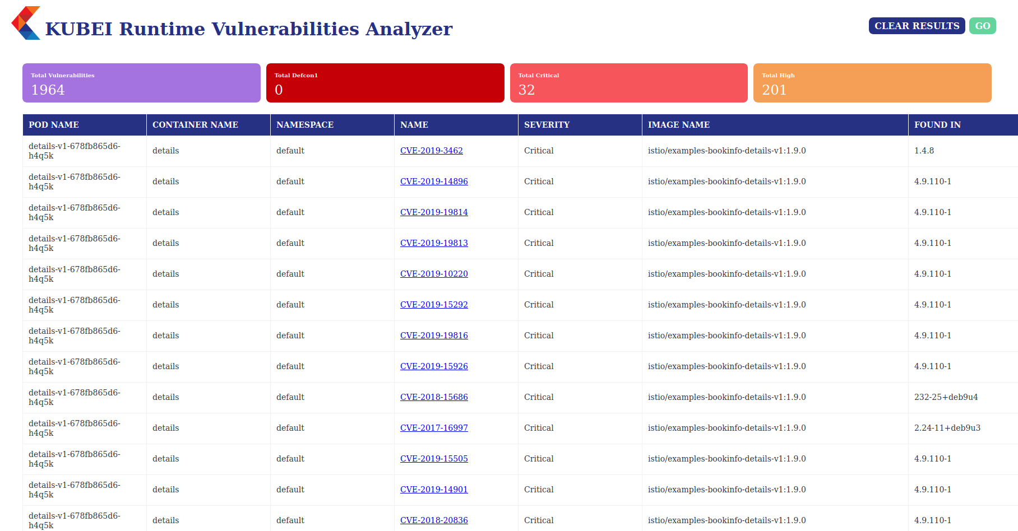
Demo

Slide 10
Advanced Risk Detection: CD Pipelines

Slide 11
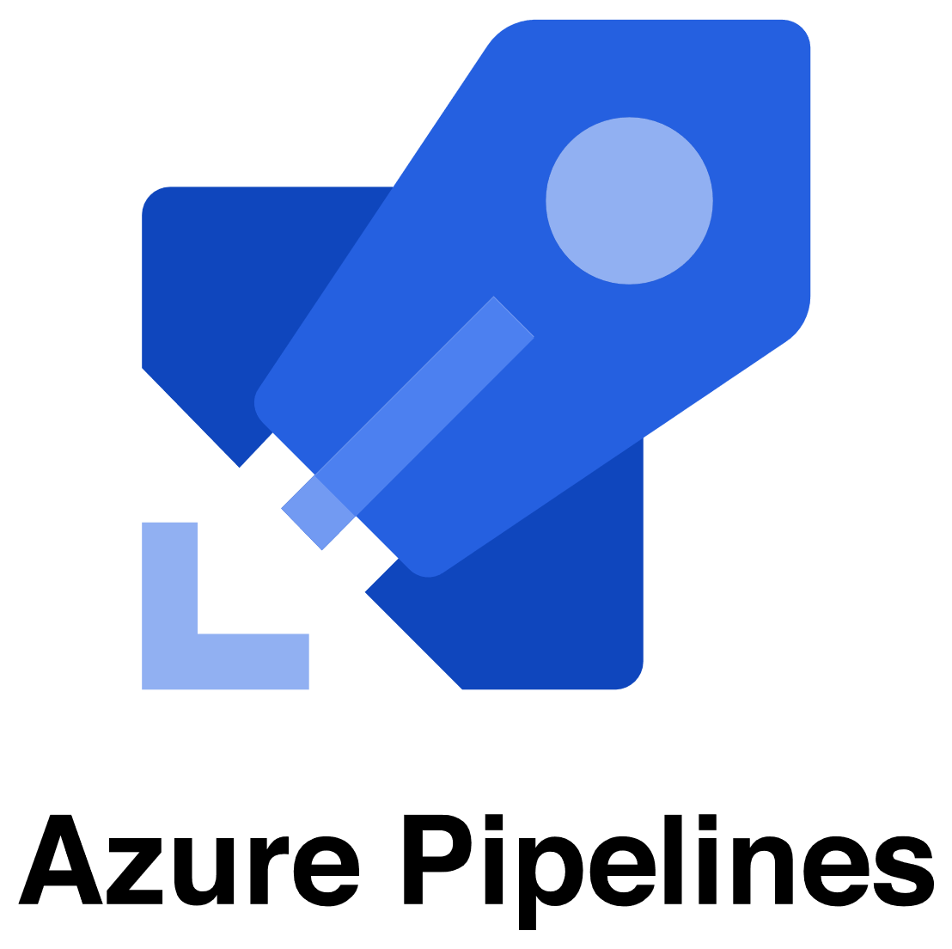
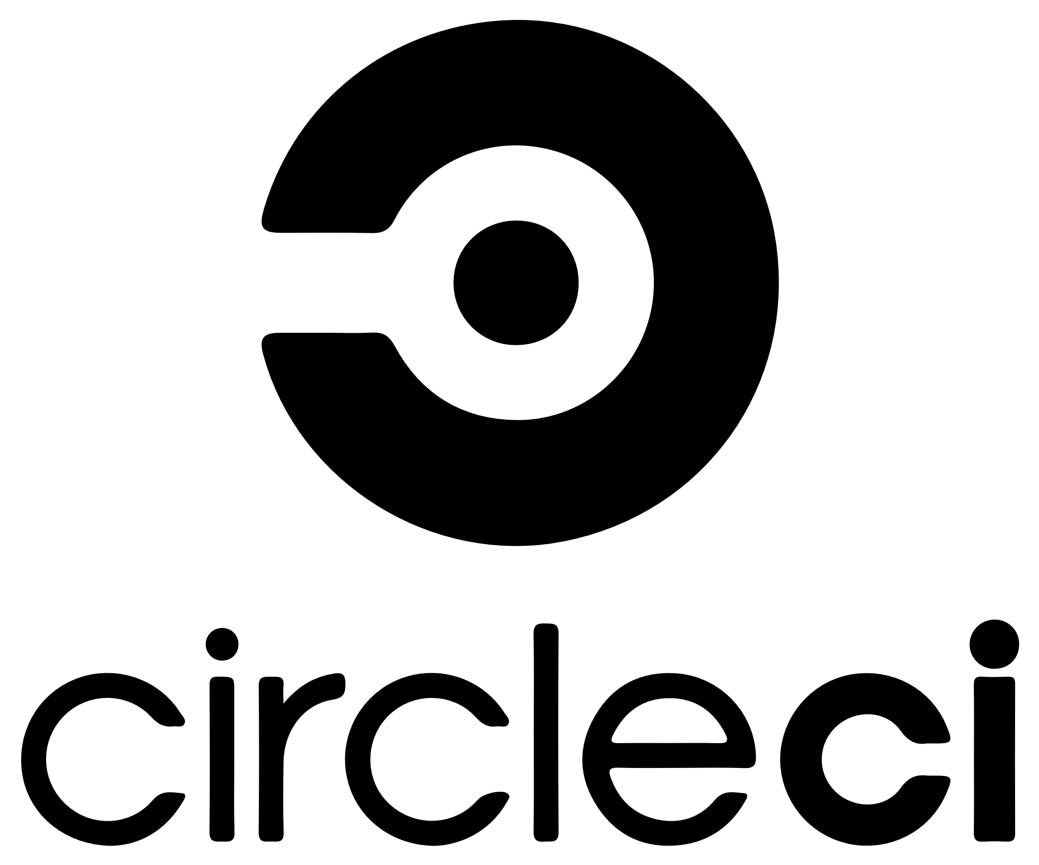
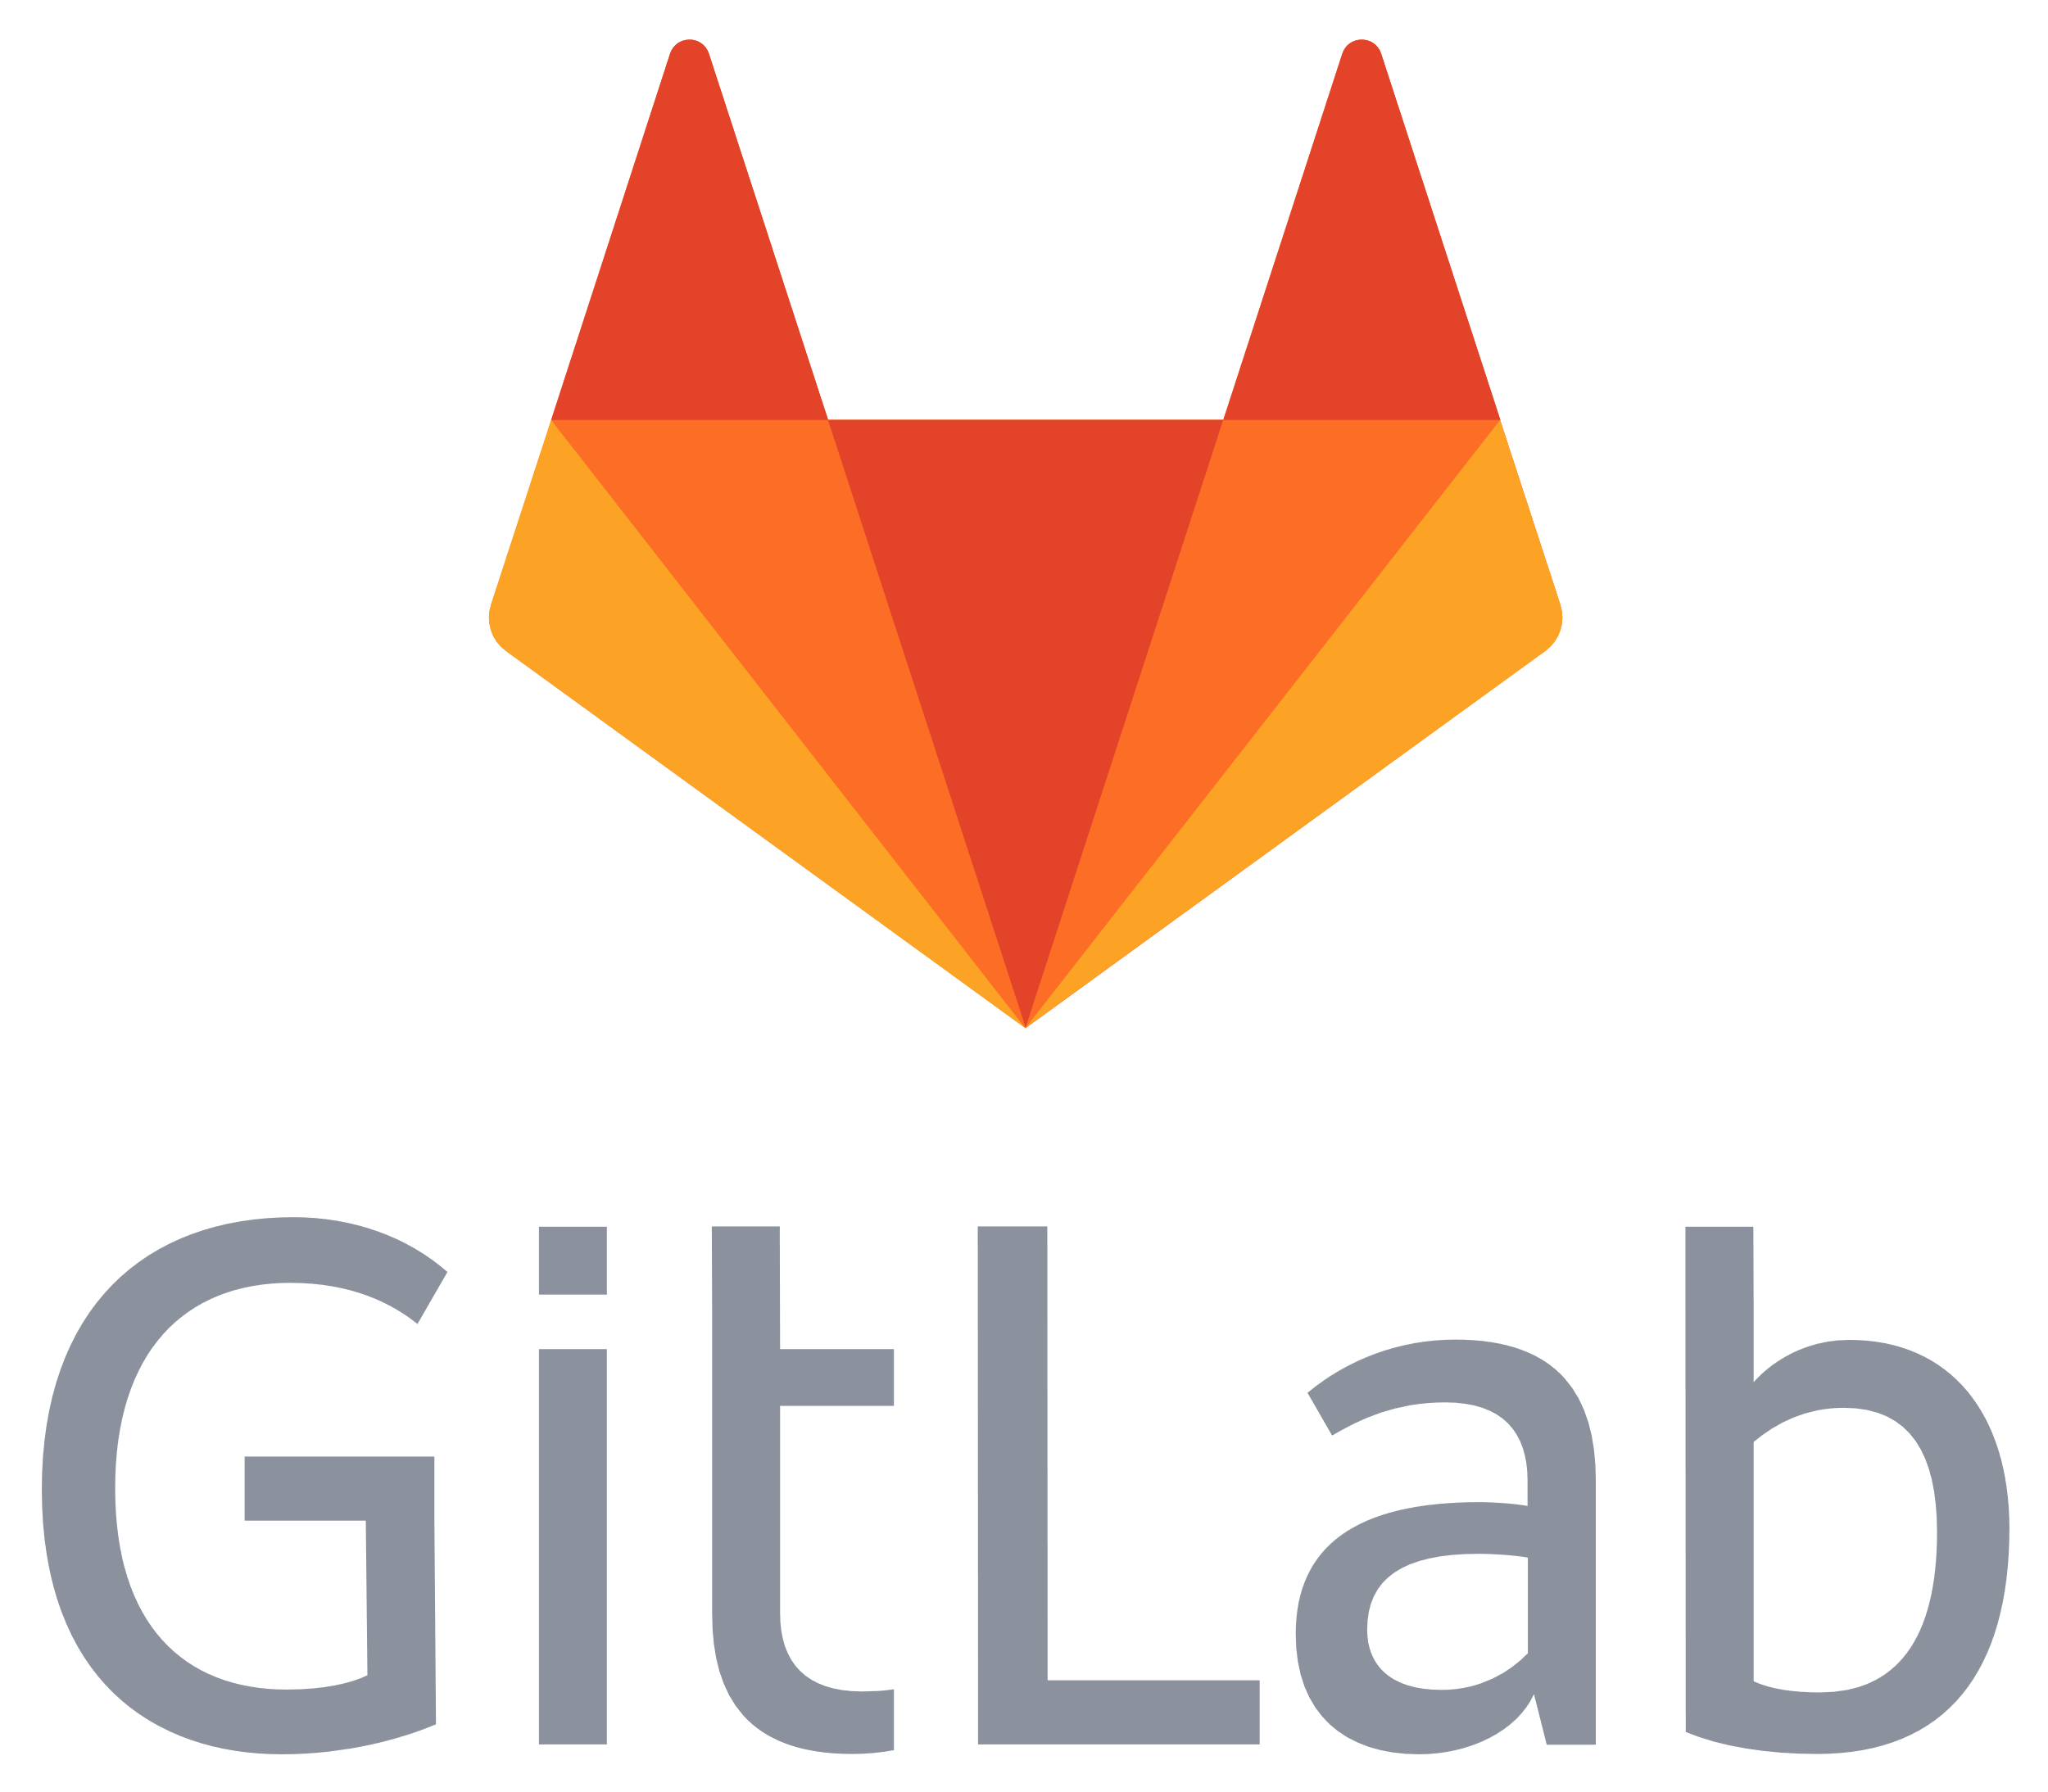
CD: Advanced detection of potential risks
Add a new security check step Integrated in the CD pipeline
Assess the risk potential prior to its deployment
Pod security context: Are we running as a root?
RBAC permissions: Do you really need to update configmap?
Secrets: Did you leave them exposed?

Slide 12
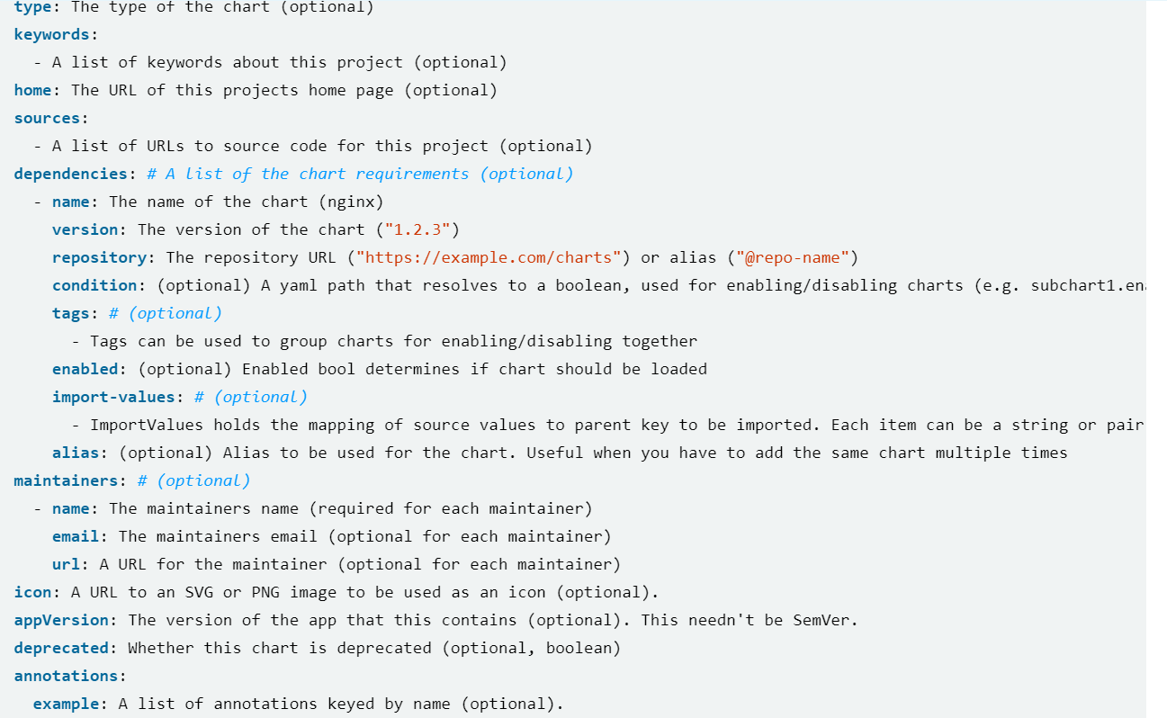
Example of Advanced Risk Detection

Slide 13
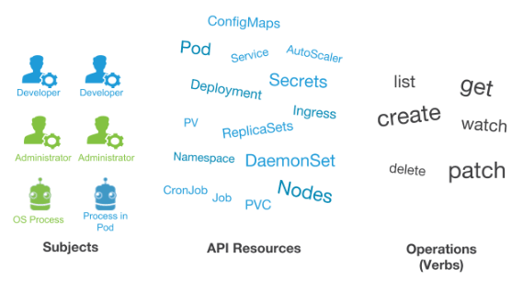
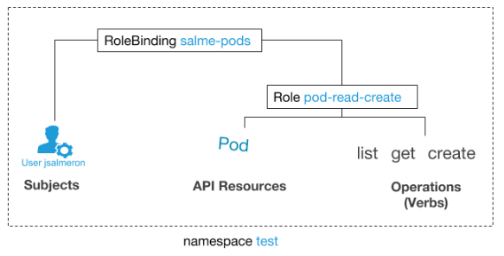
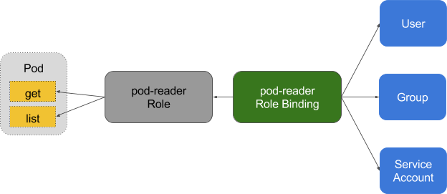
Role Based Access Control in Kubernetes

Slide 14
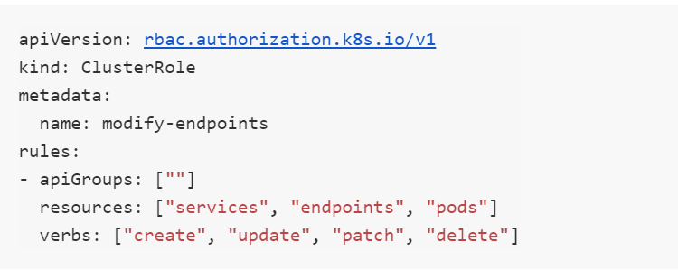
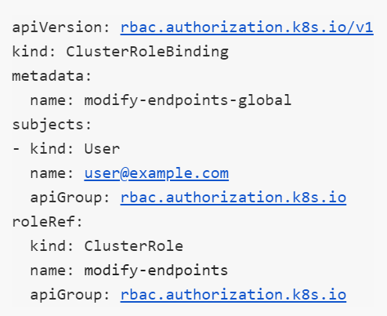
RBAC: What Can Go Wrong?
Allowing user@example.com to modify services, endpoints and pods in the whole cluster

Slide 15
RBAC: Let’s Play it Secure
Review RBAC in all clusters according to their risk classification
Review all Users, Groups, ServiceAccount and their roles
Create a Secure Policy based on:
Recommended profiles
Runtime events
Manual configuration
Get runtime events of violations of custom and recommended rules

Slide 16
Pods Deployments:
The Good, The Complex and The Intuitive way

Slide 17
Containers Attack Anatomy
Upon vulnerability exploitation, attacker will check what permissions/actions can be made on what resources
Attackers will move from the breached container to the host in-order to get exposure to more containers sharing the same host
Attacker will try to move to additional nodes or cluster resources to maximize the exhilaration potential
9

Slide 18
Kubernetes Pod Security Context
Kubernetes defines a comprehensive pod security context
The pod security context enable users to set up the needed configurations which will minimize the blast radius of attacks
Pods will be deployed with the predefined security context
Let’s examine the security context
24

Slide 19
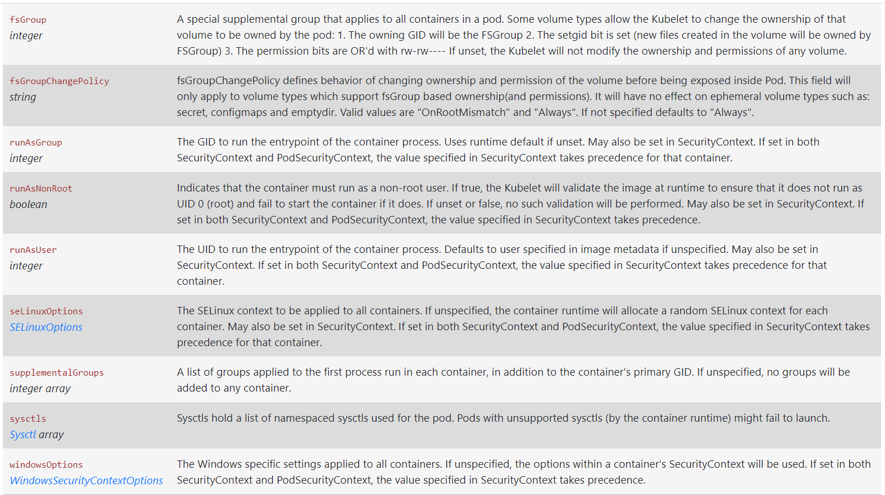
Kubernetes Pod Security Context: Deep View

Slide 20
Kubernetes Pod Security Policy to the rescue
Kubernetes Pod Security Policy is a cluster-level resource that controls security sensitive aspects of the pod specification
The PodSecurityPolicy objects define a set of conditions that a pod must run with in order to be accepted as well as defaults for the related field
24

Slide 21
Network Policies: The Life Outside the Cluster

Slide 22
Network Policies: Out of Cluster Challenges
There are few common exceptions to classical network policies rules
Popular one is creating a security-based network policies for resources outside the cluster: Which pods can access them
Typical use cases are On-Prem Database or Cloud services (Storage)
Another popular example is communication between clusters

Slide 23
The Life Outside the Cluster: Non Containerized Resources
Service Mesh Expansion allow users to extent the Istio/service mesh to non-kubernetes elements (available since Istio 0.2)
The motivation for mesh-expansion is to allow containerized application to communicate with elements which aren’t containerized/part of the Kubernetes clusters
Many applications require to access “on-prem”/legacy resources or cloud services (Cloud-Storage, managed DBs service) which aren’t containerized

Slide 24
What’s Next… Service-Mesh is Already Here
Service mesh creates discovery and routable path to the non-Kubernetes element
Service mesh also provide consistent performance metrics
Most important: Service mesh allow users to create secured access control and encrypted channel to resources that typically contain sensitive information

Slide 25
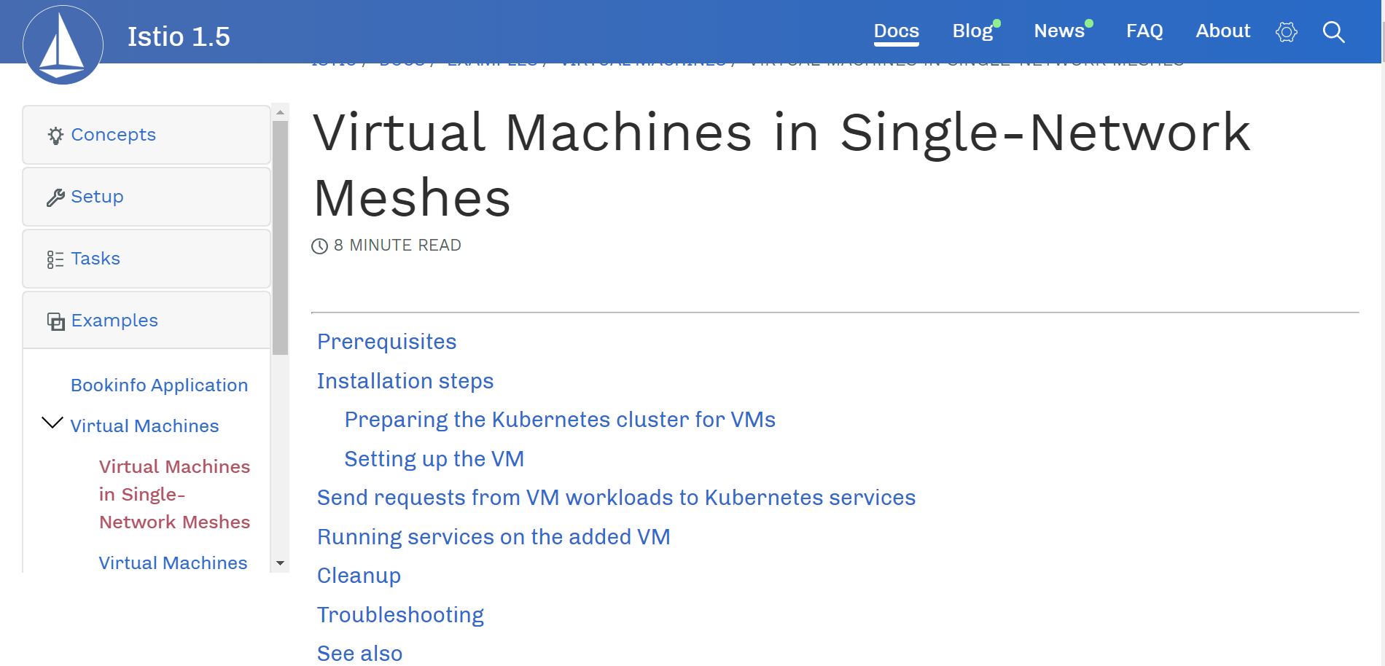
Service Mesh: The Hard Way
Istio Docs

Slide 26
Service Mesh: The Intuitive Way
To simplify the process we wrote a script that automates all the steps (updating it for each version ☹ )
Few tips:
Create a “virtual pod” within an existing namespace in the cluster (for mTLS certificate), to get mTLS certificate which will be used by the VM
Create installer that copies the certificate and additional settings to the VM
The installer installs Istio-expansion and the Envoy on the VM using the copied attributes
Synch all services to be accessible from the cluster and from the VM to allow communication

Slide 27
Cluster Security: K8s Master Protection

Slide 28
Kubernetes API and RBAC: Why Do We Need It?
K8S Server API
RBAC (Role based access control)
Resource access via HTTPS API for users and workloads (pods, secrets, configmaps, nodes, services, etc.)
"kubectl edit pod -n my-namespace my-pod"
PATCH https://34.71.145.93/api/v1/namespaces/my-namespace/pods/my-pod
Who can do what, where and in which action
Who - user/group/serviceAccount
What – API group & resource
Where - namespace/cluster
Action - create, get, update, etc.
7

Slide 29
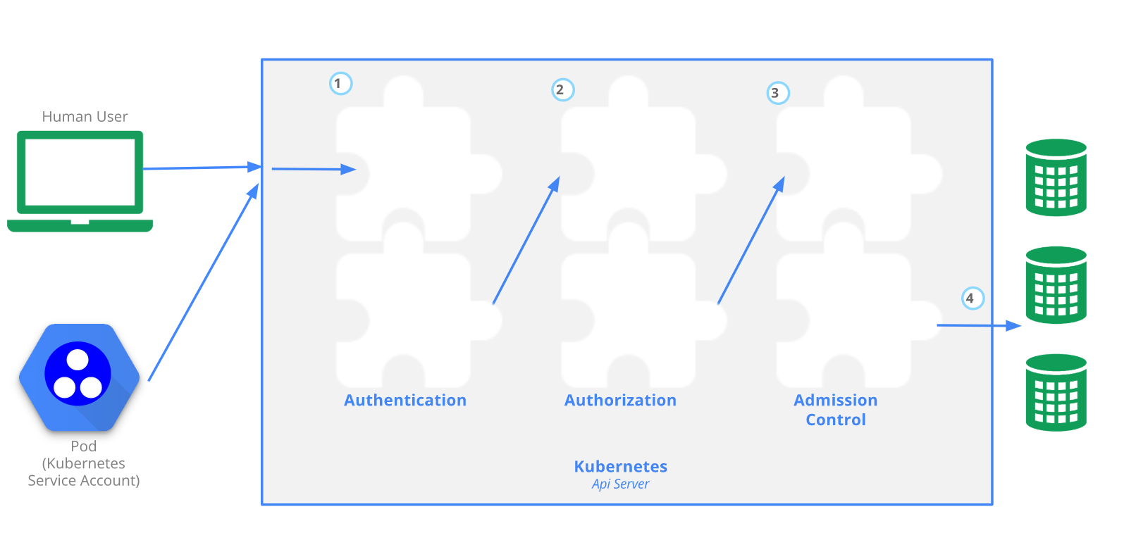
API Server architecture flow
etcd
Controls
Scheduler

Slide 30
The Ideal Protection Scheme
Runtime audit to all APIs invoked towards API server with associated risk
Block commands that create risks or violate security best-practices
Detect abnormal scenarios

Slide 31
Demo

Slide 32
Summary
Accurately assess the runtime environment - It is critical for your Kubernetes security health
Kubernetes security scope is broader than image-scanning, additional attributes need to be taken into considerations to maintain a high level of security
Network policies, are not just communication enforcement methods, they can be used wisely to govern the internal and external access potential exposure

Slide 33
Wrap Up + Shareables
https://github.com/Portshift/Kubei
https://portshift.io/runtime-kubernetes-scanning-kubei/
https://www.portshift.io/blog/kubernetes-multi-cluster-service-mesh/
https://www.portshift.io/blog/psp-kubernetes-security/

Slide 34
Q&A
Thank You

