Slide 1
July 2020
One large cluster or lots of smaller ones?
Flavio Castelli – Distinguished Engineer at SUSE

Slide 2
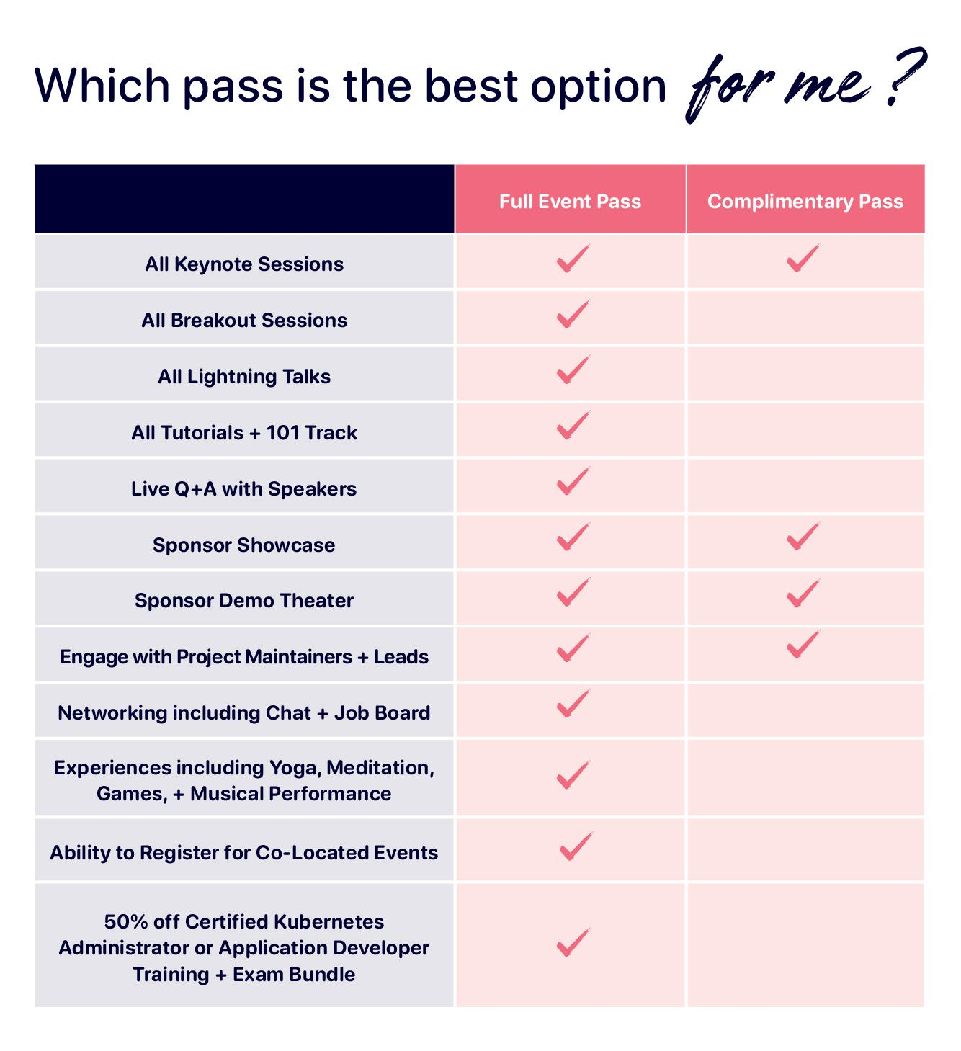
Join us for KubeCon + CloudNativeCon EU Virtual
Event dates: August 17-20, 2020
Schedule: Now available!
Cost: $75
Full Event Pass and Complimentary Pass are now available! Unsure what pass is the best for you? See the chart!
Register now!

Slide 3
A common question
Multiple teams inside of my organization need a Kubernetes cluster
Should I create lots of small clusters (one per team)?
Should I let them share a single larger cluster?
How safe is to share a single large cluster with multiple tenants?

Slide 4
The short answer...
There’s no right or wrong approach
There are limitations and benefits with both approaches
It all depends on what your requirements are, how much you want to compromise

Slide 5
Implications of having many small clusters
Advantages:
Strongest isolation between the tenants
Maximum flexibility: pick whatever Kubernetes version the tenant wants, let the tenant deploy any kind of workload
Disadvantages:
Higher maintenance
Ensure corporate policies are enforced everywhere and are kept in sync
Inferior hardware utilization
Higher costs

Slide 6
Implications of sharing a large cluster
Advantages:
Reduced maintenance
Consolidate and enforce corporate policies in a single place
Better hardware utilization
Disadvantages:
Inferior isolation compared to tenant-reserved clusters
Less flexible for end user: have to stick with the version of Kubernetes/xyz offered, have to open tickets to get certain privileged operations done

Slide 7
Today’s journey
Our challenges:
How to host different tenants on a single Kubernetes cluster?
How secure can it be?
What we will discover:
Kubernetes has many built-in features that can help with that
External projects can be used to fill the gaps
There are however some limits that cannot be overcome

Slide 8
Personas of our story
Cluster operators:
Administrators of the large Kubernetes cluster
Have ultimate access to it
Cluster tenants:
They can create and consume resources on the Kubernetes cluster
They are bound to rules put in place by the cluster operators

Slide 9
The foundation block
As stated by Kubernetes’ documentation:
Kubernetes supports multiple virtual clusters backed by the same physical cluster. These virtual clusters are called namespaces.
→ Kubernetes Namespaces can be used to isolate different tenants, different projects or any combination of these ones.

Slide 10
Kubernetes resources and Namespace
Some Kubernetes resources are cluster-wide, but the majority of them are bound to a specific Namespace
Namespaces alone aren’t enough, there are no security fences around them

Slide 11
Authentication
A Kubernetes cluster must enforce user authentication against an external identity provider
Unauthenticated users are prohibited from interacting with the cluster
Once authenticated, the Kubernetes API server will know the name of the user and the groups she belongs to

Slide 12
Authorization
RBAC policies instruct Kubernetes about what actions a user/group or users is entitled to perform against a set of Kubernetes resources
RBAC policies are expressed via:
Role/ClusterRole objects: define the target of a policy
RoleBinding/ClusterRoleBinding: associates a Role/ClusterRole to a user/group of users

Slide 13
Built-in Roles
Kubernetes has a some built-in ClusterRole objects
These can be used to quickly define RBAC policies both at cluster and at Namespace level
Most useful ones:
admin: read/write access to most resources, can manage RBAC policies inside of the Namespace
edit: like admin, but no way to view or modify RBAC policies. Note well, they can interact with Secrets too
view: read only access, no way to interact with RBAC policies and Secrets

Slide 14
Building fences around a Namespace
Quick way: rely on built-in ClusterRoles and create RoleBinding to make them effective inside of a specific Namespace
Define ad-hoc Roles/ClusterRoles and bind them to a specific Namespace

Slide 15
Network isolation
By design all Kubernetes Pods can communicate with each other, regardless of the namespace they belong to
Kubernetes NetworkPolicy can change this behaviour
Namespace A
Namespace B

Slide 16
Network Isolation of a tenant
Pod to Pod communication is allowed inside of the “tenant-a” Namespace
Outgoing connectivity from “tenant-a” is allowed
Ingress connectivity from other Namespaces is not allowed
apiVersion: networking.k8s.io/v1
kind: NetworkPolicy
metadata:
name: isolate-tenant-a
namespace: tenant-a
spec:
podSelector:
matchLabels:
ingress:
- from:
- podSelector: {}

Slide 17
Reflections on the previous NetworkPolicy
Pros: no need to add more policies when other tenants are added to the cluster
Cons: some ingress traffic should be allowed (eg: expose a service, collect metrics,...)
👎
👍
Reaching exposed service
Namespace A
Namespace B

Slide 18
Allow some ingress traffic
apiVersion: networking.k8s.io/v1
kind: NetworkPolicy
metadata:
name: allow-from-ingress-namespace
namespace: tenant-a
spec:
ingress:
- from:
- namespaceSelector:
matchLabels:
network/policy-group: ingress
podSelector:
matchLabels:
policyTypes:
- Ingress
Allow incoming traffic from Namespaces with the specified label
Assumes the ingress controller (nginx-ingress, traefik,…) is deployed inside of a Namespace with the specified label

Slide 19
Limit cluster resource usage
We want to prevent tenants from starving each other
We want to properly size the “virtual clusters” of the tenants
→ We need to put limits on resource usage on a Namespace basis

Slide 20
Resource Quotas
ResourceQuota is a namespaced object
Defines the amount of resources that are available to a specific Namespace
Resources can be:
Compute resources: CPU, memory
Extended resources (e.g. GPUs)
Storage resources
Other types of Kubernetes objects: Services, CronJobs, Deployments, …

Slide 21
Storage Quotas
PersistentVolumes are cluster-wide resources
PersistentVolumeClaims are namespaced → controllable by Storage Resource Quota
Storage Resource Quota offers flexibility:
Limit the global amount of storage consumed by the Namespace
Define different limits based on the storage class used

Slide 22
Object Count Quota
Can limit the number of Kubernetes objects a Namespace holds: Pods, Deployments, Secrets, ConfigMaps, …
Worth of note: limit the number of Services of type LoadBalancer

Slide 23
Linux Containers
Kubernetes Pods are made of Linux Containers
Linux Containers provide workload isolation, but the kernel of the host is shared with the containerized application
This has always security implications, but these becomes greater when multiple tenants are sharing the same Kubernetes cluster

Slide 24
How to properly secure Linux containers
Limit the Linux capabilities granted to containerized workload
Use a SELinux or AppArmor profile
Use a seccomp profile
Do not share host kernel namespaces with the container
Limit/ban access to the host filesystem
Limit access to Linux sysctl
Do not run containerized applications as “root”
Do not run privileged containers

Slide 25
Pod Security Policies
Allow the cluster operator to create security profiles for Pods:
Define what is considered unacceptable (e.g. access host network, run privileged containers, run containerized application as root,…)
Define default values (e.g. enforce usage of seccomp, AppArmor/SELinux)
PSP are cluster level objects
Pods violating a PSP won’t be accepted by the Kubernetes API server
PSP are bound to users/groups via ClusterRoleBinding/RoleBinding

Slide 26
How can we leverage Pod Security Policies?
Operator can define global PSP policies that apply to all users
Operator can also define ad-hoc PSP that apply to a specific virtual cluster (Namespace) or to specific users
Is that enough?

Slide 27
Using different Container Runtime
Majority of Kubernetes deployments uses runC to create Linux Containers
runC is the reference implementation of the OCI Runtime Specification
runC can be replaced by other alternative runtimes, as long as they implement the OCI Runtime Specification

Slide 28
Other OCI runtimes with focus on security
Kata containers: provide stronger isolation by wrapping application containers inside of a lightweight VM
gVisor: containerized workloads do not share the kernel with the host, they use an application kernel provided by gVisor

Slide 29
Kubernetes Runtime Class
Allows definition of additional container runtimes that can be used to schedule containers
Trusted workloads: use a container runtime that uses runC
Untrusted workloads: use a container runtime that provides higher isolation
kubelet
containerD/CRI-O
runC
runsc
kata-shim

Slide 30
Using Kubernetes Runtime Class
RuntimeClass is a cluster-wide object that must be defined by the cluster operator
Cluster operators must configure the worker nodes of the cluster accordingly: install required software, properly configure containerD/CRI-O
To use the non-default runtime class: fill the runtimeClassName attribute when defining a Pod
apiVersion: v1
kind: Pod
metadata:
name: mypod
spec:
runtimeClassName: secure
# ...

Slide 31
Is this level of separation enough?
We can use security-focused OCI runtimes to isolate the tenants workloads from each other, but...
Workloads from different tenants would still be scheduled on the same set of nodes
Some tenant workloads might require less isolation (use runC, maybe with a more relaxed PSP)

Slide 32
Influencing Kubernetes’ scheduler
Last node has a taint that prevents generic workloads from being scheduled on it
Purple workloads have a toleration that allows them to be scheduled on the tainted node
Purple workloads can still be scheduled on other nodes of the cluster
Node 1
Node 2
Reserved Node Purple

Slide 33
Influencing Kubernetes’ scheduler
All the nodes have: tenant-based taint and a tenant-based label
All the tenant workloads have: right toleration and nodeSelector constraint
Reserved Node Green
Reserved Node Yellow
Reserved Node Purple

Slide 34
Validation and sanitization of user input
Many of the features shown before rely on the user providing “special” information:
Quotas: when enforced the user must specify resource limits and requests, otherwise the workload won’t be scheduled
Secure Container Runtime: the workload must specify the RuntimeClass to be used, otherwise the default one (probably runC) will be used
Influencing Kubernetes’ scheduler: the right toleration and nodeSelector constraints must be written

Slide 35
Kubernetes Admission Controllers
Used to intercept and process all the requests made against Kubernetes’ API
They handle requests after:
Authentication has been successfully completed
RBAC policies checks passed
Two types of admission controllers:
Validating: accept/reject invalid requests
Mutating: accept/reject or accept a modified version of the request

Slide 36
Request validation: use cases
Influencing the scheduler:
Avoid tenant “green” workloads to tolerate the taints of tenant “purple”
Avoid tenant “green” to use the nodeSelector constraint of tenant “purple”
Resource quotas:
Ensure all workloads have resource request and limits specified
Add default request/limit when needed → prevent workloads from being unschedulable
Container Runtime Class: modify the workload definition to ensure the right runtime is going to be used (instead of the default one)

Slide 37
How to use admission controllers
Kubernetes has already some compiled-in admission controllers
These controllers are always available (they are part of the api-server process)
Some of the compiled-in controllers can solve our problems:
Quotas: LimitRanger, provide default values
Influencing the scheduler: NodeRestriction, allows only admins to change certain node labels (makes nodeSelector more secure)
Pod Security Policies are implemented using an admission controller

Slide 38
Write custom admission controllers
The compiled-in admissions controllers aren’t enough
It’s possible to create custom admission controllers by creating a Dynamic Admission Control

Slide 39
How Dynamic Admission Control works
Two types:
ValidatingAdmissionWebhook
MutatingAdmissionWebhook
User implements validation/mutation logic inside of a web application
kube-api server sends request to HTTP callback and waits for response
The controller can be deployed on top of the Kubernetes cluster itself
Note well: the API server is going to validate the request returned by a Mutating Admission Control, it can reject it if invalid

Slide 40
Caveats of Dynamic Admission Control
You can’t assume they are always reachable and responding properly
Kubernetes has two “failure policies” for external admission controllers:
Ignore: the request is considered valid and accepted as it is
Fail: the request is rejected even though it might be perfectly acceptable
The “Fail” policy should be used carefully: it could make the cluster unusable

Slide 41
Standing on the shoulders of giants
Do you really want to write your own Dynamic Admission Control?
There’s more work to do on top of writing the actual validating/mutating business logic

Slide 42
Open Policy Agent (OPA)
CNCF project – incubating stage
Currently undergoing some architectural changes, I’ll focus on its next-gen architecture

Slide 43
Writing custom policies
Policies are written using a high-level language called Rego
OPA provides a unit test framework to validate the policies
Policies are “loaded into Kubernetes” by using a Custom Resource defined by OPA
Key point: users can focus on what matters the most, writing policies!

Slide 44
Gatekeeper
Dynamic admission controller provided by OPA
Users write their own policies and Gatekeeper enforces them
Currently a validation controller, there are plans to add mutating capabilities.

Slide 45
Generic problems of Admission Controllers
Policies evolve over time: what was considered a valid API request yesterday could be rejected today
What to do when the Dynamic Admission Controller isn’t reachable/behaving as expected?
Can we set its failure mode to Ignore?
What if something “slips-into the cluster” due to the Ignore failure mode?

Slide 46
OPA - Auditing feature
OPA policies can be periodically re-evaluated
Violations are stored inside of the status field of the policy

Slide 47
Final considerations

Slide 48
Time for a recap
It’s possible to share a large Kubernetes cluster with different tenants
Each tenant can have a dedicated space
We can put a reasonably secure fence around these dedicated spaces
This can be done by leveraging features provided by Kubernetes itself
Some external projects are required to fill some of the gaps (e.g. secure container runtimes, external admission controllers)

Slide 49
Advantages of sharing a single cluster
Reduced maintenance:
Infrastructure: you can limit the number of control plane nodes (master nodes, etcd)
Consolidate and enforce policies and rules in a single place
Share Kubernetes “add-ons”: monitoring, logging, tracing, service mesh, ingress, …
Better hardware utilization (unless you start to influence Kubernetes’ scheduler)

Slide 50
Disadvantages of sharing a single cluster
There’s a limit on the isolation and security we can achieve (*):
Control plane is shared between the tenants
Have to trust Kubernetes/cluster administrators/external components: security vulnerabilities, bugs inside of policies, corner cases,…
Everybody has to stay with the same version of Kubernetes
Deploying certain privileged workloads isn’t allowed to “mere” users: e.g. cluster-wide operators must be installed by the cluster operators
(*) another project worth to be explored is the “Virtual Cluster” one from SIG multi-tenancy

Slide 51
Advantages of having many smaller clusters
We can achieve the strongest level of isolation
Everybody gets the version of Kubernetes they need
Tenant/team can have its own set of admins that can do “everything” on the cluster

Slide 52
Disadvantages of having many smaller clusters
Increased maintenance:
More machines to keep up to date
Eventually more Kubernetes versions to care about (from a security POV)
Multiple instances of the Kubernetes “add-ons” (monitoring, logging,…)
Ensure corporate policies are enforced everywhere and are kept synchronized
Inferior hardware utilization
Higher costs

Slide 53
Thank you.

