Slide 1
How to Run Kubernetes
Securely and Efficiently
September 2020

Slide 2
Presenters
ROBERT BRENNAN
Director of Open Source - Fairwinds
Robert drives software initiatives at Fairwinds with a heavy focus on open source. He helps companies adopt and maintain Kubernetes clusters in a secure, scalable, and user-friendly way.
JOE PELLETIER
VP of Product - Fairwinds
Joe heads up product and strategy at Fairwinds. He is passionate about building great teams and solutions that bridge the gap between developers, security, and operations.
Notes:
Joe 2-10

Slide 3
Today’s agenda
Why organizations choose Kubernetes
Key challenges
Technical implications for security and efficiency
How Configuration Validation can help
Q&A

Slide 4
Containers change how software is developed
1
Software packaging is shifting left
Developers take responsibility for containerizing applications as part of CI process
Developers also responsible for parts of the Kubernetes configuration
Container adoption is growing quickly – by 2023, 70% of global enterprises will be running two or more containerized applications, up from 20% last year*
Kubernetes is entering the mainstream – and in many cases, through development teams starting new projects
2
3
* Gartner, “3 Critical Mistakes That I&O Leaders Must Avoid With Containers. (Available by subscription-only)”
Notes:
Complexity
Shifting left towards dev
Dev introduces K8s (velocity, new ways of doing things) or pushed top down (policy, process)
K8s promises efficiency, but each workload requires its own attention

Slide 5
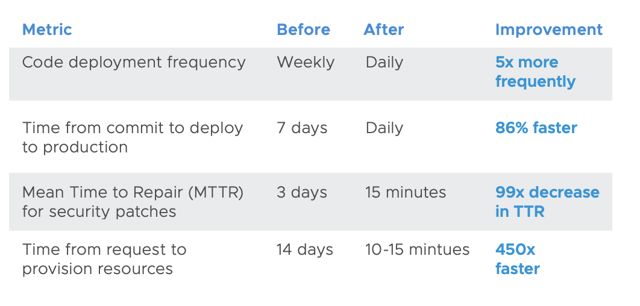
Containers and Kubernetes enable teams to ship faster
Source: Amazon Web Services (AWS), “Application Portability with Kubernetes” https://www.slideshare.net/AmazonWebServices/application-portability-with-kubernetes-cmp310s-aws-reinvent-2018
Notes:
Here are some proof points on the impact of container technology. At a high level, companies are choosing containers so they can ship faster. They can realize order of magnitude improvements in code deployments, MTTR, and releases.
When combined with cloud technologies, new projects and teams and provision compute resources with speed.

Slide 6
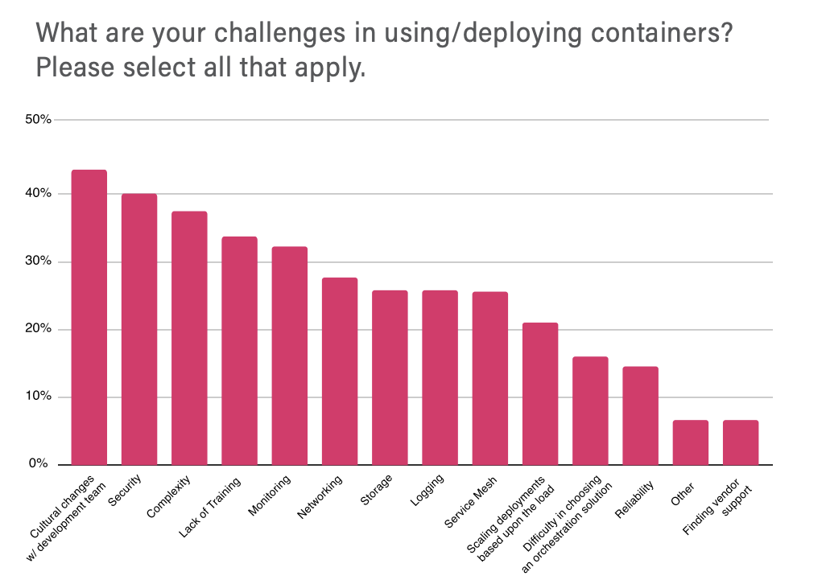
Challenges with containers
Top 3 Challenges
Cultural shift moving to containers and Kubernetes
Security
Complexity
Credit: CNCF Survey 2019, Cloud Native Computing Foundation
https://www.cncf.io/wp-content/uploads/2020/03/CNCF_Survey_Report.pdf
Notes:
However, as companies adopt Kubernetes, there are challenges. And one of the top issues is around culture. This new technology has changed people’s roles in the development process, forcing engineers to learn new concepts and Ops engineers to adapt to an “everything as code” mindset.
(Speak to CNCF findings)

Slide 7
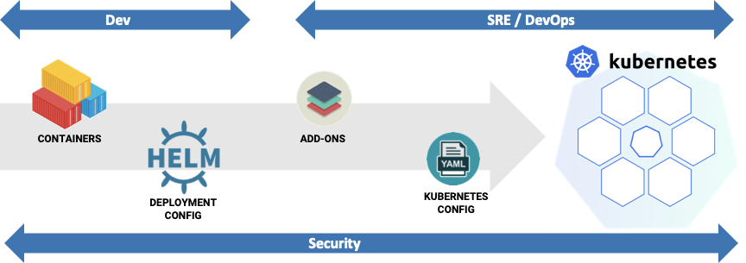
Cultural shift: Changes to the development pipeline
Notes:
What does this cultural shift look like? First, adopting container and Kubernetes means introducing new configuration and technical decisions. In this view, we have a pipeline of activities before software can run in Kube.
One of the first areas for overlap is between Dev and SRE.
Depending on the org, devs or DevOps engineers may be responsible for containers and Kube configs.
Let’s walk through an example of a typical workflow.

Slide 8
Cultural shift: Changes to the development pipeline
Known vulns / CVEs
Untrusted images
Missing patches
Old versions
Missing or insecure configurations:
Over-permissioning
Privilege escalation
Missing health checks
Too much compute allocated

Slide 9
Complexity: Different stakeholders, different needs
“We don’t know how much CPU and memory to provision for our application.”
“Applications are missing critical Kubernetes health checks.”
“We need to know if we’re running images with known vulnerabilities.”
“We need reliable infrastructure for our next wave of growth.”
The Developer
The SRE
The Security Team
The VPE
Notes:
With the involvement of Dev, Security and Ops resources, a new layer of complexity can emerging. Different stakeholders start needing different things.
How do you give each of these stakeholders visibility into the questions they care about? How do you ensure a smooth handoff of software from development to operations?

Slide 10
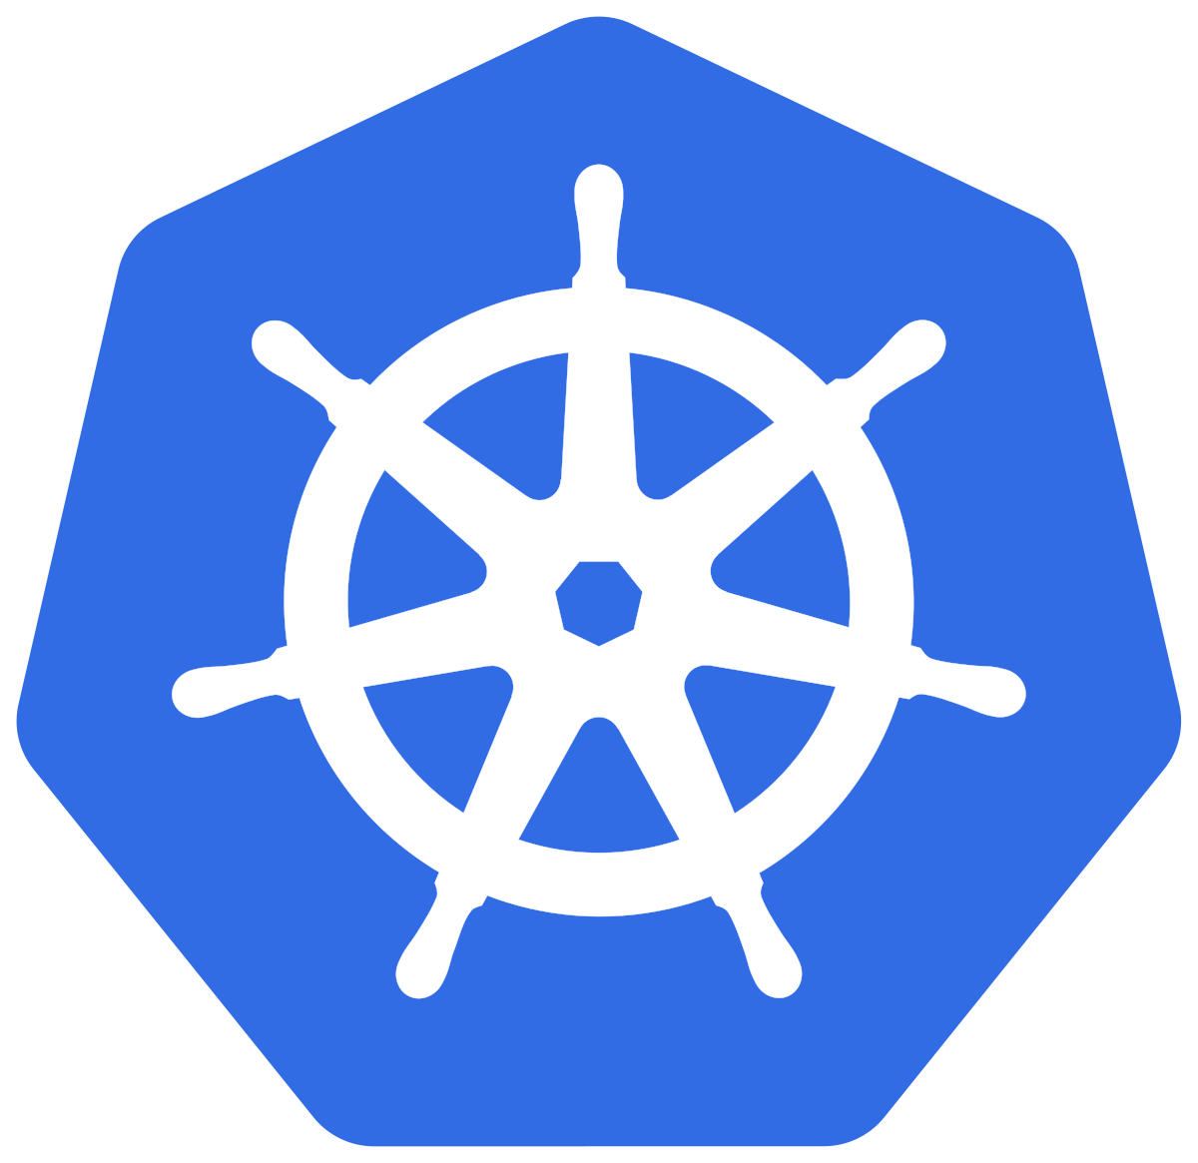
Where security and efficiency challenges emerge
Containers
Deployment Configurations
Kubernetes Clusters
☑ Security
CVEs
Image Pull Policies
☑ Security
Configuration checks
☑Efficiency
Health Checks
Missing Requests and Limits
☑ Security
Add-on Versions
Risky RBAC Profiles
Kubelet Config
☑ Efficiency
Resource Optimization Recommendations
Notes:
At a technical level, we’ll focus on the security and efficiency of three key components of a Kubernetes environment: Containers, Deployments, and the Cluster
Containers and deployments, when deployed together, turn into workloads on K8s.

Slide 11
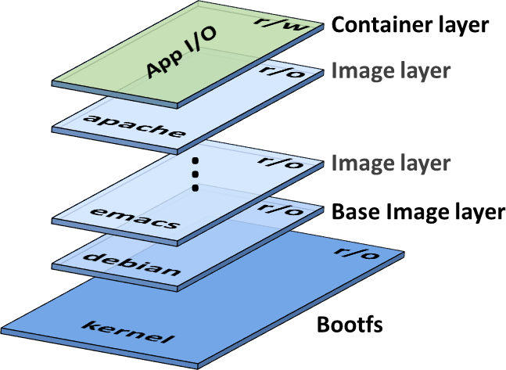
Workload Security:
What are containers & kubernetes configurations?
Kubernetes Configuration
apiVersion: apps/v1
kind: Deployment
metadata:
name: busybox-deployment
spec:
template:
spec:
containers:
- name: busybox
image: busybox:latest
securityContext:
allowPrivilegeEscalation: true
privileged: true
readOnlyRootFilesystem: false
runAsNonRoot: false
capabilities:
add:
- CHOWN
- SYS_ADMIN
- SETUID
- ALL
CVE-201X-1234
Notes:
Robert 11-16

Slide 12
Example: Container vulnerabilities
Problem
Docker images may use operating systems or libraries that contain vulnerabilities
New vulnerabilities are being discovered daily
Impact
Attackers could potentially access the running container, exfiltrate data, or trigger a DoS
Zero-day attacks could affect running containers that have already passed CI/CD

Slide 13
Example: Over-permissioned containers
apiVersion: apps/v1
kind: Deployment
metadata:
name: busybox-deployment
spec:
template:
spec:
containers:
- name: busybox
image: busybox:latest
securityContext:
allowPrivilegeEscalation: true
privileged: true
readOnlyRootFilesystem: false
runAsNonRoot: false
capabilities:
add:
- CHOWN
- SYS_ADMIN
- SETUID
- ALL
Problem
Deployments may violate the principle of least privilege
Developers may not be certain which permissions are truly needed
Impact
Attackers can escalate to gain access to entire cluster or underlying nodes
Honest mistakes can impact other workloads

Slide 14
Example: Health probes
Problem
Kubernetes uses probes to test the health of an application
But while highly recommended for production deployments, they are technically optional
Developers may fail to define liveness and readiness probes
Impact
Kubernetes may fail to detect a crashed/unresponsive application
Workloads will not scale appropriately
Workloads may experience downtime during releases
apiVersion: apps/v1
kind: Deployment
metadata:
name: busybox-deployment
spec:
template:
spec:
containers:
- name: busybox
image: busybox:latest
livenessProbe: {}
readinessProbe:
httpGet:
path: /index.html
port: http

Slide 15
Example: Inappropriate resource requests and limits
Problem
Developers need to specify the amount of CPU and memory their application needs
But it’s hard to know this ahead of time
Often developers will omit resource specs, or will over-provision resources
Impact
Kubernetes will fail to kill misbehaving applications
Memory leaks can eat up all the resources in a cluster (“noisy neighbors”)
Over-provisioning can lead to huge cost overruns
Under-provisioning can lead to instability
apiVersion: apps/v1
kind: Deployment
metadata:
name: busybox-deployment
spec:
template:
spec:
Containers:
- name: busybox
image: busybox:latest
resources:
requests:
cpu: "4"
memory: 20GB
limits: {}

Slide 16
Let’s recap
Technical
Unresolved Container Vulnerabilities
Over-permissioned Deployments
Missing Health Probes
Inappropriate Resources Requests and Limits
Business Impact
Increased security risk
Increased security risk
Potential for application downtime
Potential for cloud cost overruns

Slide 17
Why Configuration Validation?
Kubernetes configuration validation enables DevOps teams to maintain consistent configurations for containers, deployments, and cluster infrastructure.
Configuration validation solutions provide organizations with findings, fix recommendations, and Policy-driven controls that reduce risk, save money, and avoid wasting time as applications move from development to operations.
Notes:
Joe 17-26

Slide 18
Steps for implementing configuration validation
Get the Data
Analyze, Organize, and Prioritize the Data
Assign
Ownership
Remediate
Find the right tools
Script them to run
Normalize output
Aggregate & de-dupe
Assign severity
Track and audit the findings
Summarize and prioritize what to do next
Assign to owners
Integrate with downstream tools (monitoring, chat, ticketing systems)
Investigate best practices
Document remediation guidance
Train engineers
Make and validate changes

Slide 19
Ways to implement Configuration Validation
1
Build your own tools
Use open source
Use a purpose-built platform
2
3

Slide 20
Build your own tools
Pros
Fully customized to your needs
Satisfies engineers who want room to be creative
Cons
Potentially huge effort, maintenance cost
No competitive advantage to be gained
Few needs are truly unique
May fail to check important things - “unknown unknowns”

Slide 21
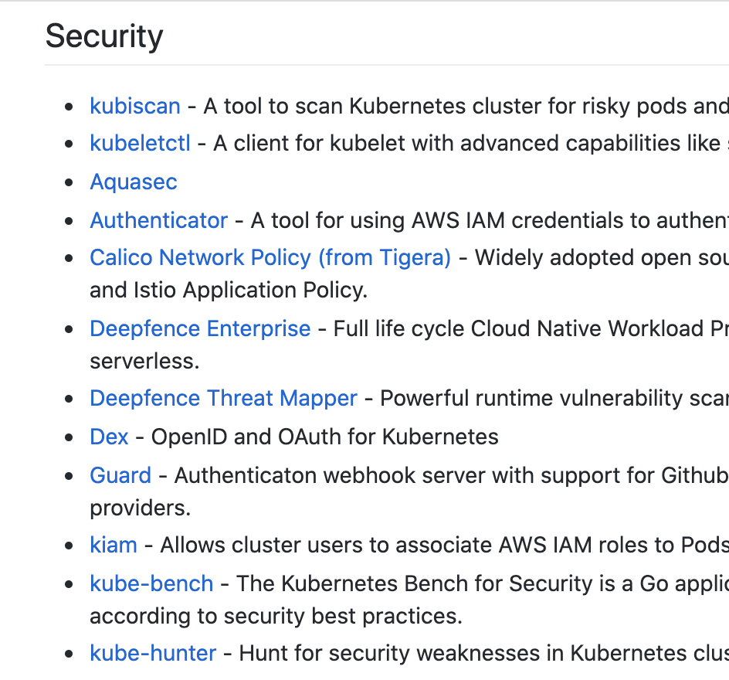
Use open source tools
Dozens of open source tools!
Pros
Free!
Many best-in-class solutions are open source
Cons
Each tool covers a single use case
Hard to operationalize
different formats
need to run on a schedule
prioritization and tracking
Tough to get support
Still needs extensive research, DIY, and maintenance
Source: https://github.com/ramitsurana/awesome-kubernetes

Slide 22
Use a Purpose-built Platform
Pros
One platform can cover many different use cases
Expertise is battle-tested across many organizations
Integrates open source
Enterprise-grade support
Cons
Costs money
May have proprietary or commercial components

Slide 23
Things to look for in a Purpose-built Platform
Prioritizes findings from multiple open source tools through single pane of glass
Offers out-of-the-box integrations with familiar DevOps tools
Addresses Containers, Deployment Configuration and Cluster risks
Offers remediation advice in-product and through support
Integrates Policy-driven features so you can automate enforcement and deployment rules
1
2
3
4
5

Slide 24
Where should you implement Configuration Validation?
PIPELINE
CLUSTER
Container security
Container security
Deployment validation
Deployment security
Cluster security
Resource efficiency

Slide 25
Business benefits of Configuration Validation
Gain continuous visibility into container, deployment and cluster risks.
Prioritize and action the riskiest issues.
Improve Security
Reduce Costs
Set the right amount of CPU and memory so your applications scale efficiently.
Avoid trial-and-error when configuring Kubernetes apps for security and efficiency gains.
Provide a single-pane-of-glass for DevOps, security, and platform teams to collaborate from.
Get feedback to app teams in the tools they use
Save Time

Slide 26
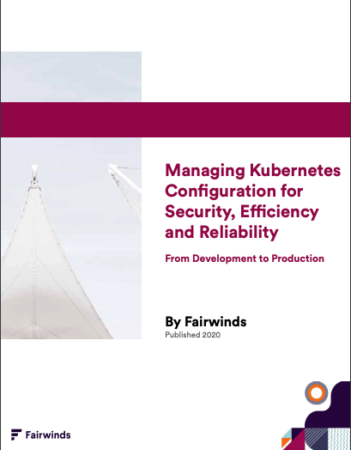
Fairwinds Guide to Managing Kubernetes Configuration
Proactively identify Kubernetes security misconfigurations to prevent breaches
Remove the guesswork when adjusting CPU and memory settings to save time and money
Avoid downtime
Learn more at Fairwinds.com > Resources
Ready to try Fairwinds Insights?
Fairwinds.com/insights

Slide 27
Thank You
Questions?

