Slide 1
Debugging your debugging tools; What to do when your service mesh goes down in production?
Neeraj Poddar
Co-founder & Chief Architect, Aspen Mesh
John Howard
Software Engineer, Google

Slide 2
What Is a Service Mesh
A service mesh is…
a transparent infrastructure layer that manages communication between microservices
so that developers can focus on business logic
while operators work independent of dev cycles to provide a more resilient environment

Slide 3
Key Benefits of a Service Mesh
Traffic Management
Security
Observability

Slide 4
Istio Architecture Overview
istiod
Pilot
Mixer
Citadel
Sidecar Injector
Config data to Envoys
Policy & telemetry
TLS certs to Envoys
Monitors K8s for new pods to inject Envoys
Ingress Gateway
Egress Gateway
Envoy
Envoy
Envoy
istio-agent
istio-agent
istio-agent
Sidecar Proxy Container
Sidecar Proxy Container
Sidecar Proxy Container
Flask
http.createserver
Spring
Python
Node.js
Java
Application Container
Application Container
Application Container
SERVICE A
SERVICE B
SERVICE C

Slide 5
Debugging Istio
Data plane
Envoy sidecar
Istio Agent
Control plane
istiod

Slide 6
Debugging Envoy
Connectivity to istiod
Enabling & understanding access logs
Debug logging
Configuration dump

Slide 7
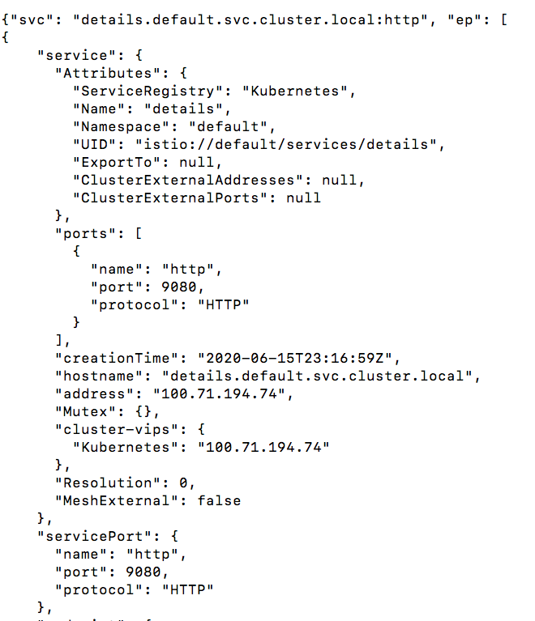
Connectivity to Istiod

Slide 8
Application Access Logs
Useful for diagnosing traffic flows and failures
End-to-end request routing across all microservices
Default “turned off” in Istio
Enabled only in “demo” profile
First tool in your debugging toolkit

Slide 9
Globally Enabling Access Logs
Globally enabling using “istioctl install”
Globally customizing encoding which defaults to “TEXT”
Reverting back to no access log
This configuration is stored in “istio” configmap as default “mesh” configuration

Slide 10
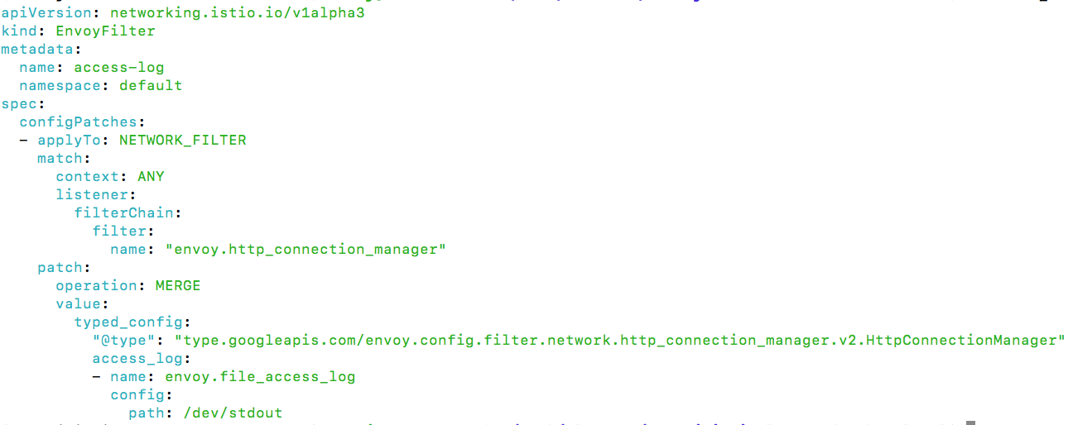
Enabling Access Logs for a Namespace
Use Namespace scope EnvoyFilter resource (Shouldn’t be used if enabled globally)

Slide 11
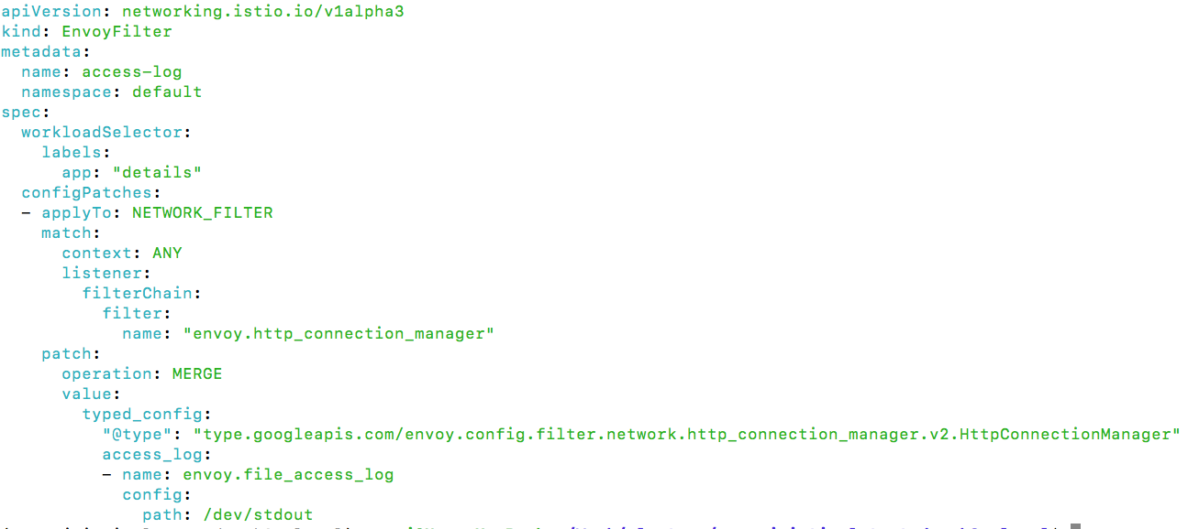
Enabling Access Logs for a Workload
Use Workload Scope EnvoyFilter resource (Shouldn’t be used if enabled globally)

Slide 12
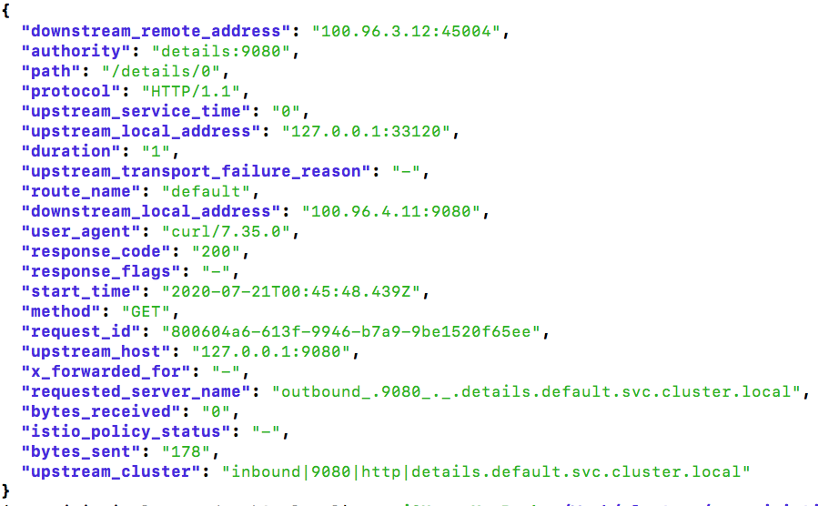
Understanding Access Logs

Slide 13
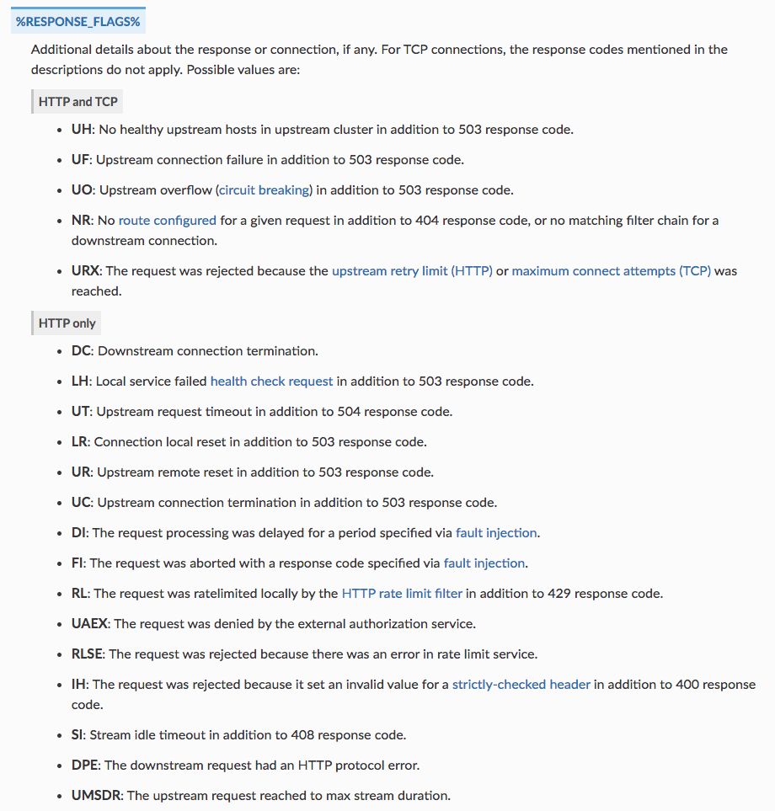
Understanding Response Flags

Slide 14
Customizing Access Log Format
Globally via
Empty value defaults to Envoy Format String
Note that Istio adds its custom format string via control plane
Can be customized at a namespace or workload level via EnvoyFilter resources
If globally access logging is turned on EnvoyFilter shouldn’t be used
Available logging fields

Slide 15
Envoy Debug Logging
Debug logging is verbose and expensive
Not recommended for permanent production usage
Defaults to “warning”
Enable debug logging for a workload using istioctl
Doesn’t require restarting the pod
Enable debug logging for a workload using annotations
Add pod annotation “sidecar.istio.io/logLevel: debug”
Requires pod restarts
Enable debug logging globally
Requires pod restarts
Notes:
Scenarios where there’s no access logging but debug logging emits messages. Cases around TLS/SNI issues

Slide 16
Envoy Configuration Overview
Most specific matched
HTTP Filters
Routes
Listeners
Filter Chains
Clusters
Endpoints
Most specific matched
Specific match order
TCP Filters
Runs in order

Slide 17
Envoy Listener Dump
Virtual inbound listener
Virtual outbound listener
Outbound listeners
All listeners

Slide 18
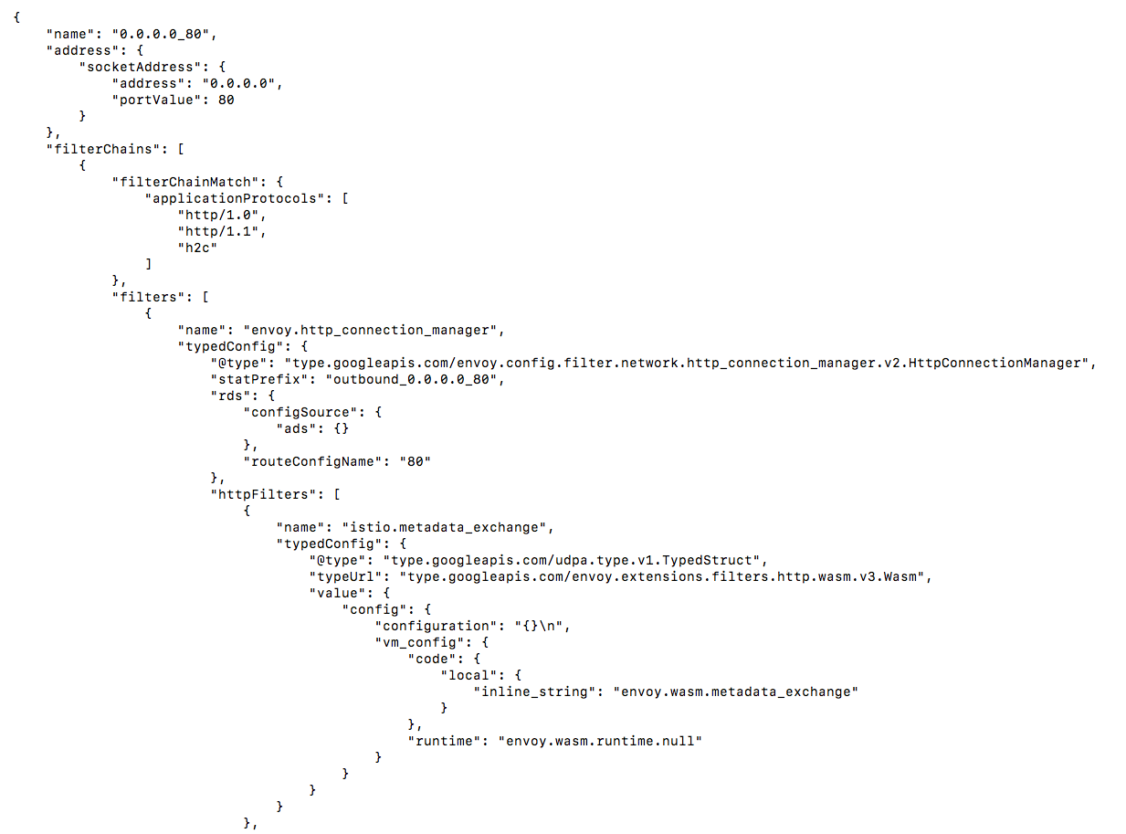
Envoy HTTP Listener Configuration

Slide 19
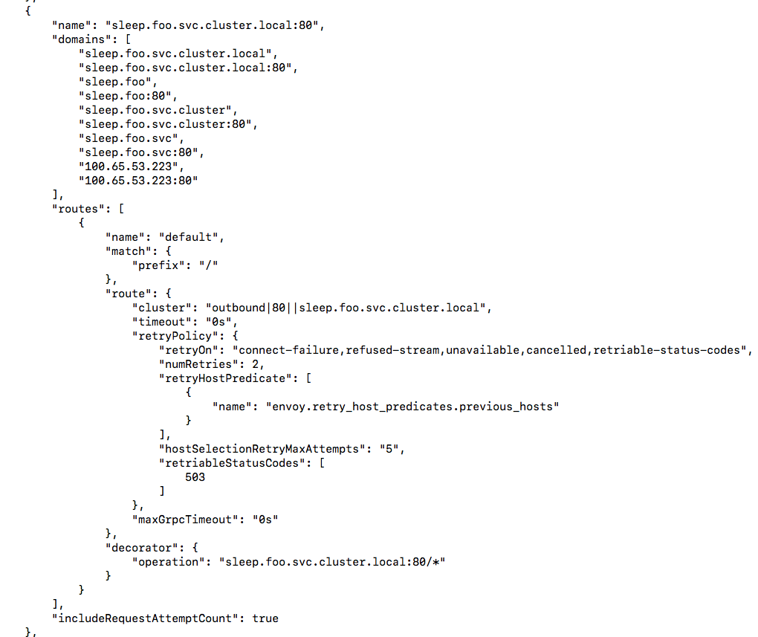
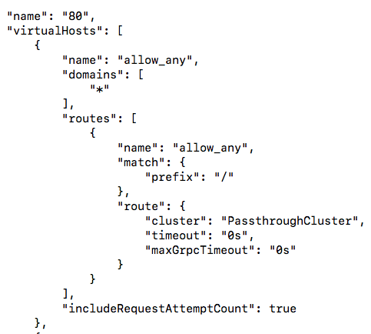
Envoy Route Dump
Configuration for a route

Slide 20
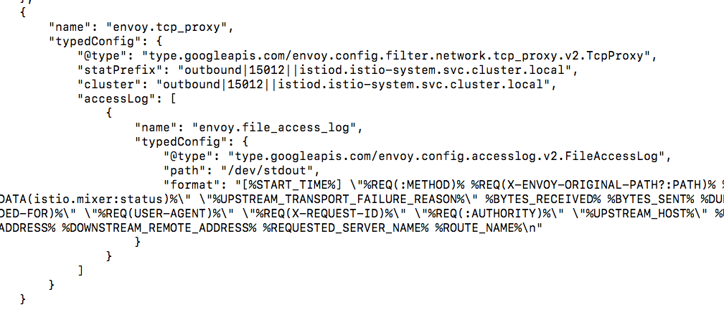
Envoy TCP Listener Configuration

Slide 21
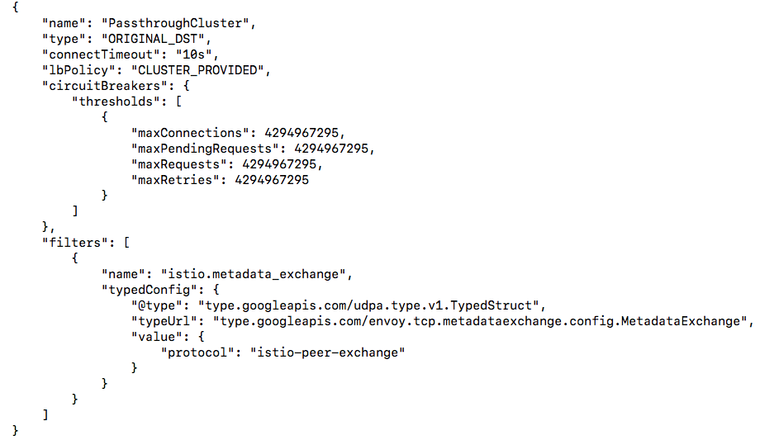
Envoy Cluster Dump
Configuration for a named cluster

Slide 22
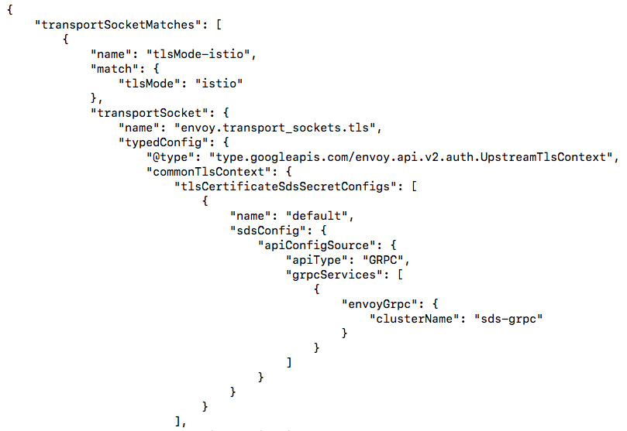
Envoy Cluster Dump
Configuration for a named cluster

Slide 23
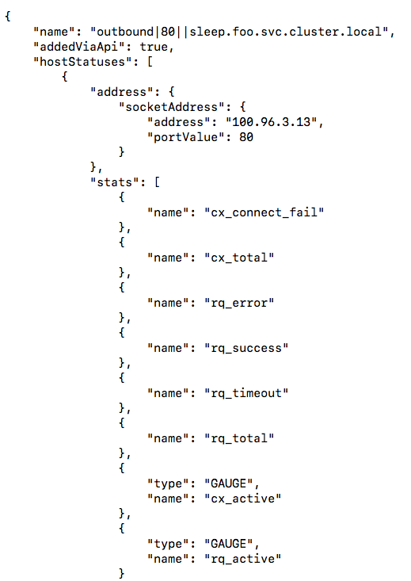
Envoy Endpoint Dump
Endpoints for a cluster
Notes:
Talk about new verbose options being added in “istioctl” 1.7

Slide 24
Mapping Resources to Envoy Configuration
Resource Type | Envoy Configuration | Notes
Kubernetes Services | Listeners Routes Clusters | New listeners if port/protocol combo is unique Add virtual hosts for existing routes One cluster per Service/Port/Subset
Kubernetes Endpoints | Endpoints
Istio Gateway | Listeners | Apply to Ingress/Egress Gateways
Istio VirtualService | Listeners Routes | Client side proxies TLS/TCP affect listeners HTTP match blocks affect routes
Istio DestinationRule | Clusters Endpoints | Client side proxies Connection/HTTP/TLS settings
Istio ServiceEntry | Clusters Endpoints | Client side proxies
Istio PeerAuthentication | Listeners Clusters | Server side proxies
Istio RequestAuthentication | Listeners | Server side proxies
Istio Authorization Policies | Listeners | Server side proxies
Istio EnvoyFilter | All | Break glass API to directly manipulate Envoy
Istio Sidecar | All | Client or server side proxies Sidecar scope sets config visibility
Notes:
This mapping can change from release to release

Slide 25
Istio Agent Bootstrapping
Istiod
Istio Agent
Envoy
1. Start Envoy
3. Fetch Cert (CSR)
Auth: JWT
2. Fetch Cert (SDS)
Auth: None (local)
4. Fetch Config (XDS)
Auth: Cert

Slide 26
Istio Agent Lifecycle
Istiod
Istio Agent
Envoy
When cert is near expired:
Refresh Cert
Push new certs
Periodic reconnect based on max conn age/keep alives
When config/endpoints change:
Push updated config

Slide 27
Istio Agent Debugging
Viewing secrets/certs using istioctl
istioctl proxy-config secret <POD>
default secret is the workload certificate
ROOTCA is the workload root certificate
Other secrets are certificates from DestinationRule/Gateway
Describe the full certificate information with openssl
istioctl proxy-config secret <POD> -o json | jq '.dynamicActiveSecrets[0].secret.tlsCertificate.certificateChain.inlineBytes' -r | base64 -d | openssl x509 -noout -text -in -
"Warming" secrets
If a secret isn't found it will be stuck warming. Traffic that relies on that secret will fail.
For gateways, may indicate the referenced Secret is not present. Check logs or istioctl analyze.
For workload certificate, may indicate issues connecting to the CA (Istiod).

Slide 28
Istio Agent Readiness
Probe: every 2s, check readiness status at localhost:15021/healthz/ready
On success, mark container ready
On 30 consecutive failures, mark container not ready
Runs for entire lifetime of the pod
Envoy proxy is NOT ready: config not received from Pilot
Indicates we don't have the correct XDS configuration
Can be from rejected config
Envoy log: gRPC config for type.googleapis.com/... rejected
istiod log: ADS: ACK ERROR ...
Metrics: pilot_xds_{cds,lds,eds,rds}_reject
Generally a bug cause by non-standard configuration
Can be from connectivity issues to istiod
StreamAggregatedResources gRPC config stream closed: 14, no healthy upstream
Check certificates are ready
Check istiod is ready
Check Network Policies if applicable
Envoy proxy is ready - Output on first successful probe

Slide 29
Istiod Debugging
Enabling debug logging
ControlZ dashboard
Istiod metrics for config synchronization/pushes

Slide 30
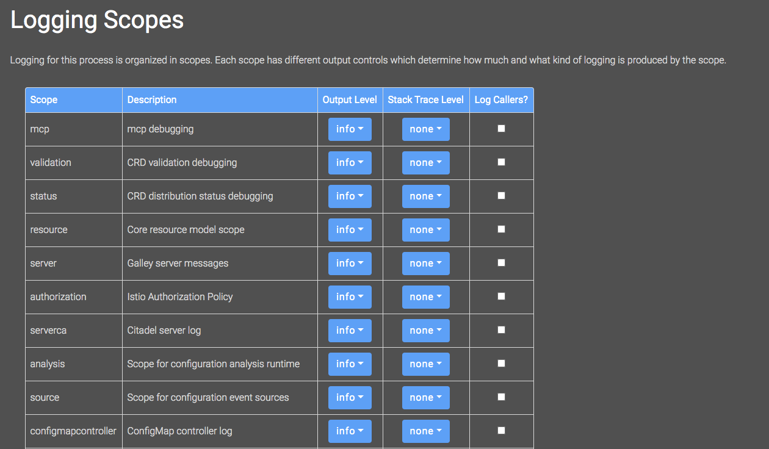
Istiod Debug Logging
Default level is “info”.Available options: “debug”, “info”, “warn”, “error”, “fatal”, “none”
Enable debug logging without restarting “istiod”
Toggle logging for a scope or for all scopes
Enable debug logging via “istioctl”
Requires re-deploying istiod

Slide 31
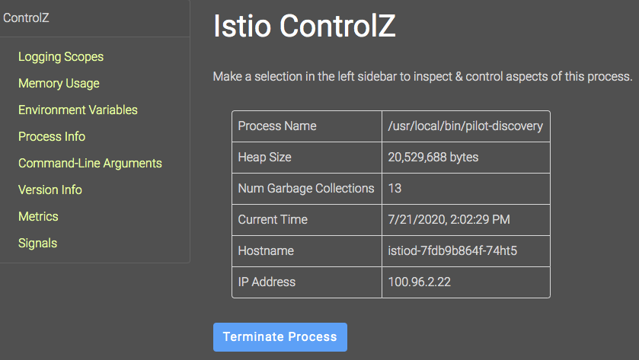
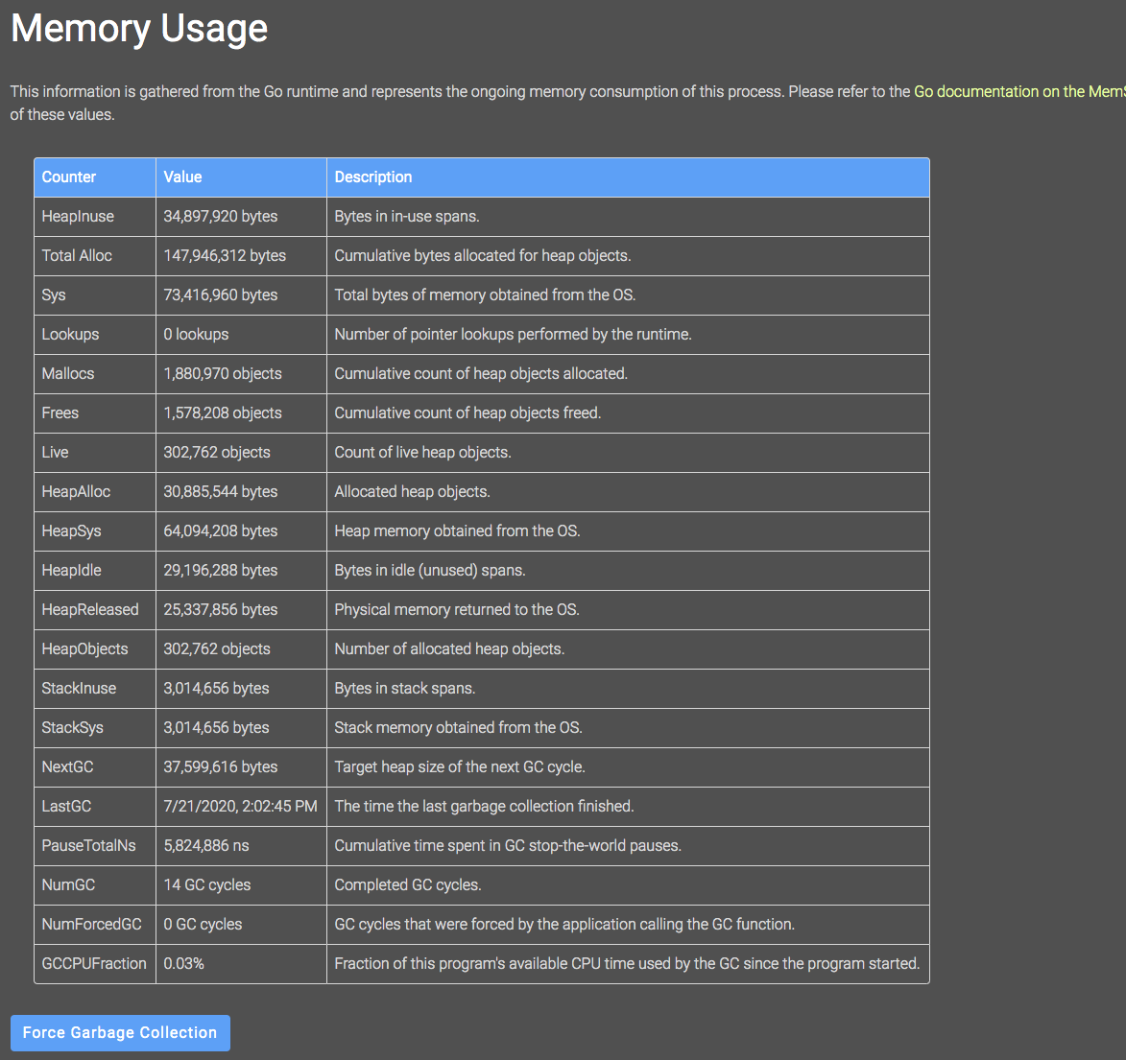
Istiod ControlZ Dashboard

Slide 32
Istiod Metrics
Grafana Dashboard comes prepopulated with useful metrics to track.
Datadog has an excellent deep dive on Istio metrics.
Useful metrics
Total number of invalid config: pilot_total_xds_rejects
Rejections generally indicate misconfiguration or bugs
Time to push config update to proxy: pilot_proxy_convergence_time
Slow times may lead to delays in config or endpoints updates. May indicate under-scaled control plane.
Number of XDS clients: pilot_xds
Useful to spot unbalanced load distribution

Slide 33
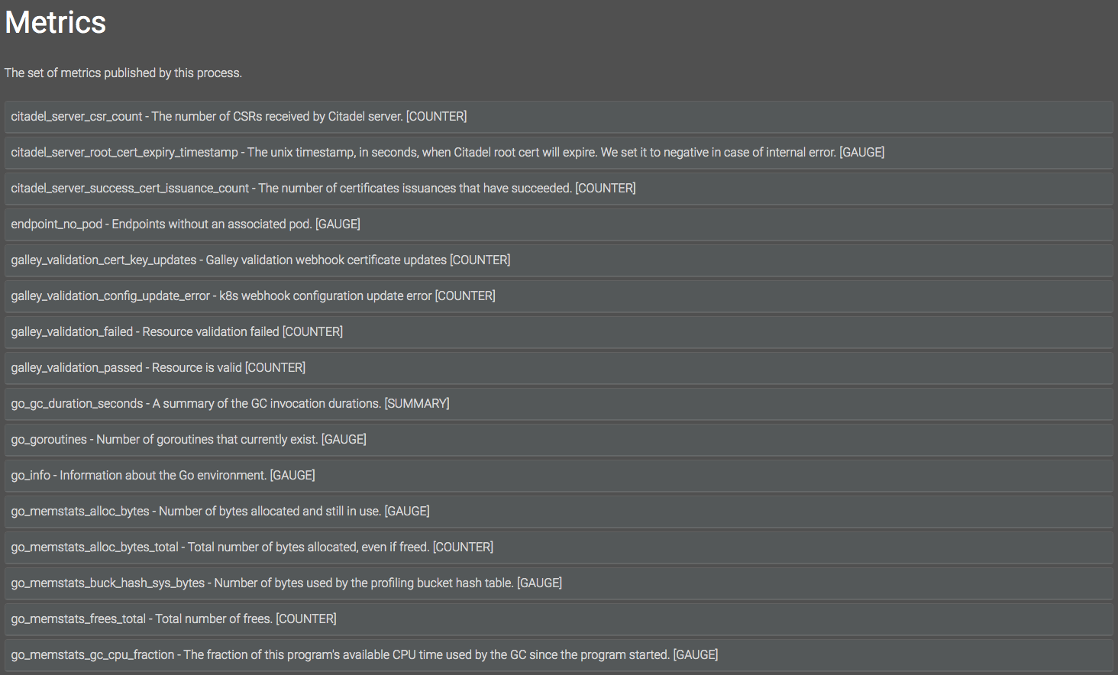
Istiod Metrics via ControlZ Dashboard

Slide 34
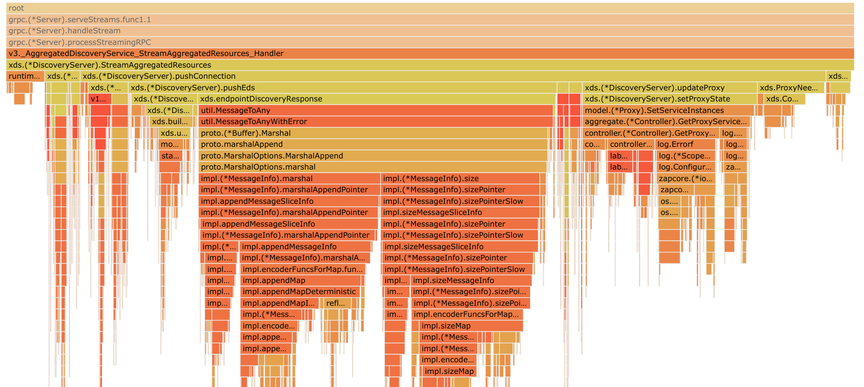
Profiling
Both control plane and data plane support profiling which can help identify CPU and memory usages.
go tool pprof -http=: localhost:8080/debug/pprof/<ENDPOINT>
profile: Captures 30s of CPU usage
heap: Captures in use and lifetime memory allocations
goroutine: Capture all goroutines in use

Slide 35
Istioctl Debugging Capabilities
Proxy status cluster-wide (Per-proxy view gives detailed config “diffs”)
Wait for config distribution (experimental)

Slide 36
Istioctl Configuration Analysis
Provides multi resource validation e.g. “Is a VirtualService tied to a Gateway that doesn’t exist”
Complete list of analyzers
Enable analyzer reporting via CRD status field

Slide 37
Common Problems

Slide 38
Scaling Istiod
Istiod can scale horizontally and vertically
Ensure CPU limit is disabled or give sufficient CPU
Throttling may lead to slow configuration updates
Use the latest Istio version!
Each release has substantial performance improvements

Slide 39
Factors for Istiod Scaling
Size of config to generate
Impacted by total number of services/pods & Istio resources
For large scale, Sidecar scoping is recommended to bring down size of config
Rate of change of environment
Every time a new Service is created or Istio configuration is changed full updates are sent to proxies
Adding new endpoints are cheap as only incremental updates are sent
Number of proxies for which configuration needs to be generated
Impacted by number of pods with a sidecar, and gateways

Slide 40
Unbalanced Istiod Load
xDS connection is a long lived gRPC stream
Makes load balancing challenging
Connection will close every 30m to slowly rebalance load
Quick scaling events may cause new instances to have small load
This can trigger HPA to scale up and down repeatedly
Running at least 2 replicas can help alleviate this issue

Slide 41
Webhook Issues
Validation webhook
Verifies that the configuration is valid
Called on each “kubectl apply” for any Istio resource
Viewing webhook configuration
Mutating webhook
Invoked every time a pod is created
If auto-injection is enabled, it injects the sidecar
Failures may block pod startup
To view errors, check “kubectl describe replicasets”

Slide 42
Webhook Issues
Ensure webhook validation is enabled
Webhook Certificate Issues
x509: certificate signed by unknown authority
Webhook exposed on HTTPS, CA certificate is in the webhook, updated at runtime by Istiod
Check “caBundle” to ensure its correctly set
Network connectivity issues
net/http: request canceled while waiting for connection (Client.Timeout exceeded while awaiting headers)
Check firewall rules - API server needs connectivity on port 443 (without --enable-aggregator-routing) or port 15017 (with --enable-aggregator-routing).
No available/ready “istiod” pod
with --enable-aggregator-routing: no endpoints available for service "istiod"
without --enable-aggregator-routing: dial tcp <istiod-service-ip>:443: connect: connection refused
Istiod Service does not exist
Service "istiod" not found
Check Istio installation
Notes:
Webhook listener not running in Istiod
dial tcp <istiod-service-ip>:443: connect: connection refused

Slide 43
Understanding mTLS
DestinationRule: what type of traffic is sent
mode: DISABLE sends plain text. Common for services outside of the mesh
mode: ISTIO_MUTUAL sends mTLS
mode: SIMPLE/MUTUAL can be used to originate TLS
PeerAuthentication: what type of traffic is accepted
mode: DISABLE accept only plain text
mode: STRICT accept only mTLS
mode: PERMISSIVE accept mTLS or plain text
Client
Server
Envoy
Envoy

Slide 44
Understanding Auto mTLS
Auto mTLS: what type of traffic is sent
If DestinationRule is configured, use DestinationRule settings
If server has a sidecar and PeerAuthentication allows mTLS, send mTLS
Otherwise, send plain text
PeerAuthentication: what type of traffic is accepted
mode: DISABLE accept only plain text
mode: STRICT accept only mTLS.
mode: PERMISSIVE accept mTLS or plain text.
Client
Server
Envoy
Envoy

Slide 45
Troubleshooting Guide
Step 1
Step 2
Step 3
Step 4
Step 5
Step 6
Step 7
Step 8
“istioctl analyze”
“istioctl proxy-status”
“istiod” logs
Access logs
Resp flags
Envoy
config dump
“istiod” metrics
“debug” logging
Profiling
Notes:
How routing works

Slide 46
Production Istio Installation
Metrics & logs from control & data plane
Setup alerts
Enable Access logs
Outbound traffic control
Strict mTLS instead of “auto”
Scale out control plane
Configure HPA
Configure pod anti-affinity
Non self signed CA certificates
Locking down Ingress GW ports
Auto sidecar injection
Production grade Prometheus & Jaeger

Slide 47
Questions?
Neeraj Poddar
@nrjpoddar
neeraj@aspenmesh.io

