Slide 1
Migrating Real-Time Communication Applications to Kubernetes at Scale: Learnings from 8×8’s Experience
Pankaj Gupta, Citrix PankajOnCloud
Lance Johnson, 8x8
Michael Laws, 8x8
AUGUST 12, 2020
Notes:
.

Slide 2
Microservices-Based Applications for Business Continuity
Read “A Pandemic Plan for Application Architecture” at https://tinyurl.com/K8sApp
Modular App Architecture
Faster Releases
Portability
Break application in small services, which can be developed, deployed and auto-scaled independently
Very frequent
application updates
(even many times a day)
Continuous delivery to automate deployment
Self-contained runtime
Application portability across clouds

Slide 3
Diverse Stakeholders Have Unique Needs
DevOps
SRE
Faster release & deployment cycles
CI/CD & automation
Canary & progressive rollout
Application availability
Observability
Incident response
Postmortems
Platform Team
Platform governance
Operational efficiency
Developer agility
Developers
NetOps
User experience
Troubleshooting
Microservice discovery & routing
Network policy & compliance
Manage, control & monitor network
Resources & capacity planning (visibility)
DevSecOps
Application & infrastructure security
Container security & API gateways
Automation
3
© 2019 Citrix | Confidential
Notes:
TO do this requires a unified approach to application delivery.
Today the application landscape and its respective delivery mechanisms is fragmented. Indeed, configuring the ADCs that will control the delivery is manual, time-consuming and error-prone
The Applications are distributed across different environments – on premises data centers, private clouds, co-location sites, public cloud infrastructure. While this may bring many advantages it creates challenges for admins whose job it is to ensure that the applications are put in front of the people that need them when they need them.
The different environments create silos that have different ways to do things.
It can be difficult to define and enforce security policies across so many environments
Especially when there is a lack of clear visibility into how the application is being delivered.
Further, all of these different environments have their own sets of tool which create fragmented trouble shooting capabilities.
What Is needed a consistent approach application delivery across the entire hybrid multi cloud. An approach to management that enables consistent, automated ADC configuration.
A capability that allows for consistent security policies to be defined, enterprise-wide and easily tracked and enforced
There needs to be a consolidated holistic visibility over all the applications, regardless of type, where it is deployed or what is fronting it.
This would then provide faster, intuitive trouble shooting from a single place that will allow the business to respond quickly to change and innovate more rapidly.
– What required is a consistent approach to application delivery across the entire hybrid multi cloud infrastrucutre
to take advantage of

Slide 4
Microservices App Delivery Solution Principles
Read “7 Key Considerations for Microservices-Based Application Delivery” at https://tinyurl.com/7Consideration
Architecture
Flexibility
Move at speed of your IT skill set
Balance benefits & complexity
Integrated With Your Platform & Tools
Get apps to production fast with vast K8s platform & opensource tools support
Performance
& Scale
Support large clusters & very dynamic microservices
Consistent App & API Security
Break the silos
of monoliths & microservices
Complete
Observability Stack
Gain visibility & troubleshoot problems faster, Break the silos
Production-Grade Solution at the Speed of Business
4
Notes:
This is exactly what Citrix application delivery management does.
It brings together the important aspects of application delivery to provide control for the business
It transforms configuration and monitoring of application delivery through automation.
ADM collects telemetry data about your ADCs as well as the applications they front across your entire hybrid multi cloud. It processes this data and gives valuable insight into the performance of your applications as well the status of your delivery infrastructure and the security of your systems all from a single place.
Because ADM is tracking all this data it makes it easier to troubleshoot more quickly.
ADM has intuitive, interactive dashboards that highlight issues proactively and enable you to drill down with a few clicks to isolate the root cause and take remedial action.
Configuration
Simplified, logical configuration
Automated, programmatic config changes
Insight
Simple, comprehensive visibility to applications and delivery infrastructure
Holistic across all environments
Comprehensive and actionable
Trouble shooting
Intuitive to use
Pro-active to get ahead of issues
Interactive to enable faster remediation

Slide 5
DevOps “Three Body Problem”

Slide 6
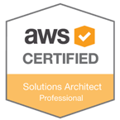
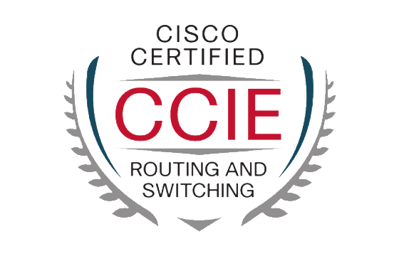
Introductions
Lance Johnson, Director of Engineering, Cloud R&D
https://twitter.com/johnsonrl
https://github.com/rljohnsn
https://www.linkedin.com/in/lancejohnsn/
Michael Laws, Sr. Site Reliability Engineer @8x8
https://www.linkedin.com/in/mikelaws/

Slide 7
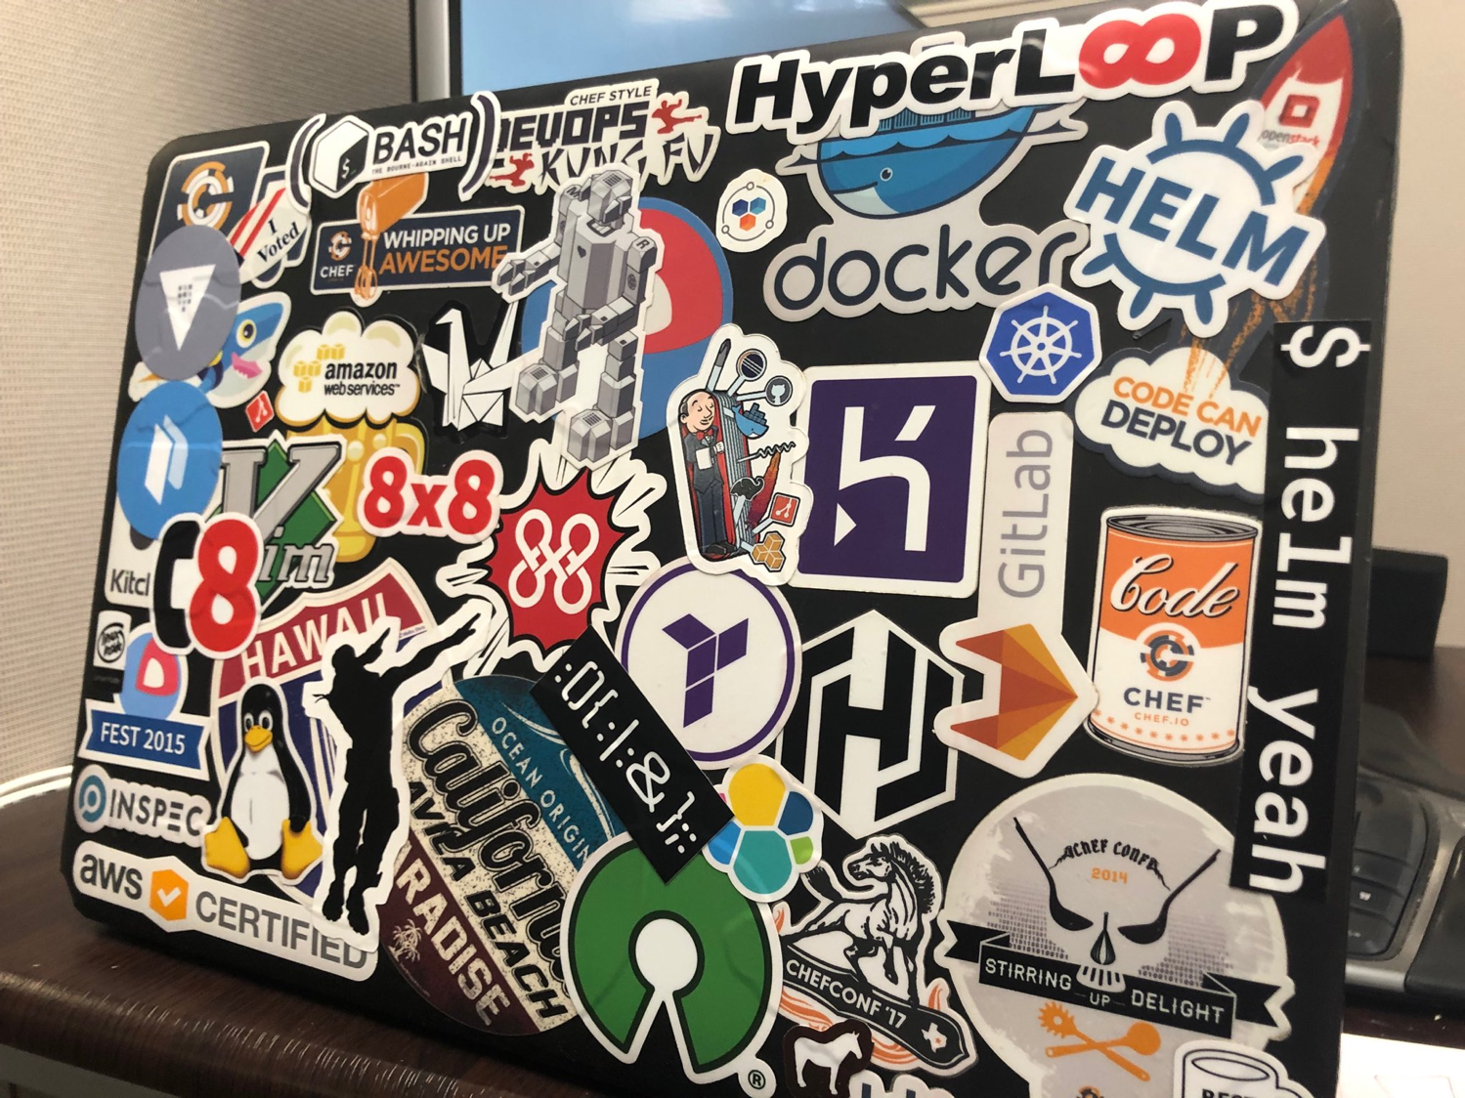
Metrics
Notes:
8x8 metrics
Regions
Applications
Customer metrics
Meetings

Slide 8
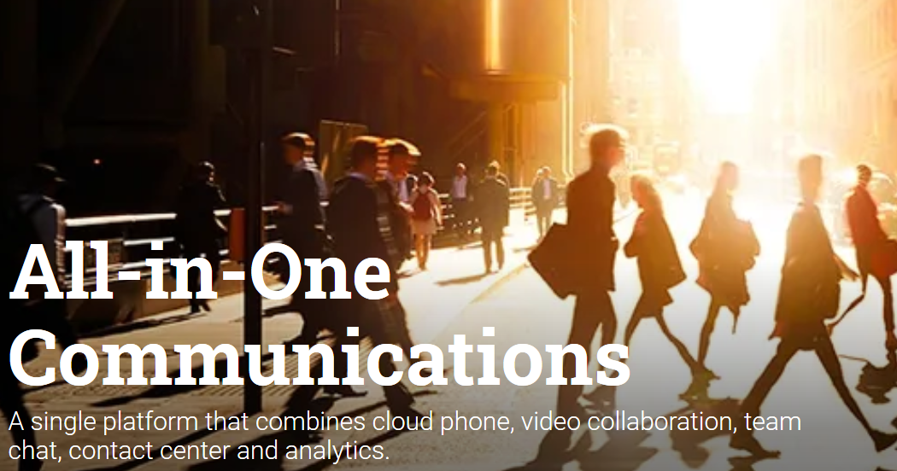
Unified Communications

Slide 9
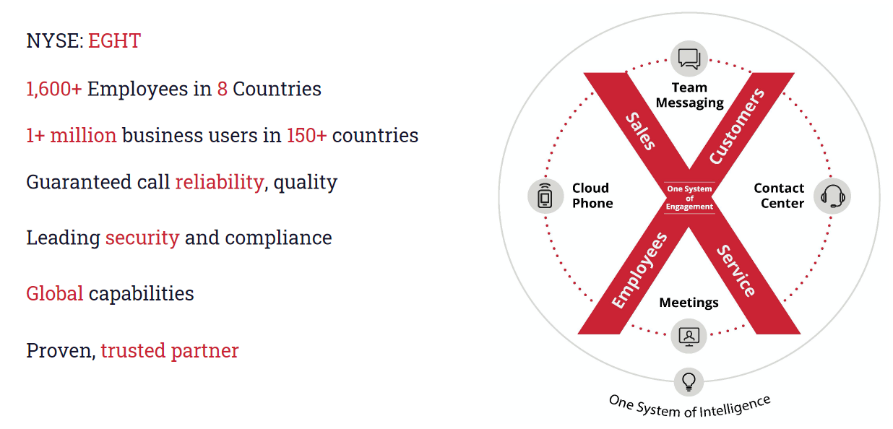
At a Glance
Notes:
8x8 metrics
Regions
Applications
Customer metrics
Meetings

Slide 10
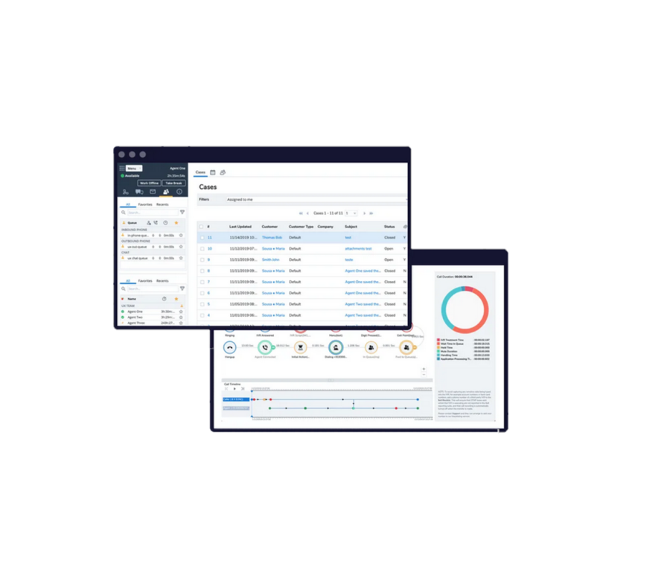
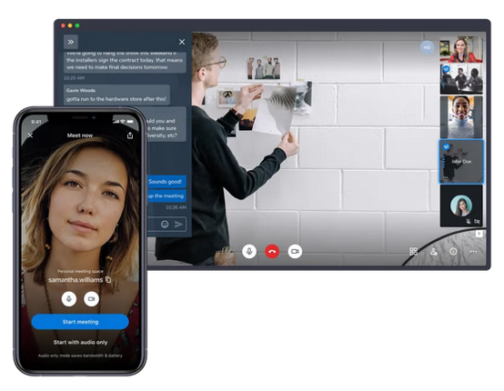
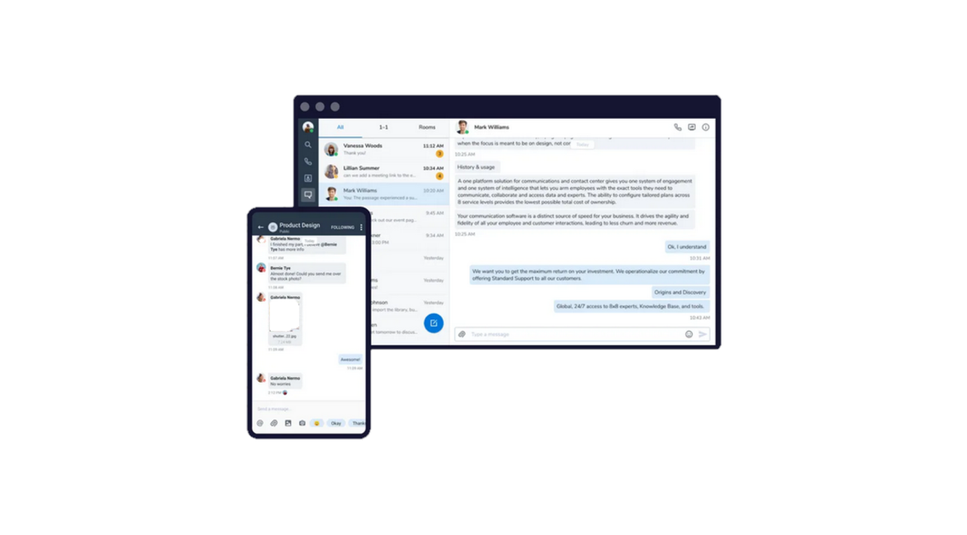
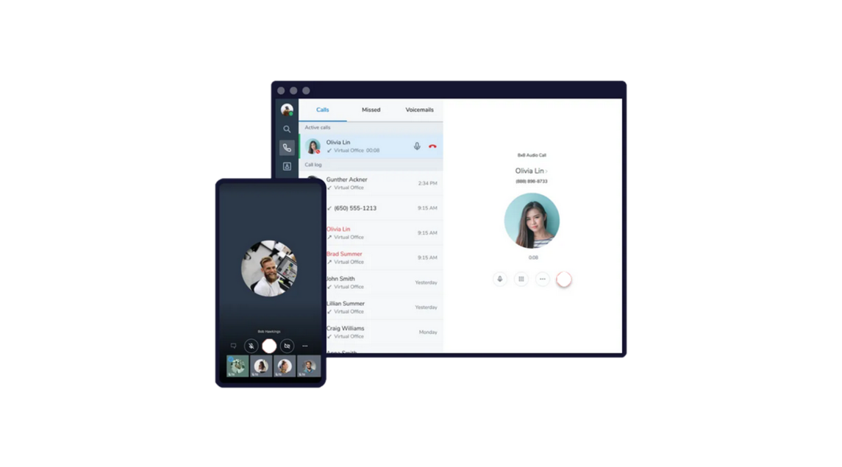
Unified Communications
Call Center
Meetings
Voice
Chat
Notes:
One service covering voice, video meetings, chat and call centers.
-combine slides 3 and 5 into a single slide

Slide 11
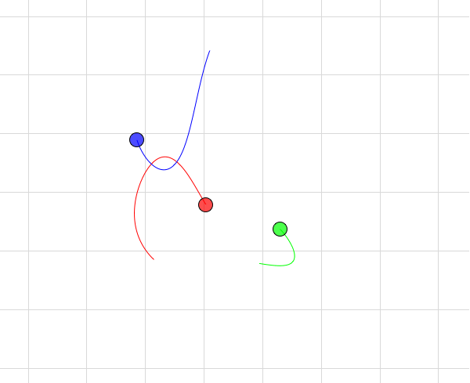
The Three Body Problem
Unsolvable mathematical problem
Notes:
Banner at the bottom with what the key take away is
Statement describing analogy

Slide 12
DevOps Three Body Problem
Deployments
Ssh
Jenkins Pipelines
HyperLoop
Ansible
Chef
Terraform
Cloudformation
Customers
DNS
LTM
GTM
Route53
Geo
Proxy
CloudFlare
Ambassador/Envoy
Dependencies
Data Centers
Clouds
Files
Databases
Random VPC
Public
Private
How did 8x8 approach the problem?
Notes:
How did 8x8 address the problem?
Key take away

Slide 13
“What is your Quest?”

Slide 14
DevOps Fundamentals
Safety
Provide a way for changes to be validated and tested.
Automation
Deliver the changes the same way for any environment
Knowledge Sharing
Learn from each other with open collaboration
Autonomy
Immediate visibility that changes deployed are safe
Continuously verified for every change

Slide 15
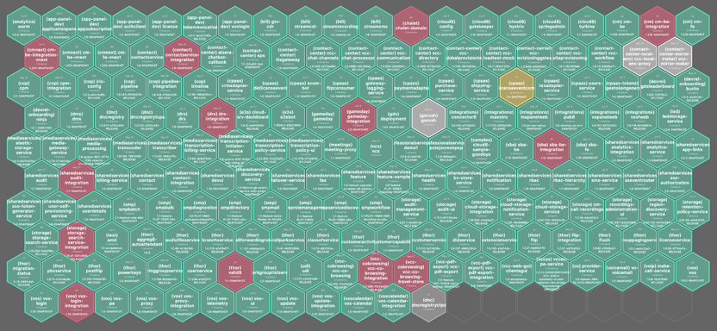
Adoption of Microservices: 100s of Them!
Why
Divide and conquer
Technology refresh
Team Autonomy
Which
Foundational Framework services (Cloud8)
Shared Services
Stateless Application Services

Slide 16
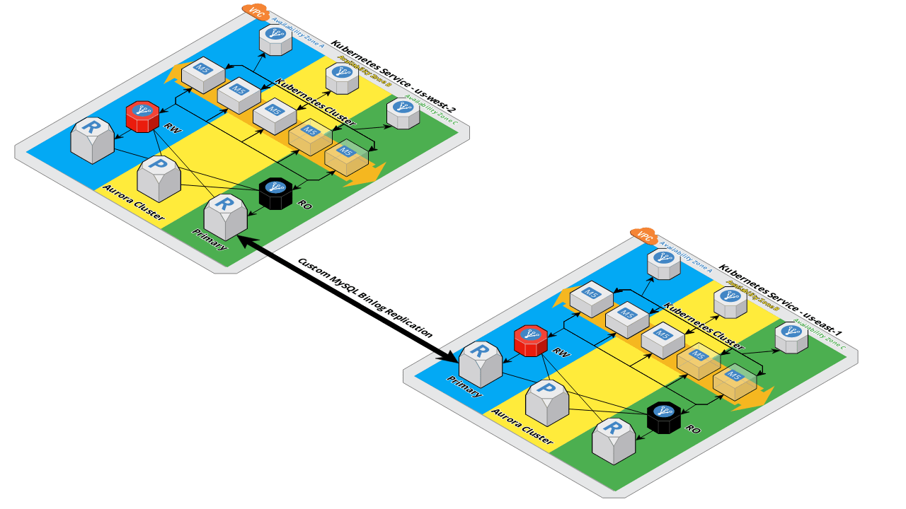
Design Goals
Uniform deployment regardless of environments
Service Discovery
High availability and automatic recovery
Container Packaging
Native Kubernetes
Public Charts
Scaffolding Charts

Slide 17
Deployment Environments - Cloud

Slide 18
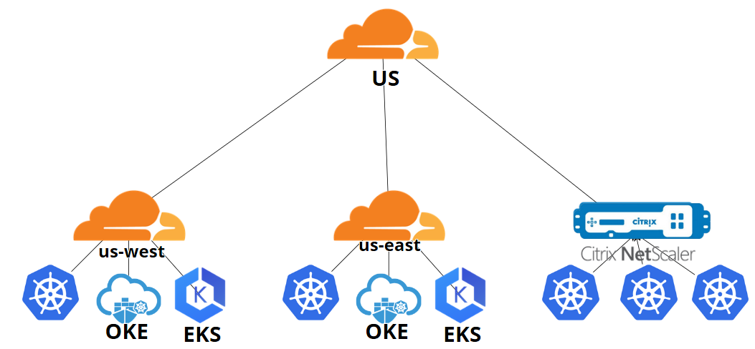
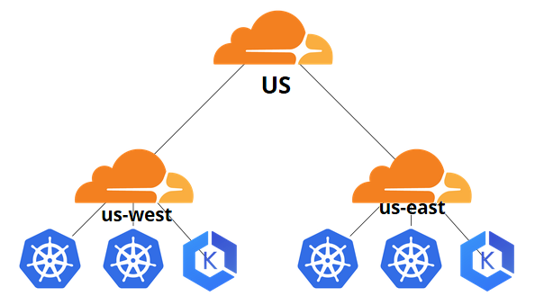
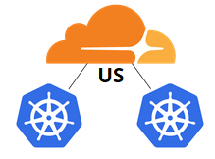
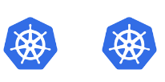
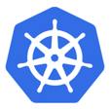
Deployment Environments - Hybrid

Slide 19
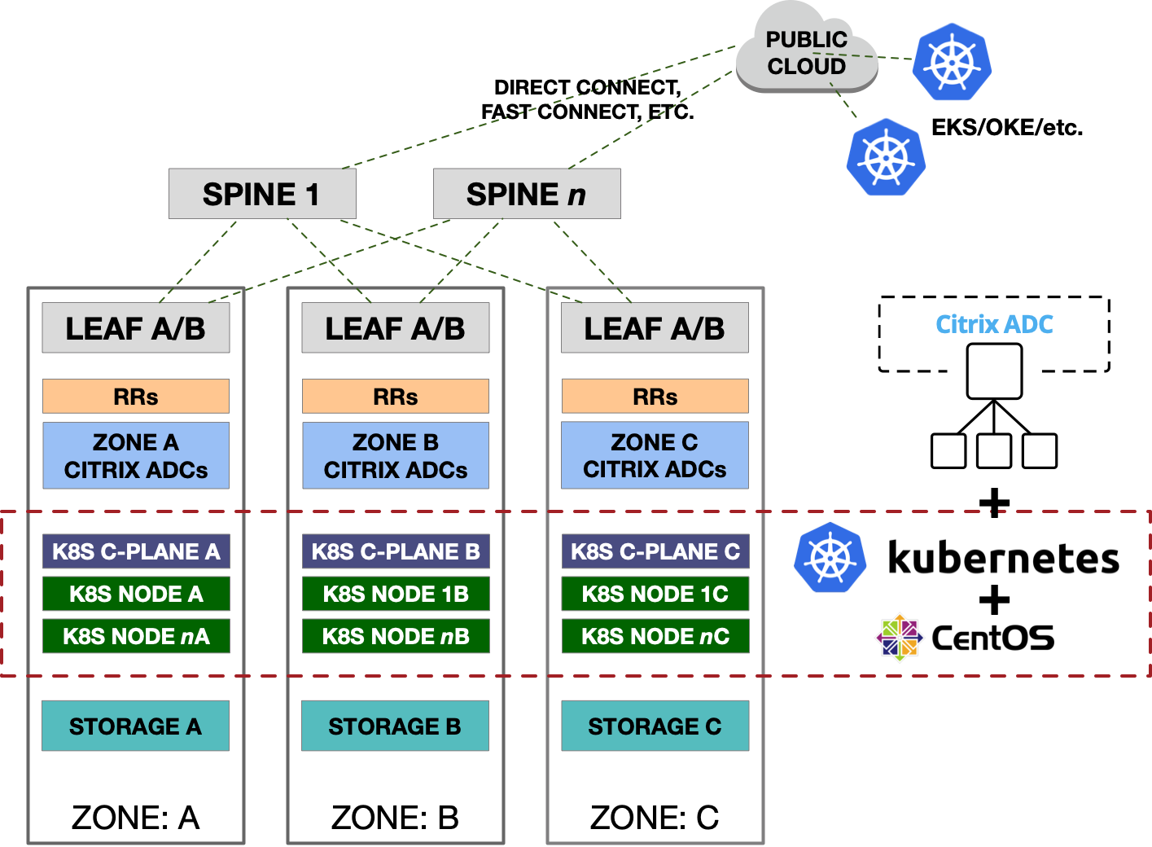
Deployment Environment - On Premise
* Mainline K8s (1.17+)
* L3 Leaf-Spine
* 3 Zones/DC
* Zone Storage
(& CSI Topology)
* BGP (Calico + Bird)
- Citrix ADC
- Route Reflectors
- BGP to Host

Slide 20
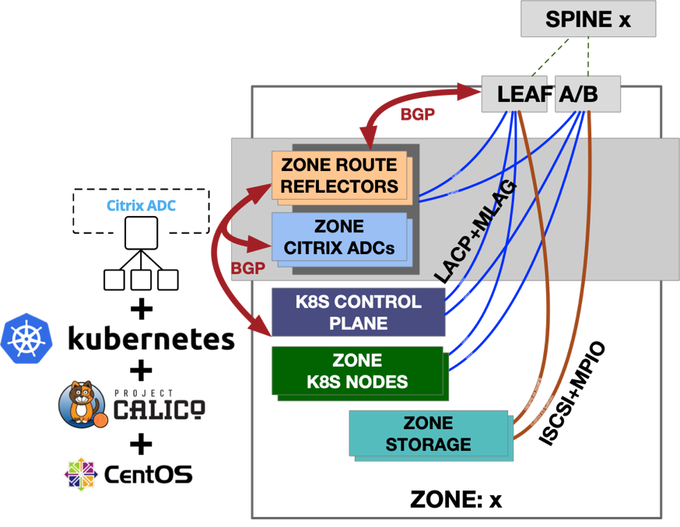
Deployment Environment - Anatomy of a Zone
Requirements:
* Horizontal Scale
* Zone isolation
topology.kubernetes.io/region=us-west
topology.kubernetes.io/zone=sjc01a
* Specialized network
Use-cases (DSR, ECMP, Anycast)
* Service IPs (VIPs) via BGP
* K8s-native APIs/resources
kind: Service
type: LoadBalancer

Slide 21
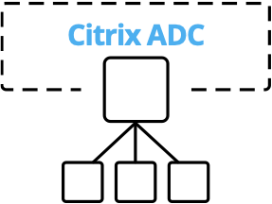
Load Balancing Tier - Citrix ADC
Key Decision Factors:
Supports Kubernetes Services and Ingresses (and Ingress Classes)
Supports Complex, Zone-Aware Infrastructures
Full-Feature BGP Support (e.g. Route Reflectors, Auth, RHI, ECMP)
Horizontal/Linear Scale (using VPX in VMware)
Rich Feature Support via CRD/Annotation (Cert Mgmt, Rules, Policy, IPAM, etc.)
Simple, Hands-Off, Reliable Deployment and Configuration
Flexible Licensing Options & Editions (MPX, VPX, CPX, etc.)

Slide 22
Recommendations
01
Choose your battles
Only stateless microservices initially
New framework from the ground up
02
Alignment
Strong collaboration between operations and development
Shared goals between teams
03
Self Service
Both engineering and operations could react independently
04
Cloud First
Started in the cloud for a uniform experience
100% of the resources were automatable
05
Reserve System Resources
System level, guarantee the OS a percentage
Namespace LimitResource defaults
Right size your workers

Slide 23
Recommendations
06
Embrace A Service Mesh
Telemetry
Better Security
Connect desperate clusters
07
Security
Limit kubectl usage
Helm safer
Cluster Role for a power user
08
Ingress vs Services
Use an ingress strategy
Saves money
Provides Telemetry
09
Common Logging Format
Simply it for the teams, send to standard out
Build into your framework or endorse a specific format
10
Centralize Metrics and Logs
Prometheus has vast library of existing dashboards
Collect and ship using Daemonsets
Newrelic with Pagerduty

