Slide 1
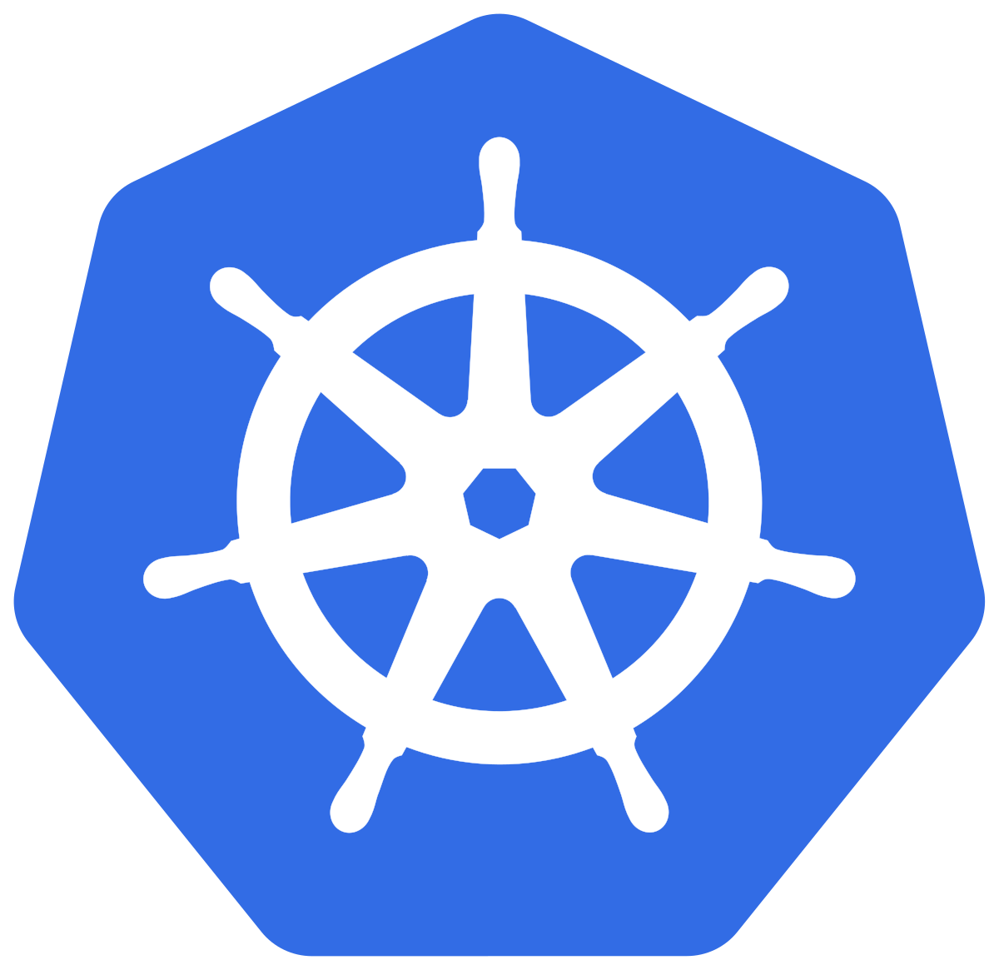
Kubernetes for Storage. An overview
Container Attached Storage
Built on Kubernetes for Kubernetes
A complete solution for the use of Kubernetes as a data plane
CNCF Webinar
July 16, 2020

Slide 2
Join us for KubeCon + CloudNativeCon Virtual
Event dates: August 17-20, 2020
Schedule: Now available!
Cost: $75
Register now!

Slide 3
Before we begin...
They say, It’s(CAS) is a sign
Varys tells Tyrion that on the streets it is called the Red Messenger.
The comet is interpreted differently by different people in Westeros and Essos.
To some, like Melisandre and Old Nan , it signals the coming of dragons.
Notes:
> Thank you so much for joining today! Before we get started I just wanted to make sure/remind that there is a comet out there and I hope you have seen it. And I just had to put in a GOT slide somewhere in here.

Slide 4
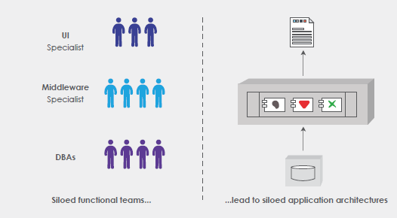
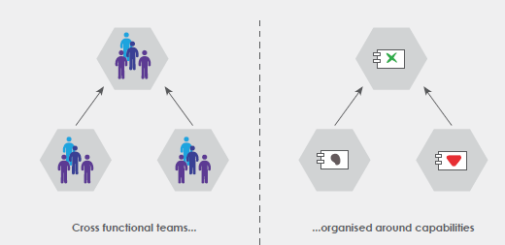
Conway’s Law for Software Development
Notes:
> I am going to be referring to Conway’s law a few times, and probably it is just worth stating that upfront for the benefit of those that have never heard it before.
Conway’s law states that the team structures reflect the system design = siloed/hierarchical teams tend to develop monolithic architectures and small (pizza) autonomous teams develop loosely coupled systems. Aka microservices, DevOps, Cloud Native patterns! If you like me are interested in learning about team cultures in cloud-native companies like Amazon, Netflix, Bloomberg - you will notice that they emphasize on having small autonomous and independent teams operating at great agility.
https://www.tothenew.com/blog/an-overview-of-microservice-architecture-part-i/

Slide 5
Your Presenters:
@kiranmova @muratkarslioglu @brian_matheson
kiranmova murat Brian Matheson
Kiran Mova
Chief Architect
Co-Founder
MayaData Inc
Murat Karslioglu
VP of Products
MayaData Inc
Brian Matheson
Developer Advocate
MayaData Inc
Notes:
> I am joined today by Murat and Brian - we all work at MayaData, which has always been a remote-first company with all of us distributed across the globe.
> As we present, you will probably notice how Conway’s law has manifested itself within our org helping us to form small autonomous teams. For instance - OpenEBS has several engines unlike many storage companies that just have a single engine.

Slide 6
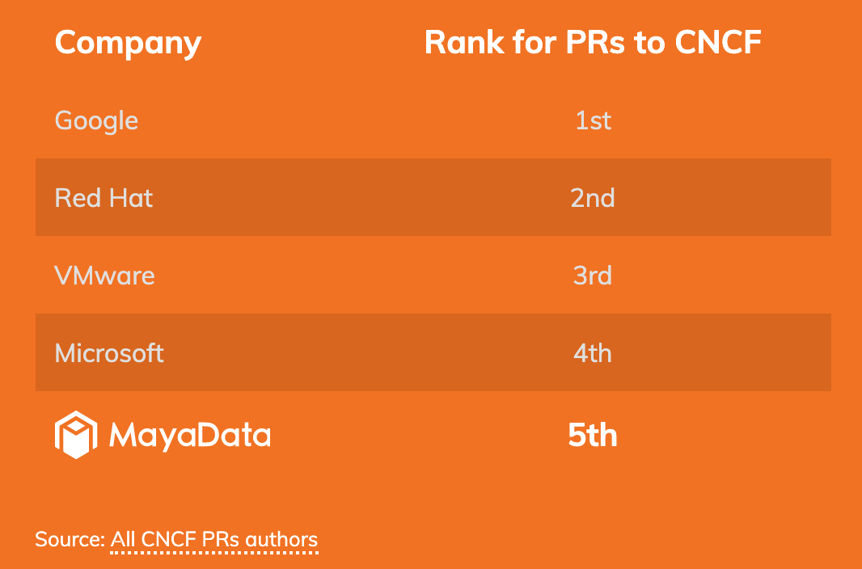
Who is MayaData? Popularity of OpenEBS?
Code is marketing
Contributing in CNCF ecosystem
19 CKAs & growing
4X yr/yr growth in container pulls
#1 CNS in trial per CNCF survey
Rapidly becoming the defacto standard for stateful workloads on Kubernetes
Notes:
> You may have not heard about MayaData but you must have come across the products that MayaData has helped develop. we are among the top 5 contributors to the CNCF which is attributed to the OpenEBS and Litmus projects that are now CNCF Sandbox projects. In addition, most of us are active in the Kubernetes space with a growing number of CKAs (probably a record for a startup) and several other eco-system projects like Velero and Kubernetes itself. My personal favorite is to make sure we maintain NFS Provisioner in the Kubernetes SIGs.
OpenEBS happens to be leading Container Attached Storage - choice.
Litmus is hugely popular among the developers and SREs to apply Chaos Engineering to Kubernetes applications in a Kubernetes native way.

Slide 7
Data On Kubernetes Community (DOKC)
DOKCs will be an openly governed and self-organizing group of curious and experienced operators and engineers concerned with running data-intensive workloads on Kubernetes.
The first DOKC talk will be held as a virtual meet-up July 21st and will feature Patrick McFadin, VP Developer Relations, DataStax.
Other companies that have volunteered to participate - Confluent, Arista, Yugabyte, Optoro, 2nd Quadrant
Demetrios Brinkmann
https://dok.community/
Notes:
> MayaData is also leading the efforts in building a community for Data on Kubernetes (DOKC). We are partnering with both management Kubernetes providers as well as Stateful Application vendors like Datastax and more.

Slide 8
Agenda
K8s for Stateful
Container Attached Storage (CAS)
Benchmarking Stateful workloads and Storage in K8s
And some resources you can use to do it yourself
K8s as Data Layer - Challenges and Best practices
Q and A
Notes:
> Here is a rough outline of what we are going to talk about. A quick review of the evolution of Stateful workloads in Kubernetes - followed by the changes in the technology and mindset of the operators and engineers that is forcing us towards a new pattern of building storage system - namely Container Attached Storage. Walk through some early adopter stories that can help answer some of your questions as well as present the results of some performance tests we have been carrying out.
It is a lot to cover, but we can always continue the discussions on the Kubernetes slack = #openebs channel, where most of us are online.

Slide 9
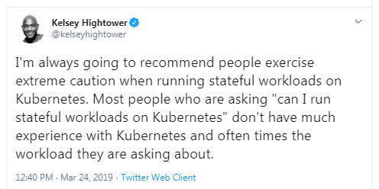
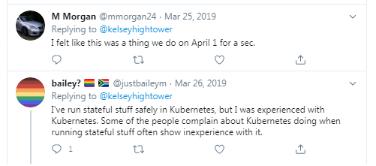
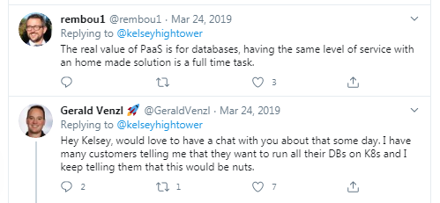
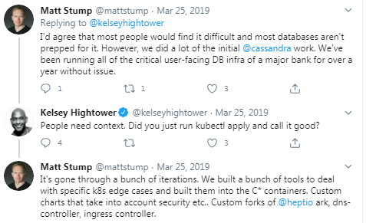
K8s for Stateful: A polarizing topic
Notes:
To speak about Stateful Workloads in Kubernetes remains an highly polarizing topic. While we all would love to see community grow in a vendor neutral way, the companies and the economics have a way to take over. Open Source has won, just like Internet has. It didn’t stop the browser wars. Kubernetes has won it, but the the State wars. There are several folks that are taking the Stateful workloads in different directions.
Cloud and Managed service providers would love to have the state within them (locked and paid for, obviously for better managed services). Data and the data transfer costs is how these large cloud providers can make money.
Stateful application vendors want to keep the management of state within them. We will talk more on this and the Rise of Local PVs later-on.
End users would love to maintain state in their private data centers
Then there is a cultural shift that is needed - that involves consultants and partners and developers..

Slide 10
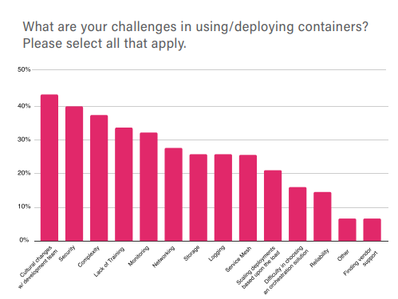
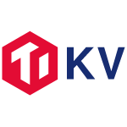
K8s for Stateful : A cultural shift
Notes:
> To be fair, even Kubernetes was looked at as another fad a few years ago. Skepticism is good, but so is the need for people to learn, evaluation, and make decisions for themselves. But open source communities and early adopters have a way of winning over the FUD.
In the last year, we have seen running data on Kubernetes as an increasingly common pattern - with several projects that manage state within Kubernetes or being Stateful applications move up the ladder towards graduation in CNCF.
CNCF does thorough due diligence on the projects under its purview and heavily relies on products being used in production by end-users.
Technology is here. It is the culture shift that is needed to adopt stateful workloads on Kubernetes.

Slide 11
PostgreSQL on OpenEBS Local PV
Notes:
https://www.2ndquadrant.com/en/blog/local-persistent-volumes-and-postgresql-usage-in-kubernetes/
Here are a few examples of users and database professionals that have transitioned to Kubernetes. For example this large PostgreSQL focused company did an indepth analysis and step by step instructions of running PostgreSQL on Kubernetes. Note that they used OpenEBS LocalPV which is one of the OpenEBS data engines we will discuss shortly.

Slide 12
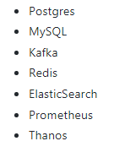
K8s for Stateful : More on Local PV
The vast majority of applications are able to better handle failover and replication than a block level device.
Instead of introducing another distributed system into an already complex environment, OpenEBS's Local PVs allow us to leverage fast local storage.
Additionally, by leveraging ZFS we are able to have encryption at rest for all of our workloads, compression, and the peace of mind of a COW based file system. OpenEBS has allowed us to not introduce a complicated distributed system into our platform.
The adoption has been smooth and completely transparent to our end users.
Notes:
https://github.com/openebs/openebs/blob/master/adopters/optoro/README.md
Here is another case where a large SaaS provider wanted to use fast local storage and wanted to leverage the application level for most of their replication. So again - they chose Kubernetes extended w/ OpenEBS. You'll notice that they had no interest in introducing a complicated additional distributed scale out system - meaning a storage system - under their kubernetes. We will come back to that as this is a theme we hear again and again.

Slide 13
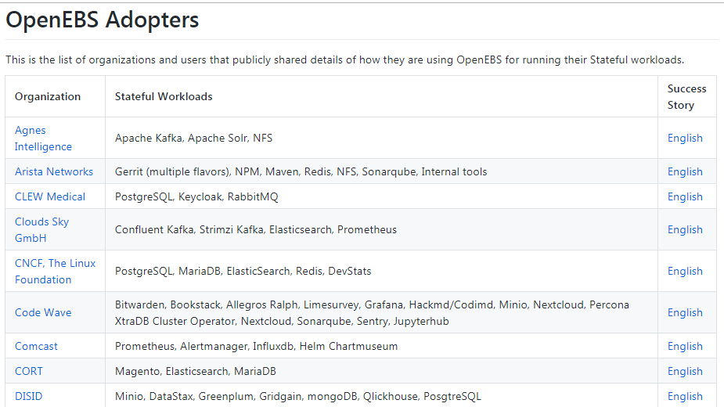
K8s for Stateful : Resistance is Futile
Notes:
https://github.com/openebs/openebs/blob/master/ADOPTERS.md
You can read a lot more about specific use cases on the OpenEBS community. Yes - the CNCF itself is a reference user. Many different examples and use cases

Slide 14
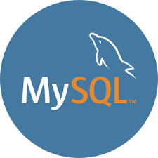
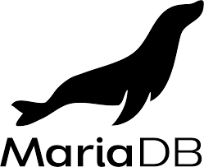
Example references and workloads

Slide 15
K8s for Stateful : The primitives
Native interfaces for connecting workloads (Pods) to Persistent Volumes (PVs).
Dynamic provisioning of PV via Persistent Volume Claim (PVC) and Storage Class (SC).
More abstraction through community efforts around Persistent Volumes (PV) and Persistent Volume Claims (PVC) and Container Storage Interface (CSI)
CSI to handle vendor specific needs and avoid wildfire of “volume plugins” or “drivers” in K8s main repo
Volume
In-tree Volumes
PV
PVC
Flex Volumes
SC
External Provisioner
Pools
CSI
Topology Aware
Data Source
Notes:
Kubernetes (or Borg) was not intended for stateful workloads. Once it become open source and more and more users and companies started adopting it for stateful, the primitives had to evolve. This is also another instance of Conway;s law at play. The cloud and storage providers are moving out of the Kubernetes repo and being independently maintained.
CSI is the best thing that has happened so far, and the Kubernetes and the Cloud Native community is continuing to make progress on the standard primitives that workloads would require. Join sig-storage or the data-protection workgroups if you are interested in contributing to the discussions or helping with new spec implementations.
IMO, the power of Kubernetes and CSI is not fully utilized yet.

Slide 16
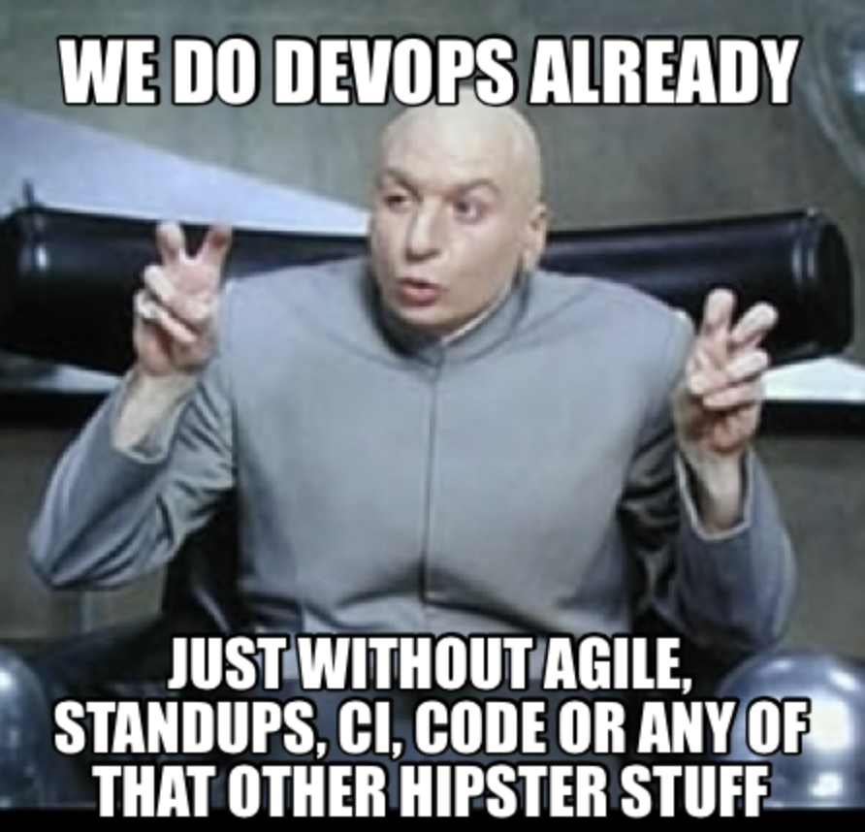
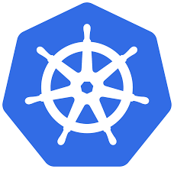
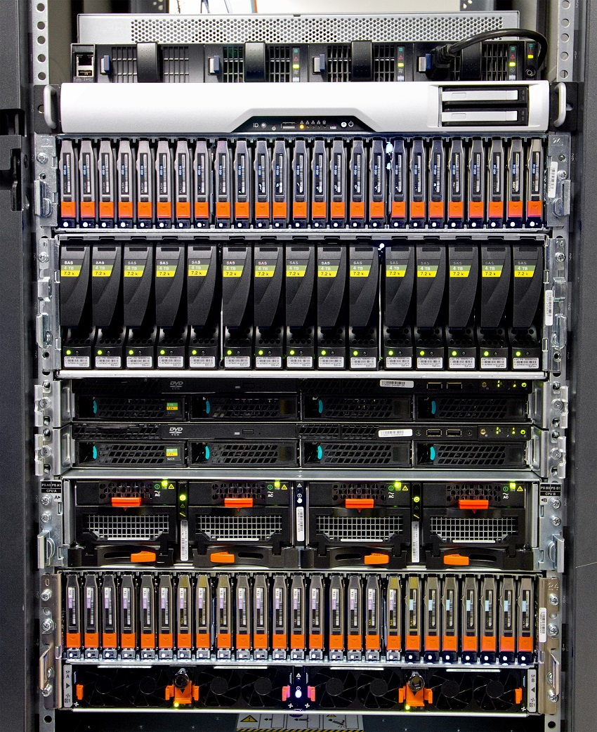
K8s for Stateful: Can’t I just?
UI
Micro service 1
REST API
Micro service 2
CACHE service
db2
db n
db1
Redis
CSI
Of course you can. And you do.
However you lose so many benefits of moving to Kubernetes.
Most workloads just use Direct Attached Storage instead.
Notes:
Yes - you can just connect your legacy storage array OR you storage managed service which practically speaking under the hood are the same idea. We won’t get into the detail here about this however - suffice it to say that you will then lose many of the benefits of Kubernetes and of the architecture you are intending to enable.

Slide 17
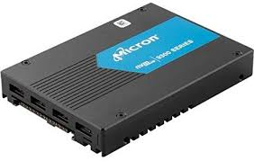
K8s for Stateful: What is inside that SAN?
UI
A shared storage system is a complex monolithic distributed system built before
Kubernetes
Micro service 1
REST API
Micro service 2
CACHE service
These systems have DBs for metadata
They have provisioning systems
They have retry & other logic
db2
db n
db1
Redis
They take all the IO, mix it together, and do their best
UI
Middleware
Designed when storage media was slow and apps were NOT resilient
DB
Notes:
And as a quick side note - did you ever consider what a legacy SAN actually IS?

Slide 18
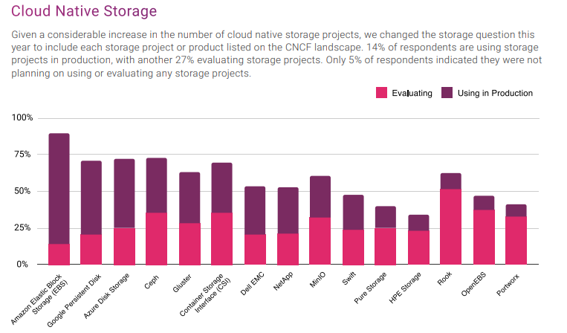
K8s for Stateful : CNCF Survey
Container Attached Storage most evaluated
Notes:
As you will seen the following slides, there is a lot of FUD around making sure users use the CSI to external storage model and thats how a lot of folks get started with their journey to Stateful workloads in Kubernetes.
They soon realize that managing the costs and managing the availability of those externally provisioned volumes - will create a dependency on the vendor or provider that is hard to break.
Have you noticed that most of the cloud vendors now provide (ephemeral) Local SSDs options to the Instances. This is not a co-incidence. Most Kubernetes nodes run Distributed workloads that can replicate and handle node failures themselves. They don’t need another distributed storage layer, that can potentially be a single point of failure.
This is where the container attached storage pattern is emerging in popularity. As you can see in this 2019 survey that folks have started evaluating the Open Source CAS patterns more than other options.

Slide 19
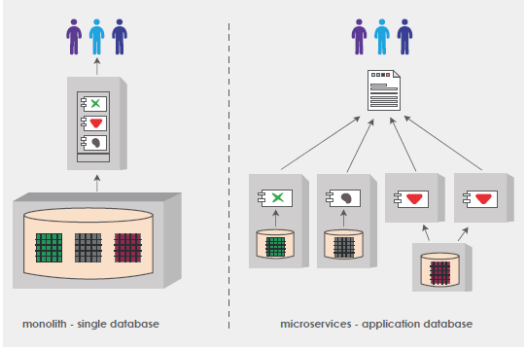
Conway’s Law for Data Management
loosely coupled teams
loosely coupled applications
loosely coupled data
Notes:
Application architecture has changed! and so are the demands on the underlying storage systems. Monolithic databases are being broken down into multiple databases - even picking the right database that really suits the needs of the service it servers. This freedom of choice in turn drives agility.
https://www.tothenew.com/blog/an-overview-of-microservice-architecture-part-i/

Slide 20
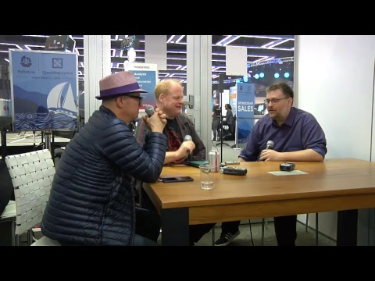
CNCF end user
Steven Bower at Bloomberg
Moved to Kubernetes in order to simplify and standardize their environments
CNCF end user of the year 18/19
Running dozens of different stateful workloads at scale
Believes in open source
Not about cost savings - about agility
Everything loosely coupled
Teams are autonomous and full stack
Does not use shared storage
Uses OpenEBS - different flavors
https://www.youtube.com/watch?v=0CEHN6ECaPs
https://www.youtube.com/watch?v=z_LbRfDKPvE
Notes:
Yet another link - you might find this interesting if you are not clear as to the importance of team autonomy and control.
> CNCF End User
This is one of the best videos I have seen on how a CNCF end-user, in this case, Steven Bower who is heading the Platforms team at Bloomberg, explains the benefits of moving towards Kubernetes and autonomous teams and running Stateful workloads in a loosely coupled way. Do check out the videos.
IMO Kubernetes has changed the job responsibilities of a typical operations engineers into becoming more automation engineers - could be writing terraform scripts or YAMLs to bring up infrastructures in a GitOps way. Automation is the key to building 10s of 1000s of autonomous teams.

Slide 21
Data Gravity - Lockin / Costs
As data grows — it has the tendency to pull applications towards it (gravity)
Everything will evolve around the sun and it dominates the planets
Latency, throughput, IO blender
If the sun goes super nova — all your apps circling it will be gone instantly
Some solutions involve replicating the sun towards some other location in the “space time continuum”
It works — but it exacerbates the problem
Notes:
> Data Gravity is this notation that the storage systems tend to pull the application towards them and they tend to only get bigger and bigger over time and almost become impossible to move away from them eventually.
Of course this in the interest of anyone that is in the storage business. In the past, I have worked with teams that were tasked with building data centers, and 60% of the cost was consumed by the storage system and most likely that hasn’t changed much. It could, but it hasn’t.
Also, the hardest problems that Operations folks hit is around keeping them systems up, when faults happen at the storage layer. Quay.io is a recent example.
If you see the popularity in the adoption of software-defined storage - the main driving factor was the promise that anyone can build storage using commodity hardware and it is not controlled by a few.
With the CSI connecting to a particular closed source storage system, the lock-in is just being shifted to either the Cloud Providers or the storage vendors.

Slide 22
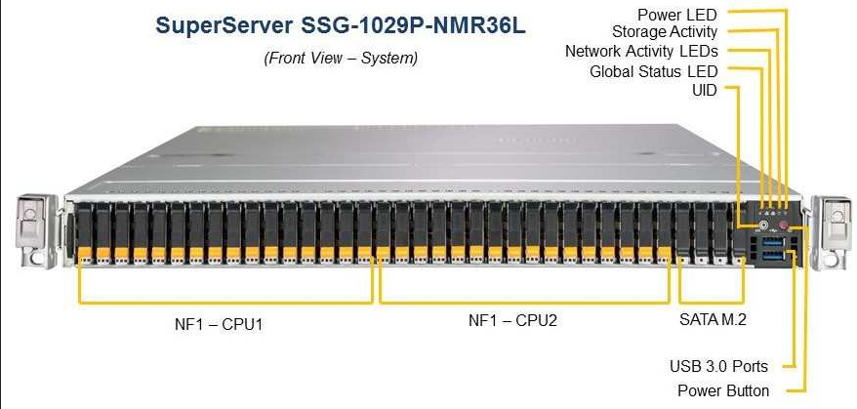
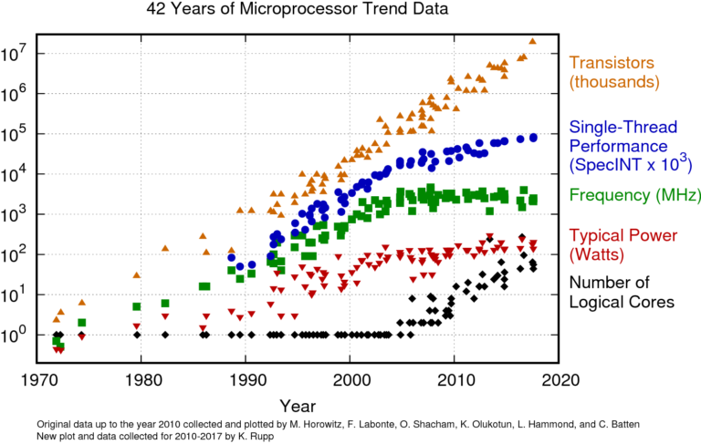
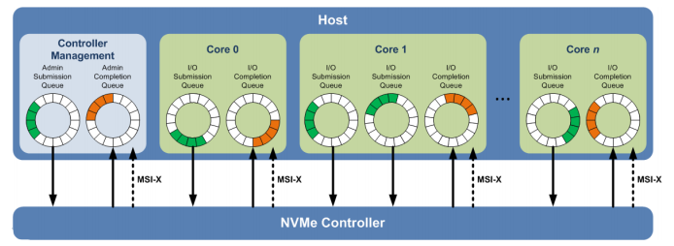
Under-utilization of Technology
https://github.com/karlrupp/microprocessor-trend-data
Notes:
> Hardware Trends
There is a significant increase in the number of logical cores that are packed into a single node. The node shown on this page is a super micro node with 96 cores and 1TB NVMe Flast.
Speaking of storage - to make use of the power of high capacity low latency solid-state drives and the availability of the cores, NVMe protocol has to be adopted that lets you increase the number of storage commands that you can process in a queue from 32 or 64 to 64K.
This doesn’t necessarily mean that you can apply a legacy program that was written for systems in 2000 will run at scale by putting on the new nodes. The application have to be rewritten taking into account the new concurrency primitives.

Slide 23
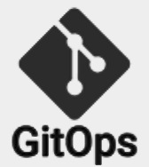
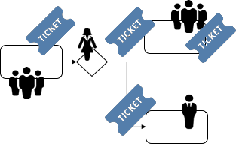
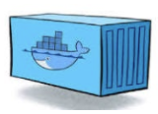
Summary - challenges around K8s storage
1
Conway’s Law
2
Costly lock-in
3
Process mismatch & 100x more dynamism
Shared everything
Per workload, per team
vs
vs
Traditional processes
Automated Kube - Ops
Data gravity
External storage
Container native
4
5
^{instructions}
External know-how required for traditional storage
Under-utilized K8s investment!
^{Storage sys.}
^{instructions}
SRE

Slide 24
Container Attached Storage
K8s Storage done right.

Slide 25
CAS : Apps have changed ...
Meta languages, Go, Rust,...
Apps are often distributed systems themselves
Is a distributed storage system still needed?
Designed to fail and expected to fail
Across racks, DC’s, regions and providers, physical or virtual
Scalability batteries included
HaProxy, Envoy, Nginx, Auto scaling
Loosely Coupled. Agility:
releasing frequently - always changing
Notes:
> Languages and Apps
Kubernetes has enabled writing applications in a much easier way using YAML. OK that is debatable, but I was mainly pointing towards Bellerina, Metaparticle. Go and Rust that have some pretty new concurrency primitives that help in building highly scaled systems. In fact, forcing rewrites of several software projects.
An interesting trend in the stateful application in the past few years has been to include high availability batteries within themself. They almost don’t need the distribution logic in the underlying storage systems. This also explain the rise in popularity of the Local PVs within Kubernetes.

Slide 26
CAS : Built for Cloud Native IO demands ...
Datasets of individual containers relativity small in terms of IO and size
Prefer having a collection of small stars over a big sun?
Multiple smaller databases than large databases (Conway’s Law)
Hardware Trends are changing
Built using low latency technologies
NVMe, DPDK/SPDK
Notes:
As the applications are becoming more distributed in nature, their demands in terms of the capacity per volume also have significantly come down. for instance I am currently working with an user who is refactoring their OLAP Database that needed around 100TB volume to 100 pods required 1TB volume per pod.
We spoke briefly earlier about the need for NVMe to fully utilize the powerful nodes that are at the users disposal. DPDK/SPDK is yet another technology that lets developers gain access to the power of the underlying hardware without having to go through or depending on the kernel calls.

Slide 27
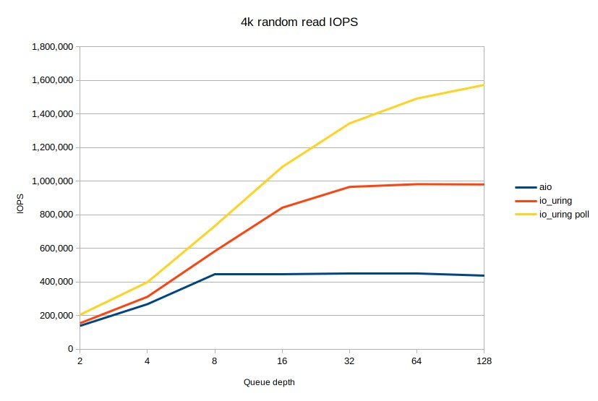
CAS: Ring based communication channels
One queue is used for submitting new requests
A separate queue is used to store requests that have been completed
Sometimes a third queue is used to submit admin commands
io_uring a new interface added to the kernel to “catch up” with the high speed devices, poll mode FTW.
Notes:
Another change is in the Linux kernel itself that shows the impact of how the poll mode driver implementation vs the async-io implementation deliver different results as the number of cores in the node increase.

Slide 28
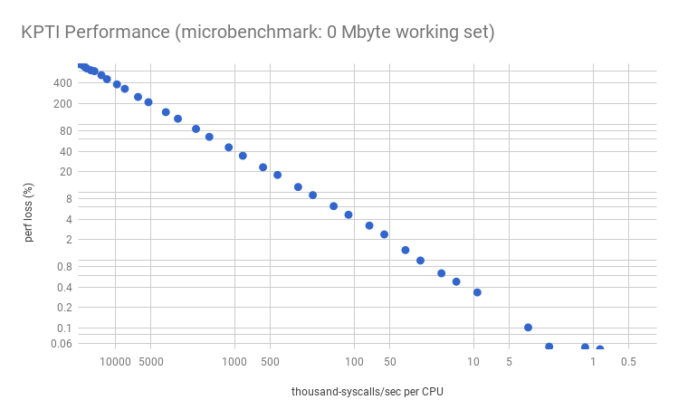
CAS: Hardware bugs and their impact
High number of system calls have a huge impact on performance
Two solutions to mitigate this:
Making use of huge pages
Try to do as much as possible in user space
Notes:
> HW Bugs Impact
This diagram from Brendan Burns showcasing the impact on the performance depending on the number of system calls made by the application is pretty interesting. This combined with the fact that hardware does have bugs and when you encounter them via the kernel it is pretty hard to fix.
The way to mitigate and scale-up is to move towards user space.

Slide 29
CAS: NVMe => Less is More
NVMe is a protocol that dictates how bits are moved between the CPU/device but also -- between devices
Its origin can be found with Infi Band used in HPC for many years (1999)
NVMe over Fabrics extends the protocol over TCP, RDMA, FC, virtio
A complete replacement of the SCSI protocol which goes back all the way to 1978
App
App
block layer
kernel bypass
SCSI
NVMe
SAS
SAS
SCSI
device
device
Notes:
The protocol for finds its origin from the HPC world and it enables fast transfer of data between the application and the device. When using NVMe, you can also completely by-pass the kernel/block layer by implementing around 9 APIs.
NVMe over Fabric - TCP and so forth is gaining popularity and is looking very promising to replacing iSCSI which has been around for a very long time and can become a bottleneck when you want to drive your performance up.

Slide 30
CAS: Impacts of HW changes on the stack
Packets come in at a very high rate, single CPU 100% how to scale?
CPU has ~67ns per packet @3GHz
Solution: spread across multiple cores which requires locking
Locks are expensive and locks are in memory which is 70-40ns away?
Amdahl's law starts to dominate the performance envelope
Context switches and system calls have gotten far more expensive post spectere meltdown
What we seem to need are lockless queues that scale per core
Poll mode drivers
Partial rewrites are inevitable, the rewards are high
ScyllaDB, VPP, Open vSwitch,
Notes:
These improvements in the underlying hardware changes are forcing some of the infrastacks to be re-written. for instance this captures the story of how the network switches are trying to benefit/scale the number of packets they process by using poll mode drivers.
Within the storage space - ScyllaDB is another example that has taken up the partial rewrite of their stack to deliver high performance using the latest hardware.

Slide 31
CAS : Pattern - Distributed Apps
App (R1)
App (R2)
App (R3)
PVC 1
PVC 2
PVC 3
Hostpath
Block Device
Local ZFS / LVM
Local PV 3
Local PV 2
Local PV 3

Slide 32
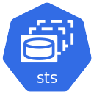
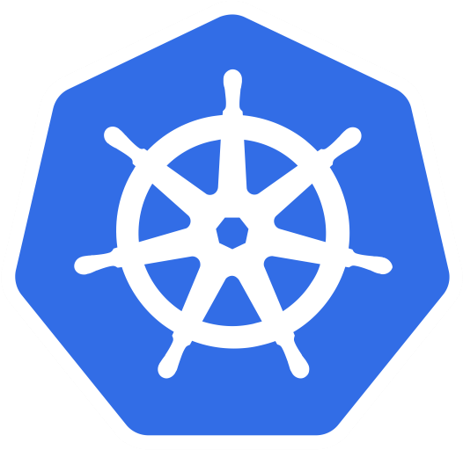
Connect a Stateful App to OpenEBS LocalPV
Internet
NDM knows if disk is in use
LocalPV Device
Node 1
STS with Node Selectors
Application Namespace
Physical Hard disks
Creates volume in user defined ZFS pool
ZFS LocalPV
Node 2
ZFS Pool
LocalPV HostPath
Node 3
WaitForFirstConsumer
Persistent Volume for Application
XFS or EXT:
Create LocalPV StorageClass

Slide 33
CAS : Pattern - Replicated and Isolated
App
PVC
Jiva/Longhorn
PV (Target)
cStor
Mayastor
Replica 1
Replica 2
Replica 3

Slide 34
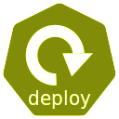
Connect a Stateful App to OpenEBS cStor Storage
Internet
OpenEBS Namespace
Application Namespace
Physical Hard Disks
cStor Replica Pods
iSCSI Target
(PV)
Stateful Application Running Inside Pod in Kubernetes
Persistent Volume for Application
cStor Replica Pod with 8 Disks
Create a cStor StorageClass
cStor Replica Deployments (nodeSelectors)

Slide 35
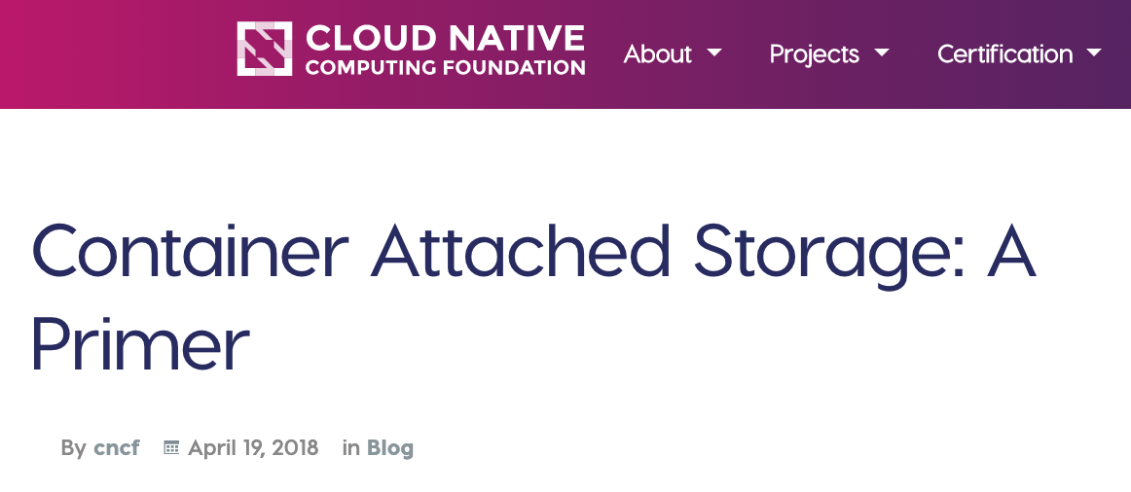
CAS - using K8S as a data layer
UI
Micro service 1
REST API
Every workload & team its own system
Micro service 2
Different engines for different workloads
CACHE service
Built on Kubernetes for Kubernetes
db n
db2
db1
Delivers the benefits of for data
No lock-in
Open source
Runs consistently everywhere
Any underlying cloud or disk or SAN
Redis
AND the right architecture for NVMe
Notes:
What if we “kept it in?”

Slide 36
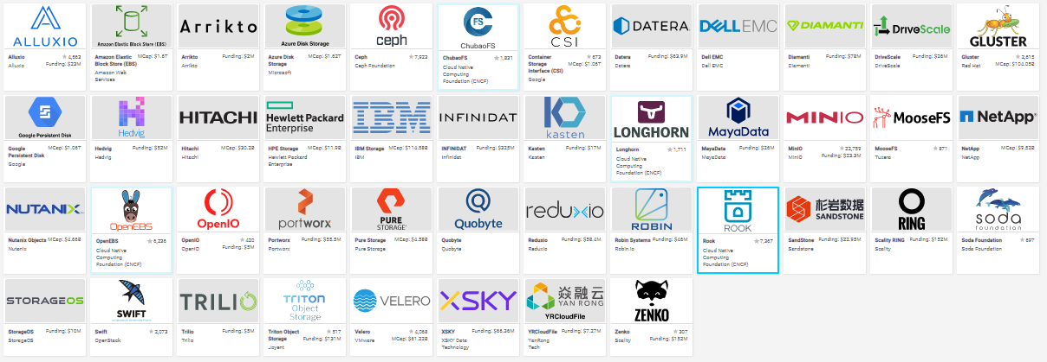
CAS Examples on CNCF Landscape

Slide 37
Summary - Unleash the power of K8s with CAS
Based on OpenEBS, Open Source,
5th largest CNCF contributor
Compute
Built on Kubernetes for Kubernetes
^{Storage.}
Data
^{instructions}
SRE focus on K8s, and K8s only
Network
Container attached storage using disk within the K8s cluster.
Workload-down storage - ideal for small micro ‘2 pizza’ teams
Avoid Lock-in
Cross Cloud visibility
Multi-platform abstraction
50-70% reduced storage TCO
High Availability - limited blast radius
Data portability and no gravity issues
Native Hyperconvergence: Truly Cloud Native Storage for Kubernetes
Notes:
To work within the Kubernetes StorageClasses framework, to power and unleash the best of Kubernetes and make it a data plane - in the most invisible manner, so to an SRE, OpenEBS is just another application within Kubernetes, and not ‘storage.’ This aligns perfectly to the promise Kubernetes offers of developer-friendly, SRE efficient, control plane

Slide 38
CAS : What about performance?
For low latency workloads - that are already distributed in nature - use different flavors of OpenEBS Local PV.
cStor (though it is relatively slow due to its strict consistency checks), fares well in workloads that are not very IO intensive. Have users running 50+ workloads on cStor in 3 node cluster.
Mayastor - specifically targeted for low latency workloads operates at Local PV - low latency numbers - while maintaining strict consistency and offering storage services.

Slide 39
CAS: OpenEBS Mayastor 0.2.0 - ALPHA
https://www.youtube.com/watch?v=_5MfGMf8PG4
100% user space implementation
Crucially important to avoid cloud dependencies; ubuntu-GKE != ubuntu-AWS
Leverages poll mode drivers and auto detects uring support
The Nexus supports several storage protocols and can be used with existing iSCSI, NVM-oF targets and local storage
Can do n-way mirrors i.e iscsi://<host>/iqn + nvmf://host/nqn + file:///dev/sdb
Also API driven, i.e write to NVMe directly by passing the kernel

Slide 40
Container Attached Storage
Performance Benchmarking
Ben Hundley
https://getoctane.io/
Solving costs on Kubernetes

Slide 41
Performance Benchmarking - Test Details
Kubernetes Cluster Details
m5ad.2xlarge on AWS (8 cores, 32GiB RAM, 300GiB NVMe SSD)
Kubernetes 1.16.8
Amazon Linux 2
FIO and pgbench
Fio profiles for Postgres were generated with pgbench and blktrace.
Fio command to replay the profile.
https://github.com/openebs/performance-benchmark/tree/master/benchmark-tool

Slide 42
Performance Benchmarking - CAS
Tuning the nodes for performance - as part of your Terraform / Ansible
Test for scale - number of workloads
Day 2 Operations in Progress
Noisy neighbour / Load
Chaos

Slide 43
Per workload Benchmarks
(*) Default settings without iSCSI/cStor tunables
(**) NVMeoF offers 2-3x more performance.

Slide 44
Application Benchmarks
 | IOPS |  | Throughput (MiB/s)
 | Read | Write | Read | Write
OpenEBS Hostpath | 10200 | 16300 | 79.9 | 252
OpenEBS Device | 9042 | 14500 | 71 | 224
OpenEBS cStor* | 1383 | 2214 | 10.9 | 34.3
OpenEBS Mayastor** | 10200 | 16200 | 79.5 | 251
(*) Default settings without iSCSI/cStor tunables
(**) NVMeoF offers 2-3x more performance.

Slide 45
FIO
(*) Default settings without iSCSI/cStor tunables
(**) NVMeoF offers 2-3x more performance.

Slide 46
FIO
(*) Default settings without iSCSI/cStor tunables
(**) NVMeoF offers 2-3x more performance.

Slide 47
Container Attached Storage
Data Agility

Slide 48
Data Protection
UI
Micro service 1
REST API
Micro service 2
S3 storage
CACHE service
db n
db2
db1
Redis
DMaaS
CSI
CSI
Per workload storage
Per workload backup
Per workload management
Seamless integration w Optane & bare metal & CSI provisioned clouds and legacy storage

Slide 49
Kubera = Kubernetes as your data layer
Stateful Applications
Kubernetes
Kubernetes without OpenEBS & other extensions limited in data capabilities
Kubernetes APIs
D2IQ Konvoy
Amazon EKS
Azure AKS
Google GKE
VMware Tanzu
Policy based storage
Backup and DR
Policy and environment based application granular placement of PVs
Application and data availability.
Compliance & Governance
Monitoring & Actions
Management of data ACLs.
Anomaly detection and proactive config optimization optimized for data

Slide 50
Kubera = Multicloud Data Agility toolset
Off-cluster Log Storage
Turn K8s into data layer
Visualize and Monitor Kubernetes Topology
Data Protection & DR
https://account.mayadata.io/login

Slide 51
MayaData Kubera
Advanced Anomaly Detection
Adaptive Backup and Restore
Unlimited Alerting
Workload Lifecycle Management
AD Authentication
Mutl-vendor Data Management
Active Health
Check
K8s Data Management
CPU and I/O performance budgeting
Granular visualization
Automated Deployment
Performance monitoring
Capacity reporting
Managed resilience SLAs
OpenEBS Litmus
Many more CNCF projects ...
Workload Backup
ChatOps
Air Gapped
Pre-flight check
AI Ops
Open Source
Guided Benchmark
Application discovery
Kubera BASIC
Advanced compliance
Provisioning, configuration templates
Bug fix support
GitOps
Topology Views
Kubera STANDARD
Advanced Workload Back-up
OnPrem
CSI Lifecycle Management
Long life support
1yr log retention
Kubera ENTERPRISE
Chaos Engineering
Adaptive Cost Management
Managed Backup
Proactive DR
Unlimited Team Management
Notes:
To work within the Kubernetes StorageClasses framework, to power and unleash the best of Kubernetes and make it a data plane - in the most invisible manner, so to an SRE, OpenEBS is just another application within Kubernetes, and not ‘storage.’ This aligns perfectly to the promise Kubernetes offers of developer-friendly, SRE efficient, control plane

Slide 52
Conway’s Law
Small teams
Small workloads
Loosely coupled
Different engines per workload & per team
Operations - automated
K8s as data layer
24 / 7 support
SaaS & on premises
Any Kubernetes
100% user space

Slide 53
Data On Kubernetes Community (DOKC)
DOKCs will be an openly governed and self-organizing group of curious and experienced operators and engineers concerned with running data-intensive workloads on Kubernetes.
The first DOKC talk will be held as a virtual meet-up July 21st and will feature Patrick McFadin, VP Developer Relations, DataStax.
Other companies that have volunteered to participate - Confluent, Arista, Yugabyte, Optoro, 2nd Quadrant
Demetrios Brinkmann
https://dok.community/
Notes:
> MayaData is also leading the efforts in building a community for Data on Kubernetes (DOKC). We are partnering with both management Kubernetes providers as well as Stateful Application vendors like Datastax and more.

Slide 54
Q and A
Kubernetes Slack #openebs

Slide 55
Storage Operations fades away!

Slide 56
LocalPV Device: Performance with Isolation
Label Devices you want to consume directly like this:
openebs.io/block-device-label=\
STORAGE_CLASS_LABEL
Internet
LocalPV Device
Storage Node 1
STS with Node Selectors
Application Namespace
LocalPV Device
Storage Node 2
Physical Hard disks
LocalPV Device
Storage Node 3
Physical Hard disks
Physical Hard disks
Stateful Application Running Inside Pod in Kubernetes
Persistent Volume for Application
Why LocalPV Device?
Native Device Performance
Same Developer Experience
IO isolation
Create LocalPV Device StorageClass with bd label

Slide 57
ZFS LocalPV: Aggregation and Dynamic Sizing
Internet
ZFS Pool for dynamic vols
ZFS Pool
LocalPV Device
Storage Node
STS with Node Selectors
Application Namespace
Physical Hard disks
Dynamically created ZFS Volume
Stateful Application Running Inside Pod in Kubernetes
Persistent Volume for Application
Why ZFS LocalPV?
Aggregate disks for large volumes
Same Developer Experience
Great for many small volumes
Create ZFS LocalPV StorageClass

Slide 58
Connect a Stateful App to OpenEBS cStor Storage
Internet
OpenEBS Namespace
Application Namespace
Physical Hard Disks
cStor Replica Pods
iSCSI Target
(PV)
Stateful Application Running Inside Pod in Kubernetes
Persistent Volume for Application
cStor Replica Pod with 8 Disks
Create a cStor StorageClass
cStor Replica Deployments (nodeSelectors)

Slide 59
cStor IO Path
Aggregates hard disks in the replica pods
Exposes volumes at iSCSI target / controller svc
Attaches volume to application worker node
Mounts filesystem and binds to application pod
OpenEBS Namespace
Application Namespace
iSCSI Target
(PV)
cStor replica Pods
cStor custom block protocol
iSCSI
OS Driver

Slide 60
cStor vs Mayastor IO path
Mayastor / cStor
sequential read 2-way mirror: (groupid=0, jobs=1): err= 0: pid=32573: Thu Feb 13 21:23:41 2020
read: IOPS=79.2k, BW=309MiB/s (324MB/s)(9280MiB/30002msec)
sequential write 2-way mirror: (groupid=1, jobs=1): err= 0: pid=32651: Thu Feb 13 21:23:41 2020
read: IOPS=77.8k, BW=304MiB/s (319MB/s)(9115MiB/30002msec)
random write 2-way mirror: (groupid=2, jobs=1): err= 0: pid=32718: Thu Feb 13 21:23:41 2020
write: IOPS=47.6k, BW=186MiB/s (195MB/s)(5582MiB/30003msec)
random read 2-way mirror: (groupid=0, jobs=1): err= 0: pid=1020: Thu Feb 13 21:23:41 2020
read: IOPS=76.9k, BW=301MiB/s (315MB/s)(9017MiB/30002msec)
New
Storage Engine for
Performance with Features.
Same
Declarative,
Composable Data Plane with
Developer Friendly Mgt and
API-Driven Orchestration.
Low latency for NVME, flexible enough to work with anything

