Slide 1
Maximizing M3:
Pushing performance boundaries in
a distributed metrics engine
CNCF Member Webinar 2020

Slide 2
/usr/bin/whoami
Ryan Allen
Senior Software Engineer @ Chronosphere
Formerly at Applied Predictive Technologies (APT)
LinkedIn
Notes:
Chronosphere is a highly scalable hosted metrics platform that runs on M3 and that provides alerting and monitoring, compatible with Prometheus and also has tracing integration that lets you go from metrics graph to exact trace.

Slide 3
Monitoring: what is a metric?
Schema for data you would like to collect and aggregate
Name
http_requests
Dimensions/Labels
endpoint (e.g. /api/search)
status_code (e.g. 500)
deploy_version_git_sha (e.g. 25149a04c)

Slide 4
Problem 1: Scale
ID | Timeseries
1 | __name__=cpu_seconds_total, pod=foo-123abc
8 | __name__=memory_memfree, pod=foo-123abc
33 | __name__=cpu_seconds_total, pod=foo-456def
44 | __name__=memory_memfree, pod=foo-456def
45 | __name__=cpu_seconds_total, pod=bar-768ghe
58 | __name__=memory_memfree, pod=bar-768ghe
 | … millions .. and if you are unfortunate... billions
Timeseries from lots of hosts and container pods

Slide 5
Problem 1: Scale
1. We have monitoring, it’s awesome and developers are happy with standardized metrics mostly.
2. Developers put custom metrics on everything and I am deploying tons of applications in something like Kubernetes, things are ok!
3. Things are on way too on fire, we can’t manage this many things anymore, can everyone just stop please.
???
??

Slide 6
Problem 1: Scale
Grafana
Single node execution
Read all index segments relevant to this time window and data chunks for time windows included by query, if too much index data then can’t hold it entirely in memory.
Other Prometheus Remote Storage Query Service
S3
S3
S3

Slide 7
Problem 2: Reliability
Single node metrics solutions susceptible to outages
Metrics monitoring infrastructure cannot go down… otherwise you lose visibility into your actual infrastructure

Slide 8
M3: Scale
Grafana
Map/reduce execution
Find metrics matching query and return in parallel knowing
exactly where to extract series data from local store.
M3 Query
m3coordinator
M3DB Node
M3DB Node
M3DB Node
M3DB Node
...
Cloud Disk/ Storage
Cloud Disk/ Storage
Cloud Disk/ Storage
Cloud Disk/ Storage

Slide 9
M3: Reliability
Designed for high reliability & scale
Regionally available for writes/reads
Zero-downtime upgrades, restarts, withstand entire replica failures
Able to be deployed multi-region and join data at query time across regions transparently
At Uber warehouses more than 1PB of metrics data (10B series), storing 40million datapoints per second (3.4 trillion a day)
Zone A
M3DB
M3DB
M3 Coordinator
M3DB Rep #1
Prometheus
Zone B
M3DB
M3DB
M3 Coordinator
M3DB Rep #2
Prometheus
Zone C
M3DB
M3DB
M3 Coordinator
M3DB Rep #3
Prometheus

Slide 10
M3: Scale & Reliability
Designed for high reliability & scale
Still regionally available for writes/reads
Zero-downtime upgrades, restarts, withstand entire replica failures
Able to be deployed multi-region and join data at query time across regions transparently
At Uber warehouses more than 1PB of metrics data (10B series), storing 40million datapoints per second (3.4 trillion a day)
Zone A
1 node down
M3DB
M3DB
M3 Coordinator
M3DB Rep #1
Prometheus
Zone B
M3DB
M3DB
M3 Coordinator
M3DB Rep #2
Prometheus
Zone C
M3DB
M3DB
M3 Coordinator
M3DB Rep #3
Prometheus

Slide 11
M3: Scale & Reliability
Designed for high reliability & scale
Still regionally available for writes/reads
Zero-downtime upgrades, restarts, withstand entire replica failures
Able to be deployed multi-region and join data at query time across regions transparently
At Uber warehouses more than 1PB of metrics data (10B series), storing 40million datapoints per second (3.4 trillion a day)
Zone A
Many nodes down
M3DB
M3DB
M3 Coordinator
M3DB Rep #1
Prometheus
Zone B
M3DB
M3DB
M3 Coordinator
M3DB Rep #2
Prometheus
Zone C
M3DB
M3DB
M3 Coordinator
M3DB Rep #3
Prometheus

Slide 12
M3: Scale & Reliability
Designed for high reliability & scale
Still regionally available for writes/reads
Zero-downtime upgrades, restarts, withstand entire replica failures
Able to be deployed multi-region and join data at query time across regions transparently
At Uber warehouses more than 1PB of metrics data (10B series), storing 40million datapoints per second (3.4 trillion a day)
Zone A
All nodes down
M3DB
M3DB
M3 Coordinator
M3DB Rep #1
Prometheus
Zone B
M3DB
M3DB
M3 Coordinator
M3DB Rep #2
Prometheus
Zone C
M3DB
M3DB
M3 Coordinator
M3DB Rep #3
Prometheus

Slide 13
M3: Scale & Reliability
Designed for high reliability & scale
Now unavailable for writes (still available for inconsistent reads)
Zero-downtime upgrades, restarts, withstand entire replica failures
Able to be deployed multi-region and join data at query time across regions transparently
At Uber warehouses more than 1PB of metrics data (10B series), storing 50million datapoints per second (3.4 trillion a day)
Zone A
All nodes down
M3DB
M3DB
M3 Coordinator
M3DB Rep #1
Prometheus
Zone B
Any nodes down
M3DB
M3DB
M3 Coordinator
M3DB Rep #2
Prometheus
Zone C
M3DB
M3DB
M3 Coordinator
M3DB Rep #3
Prometheus

Slide 14
New Problem
We now have “infinite” horizontal scale via distributed storage… so now we can scale indefinitely, right??
Blocker (or at least dissuader) no longer is PHYSICS…
but rather $$$.
And also… cardinality only continues to grow with modern times

Slide 15
Maximizing perf / $
Maximizing metric / compute

Slide 16
Maximization Problem A: Query Load
Query load is unpredictable and spiky…
How do we optimally resource plan (and not pay just to support the rare spikes)?

Slide 17
Query Stats & Limits
We don’t want to have to provision M3 to support worst-case scenarios (needless cost)
Instead,
Provide engineers controls to tune clusters for optimal usage (i.e. pay up to the need, and no more)
Provide engineers transparency into usage and how their clusters tend to behave to inform optimal tuning

Slide 18
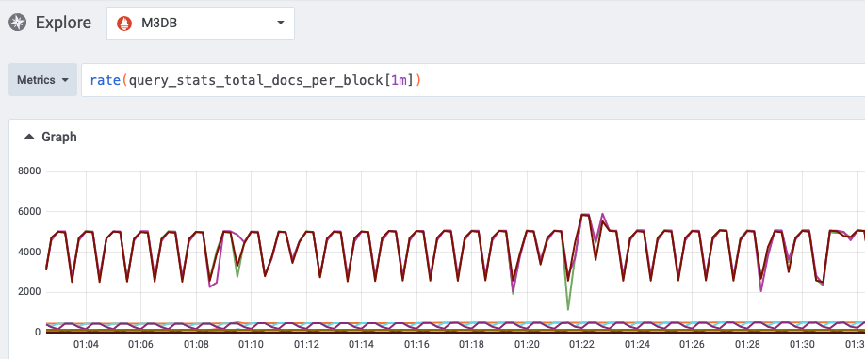
Limit Memory Globally
M3 automatically surfaces histogram metrics on concurrent memory use from queries per m3db node

Slide 19
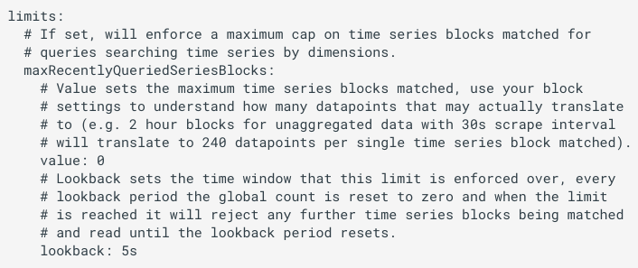
Limit Memory Globally
Configure m3db nodes to enforce custom limits (docs)

Slide 20
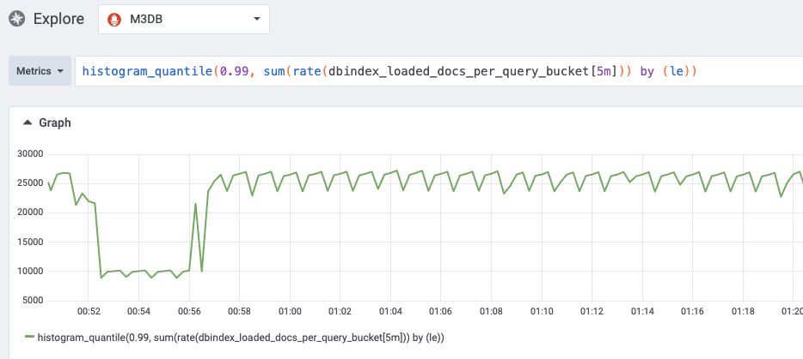
Limit Memory per Query
M3 automatically surfaces histogram metrics on per-query results sizes

Slide 21
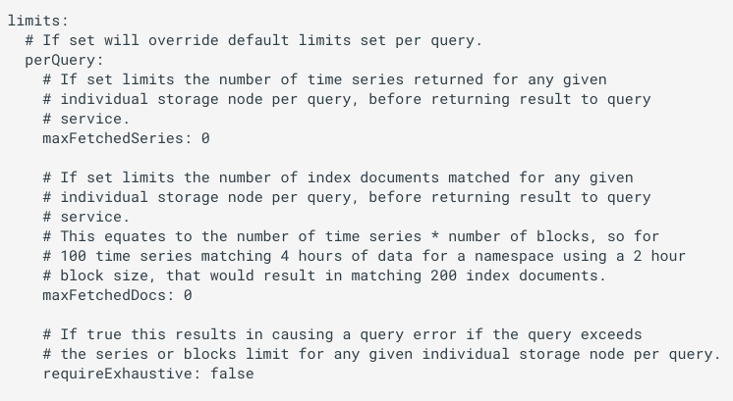
Limiting Max Memory per Query
Configure m3db nodes to enforce custom limits per query (docs)

Slide 22
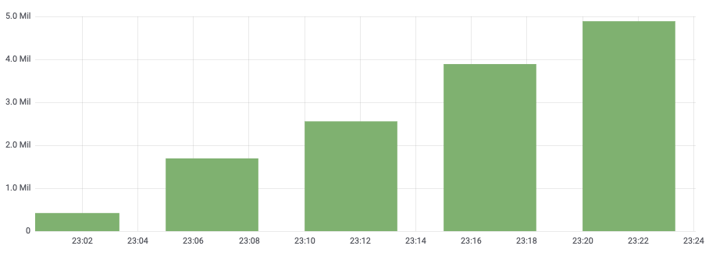
Maximization Problem B: Write Load
As we ingest more and more new metrics over time, how can we do so without just indefinitely paying more?

Slide 23
Aggregator Rollups
Reliable aggregation with replication
Optionally keep all or just some metrics downsampled with streaming aggregator.
Able to aggregate across arbitrary dimensions, e.g. ingestion time rollup rules allow for sum() by () of metrics with cardinality in millions.
Move expensive recording rules to streaming aggregation, store less and alert on very high cardinality cheaply.
M3 Aggregator
M3 Aggregator
Prometheus Remote Write
M3 Coordinator
M3DB
M3 Coordinator
M3DB
M3DB

Slide 24
Aggregator Rollups
Reliable aggregation with replication
Leader election is uses keep single aggregator replica will emitting results to downstream M3DB.
Flushed state per time window is kept so on leader failover no time windows are missed.
Zone A
M3 Aggregator
Shard 0..15
(Leader)
M3 Coordinator
M3 Coordinator
Lock
Campaign
etcd
(/shardset/0..15/lock)
(/shardset/0..15/flushed)
Watch
Campaign
Zone B
M3 Aggregator Shard 0..15
(Follower)
M3 Coordinator
M3 Coordinator

Slide 25
Aggregator Rollups
HA rollup across millions of time series
HTTP request latency broken down by server version.
Unique values on original metric multiply to create cardinality of 24 million series.
Using aggregator rollup we can aggregate at ingestion time this to 240 thousand series. Now can alert and query on each HTTP route only needing to touch a few thousand series (~5 thousand).
Metric dimension | Unique values
Pod (“k8s_pod”) | ~100 pods per region
Bucket (“le”) | ~30 buckets
Status (“status_code”) | ~10 status codes
Route (“route”) | ~50 HTTP routes
Git SHA (“git_sha”) | ~4 active versions
Region (“region”) | ~4 regions

Slide 26
E.g. Rollup across millions of series
HA rollup across millions of time series
Stage 1: Take delta increase
Stage 2: Sum by dimension
Stage 3: Create monotonic cumulative counter
Documentation: docs.m3db.io/operational_guide/mapping_rollup
- name: "http_request latency by route and git_sha without pod"
filter: "__name__:http_request_bucket k8s_pod:* le:* git_sha:* route:*"
transforms:
- transform:
type: "Increase"
- rollup:
metricName: "http_request_bucket"
groupBy: ["le", "git_sha", "route", "status_code", "region"]
aggregations: ["Sum"]
- transform:
type: "Add"
storagePolicies:
- resolution: 30s
retention: 720h

Slide 27
E.g. Rollup across millions of series
Example: Rollup rule deep dive
Stage 1: Deltas
Stage 2: Sum by dimension
Stage 3: Add cumulative
- name: "http_request latency by route and git_sha without pod"
filter: "__name__:http_request_bucket k8s_pod:* le:* git_sha:* route:*"
transforms:
- transform:
type: "Increase"
- rollup:
metricName: "http_request_bucket"
groupBy: ["le", "git_sha", "route", "status_code", "region"]
aggregations: ["Sum"]
- transform:
type: "Add"
storagePolicies:
- resolution: 30s
retention: 720h

Slide 28
E.g. Rollup across millions of series
Example: Rollup rule deep dive
Stage 1: Deltas

Slide 29
E.g. Rollup across millions of series
Example: Rollup rule deep dive
Stage 1: Deltas

Slide 30
E.g. Rollup across millions of series
Example: Rollup rule deep dive
Stage 2: Sum by dimension
Sum each with same "le", "git_sha", "route", "status_code", “region”
- name: "http_request latency by route and git_sha without pod"
filter: "__name__:http_request_bucket k8s_pod:* le:* git_sha:* route:*"
transforms:
- transform:
type: "Increase"
- rollup:
metricName: "http_request_bucket"
groupBy: ["le", "git_sha", "route", "status_code", "region"]
aggregations: ["Sum"]
- transform:
type: "Add"
storagePolicies:
- resolution: 30s
retention: 720h

Slide 31
E.g. Rollup across millions of series
Example: Rollup rule deep dive
Stage 2: Sum by dimension
Sum each with same "le", "git_sha", "route", "status_code", “region”
2
1.5
3
3
3
1.5
4
= 7 3 5

Slide 32
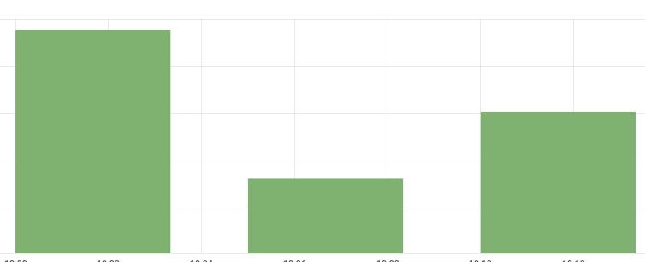
E.g. Rollup across millions of series
Example: Rollup rule deep dive
Stage 2: Sum by dimension
Sum each with same "le", "git_sha", "route", "status_code", “region”
= 7 3 5

Slide 33
E.g. Rollup across millions of series
Example: Rollup rule deep dive
Stage 3: Add cumulative
Running sum of same "le", "git_sha", "route", "status_code", “region”
- name: "http_request latency by route and git_sha without pod"
filter: "__name__:http_request_bucket k8s_pod:* le:* git_sha:* route:*"
transforms:
- transform:
type: "Increase"
- rollup:
metricName: "http_request_bucket"
groupBy: ["le", "git_sha", "route", "status_code", "region"]
aggregations: ["Sum"]
- transform:
type: "Add"
storagePolicies:
- resolution: 30s
retention: 720h

Slide 34
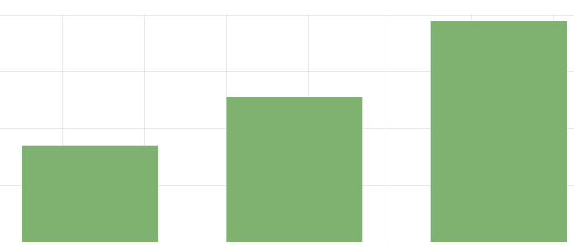
E.g. Rollup across millions of series
Example: Rollup rule deep dive
Stage 3: Add cumulative
Running sum of same "le", "git_sha", "route", "status_code", “region”
= 7 10 15

Slide 35
Optimization Summaries
Query limits (READ)
Provides controls over global and per-query limits
Limits available on series and/or blocks (i.e. memory read)
Aggregator rollups (WRITE)
For very high cardinality metrics avoid constant heavy reads against TSDB with recording rules.
Optionally drop uninteresting labels (faster queries at cheaper cost).
Keep ability to apply further transforms and rate interval at query time.
Notes:
Flexibility on underlying series:
Ability to keep raw underlying series for any retention period.
Ability to drop them at ingestion time.
Flexibility on rolled up series:
Ability to keep new series at any resolution and retention.
Ability to retain the same metric name and tags on new series (should delete underlying series to avoid conflicts).

Slide 36
Thank you, questions?
Thank you to M3 contributors: …@chronosphere.io, …@uber.com, …@linkedin.com, …@aiven.io, …@cloudera.com and many other great individuals! Learn more:
Slack: https://bit.ly/m3slack
Office Hours (every 3rd Thursday, 11-1pm EST): signup for slot here
Meetup: https://www.meetup.com/M3-Community/
GitHub: https://github.com/m3db/m3
Documentation: https://m3db.io
Contact us: contact@chronosphere.io

