Slide 1
Highly scalable SaaS Apps on Oracle Kubernetes Engine (OKE) : Real Life Case Studies
Practical Experiences with OKE in Production at Scale
Ram Kailasanathan Richard Bair
Senior Director Product, Oracle Cloud Native
Senior Director Engineering, Oracle IoT Apps and BlockChain

Slide 2
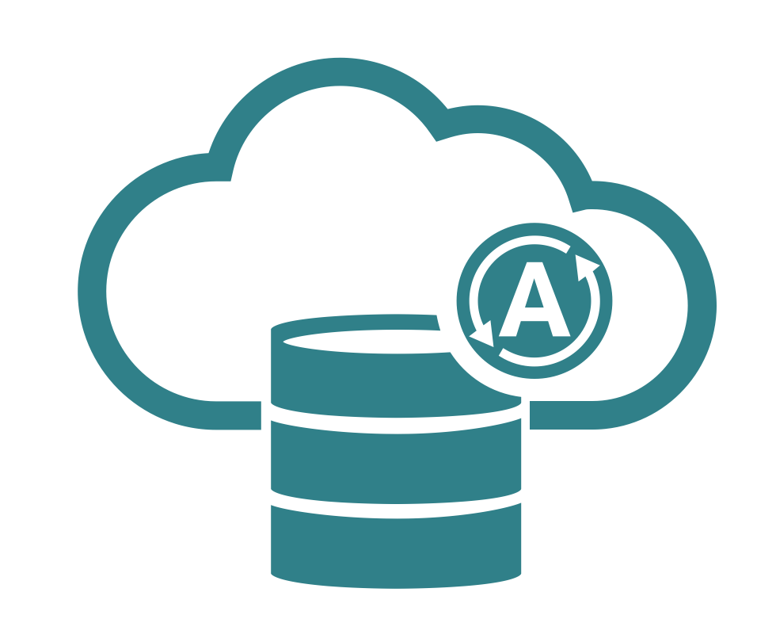
Oracle Cloud Infrastructure: Complete set of services
Governance
IAM, Tagging, Cost Analysis
Security
IAM, Audit, KMS, CASB
Management
Monitoring, Notifications, Alarms
Automation
Resource Manager, Ansible
Analytics / Integration / SOA Suite / Identity / Management / Content / API Platform / Developer / Visual Builder / Digital Assistant/ DataFlow / Data Science / Data Safe
Containers
Containers and Kubernetes
Data Movement
Storage appliance, Data Transfer
Autonomous Database
Transactions, Data Warehouse
Cloud Native
Events, Streaming, Functions
Fully managed, certified Kubernetes service with Docker containers
Software NAS gateway, data ingest service with full chain of custody (HDD or appliance)
Fast provisioning. Automatic tuning, patching, securing. 99.995% availability.
Fully-managed FaaS, event-triggered functions, high-volume data ingest,
notifications
Compute
Bare metal/VM, CPUs/GPUs
Storage
NVMe, Block, File, Object, Archive
Database
Bare metal, VMs, Exadata
Networking
VCN, LBaaS, FastConnect, VPN
Up to 64 CPU cores, 8 GPUs, 768 GB RAM, 51 TB local NVMe SSD, 5M IOPS, AMD and Intel processors
Predictable IOPS Block Storage for up to 98% less, storage for whole lifecycle
Millions of TPS; Full RAC and Active Data Guard support
Isolated networks with reserved IPs, security lists, firewalls, lowest cost private connectivity
Public regions Government regions
Notes:
A brief overview of our services.
High performance servers, storage and database support millions of IOPS, I/O and transactions, and scale up and down based on your need.
This is the true enterprise cloud you’ve heard mentioned. We don’t focus on micro-instances, or VMs with time-sliced fractional CPU allocations. We focus on providing what businesses need to run real production workloads. Workloads that may have to scale up, as well as out. Workloads that may require the reliability of a solid traditional hardware infrastructure in addition to the “plan to fail” approach of cloud. Workloads that need low-latency access to storage and networks. And we provide businesses with simple pricing and predictable costs, instead of an arcane system that penalizes you for running the high performance production applications you depend on.

Slide 3
Oracle Strategy for Cloud Native
Complete Cloud Native Stack
Open Source
Managed Services
Deliver tools and services that are complete, integrated and open
Continuous Integration & Deployment, Container Registry, Orchestration /Scheduling, Management /Operations, Analytics /Introspection
With an application development platform for serverless and microservices
Actively participate in community driven open source container technologies
Investing in Kubernetes, Docker, Fn, & CNCF, DevTools, and DevOps, with engineering resources, code contributions & sponsorships
Active support from Oracle’s portfolio of open source assets (Java, etc.)
Differentiate on quality of implementation, service and operational excellence
Full, transparent management
Open Source Compatible
Standards compliant
Deployed to Oracle Cloud Infrastructure
Enterprise grade performance, security, HA, and governance

Slide 4
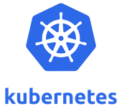
Kubernetes – Necessary but not sufficient
Logging
Monitoring
Add-on mgt
Service Mesh
Integration/APIs
Security/Compliance
Hybrid
Networking
(CNI)
Storage
(CSI)
Source: CNCF Survey
Notes:
Orchestration / Run time / Registry
Observability
Service Mesh
Hybrid
CI/CD Integration
Security and Compliance
Commercial / FedRAMP
Signing
Scanning
Dev UX (Dev vs Ops vs IT)
Interfaces / APIs
Terraform
TaaS
Docker Registry API
Service Broker
Marketplace (ISV support)

Slide 5
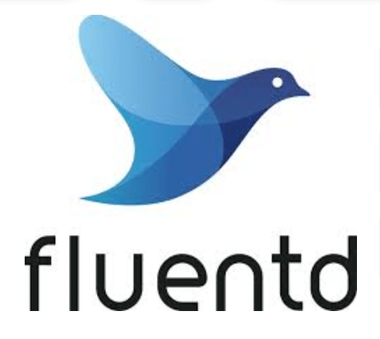
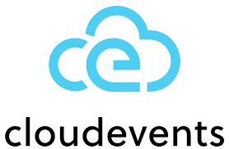
Comprehensive Developer Services Portfolio
Easy to Start
(Adopt)
App Development (Develop)
Deploy
Operate
Console
API Design*
API Gateway
Monitoring
Logging
Events
Notification
Email
QuickStart
SDK/CLI
Cloud Shell
Resource Manager
CI/CD*
Streaming
Marketplace
Source Control*
Container Registry
Container Engine (OKE)
Functions
Always Free Tier
Cloud Native Java
OCI Core Infrastructure Services
*Under Development
Notes:
Deliver tools and services that are complete, integrated and open
Deliver tools and services that are complete, integrated and open
Continuous Integration & Deployment, Container Registry, Orchestration /Scheduling, Management /Operations, Analytics /Introspection
With an application development platform for serverless and microservices
Invest in and leverage open source technologies as the fundamental basis for portability
Actively participate in community driven open source container technologies
Investing in Kubernetes, Docker, Fn, & CNCF, DevTools, and DevOps, with engineering resources, code contributions & sponsorships
Active support from Oracle’s portfolio of open source assets (Java, etc.), Helidon – Java Microservices, GraalVM and other projects
Managed Services
Differentiate on quality of implementation, service and operational excellence
Full, transparent management
Open Source Compatible
Standards compliant
Deployed to Oracle Cloud Infrastructure
Enterprise grade performance, security, HA, and governance
“Managed Cloud native for the enterprise” – Agility of OSS cloud native technologies coupled with fundamental OCI platform -> security, governance and compliance.
SCM/CI/CD Roadmap for early calendar 2021
API Design -> Apiary acquisition (Feb 2017), moving to OCI.

Slide 6
OKE @ Scale
Big Clusters, and a lot of ‘em
Notes:
Today, we have two items on the agenda. I'm going to talk first a little bit about the IoT project and the scale at which we use Kubernetes. I'm then going to review four lessons that we learned through failure and experience

Slide 7
17,000+
Cores
Notes:
In total across all our tenancies we have over 17,000 cores running in OKE.

Slide 8
50+
Clusters
Notes:
Those 17,000 cores are spread unevenly across more than 50 different OKE clusters. We've got Big clusters, and a lot of ’em.

Slide 9
OKE all the way
Started using OKE ~ late 2018
We use OKE on OCI for all dev, test, staging, and production workloads
The OKE team has been a very good partner in allowing us to run at scale
OKE makes Kubernetes a lot easier than running it ourselves
Notes:
The IoT products have been in production since around 2016. We started on internal compute VMs. We moved in 2017 to external compute. Around the same time we started using Docker heavily internally for development and testing. When we began our migration to OCI in 2019, we wanted to use Docker for development, testing, staging, and production, and made the decision to use OKE on OCI for everything. We have successfully migrated all our customers to OKE on OCI.
Every developer has some quota on a development OKE cluster, and all automated SQE tests are run on development or staging clusters. We try to keep our development environment as close to production as possible in every way. This strategy is working out much better for us than in the old days of OCI-C where we’d test on Docker and deploy on PSM and JCS.
Finally, I’d be remiss if I didn’t acknowledge the tremendous support that the OKE team gives us. We wouldn’t be able to run our products at scale without them. They make running a Kubernetes cluster so much easier.

Slide 10
Lesson #1
Things die. Deal with it.

Slide 11
Kubernetes provides all the tools for high availability
Deployments and Stateful Sets try to maintain a specified number of replicas
Kubernetes monitors each pod’s readiness and health. Unhealthy pods are automatically replaced
Anti-affinity rules can be defined to cause Kubernetes to place pods into different availability / fault domains
Pod disruption budgets will prevent Kubernetes from bringing down more pods than your application can handle
Notes:
Operating anything at scale requires careful attention to the architecture and design to make sure everything is highly available. Kubernetes provides all the tools you need for high availability.
Kubernetes gives us deployments and stateful sets which will automatically try to maintain a configured number of replicas. If one dies, it tries to bring it back up.
Kubernetes monitors each pod's readiness and liveness through health checks and bad pods are automatically killed and replaced.
Kubernetes gives us declarative ways to say that pods should be spread across multiple availability domains to survive even a full AD failure
Kubernetes gives us a way to declare how many pods in a deployment or statefulset can go down at once before we lose availability. Kubernetes will then do its best to make sure that doesn't happen.

Slide 12
Things die. Deal with it.
A pod may die if:
The pod itself becomes unhealthy (stops responding, or runs out of memory, etc)
Somebody kills the pod manually (kubectl delete pod)
The cluster was scaled out and you want to rebalance the workload
The node that the pod is on dies
Why would a node die?
Upgrading the VM image requires recreating the node
Upgrading the kubelet requires recreating the node
It just stops working.*
* This happens to us a lot with X6 shapes.
Notes:
There are so many ways that a pod may die. It might become unhealthy. It might run out of memory. An admin might kill it (intentionally or accidentally). Maybe you scaled out the cluster and want to rebalance the workload by moving pods from one node to another. The node that was hosting multiple pods might die and take all the pods with it.
Nodes die for lots of results. They die because you killed it because you needed to replace it with a newer node with a newer version of the VM image. They die because the Kubelet needs to be upgraded and this requires replacing the node. Sometimes they get rebooted because the compute team had to make some change. Sometimes, they just stop working.

Slide 13
Lesson #2
Persistent pains aren’t just in old age.
Notes:
Lesson #2 is about persistent data.

Slide 14
Persistent volumes caused us persistent problems
Kubernetes pods run on Virtual Machine nodes. Each OCI VM has a limit on the number of attached volumes they support. The more persistent volumes, the fewer pods per node.
Sometimes we found persistent volumes would get mounted read-only
A persistent volume is per-AD. If a pod moves from one AD to another, then it will fail to start because it was unable to attach to its persistent volume.
CSI (replaces flex-volume) is designed to help resolve this
Persistent volumes have a minimum size of 50GB in OCI
This is far too expensive for development, so we setup our own Ceph cluster on some Dense IO bare mental machines in dev so that we could hand out much smaller volumes
Too many persistent volumes cause too much API traffic to the block volume service and you will have attach errors
I/O intensive tasks with block volumes are slow unless you have very large block volumes and VMs.
Notes:
Kubernetes has the concept of a persistent volume, which we usually just call a PV. Each PV is backed by an actual block storage volume. Our experience was that too heavy use of PV’s caused us a lot of trouble. We try to design our system now to avoid the use of PVs where possible.
For example, each OKE node is a OCI VM. Each VM in OCI is limited in the number of block volumes that can be mounted. The higher the ratio of PVs to Pods, the fewer pods you can run per node.
Sometimes we find PVs that get mounted read only for some reason.
Each block volume in OCI can only be mounted to VMs in the same AD. If Kubernetes reschedules a pod from one AD to another, the PV won't follow it and the pod will fail to start.
PVs have a minimum size of 50GB!
Too many PVs will cause too much traffic to the block volume service and you will have attach errors due to rate limiting.
I/O intensive tasks are slow unless you have large block volumes and big VMs.

Slide 15
Try using FSS and ephemeral storage
File System Service is NFS for OCI
If you need a distributed filesystem, you can use an FSS-backed PV and attach it to many pods
Store heap dumps on an FSS-backed PV
Ephemeral storage for logs and tmp
Logs are always shipped to ElasticSearch / Kibana ASAP
We only need enough ephemeral storage as a buffer
Every pod in Kubernetes can have ephemeral storage
Very useful for very small disk usage requirements
Not to be used for storing customer data
Ephemeral storage dies with the pod and is stored locally on the OKE Node
Notes:
So I mentioned in passing the fact that you can use FSS to back your PV. This gives you a multi-read/write PV – every pod can read and write to the same backing filesystem. I don’t think I’d use it as a general replacement for block volumes (which have a lot of other nice features), but for things like heap dumps and crash dumps and any time you want to mount some data to be consumed by multiple pods – it is a great choice.
Also, try to use ephemeral storage for all small disk usage needs.

Slide 16
Lesson #3
Know Thy Limits
Notes:
Lesson 3 is to know your limits.

Slide 17
Every pod should have requests and limits specified
A request tells Kubernetes what a pod’s minimum resource needs are. When Kubernetes schedules your pod, it will make sure the node it schedules the pod on has sufficient resources.
Requests ensure a pod has the resources it needs
A limit tells Kubernetes what a pod’s maximum resource needs are. The pod’s CPU will be limited at the Linux Kernel level. If the pod exceeds its memory limit, then the pod will die.
Limits prevent a pod from stealing resources from other pods
If the node begins to encounter pressure, request and limit are taken into account to decide what to evict first.
Problems due to missing limits and requests may not be visible when cluster load is low, but when the load increases, problems start to appear
Notes:
When we first started using Kubernetes, we didn’t give limits to our pods. We weren’t sure what those limits should be. But this was disastrous because one bad pod could cause every other pod on the same node to get evicted. We used to face pod evictions all the time. Setting the limit and request virtually eliminated those (the exception being, of course when the node was drained or replaced).
In Kubernetes, a "request" defines the minimum resource requirements (in memory and CPU).
A "Limit" tells Kubernetes the max CPU and memory to give to a pod.
Kubernetes uses this information for scheduling, that is, for finding what node to run a pod on. It also uses this information to determine what, if anything, can be evicted when resources on a node get low.
If you set your maximums too high, it may prevent pods from being scheduled on nodes that are otherwise mostly idle. For our workloads, we found that we are memory constrained, and so we have requests and limits for Memory, but only limits for CPU. This allows us to overprovision based on CPU, but exactly provision based on free memory and cap the max CPU any given pod can use.

Slide 18
Lesson #4
Monitoring is essential
Notes:
Lesson #4 is about monitoring. If you’re going to do anything at scale, then you need to pay some serious attention to monitoring and alerting.

Slide 19
Without good monitoring tools we’d have no chance
Every OKE cluster we create runs Prometheus to gather metrics
Thanos provides distributed Prometheus queries giving us a single pane of glass for monitoring everything!
Single Kibana / ES cluster for collecting all our logs
Alert Manager raises PagerDuty alerts based on Kibana / Prometheus data
Considering providing some “health check” REST endpoint to give infrastructure and application level health data and make it available to monitoring.
A pod may be alive, but the underlying application still unhealthy. You need to know this
We add health check status to our Prometheus metrics to expose them to Graphana

Slide 20
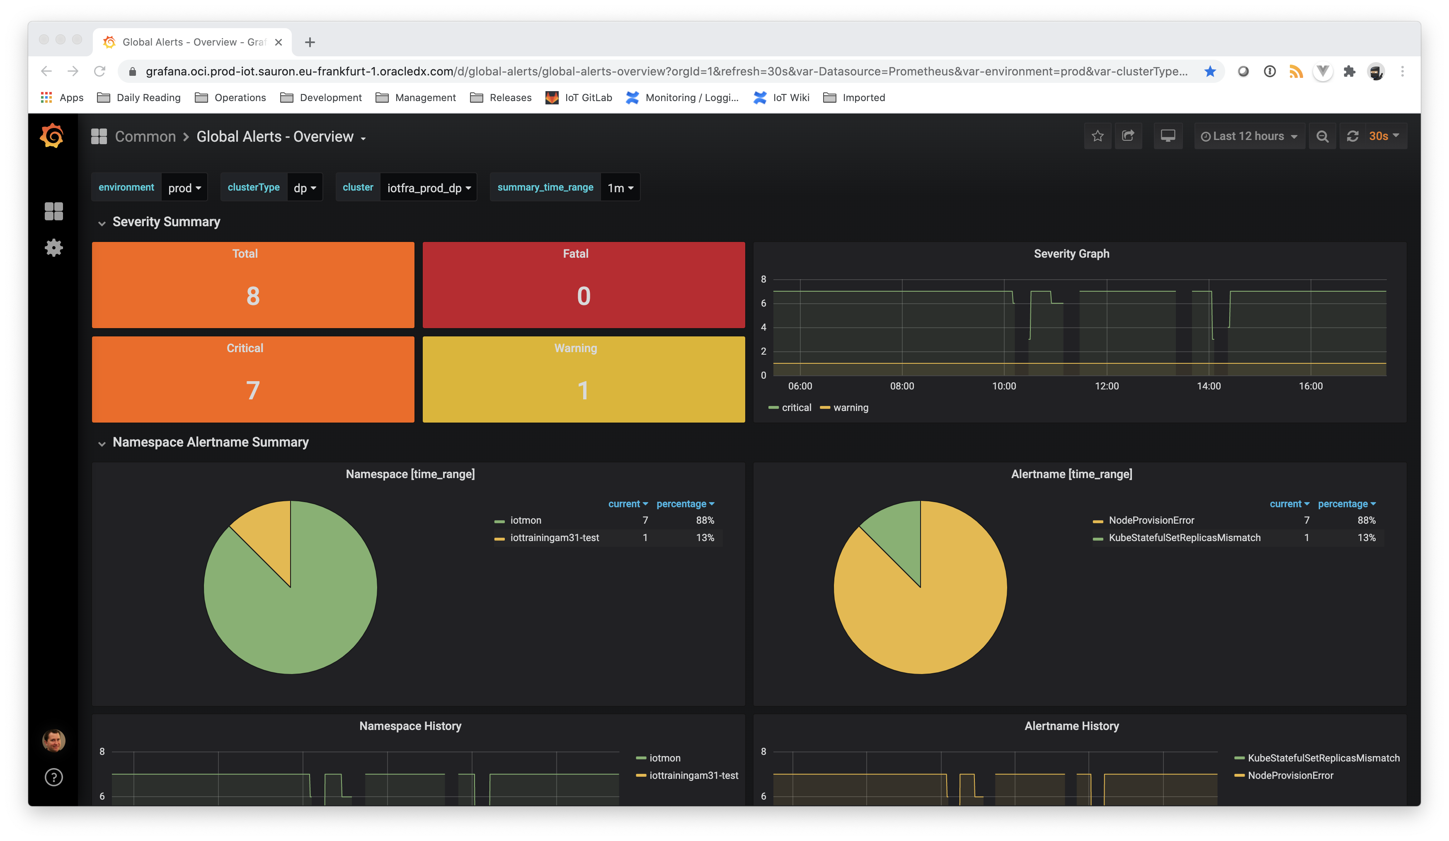
Notes:
This is one of our dashboards. The the top you can see an “environment” drop down, which lets me choose between staging and production. There is a cluster type, which is either the SM cluster, CP cluster, or DP cluster, or “all”. In the cluster dropdown I can pick all clusters or a particular one. I can then see all of the alerts currently known by the Alert Manager. It shows me a history of what alerts were ongoing at different times, and a little lower on the page is a link to each service instance that is experiencing an issue.
We broke our alerts up into Fatal alerts (which mean that the customer is experiencing some kind of downtime), critical alerts (which, if not fixed soon may lead to a fatal alert), and warnings (which, if not fixed in the near future, will lead to a critical alert). We have different SLAs for when each of these different types of alerts should be resolved.
The truth today is that we experience alerts every day. We’re constantly working to improve our product and deployments to avoid alerts, and sometimes we can go a stretch with very few alerts, but overall this is an area of continued investment. Without our monitoring tools, we would be in a world of hurt.

Slide 21
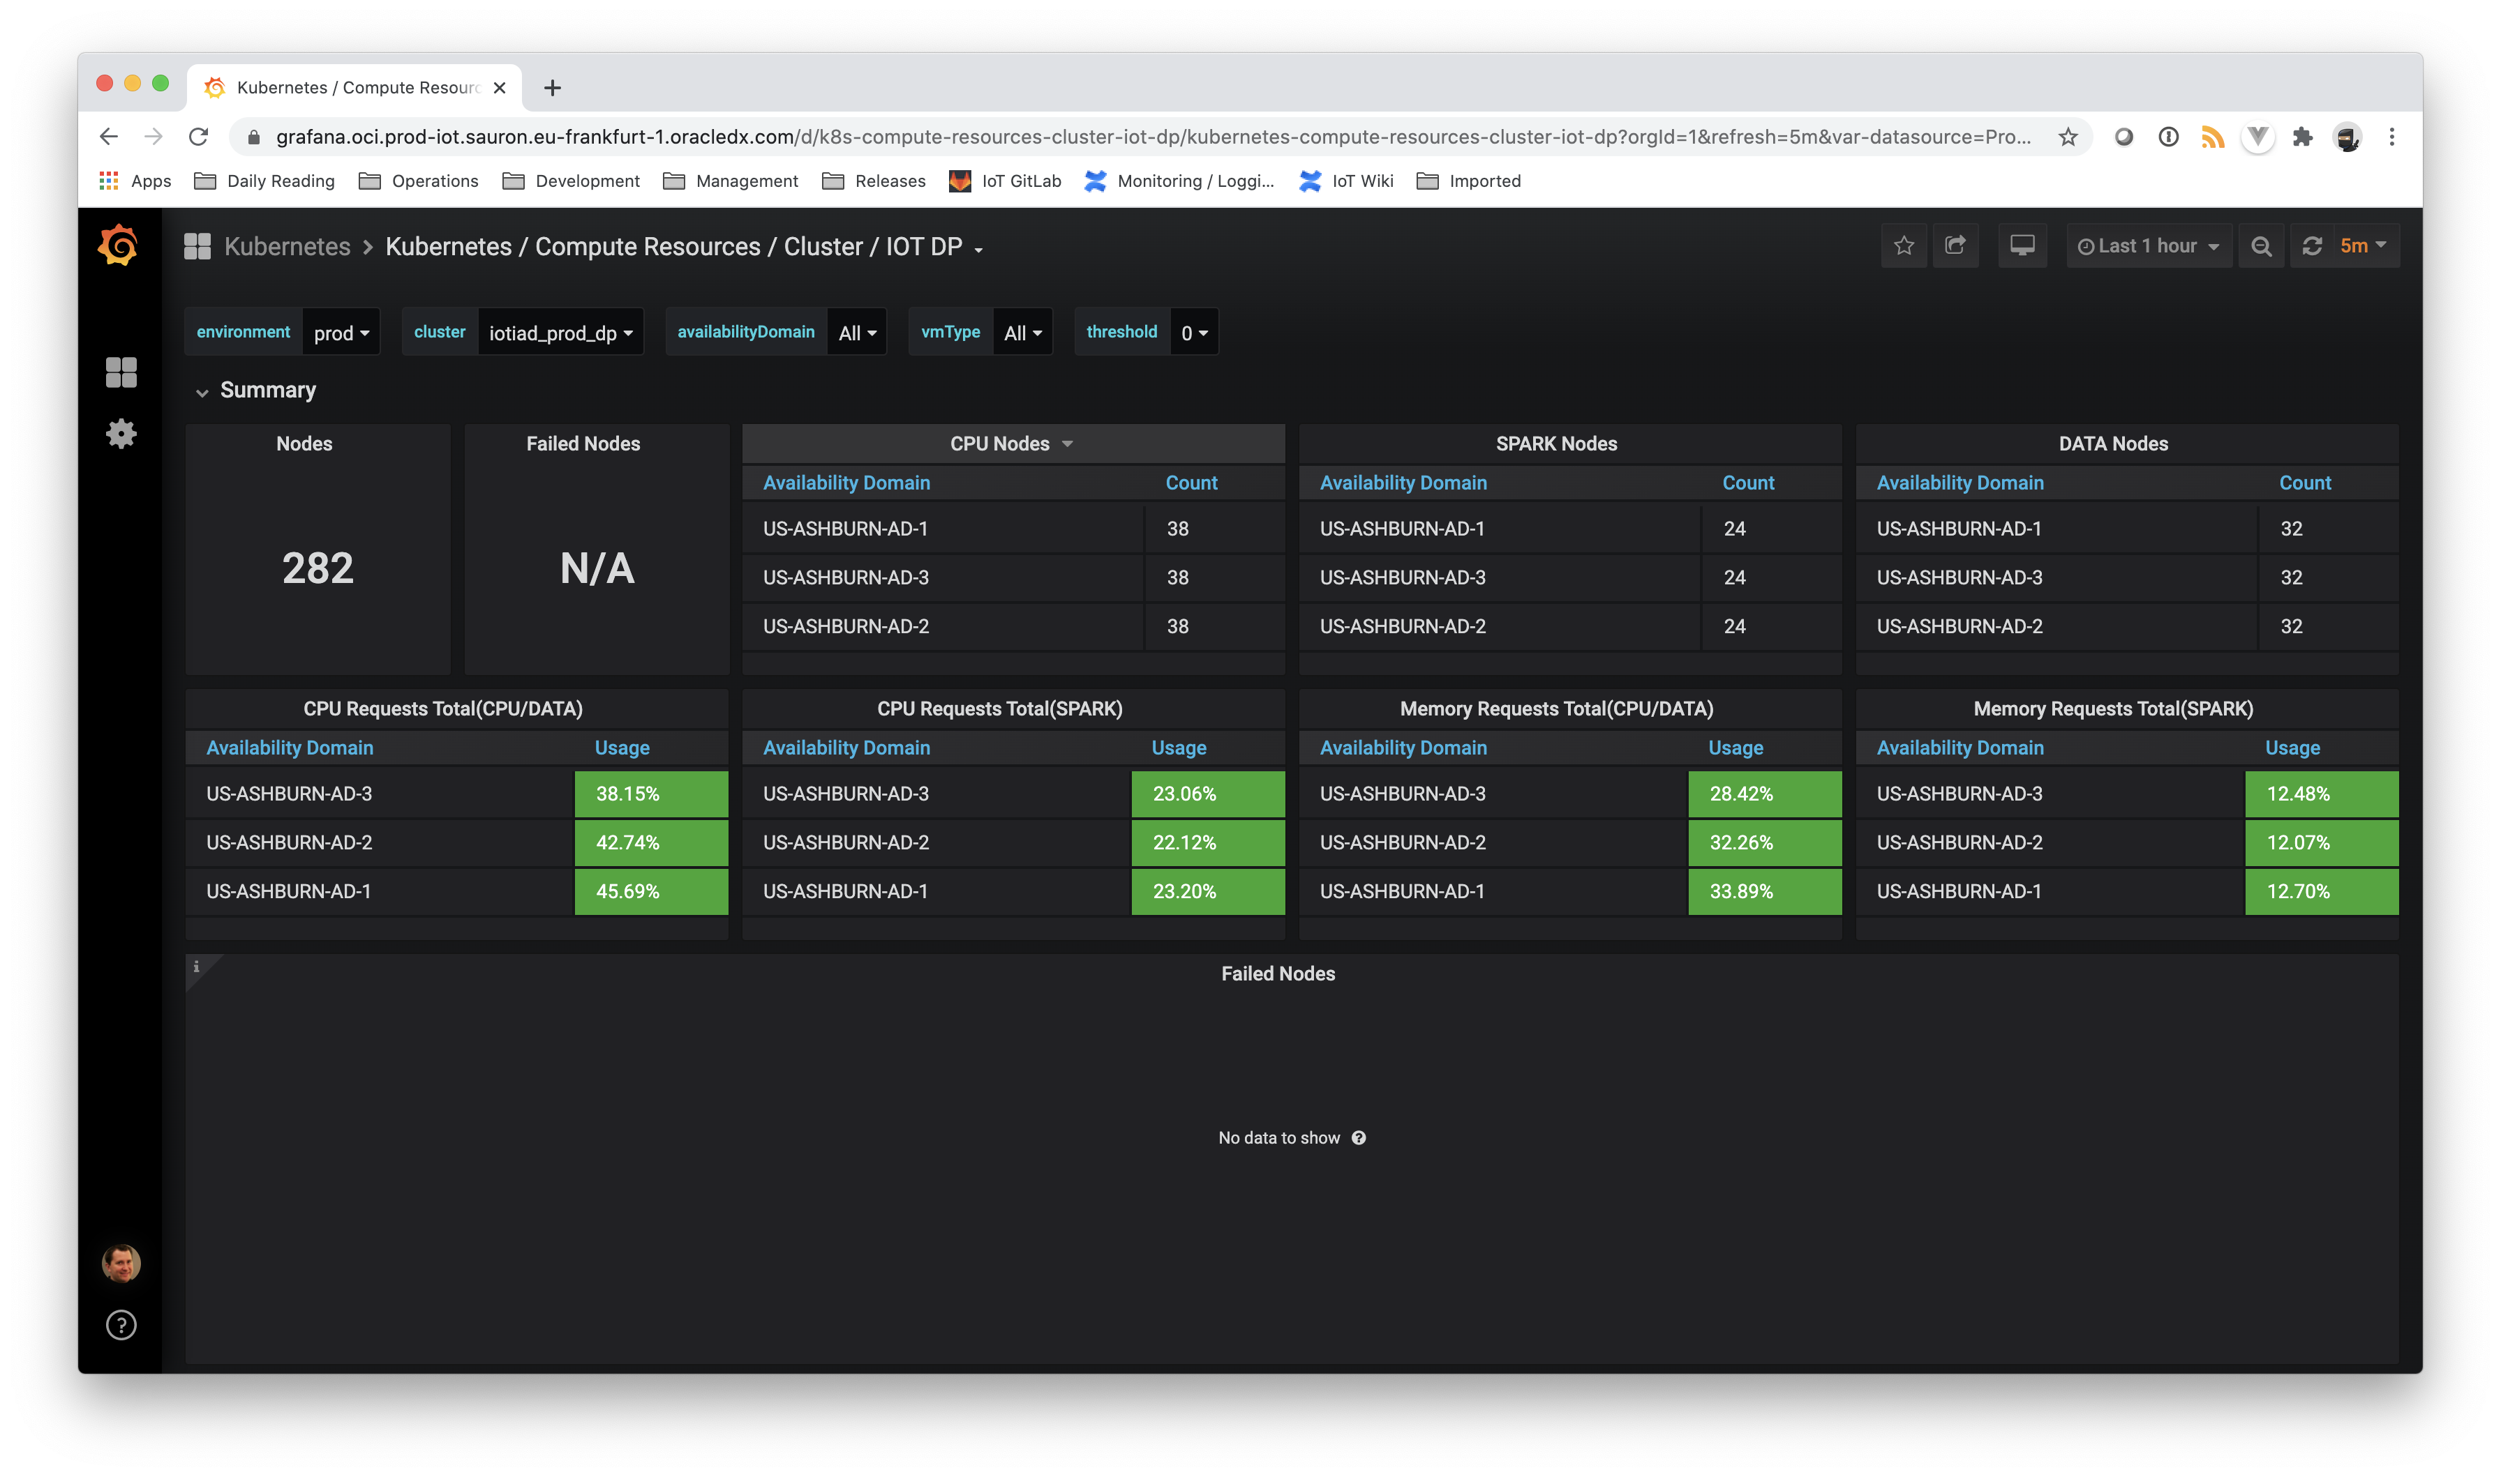
Notes:
This dashboard gives us some view on the health of the nodes themselves, rather than the workloads running on those nodes. I can look at environments and clusters as before, but I can also drill into specific Ads and specific node types (VM type is looking at some label on the nodes in the node pool to segregate them).

Slide 22
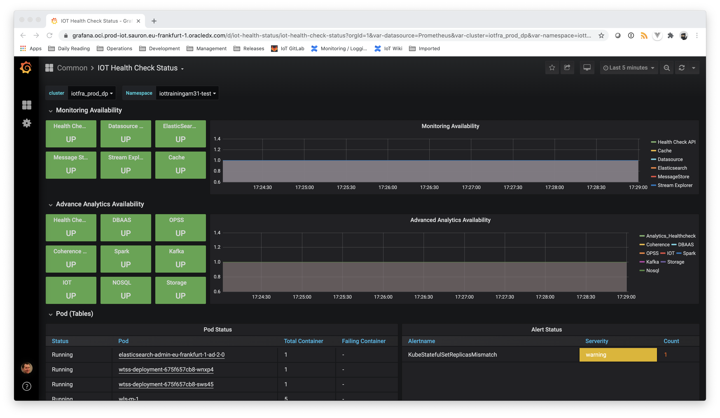
Notes:
This is the service instance dashboard. It shows the health status of various components within IoT itself.

Slide 23
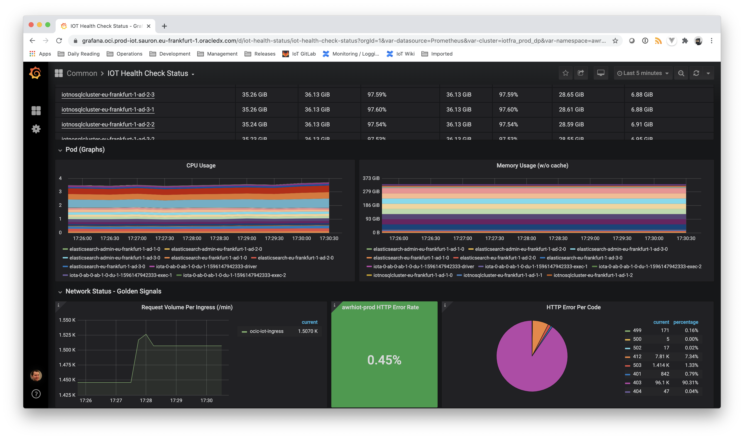
Notes:
At the bottom of this dashboard we have the golden signals – request volume, http error rates, and a pie chart for the HTTP error codes being returned to the client.

Slide 24
Lessons
Things die. Design for HA from the beginning
Use persistent volumes wisely. They can help, but they come at a cost.
Limits and Requests help make things stable.
Monitoring is essential

Slide 25
Do I recommend OKE? Yes!
What does OKE add over Kubernetes?
Fully managed Kubernetes Control Plane
Future feature to also have a fully managed Kubernetes Data Plane
What does Kubernetes add over Virtual Machines?
Managed deployment of Docker containers
All tools for liveness, readiness, capacity limits, scaling, HA, etc.
What do Virtual Machines add over Bare Metal?
More variety in VM shapes and sizes
Better support for HA / DR (e.g. network attached block volumes)
The higher up the stack, the better!

Slide 26
Resources
https://developer.oracle.com
https://www.oracle.com/cloud/free/
https://docs.cloud.oracle.com/en-us/iaas/Content/ContEng/Concepts/contengoverview.htm
https://www.oracle.com/cloud-native/
https://docs.cloud.oracle.com/en-us/iaas/Content/Resources/Assets/whitepapers/oci-security.pdf
https://www.oracle.com/a/ocom/docs/cloud/oracle-cloud-infrastructure-platform-overview-wp.pdf

Slide 27
Thank you

