Slide 1
Join us for KubeCon + CloudNativeCon Virtual
Event dates: August 17-20, 2020
Schedule: Now available!
Cost: $75
Register now!

Slide 2
Kubernetes Secrets Management
Build Secure Apps Faster Without Secrets

Slide 3
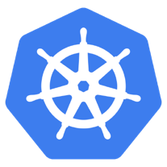
Attackers target application secrets
Tesla Cloud Account Data Breach
Attackers used credentials stored in Kubernetes to hijack cloud resources to mine cryptocurrency
Kubernetes is configured to not require a password for console access
DevOps engineer places AWS access keys in Kubernetes
Attacker finds unprotected Kubernetes console and copies the keys
Attacker uses keys to install cryptocurrency mining software in cloud
Notes:
(Tesla breach)
An unsecured Kubernetes container management console allowed cyber-attackers to breach a Tesla cloud account that contained sensitive data, including telemetry data from the company’s electric cars.
the Tesla breach resulted from the exposure of Amazon Web Services security credentials after hackers penetrated Tesla’s Kubernetes console, which was not password protected This led to the exposure of the company’s Amazon S3 cloud account, which contained sensitive data including the Tesla vehicle telemetry.
The breach also provided access to Tesla’s AWS compute services, which the hackers used to mine crypto-currency.

Slide 4
Everybody wants a secure DevOps flow, but…

Slide 5
SHIFTING SECURITY LEFT INTO DEVELOPMENT WORKFLOWS
Plan
Code
Operate
Create
Test
Release
Deploy
Enable Developer/DevOps
Easy to use (consume secrets)
Prebuilt integrations
Conjur Open Source and Secretless Broker
Free developers from security burden
Compliance, audit requests, human creds
Security budget
Empower security team
Highlight the app & tool risk
Leverage single platform – human/non-human solution serves all
Security focus
Manage security budget
Developers
DevOps
Security

Slide 6
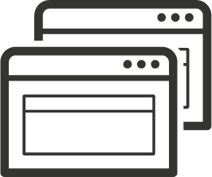
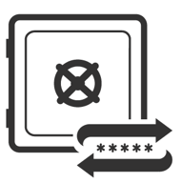
Best practices for securing secrets
Removal of Hard-Coded Credentials
Establish Identity
to Applications
Credential
Rotation
Limit Secret Leaks &
Reduce Attack Surface
Create Auditable Identity for Apps
Regularly Perform Secrets Rotation
APP ID
Enables Compliance with Audit &
Best Practices
Authorized Access that is
Limit Updates to Files, Code or DBs when Secrets Rotated
Remove Security Islands
Enforce Strong Authn for Apps, Remove Secrets Zero
Limit Application Downtime Required to Rotate Secrets
MFA
Authn
Notes:
Removal of Hard-Coded Credentials
Limits discoverability of application credentials thereby reducing the attack surface
Enables compliance with security best practices of secure secrets storage and use of stronger more complex credentials
Removes security island dilemma by enforcing centralized credential store
Credential Rotation
Password changes can now be performed regularly to comply with security best practices and audit requirements
Configuration files, app code, or database tables no longer need to be updated with new values
Application restarts (i.e. downtime) are not required to rotate credentials
Establish Identity to Apps
Creates an auditable identity to applications (homegrown and 3rd party commercial software)
Increases auditability as now any access to the credential is authorized and logged
Provides ability to enforce strong runtime authentication to applications

Slide 7
The problems with Security islands
There are many ways to vault secrets,
But:
Developers must learn multiple solutions
Hard to establish & share best-practices
Short-cuts often taken
SoD not enforced
GRC reporting is impossible
Home Grown Solutions
Islands of Security
Secrets
Secrets
Hiera
Vault
Databags
IAM / KMS
IAM / KMS
IAM / KMS

Slide 8
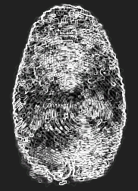
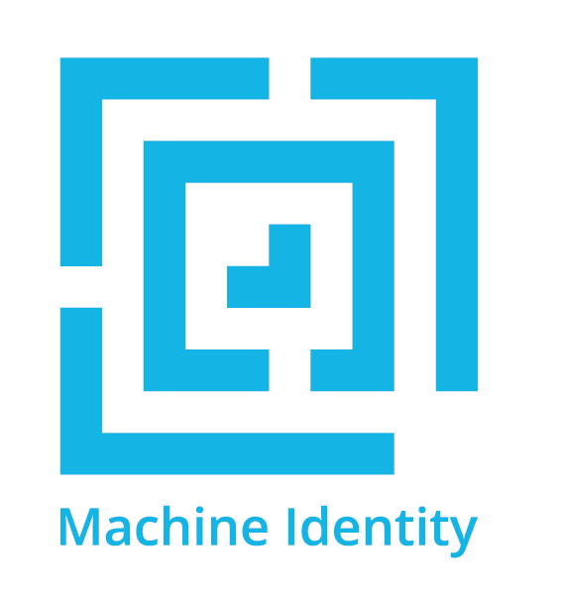
If it can be identified, its access can be managed
Build on a chain of trust
Authenticate all requests
Authorize w/ least amount of privilege
Audit everything
...and do it with code!
The Secret-Zero Problem…
Humans use their built-in vault for passwords or, failing that, answers to security questions.
Non-humans need a way to bootstrap identity that doesn’t put credentials at risk
But how to manage that initial secret required by apps to bootstrap identity?
Human Identity

Slide 9
Ways to establish & authenticate Identity
 | Use-Case | Means | Strengths | Weaknesses
Credential Based | Human identity | Passport, Password | Very familiar Humans have built-in vaults | Social engineering Insecure persistent storage
 | Pre-Configured Identity | API Key | Analogous to human uname/pwd model | Key distribution is subject to compromise Requestor can’t initiate
 | Bootstrapped Identity | Token-based | Can provide extra control factors, e.g. time, CIDR, one-time use, etc. | Secret to get a secret Stateful - requires active entropy mgmt
Attribute Based | Human Identity | Biometrics | Hard to spoof Convenient | Context dependent
 | Pre-Configured Identity | Various Factors | Multi-factor (selectable) OS user, path, MD5 hash, IP/Hostname | No trusted 3rd party Requires authn agent running local to applications Not scalable to container use-cases
 | Bootstrapped Identity | Trusted 3rd Party | Ideal for container orchestration | Platform dependencies Hard to implement for legacy technologies

Slide 10
Secrets Access Workflow
Requestor
Target
Authenticate
Access Token
Access per Policy
Retrieve secrets
Use secrets
Access Token expires after 8 mins

Slide 11
K8s attribute authentication in
1
Admin whitelists app identity with Conjur
Three options for identity granularity:
Identity = Cluster/Namespace
Identity = Cluster/Namespace/Service Account
Authenticator client in app pod submits CSR w/ platform attributes to Conjur
Conjur verifies attributes w/ platform service
Conjur issues cert & key creds to authenticator client in app pod
Authenticator client in app pod uses creds to authenticate, get Conjur access token and shares via shared memory volume.
identity
Conjur policy
2
csr
4
5
3
verify
access token
Notes:
K8s secrets risks: https://kubernetes.io/docs/concepts/configuration/secret/#risks

Slide 12
Authenticate workloads, not infrastructure
Secure Production Identity Framework for Everyone
Inspired by the production infrastructure of Google and others, SPIFFE is a set of open-source standards for securely identifying software systems in dynamic and heterogeneous environments.

Slide 13
Identity Verified using K8s Platform Attributes
1) Alllow-list identity
Credential Issuing Authority
Conjur policy
2) CSR w/ attributes
3) Validate Attributes
6) Authn
4) Legit
7) Share
Attribute Verifying
Authority
(K8s API)
5) Write Cert & Key
/access/ token
Authenticator
client container
Pod
Application container(s)

Slide 14
Conjur demo use-cases
Lab 1:
Authenticator runs as a Sidecar
App pulls DB creds with REST API
App connects to DB
Lab 2: Secrets Injection w/ Summon
Authenticator runs as an Init container
Summon pulls DB creds & calls app w/ creds in env vars
App connects to DB
Lab 3: K8s Secrets
Authenticator runs as an Init Container
K8s secret manifest names DB cred names
Authenticator retrieves DB creds & dynamically patches K8s secret w/ DB cred values
App connects to DB
Lab 4: Secretless Broker
Authenticator runs as a Sidecar Container listening on DB port
App attempts to connect to DB on local port
Authenticator retrieves DB creds, connects to DB, proxies connection for app
App connects to DB

Slide 15
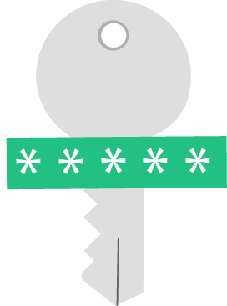
Summon for secrets injection
1
2
Summon invoked with authenticated identity
1
2
Summon fetches secrets using identity
3
3
Processes launched with secrets in environment
Learn more at: https://cyberark.github.io/summon/

Slide 16
The Secrets Lifecycle Today
Secrets Storage
Secrets Delivery
Applications

Slide 17
INTRODUCING “Secretless”
Establishes proxied connections to resources w/o direct access to secrets.
Frees developers and applications from responsibility of managing secrets.
Reduces the threat surface of secrets
Handles rotation transparently
Does not change how clients connect to services
Allows use of standard libraries and tools.
Uses an extensible driver model to connect to backend resources.
For example:
HTTP
SSH (MITM and ssh-agent approaches)
SQL and NoSQL Databases
New drivers in development, inquire within to join the effort.

Slide 18
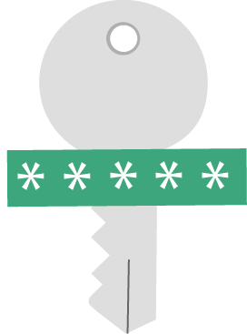
“Secretless” concept: Apps can’t leak secrets
LDAP, htpasswd, etc.
2
4
User authn
K8s Pod
HTTP Request
1
3
User (Simulated)
Billing Service
Secretless
Database
Service connects to Secretless proxy
Secretless establishes a connection to the remote database and transparently brokers the connection
1
3
Secretless proxy requests database credentials to remote database
Conjur seamlessly rotates database credentials used by Secretless
2
4

Slide 19
Stolen secrets? Inconceivable!

Slide 20
Benefits
Simple, context free, secure method for retrieving credentials in containers
End-to-end encryption of secrets through mutual TLS (Transport Layer Security) using SPIFFE-compliant resource identifiers.
Robust authentication and authorization incorporating Conjur policy, signed certificates, and an internal Kubernetes APIs.
Conjur running inside Kubernetes
SoD between applications
SoD also between the Kubernetes security operator and the development teams using Conjur policy
Credentials are not exposed to any 3rd party, reside only in memory
Full central audit trail
Notes:
since conjur verifies the Pod identities, the issued certificates have meaningful subject name and alt names that can be used for verified TLS both within the cluster and from outside the cluster into it. In other words end to end encryption.
conjur policy enables collaboration with separation of duties between the Kubernetes security operator and the development teams. The result is a very scalable workflow for onboarding applications that is also secure and audited

Slide 21
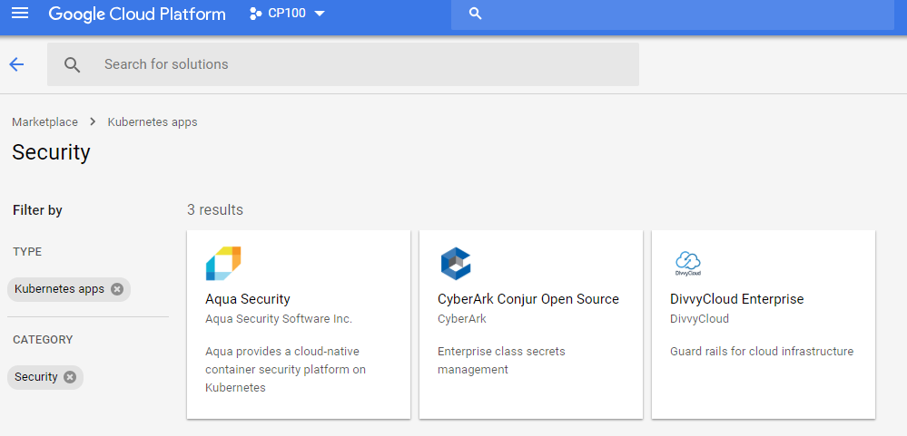
Kubernetes – Conjur Integration in Google Marketplace
Deploy Conjur Integration in Kubernetes in just a few clicks!

Slide 22
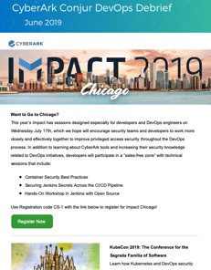
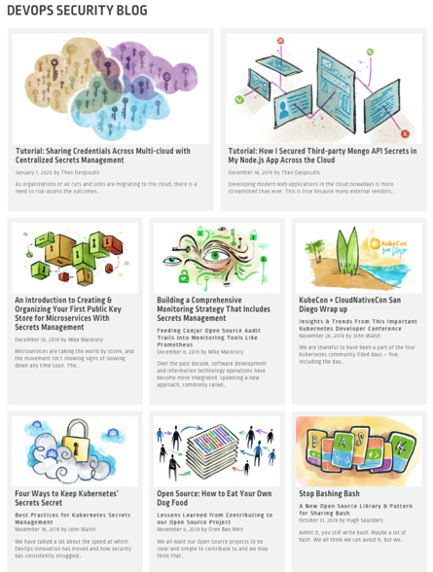
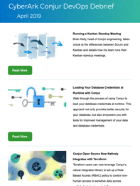
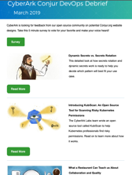
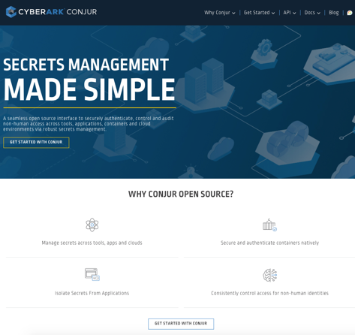
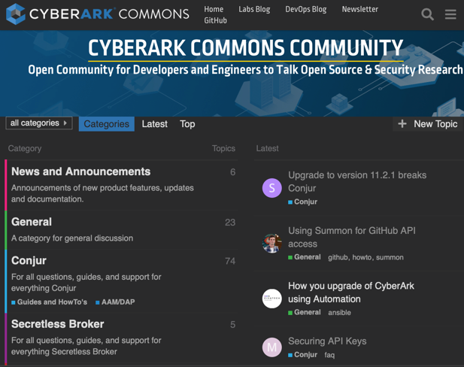
Conjur open source and the CyberArk Open source community
CyberArk Commons OSS Community:
Conjur.org
APIs, documents, tutorials, code
New technical content each month: blogs, newsletter
Streamlined user experience to get started and get hands on
Discuss.CyberArkCommons.org
Discussions and community support for open source
Hands-on Workshops, developer community events and forums
Secretless Broker: Conjur.org/api/secretless-broker
Summon: CyberArk.GitHub.io/Summon

Slide 23
THANK YOU Conjur.org Discuss.CyberArkcommons.org

Slide 24
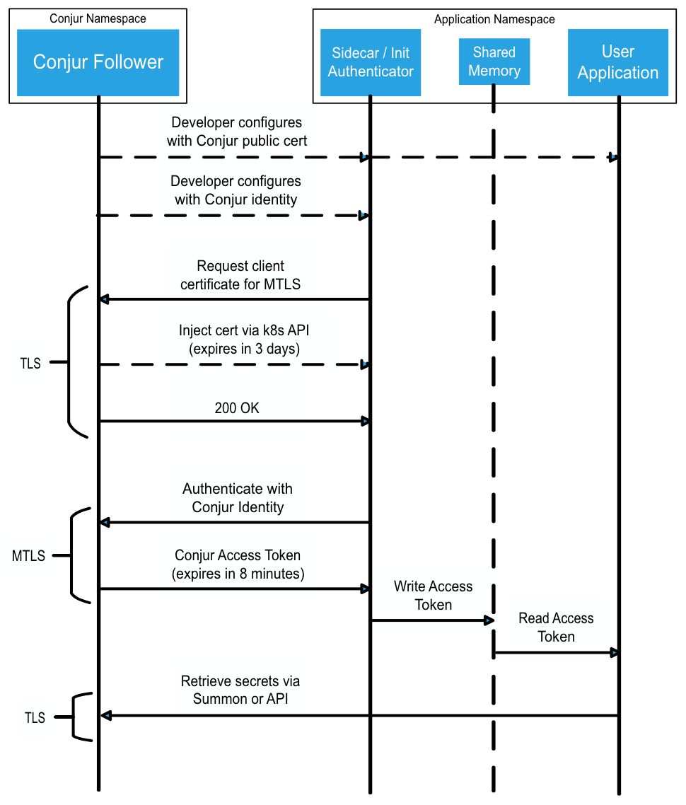
K8s authn flow

