Slide 1
Effective Kubernetes Onboarding
Jamon Camisso, Developer Educator, Community @ DigitalOcean @jamonation

Slide 2
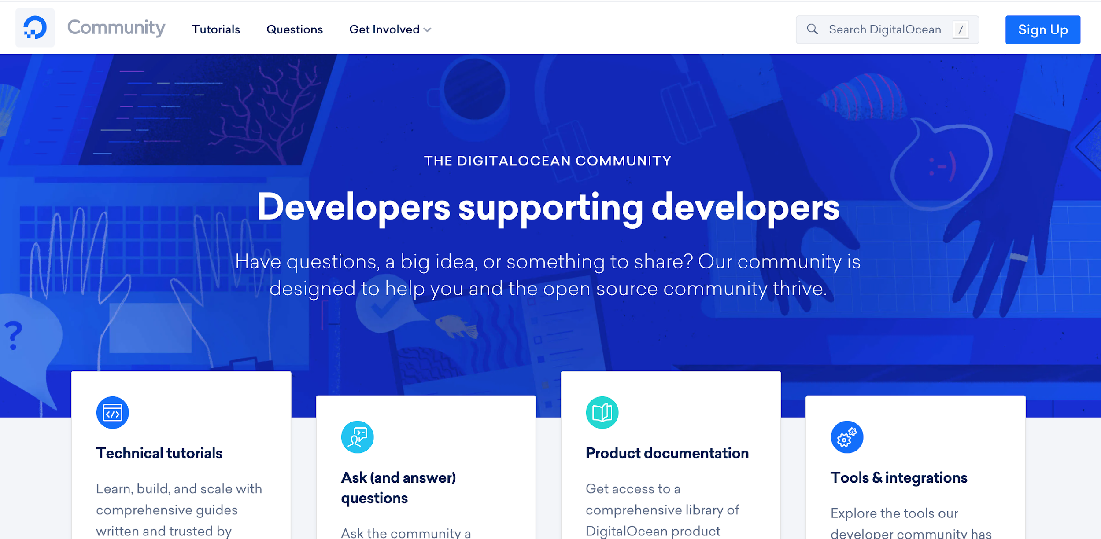

Slide 3
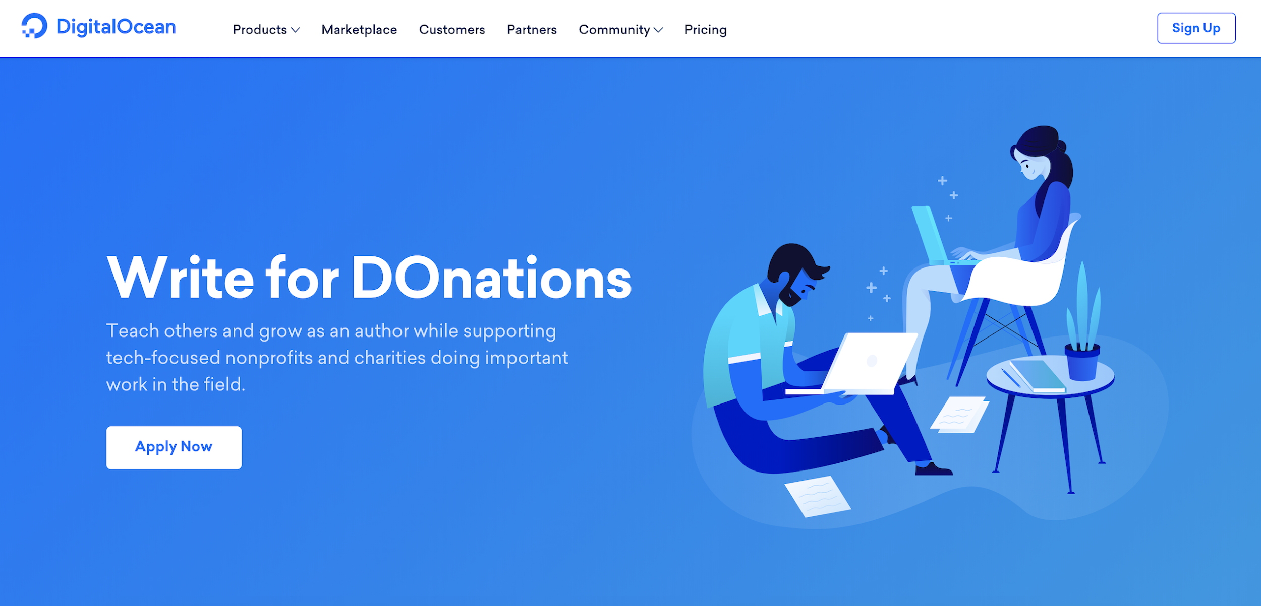
https://www.digitalocean.com/community/pages/write-for-digitalocean

Slide 4
Why Am I Here Today?

Slide 5
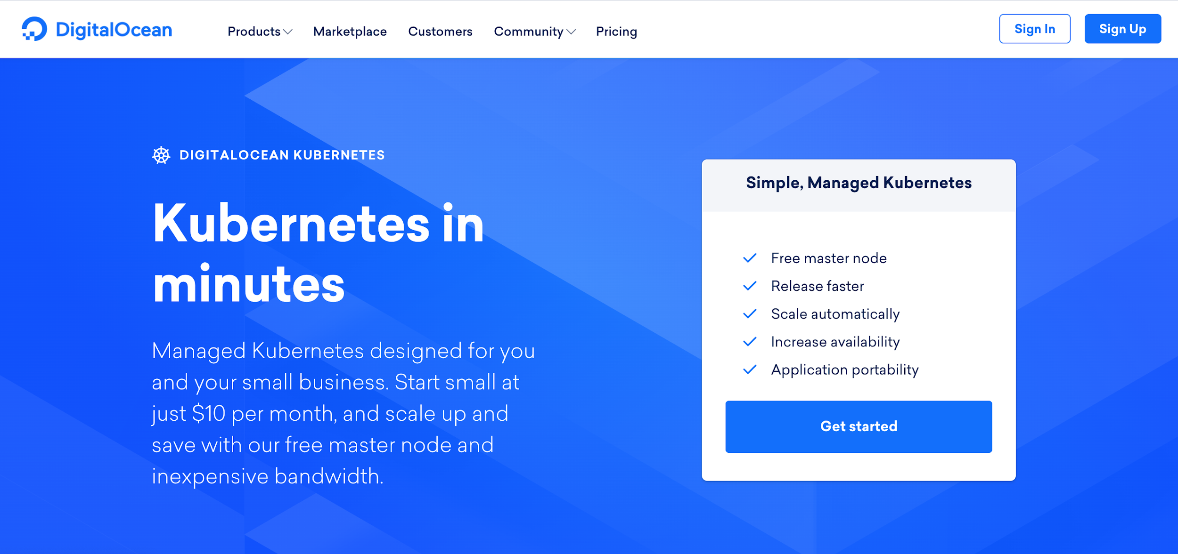

Slide 6
“Teach the world Kubernetes”
Community Team was tasked with this prior to May 2019 launch

Slide 7
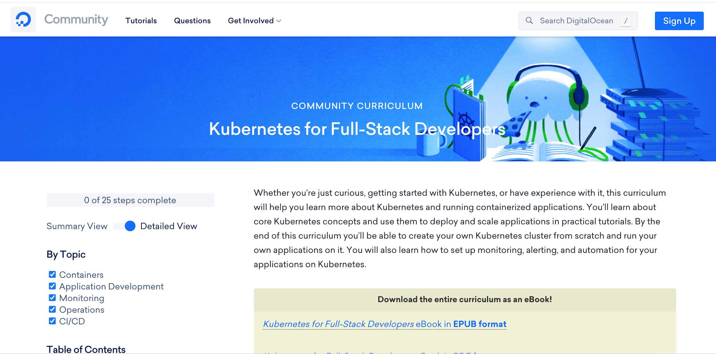

Slide 8
Effective Kubernetes onboarding?
👀

Slide 9
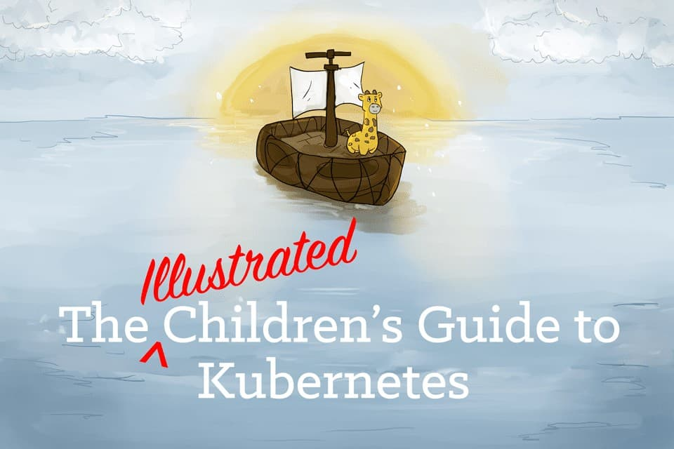
Effective Kubernetes onboarding?

Slide 10
Effective Kubernetes onboarding?
👀

Slide 11
Effective Kubernetes onboarding:
Know your audience and their objectives.

Slide 12
Effective Kubernetes onboarding:
Know your audience and their objectives.
Determine the best approach to meet those objectives.

Slide 13
Effective Kubernetes onboarding:
Know your audience and their objectives.
Determine the best approach to meet those objectives.
Scope your approach appropriately.
Plan for Day 2.

Slide 14
M MEANWHILE … ON THE COMMUNITY PLATFORM

Slide 15
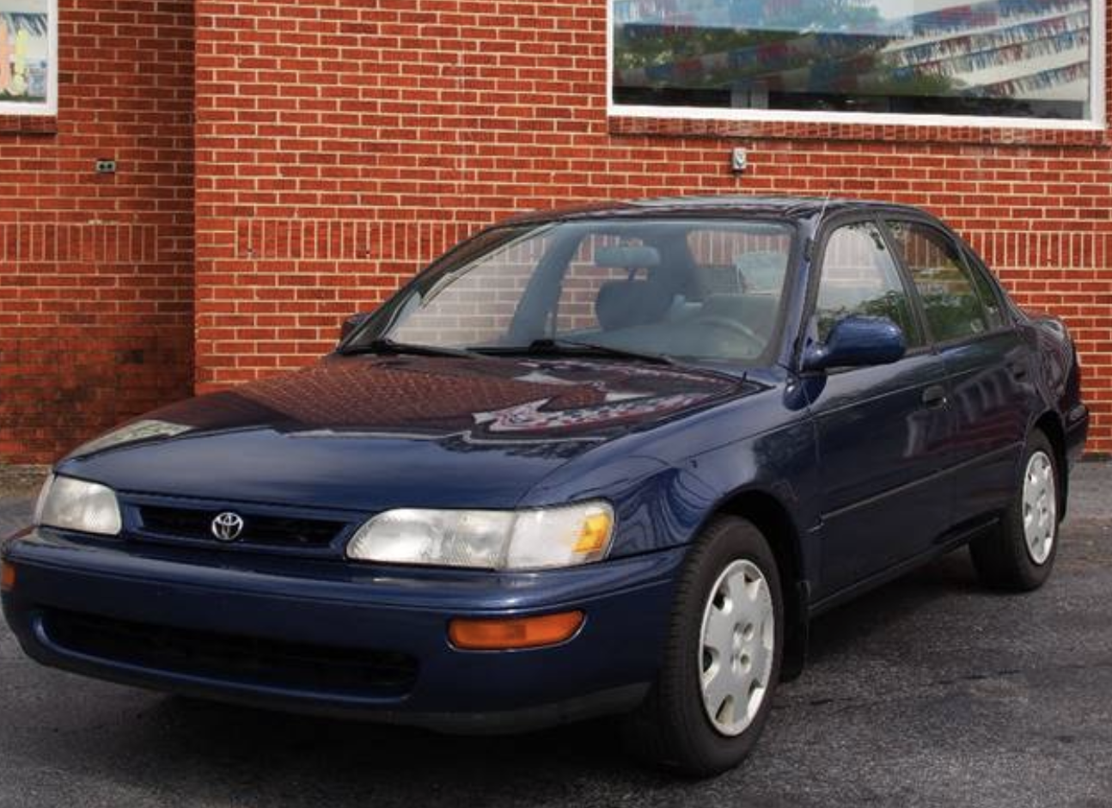

Slide 17
Effective Kubernetes onboarding:
Know your audience and their objectives.
Determine the best approach to meet those objectives.
Scope your approach appropriately.
Plan for Day 2.

Slide 18
Part I: Audience

Slide 19
Is your audience made up of
Application Developers

Slide 20
Is your audience made up of
Application Developers
Goals: 1. Develop with a distributed architecture in mind

Slide 21
Is your audience made up of
Application Developers
Goals: 1. Develop with a distributed architecture in mind 2. Deploy successfully

Slide 22
Is your audience made up of
Operators

Slide 23
Is your audience made up of
Operators
Goals: 1. Deploy successfully

Slide 24
Is your audience made up of
Operators
Goals: 1. Deploy successfully 2. Automate deployments, pipelines & backups

Slide 25
Is your audience made up of
Operators
Goals: 1. Deploy successfully 2. Automate deployments, pipelines & backups 3. Implement logging, monitoring & alerting

Slide 26
Is your audience made up of
Business Decision Makers

Slide 27
Is your audience made up of
Business Decision Makers
Goals: 1. Make responsible financial decisions

Slide 28
Is your audience made up of
Business Decision Makers
Goals: 1. Make responsible financial decisions 2. Scope long-term goals for growth

Slide 29
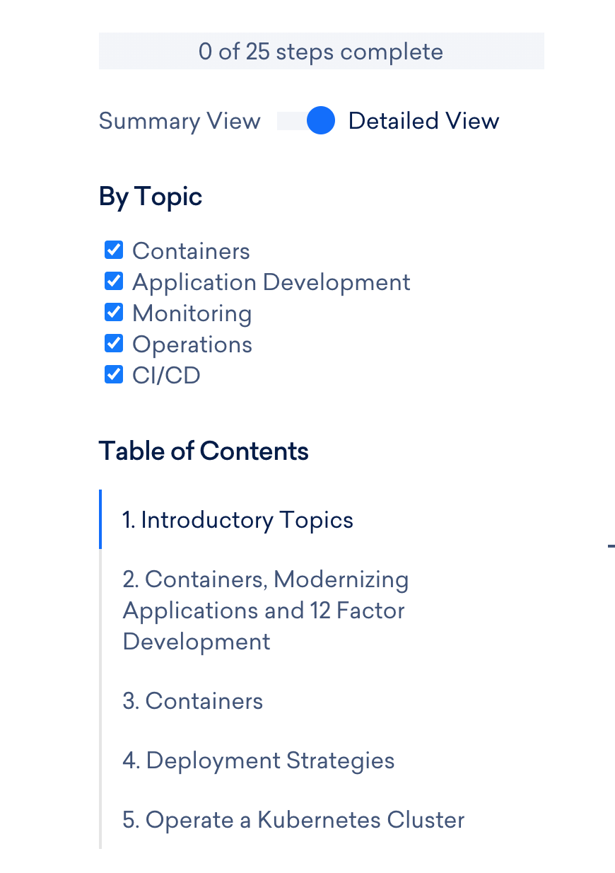

Slide 30
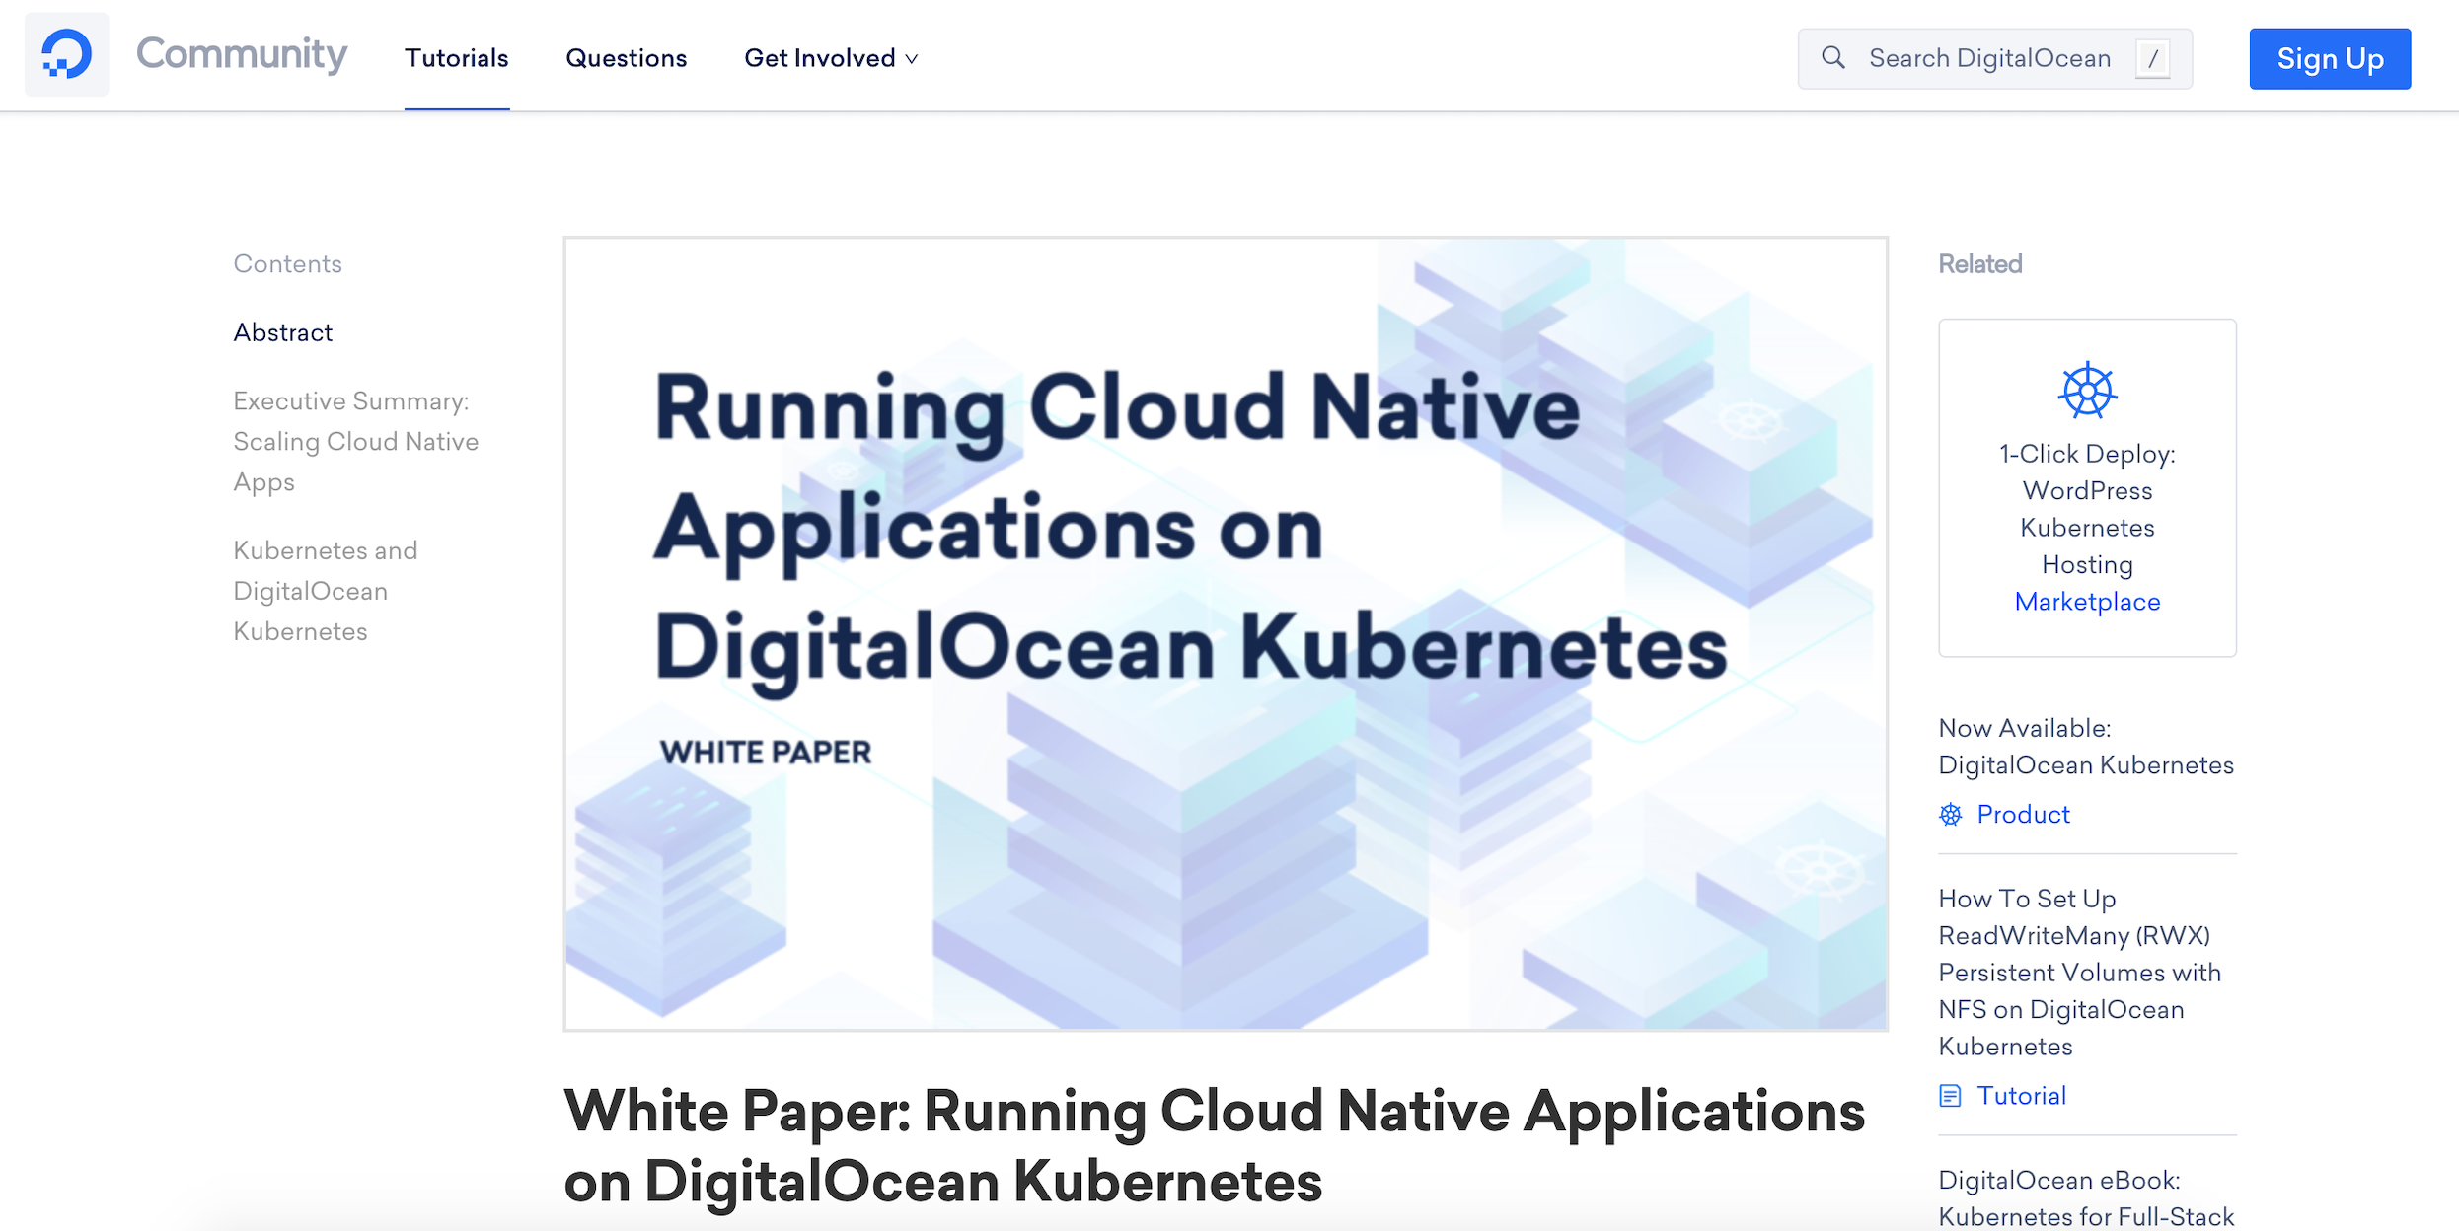

Slide 31
Part II: Approach

Slide 32
Approach:
Application Developers
Goals:
1. Develop with a distributed architecture in mind. 2. Deploy successfully

Slide 33
Approach:
12FA Application
Application Developers
Goals:
1. Develop with a distributed architecture in mind. 2. Deploy successfully

Slide 34
Approach:
12FA Application
Modernize
Application Developers
Goals:
1. Develop with a distributed architecture in mind. 2. Deploy successfully

Slide 35
Approach:
12FA Application
Modernize
Containerize
Application Developers
Goals:
1. Develop with a distributed architecture in mind. 2. Deploy successfully

Slide 36
Approach:
12FA Application
Modernize
Containerize
Deploy
Application Developers
Goals:
1. Develop with a distributed architecture in mind. 2. Deploy successfully

Slide 37
Approach:
12FA Application Blocker: Why is this necessary?
Modernize Blocker: What is a distributed architecture?
Containerize Blocker: How do containers differ from VMs?
Deploy Blocker: What will change from the tools/systems that I’m used to?
Application Developers
Goals:
1. Develop with a distributed architecture in mind. 2. Deploy successfully

Slide 38
Approach:
Meta-Level Topics: What is Kubernetes? What are containers? Operational Topics: 12FA Application
Modernize
Containerize
Deploy
Application Developers
Goals:
1. Develop with a distributed architecture in mind. 2. Deploy successfully

Slide 39
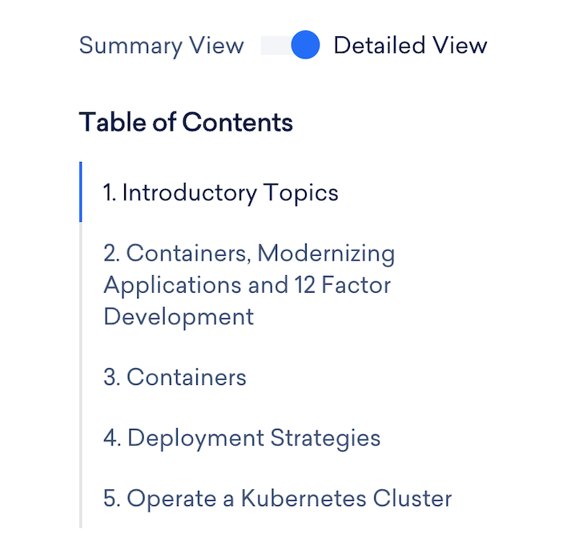

Slide 41
Approach:
Ensure understanding of:
Where secrets are located
What’s in the application/server base images
How to troubleshoot Concourse
How to kick off and roll back deployments
Developers on Community
Goals:
1. Develop with a distributed architecture in mind. 2. Deploy successfully

Slide 42
Approach:
Ensure understanding of:
Where secrets are located
What’s in the application base image
How to troubleshoot Concourse
How to kick off and roll back deployments What does it mean to deploy in a distributed environment at the application level?
Developers on Community
Goals:
1. Develop with a distributed architecture in mind. 2. Deploy successfully

Slide 43
Approach:
Key Takeaways:
Make time for meta-level discussions
Lay theoretical foundations before operational
Developers on Community
Goals:
1. Develop with a distributed architecture in mind. 2. Deploy successfully

Slide 44
Part III: Scope

Slide 45
Formats to Consider:
Documentation

Slide 50
Formats to Consider:
Documentation
Talks or videos

Slide 51
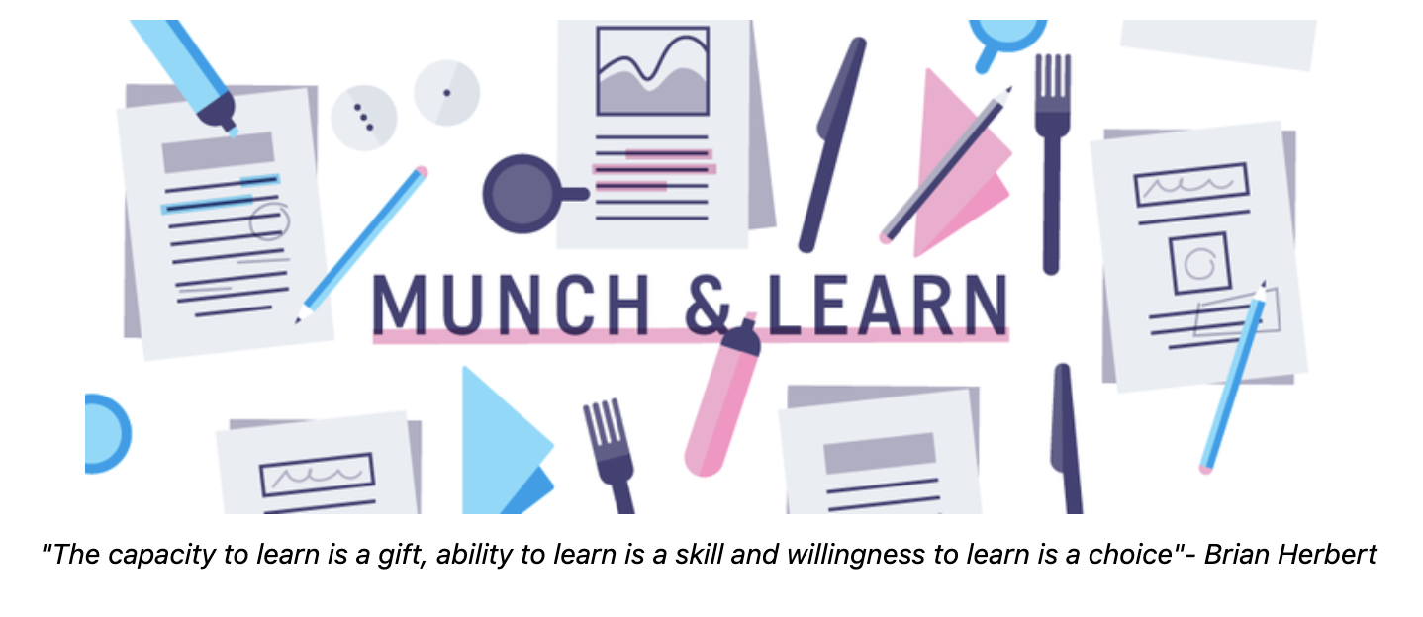

Slide 52
Formats to Consider:
Documentation
Talks or videos
Meeting

Slide 53
Formats to Consider:
Documentation
Talks or videos
Meeting
broad
narrow

Slide 54
Formats:
Internal Documentation
Meetings
Videos
Developers on Community
Scope:
1. Focused (meetings, docs) 2. Some shared resources (short videos)

Slide 55
Part IV: Day 2

Slide 56
Day 2: Changes
Audiences
Application Developers
Operations
Business Decision Makers

Slide 57
Plan for Iterative Change
Define audience and goals
Determine best approach
Scope appropriately
Lather rinse repeat

Slide 58
Approach:
Meta-Level Topics: What are Services and Ingress Controllers? What are kube-apiserver & kubelet?
Why do pods get evicted?
Operational Topics: Draining nodes
kubeadm upgrade plan
Accessing private image registries
Ops Team on a new k8s cluster
Goals:
Run an up to date cluster
Ensure no cluster downtime

Slide 59
Formats:
Meetings
Documentation
Errata from dev/staging upgrades:
Manual steps
Failures encountered
Troubleshooting
Ops Team on a new k8s cluster
Scope:
Focused planning meetings
Internal upgrade playbook
Kubernetes documentation

Slide 60
Approach:
Meta-Level Topics: What are Kubernetes CRDs? How does Rook manage Ceph?
Operational Topics: How to check ceph mon servers?
Monitoring OSD health
What does managing PGs look like?
How are new disks added to a cluster?
Storage Architect
Goals:
Deploy
Ensure no data loss
Scale storage horizontally

Slide 61
Formats:
Videos:
Learn meta-level quickly
Documentation:
Rook
Ceph
Kubernetes
Meetings
With developers & operations
With Change Advisory Board
Storage Architect
Scope:
Videos
Documentation
Documentation
Documentation
Meetings

Slide 62
Effective Kubernetes Onboarding
Jamon Camisso, Developer Educator, Community @ DigitalOcean @jamonation

