Slide 1
Pivoting Your Pipeline for Microservices

Slide 2
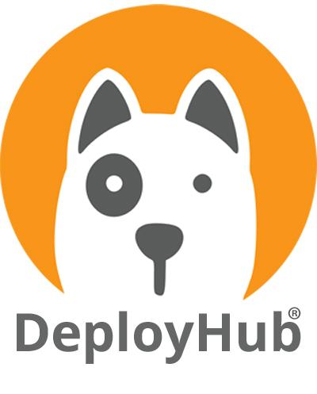
What we will cover
Changes in your CI/CD process for a K8s Platform
When you begin your Cloud Native journey, you’ll quickly find that your current CI/CD pipeline is not going to make the grade. Kubernetes is finally moving us away from a monolithic approach to software development towards a service-based approach. To support this approach, your CI/CD Pipeline will need to pivot. We will cover the problem areas.
See a use case of how that might look. Meet Nathan Martin of sagecore technologies who will provide us a real-world case study on managing microservice with service mesh routing in a modern continuous delivery pipeline.

Slide 3
Takeaways
For most organizations, microservices will have their own repository and workflows. CD tools will need to support workflow templates.
Configuration management will be lost as large monolithic builds are replaced or non-existence. Link decision making is done at runtime – not by a build manager.
Service Mesh becomes core to routing microservices and changing how we see Dev, Test, and Prod Environments.

Slide 4
Your Presenters
Tracy Ragan, CEO & Co-founder, DeployHub
Microservice Evangelist, Founding Board Member Eclipse Foundation. Founding Board member of the CD Foundation, DevOps Institute Ambassador,
20+ DevOps Experience.
Nathan Martin, CEO & Founder, Sagecore Technologies
Speaker, thought leader, Kubernetes enthusiast. Specialist in enterprise resource planning and cloud native applications.

Slide 5
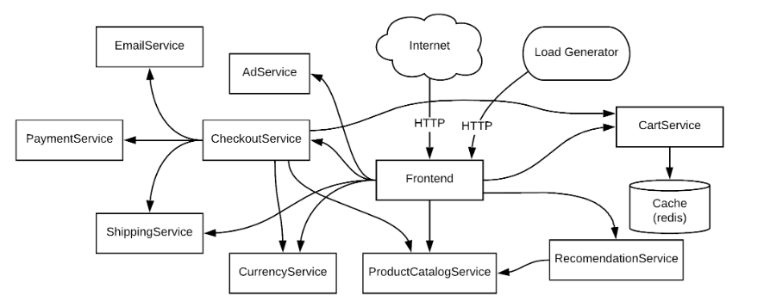
Think
Functions
The key to understanding microservices is to think ‘functions.’ With a microservice environment the concept of an ‘application’ goes away. It is replaced by a grouping of loosely coupled services connected via APIs at runtime, running inside of containers, nodes and pods.
Microservices are immutable. You don’t ‘copy over’ the old one, you deploy a new version to the cluster and manage them with Labels.

Slide 6
The Result
We have lost the ‘application’
Like taking a wine glass and breaking it into pieces.
Now we have a pile of glass, where is the wine glass?
It is still there, just in pieces.

Slide 7
With Microservices your Landscape Changes
Shifting to a modern architecture will disrupt our traditional CD pipeline.
Why is the CD process disrupted?
Microservices are deployed independently and that change impacts everything.
Dev, Test and Prod is morphing.

Slide 8
Reality of Builds
Builds are Different
Smaller code means smaller builds, if at all. Python is interpreted.
Linking is done at runtime, not at compile/link time.
Builds will focus on creating a container.

Slide 9
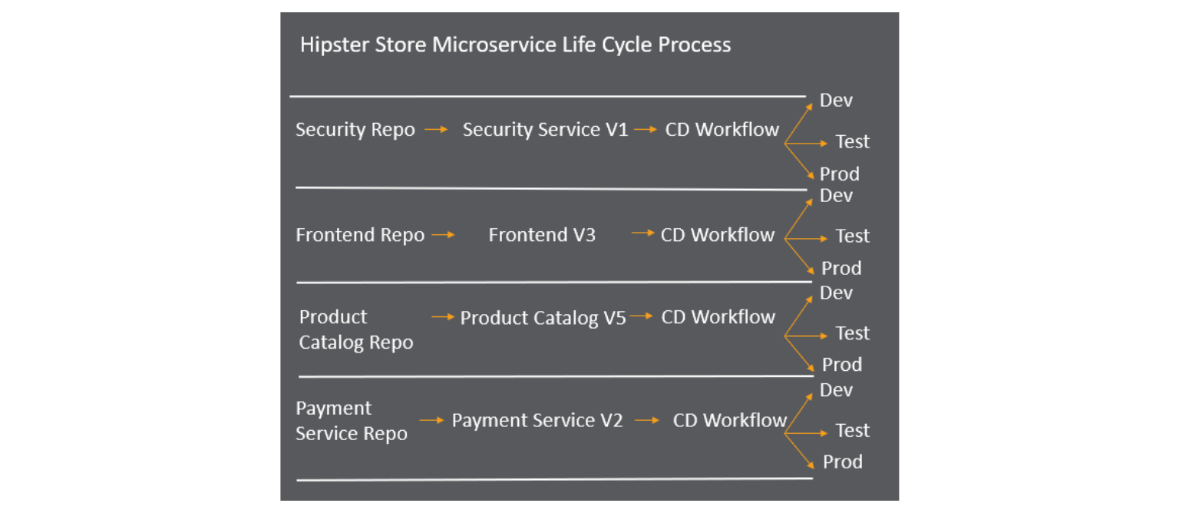
Reality of Workflows
Multiple Workflows for a Single Application
Multiple Workflows
To manage many moving parts, each microservice will have their own repository and CD Workflow. Orchestration of the CD process will become increasingly critical.
Think Templates!

Slide 10
Reality of Deployments
Loss of an Application Version and View
Independently Deployable
Because Microservices are independently deployable - they should have their own Repository and Workflow. Your application workflow will be replaced by many microservice workflows.

Slide 11
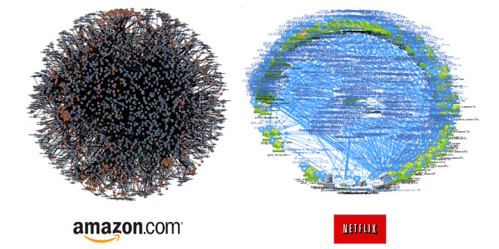
Reality of Configuration
Navigating the Deathstar
Configuration Management
Your application goes away, but a logical view is of its configuration is critical. Mapping (with versions) your service to service and application to service dependencies replaces your traditional software bill of material report.
Haunted Graveyards, Frankenstein Clusters, when do we deprecate?

Slide 12
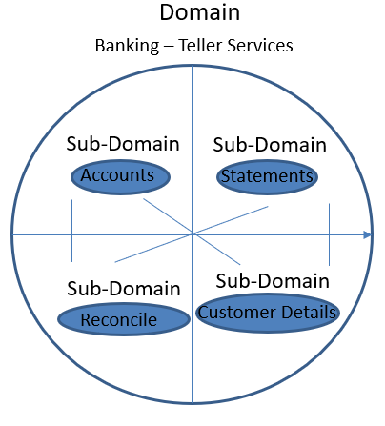
New - Domain Driven Design
Organizing Your Microservices
Domain Driven Design is where you are managing an architecture based on the microservice ‘problem space.’
To find and share microservices they must be organized in a way that meets the needs of your ENTIRE organization, and allows for them to be found and shared.

Slide 13
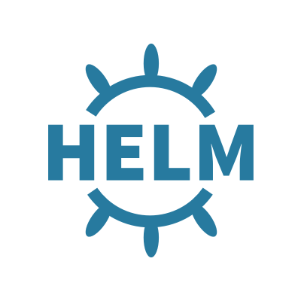
New - Applying the Container to the Cluster
Tells the Container how to interact with the Cluster

Slide 14
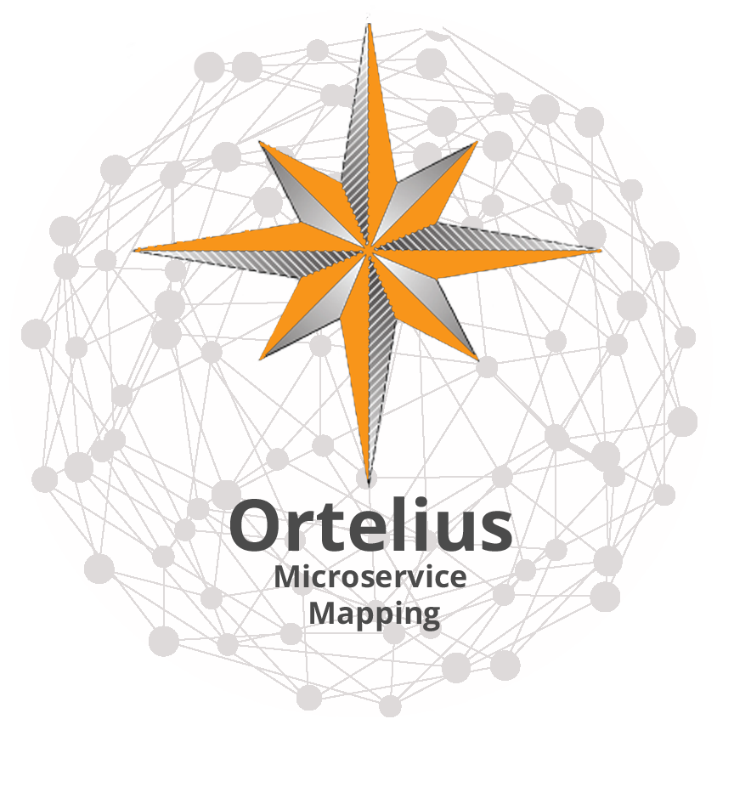
New – Dependency Mapping and Data Visualization
Tracking your Services
Tracks the microservice version to the application version that consumes them.
Supports a Domain Structure for finding and sharing microservices.
Versions the deployment meta data including the Helm Charts.

Slide 15
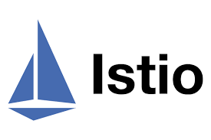
New – Service Mesh Routing
Routes the flow of traffic
Manage Policies
Monitoring and feedback

Slide 16
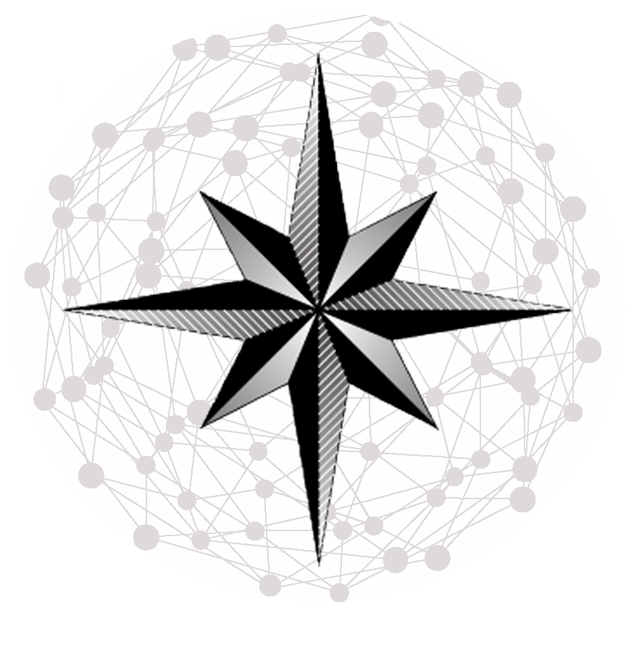
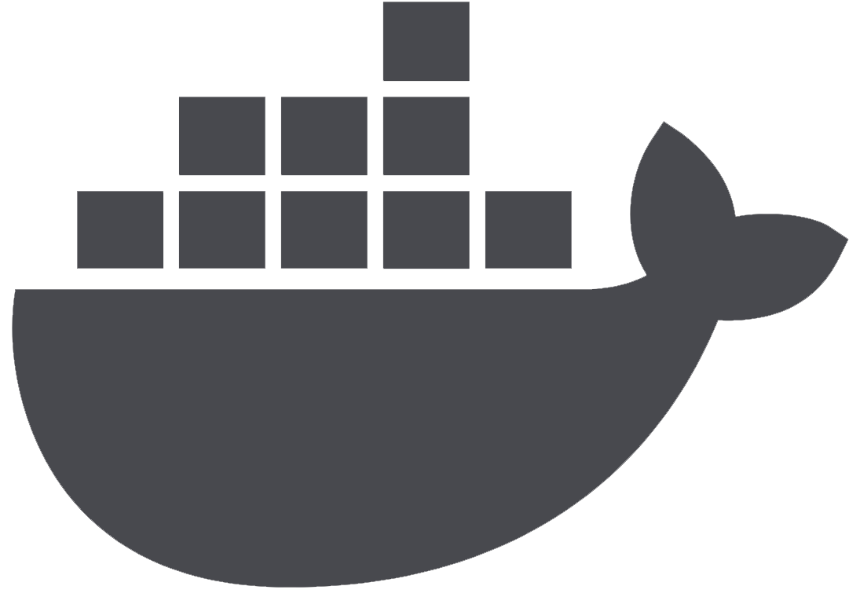
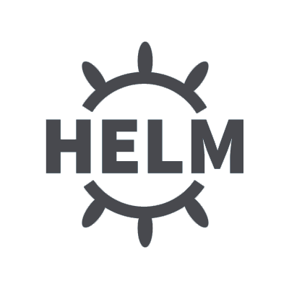
New Microservice Pipeline
New Microservice Pipeline
Continually track
service to application configurations
Build microservice container image
Build microservice container image
Push a new single microservice to the cluster (Dev,Test, Prod)
CD Pipeline for each microservice
Configuration reporting identifies impact.
Route the Service
Configuration reporting identifies impact.
Collect Feedback
Collect Feedback

Slide 17
Results
Container Image Build replaces monolithic compile/link scripts
The CD pipeline supports independently deployable microservices with 100s of workflows
Configuration management is critical to provide continuous mapping of service to service and application to service relationships (Your new BOM)
Routing and feedback delivers the microservice with the Helm meta-data.

Slide 18
myapp 10.2 (current production version)
Istio User Routing
Email Service V1.5
Checkout Service V2.7
Production User
Front End V5.5
Prod K8S
Isitio
myapp 11.1 (beta version)
Email Service V1.7
Checkout Service V2.7
Beta User
Front End V5.5

Slide 19
Real World Use Cases
Tetricor.com
Enterprise Resource Planning Software

Slide 20
Overview
Tetricor is a dynamic Enterprise Resource Planning software developed by Sagecore Technologies.
Developed on a Kubernetes Platform with Istio.

Slide 21
Overview
Our Journey’s Challenges:
Deployment Staging
Application versioning
Request routing
Mesh ( and cluster ) visualization

Slide 22
Deployment Staging
Solution: The Sagecore Technologies team recognized the need to create a dynamic lifecycle with testing as close to production as possible.
This required automation driven by a CD pipeline with rollout strategies for continuous configuration management, continuous test and continuous deployment.

Slide 23
Getting There
Setup Istio DestinationRules to easily rollout from beta ‘virtual service’ to other application versions.
What makes this different than updating routing from beta to production using K8s Ingress controller?
Ingress rules have a lag time to live. This method allows for instant rollout of a specific build, and segregation of build schedules for different users ( beta, alpha, pre-prod. etc.. )

Slide 24
Request Routing
Problem: Our SaaS model must cleverly allocate resources within our cluster to specific accounts, and routing of specific requests to their corresponding microservices for consumption.
Kubernetes ingress routing is somewhat limited, and seemingly designed for top level network design ( as mentioned before there is a lag time in deployment of service routing. )

Slide 25
Request Routing
Problem: We had necessity to route based upon
Headers
Domain ( Host )
Cookie
Custom Header
Path
Without Istio we had no way to attach various SaaS tenants to different application versions, dynamically.

Slide 26
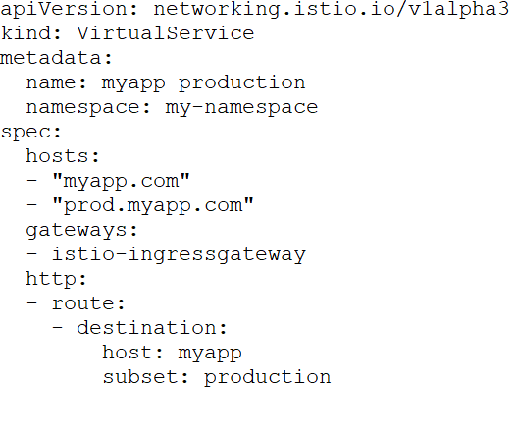
Request Routing
Host Based Routing Example:
This example routes all traffic from ‘myapp.com’ and ‘prod.myapp.com’ to the production subset.

Slide 27
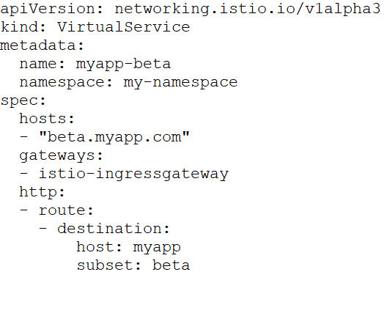
Request Routing
Host Based Routing Example:
This example routes all traffic from ‘beta.myapp.com’ to the beta subset.

Slide 28
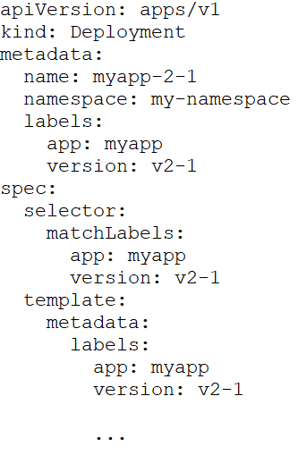
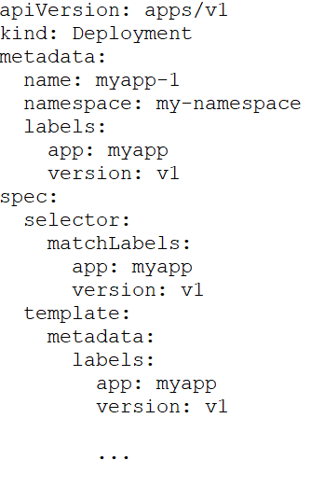
Deployment Staging
Example:
Label your deployments with a unique application version each time you deploy a new version.
Deployment ‘alpha’
Deployment ‘production’

Slide 29
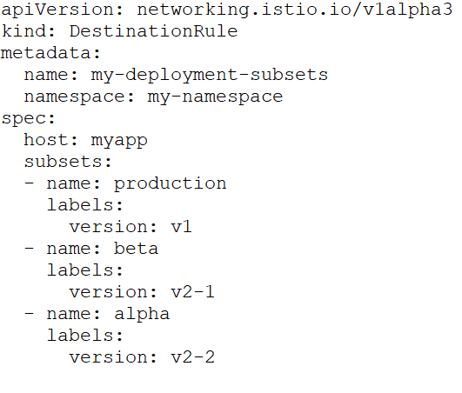
Deployment Staging
Define a DestinationRule to map your application versions into human-readable application subsets.

Slide 30
Deployment Staging
Define your VirtualServices to route to appropriate subsets.
This example routes all traffic from ‘myapp.com’ and ‘prod.myapp.com’ to the production subset.

Slide 31
Deployment Staging
Define your VirtualServices to route to appropriate subsets.
This example routes all traffic from ‘beta.myapp.com’ to the beta subset.

Slide 32
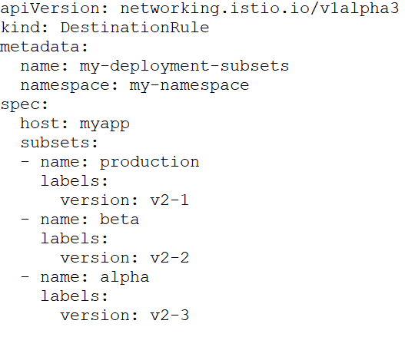
Deployment Staging
Elevating an application version is easy, simply update your DestinationRule.
In this example, beta (v2-1) was elevated to production.

Slide 33
Mesh Visualization
Problem: Migrating from a monolithic mentality can be difficult.
Visualizing your cluster and understanding how your application is behaving is crucial to deploying and managing an istio/kubernetes powered application and it’s complexity.

Slide 34
Ortelius View of Application Versions
K8S Contains 2 Versions of Email Service
myapp v2-1
(production)
Email Service V1.5
Email Service V1.7 (Beta)
myapp v2-2
(beta)
Checkout Service V2.7
Front End V5.5
Ortelius Applications Versions are applied to Isitio
Checkout and Front End shared by both versions

Slide 35
Mesh Visualization
Meet:
Which microservices are part of my service mesh?
How are they connected?
How are they performing?
How can I operate on them?
https://kiali.io/
View your service mesh from a bird’s-eye view.
Enabling solutions to problems as they arise.

Slide 36
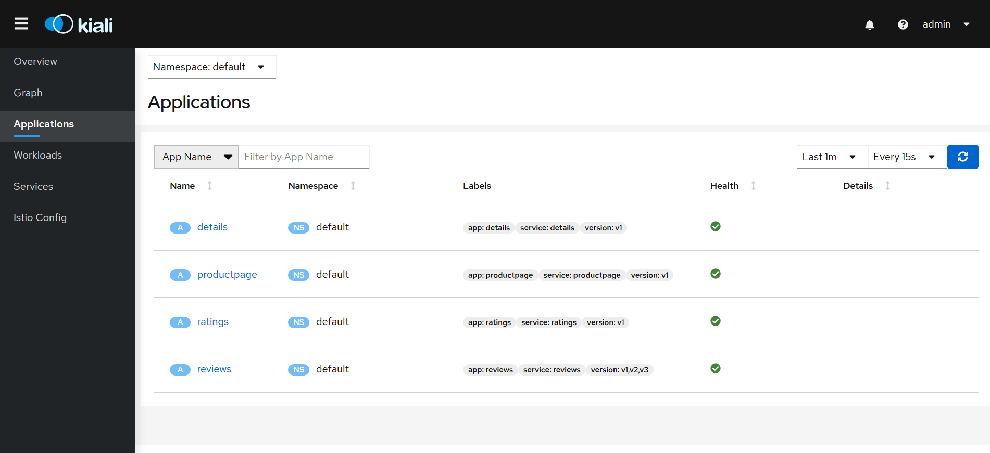
Mesh Visualization
Which microservices are part of my service mesh?

Slide 37
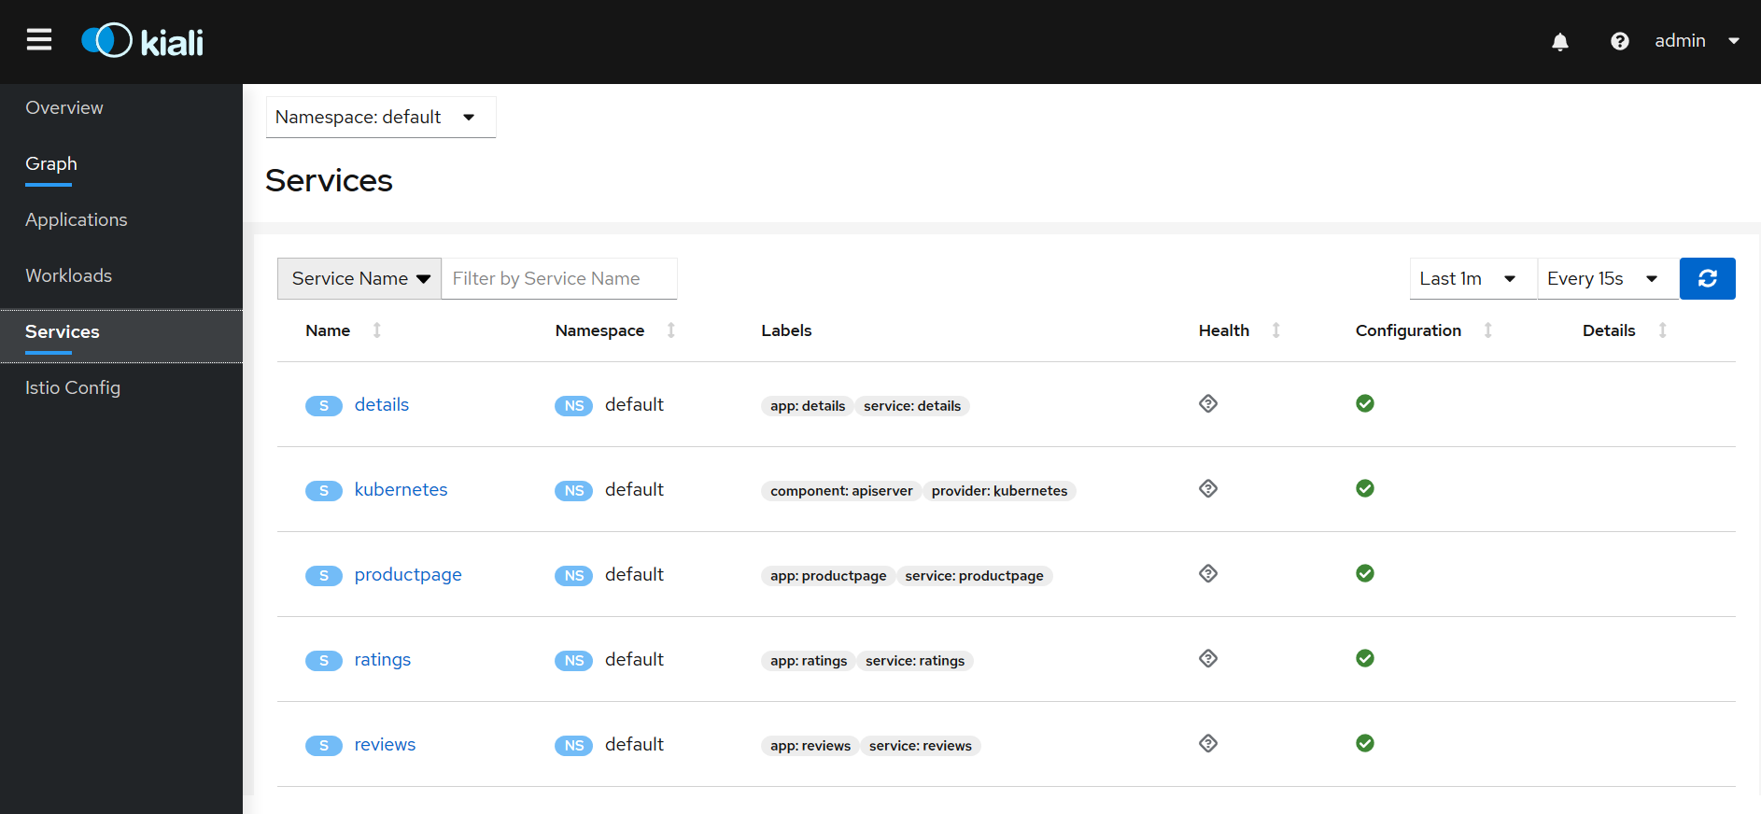
Mesh Visualization
How are my microservices performing?

Slide 38
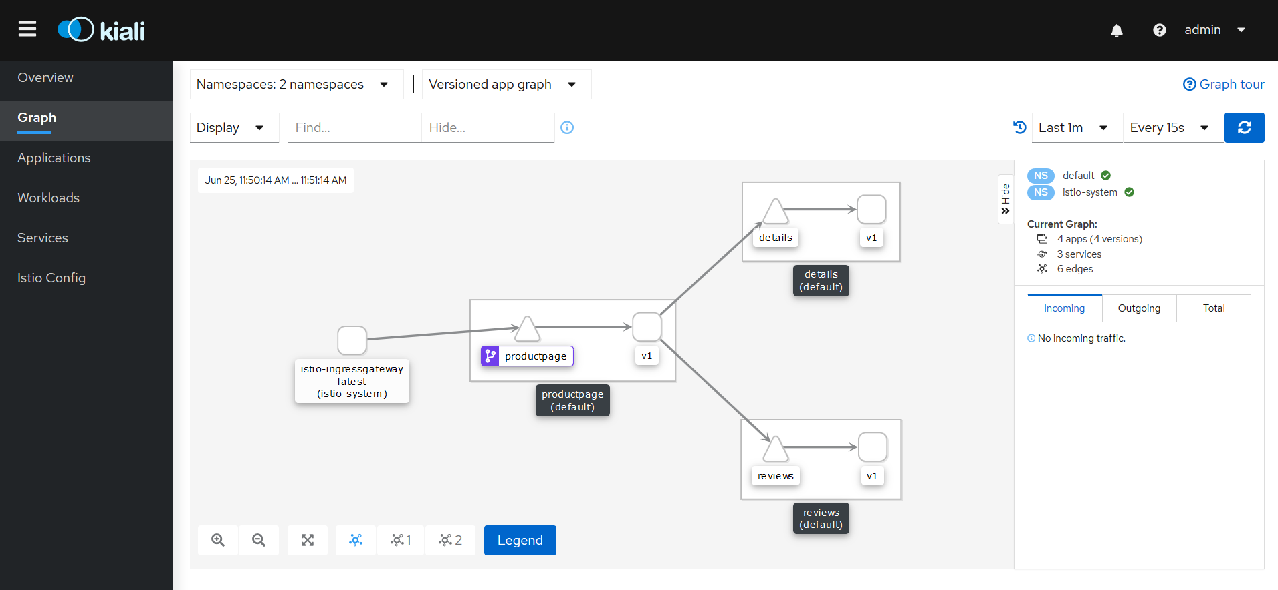
Mesh Visualization
How are my microservices connected?

Slide 39
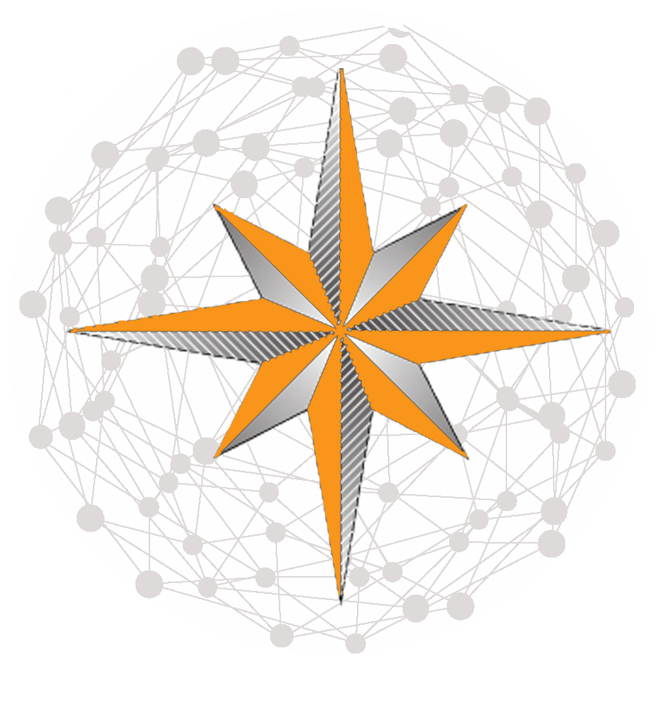
Solution – Ortelius Open Source
Microservice Management for Site Reliability, DevOps Engineers, and Release Teams
A SaaS based central “Hub” for sharing, managing and releasing microservices
Tracks and shows the “logical” application map
Simplifies the complexity of microservices so organizations can achieve business agility
Supports a Domain Catalog
Integrates into Continuous Delivery for continuous configuration management.
Ortelius is the Open Source Core of DeployHub.

Slide 40
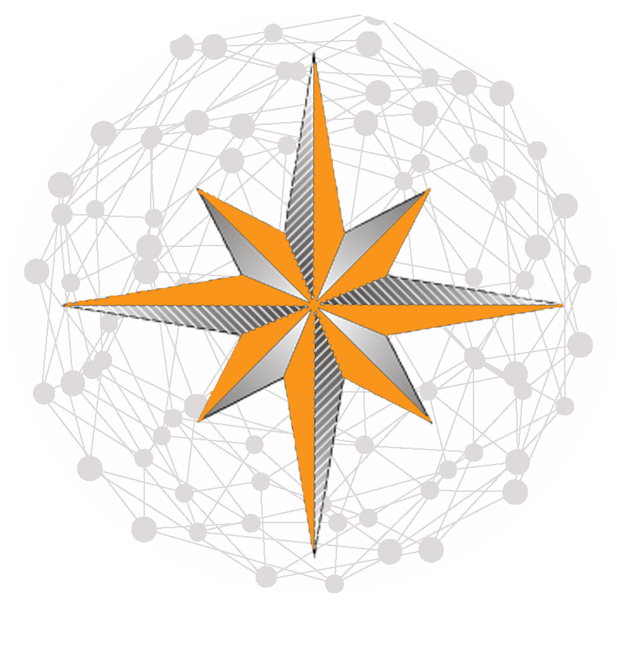
Get Involved in Ortelius
https://github.com/ortelius/ortelius
Learn more at Ortelius.io
If you think what we are doing is cool:
Give us a Star on GitHub
Become an Ambassador
Become a Committer
We need your help and insight. Everyone sees a different part of the landscape we are mapping.
Abraham Ortelius

Slide 41
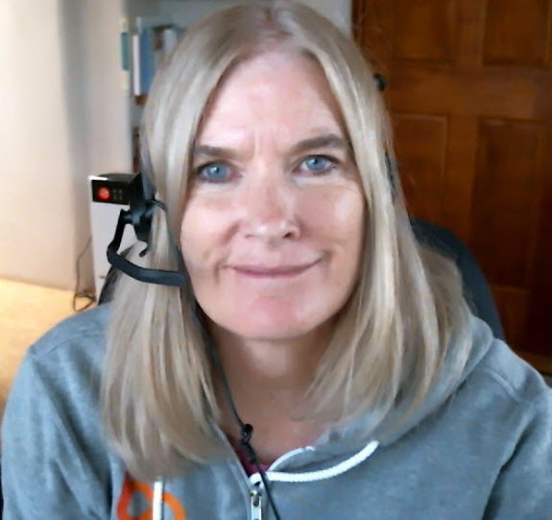
Talk to us…
LinkedIn: https://www.linkedin.com/in/tracy-ragan-oms/
Twitter: https://twitter.com/TracyRagan
Calendar: https://drift.me/tracyragan/meeting/coffeechat
Email: TracyRagan@DeployHub.com
Dig In at: DeployHub.com or Ortelius.io
LinkedIn: https://www.linkedin.com/in/nathan-martin-81333211
Email: nathan@sagecoretech.com
Dig In at: Tetricor.com OR SagecoreTech.com

Slide 43
Additional Routing

Slide 44
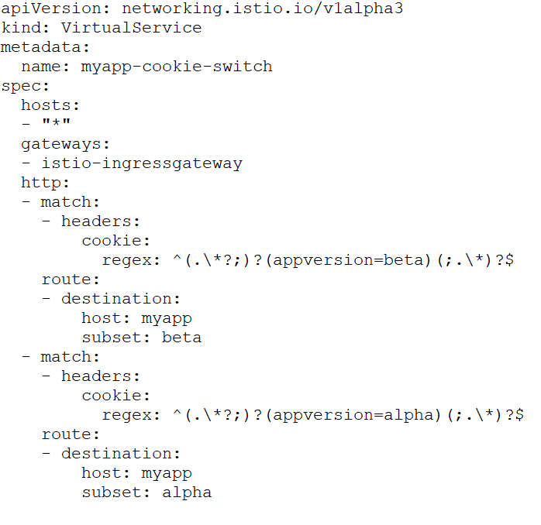
Request Routing
Cookie Routing Example:
This example will route to beta, or alpha application subset depending on the value of the ‘appversion’ cookie ( if included in the request )

Slide 45
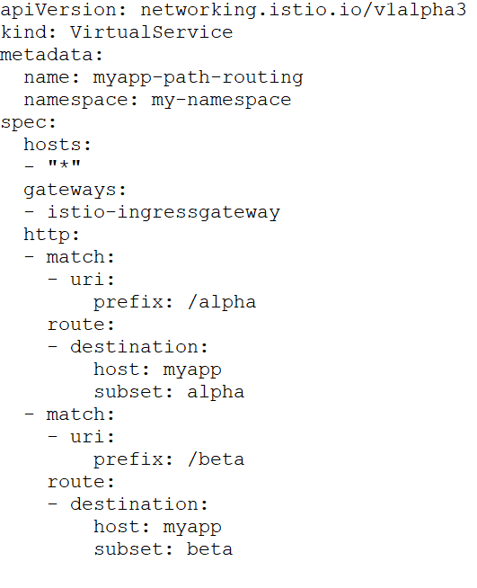
Request Routing
Path Based Routing Example:
This example will route to beta, or alpha application subset depending on the value of the uri prefix.
In this example: myapp.com/beta would route to beta subset.

Slide 46
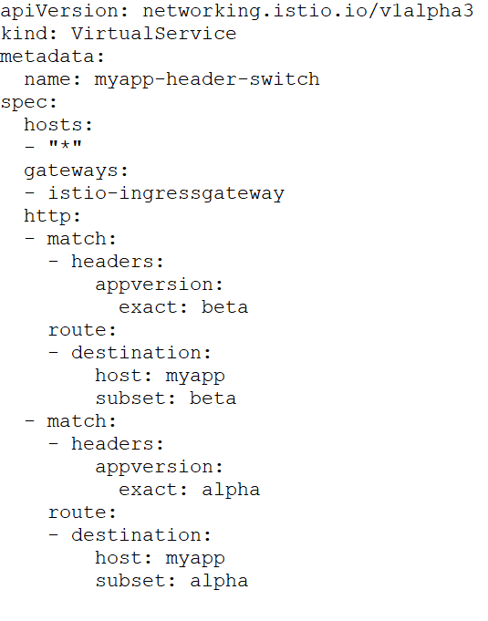
Request Routing
Custom Header Routing Example:
This example will route to beta, or alpha application subset depending on the value of the ‘appversion’ header ( if included in the request )

