Slide 1
Monitoring Kubernetes clusters by “chatting” with them
InfraCloud Technologies
25 June 2020
https://twitter.com/infracloudio
Notes:
Welcome to this webinar on monitoring Kubernetes clusters by “chatting” with them.

Slide 2
Speakers
Prasad Ghangal
Creator of BotKube and Software geek @InfraCloud
Vishal Biyani
CTO
@InfraCloud
Hrishikesh Deodhar
Director of Engineering @InfraCloud
Notes:
A quick introduction.
I am Prasad and I created BotKube as part of an internal hackathon and I have been building it for over 1.5 years now. My interests are <>
I am Vishal - and I am CTO and Founder at InfraCloud technologies - we are a cloud native company helping companies adopt and implement cloud native technology. I also contribute to Fission which is a FaaS platform built with Kubernetes. My interests are mostly around Kubernetes, Serverless and enterprise adoption of the modern technologies.
I am Hrishikesh - and I am director of engineering at InfraCloud. Helping customers adopt cloud-native technologies interests me.

Slide 3
Brief Agenda
BotKube Introduction
Notifier
Chat with Kubectl
Filters
Use Cases
Debugging & monitoring applications
Collaborative debugging in teams
Monitor and Audit events
Incident management
Notes:
[Vishal] So today we are briefly going to talk about BotKube - what problem it solves and what use cases it enables. We will start with introduction to basics of botkube and capabilities. We will then see the real use cases we have seen end users using BotKube for.

Slide 4
Introduction to

Slide 5
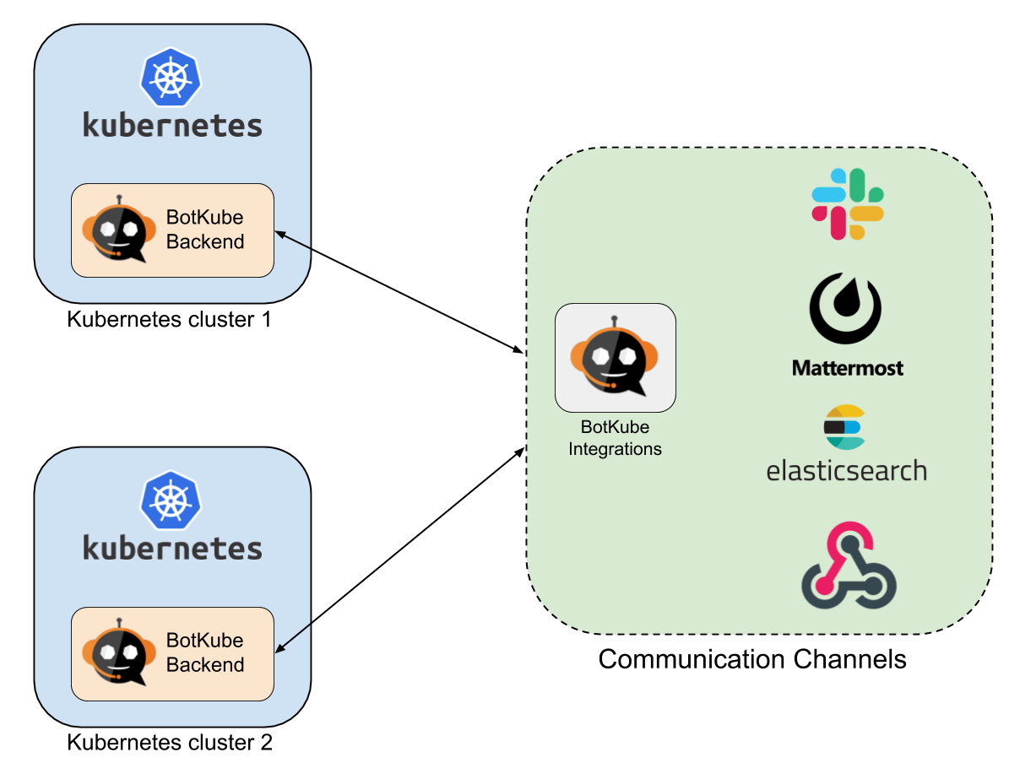
What is BotKube?
A bot for Kubernetes clusters
Monitoring & auditing tool
Enables Collaboration
Notes:
BotKube is an application written to enable teams manage their kubernetes clusters right from their daily messaging and collaboration platforms.
It enables monitoring and auditing of multiple Kubernetes clusters in a collaborative manner. We will look at all of the aspects around monitoring, debugging and collaboration in the following slides.
BotKube supports multiple backends - including Slack, MatterMost and Elastic and while we know there are differences in each of these, let’s talk in context of Slack for now.
So in terms of getting setup, you will need to install first the BotKube app in Slack and then For each cluster that you want to monitor - the BotKube has to be installed in the cluster with Helm chart by providing the appropriate Slack keys and other details.

Slide 6
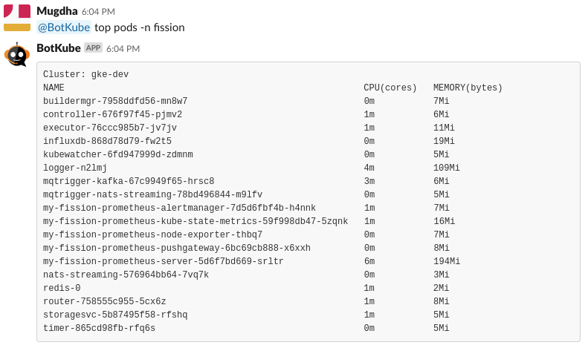
Kubectl at your fingertips
Fire Kubectl commands to BotKube or in a channel
Sub-commands and types exposed configurable too!
Enable/Disable for a cluster
Notes:
Lastly - once BotKube is configured in cluster and in Slack - you can run Kubectl commands in a channel or individually. The details of which commands to allow, which objects should be visible etc. is completely configurable. But this allows teams to debug collaboratively!

Slide 7
Various Targets
Bi-directional
Sink
Slack, Elastic, MatterMost supported
Discord, Microsoft Teams and Telegram coming
💡
Give BotKube a spin - visit BotKube.io
Notes:
As of today Slack, MatterMost and Elastic are supported. In case of Elastic it acts as a pure sink for all events and information - whereas in case of Slack and MatterMost it is more interactive
We are also adding support for Microsoft Teams, Discord and Telegram.

Slide 8
Filters - like custom interceptors
Event Source
Write “custom logic” for certain events
An event can pass through multiple filters
Do something custom with event (Enrich event or add logic)
Filter
Target
Notes:
BotKube has concept of filters - which are like interceptors. You can intercept an event and decide to something custom on that. For example for a specific events - you might want to gather more information or enrich message before sending it to slack.

Slide 9
BotKube on GitHub: Star & Show
You can Star & show ❤️ here
https://github.com/infracloudio/botkube
Notes:
While you are here, please go to BotKube’s GitHub repo and show some love by starring the repo! We would also love to see if there are features you would like to see - so please feel free to file an issue too!

Slide 10
Let’s Talk about
Use Cases

Slide 11
Monitoring & Auditing events
Notes:
One usecase other than receiving event based notifications is also when we use BotKube for alerting based on Audited logs.

Slide 12
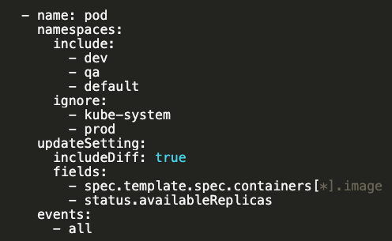
Configure Events for your needs
Resource configuration.
Resource & event level configuration
Specific fields and diff
Namespace level filtering
Notes:
Now when you install BotKube - you can configure quite a few things and the configuration is quite flexible
There are a few broad kinds of configurations, the example here is of the resource configuration. It allows you to configure which resources you want the events for and specifically which events out of CRUD operations you care for and also namespace granularity is configurable.
You can also additionally decide to include the diff of change and look for specific field changes by using JSON path expression.
There is also communication config in which you can configure Slack endpoint or other endpoints to send to

Slide 13
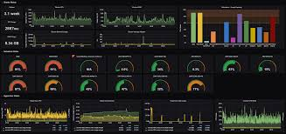
Monitoring & Auditing events
Audit Events
A bot for Kubernetes clusters
Monitoring & auditing tool
Enables Collaboration
BotKube as a event sink via WebHook
- Apply filters to audit events
- Alert immediately on crucial events and store rest of them
Important Events
All Events
Notes:
The kube-api server generates audit events which generate an audit trail of the actions that are performed on the cluster. BotKube can be used to alert for specific events that happened by parsing the audit logs on the cluster. The BotKube application does not store any audit events but rather can act as a forwarder to an audit sink such as Elasticsearch. Botkube can immediately alert for an audit event which needs attention.
For eg: somebody tried to exec into a pod.

Slide 14
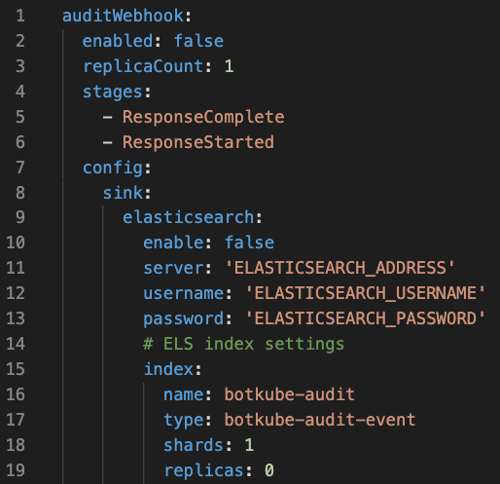
Audit Events 1/2
A sample audit configuration
Stages of audit event
Sink targets
Notes:
The audit event processing configuration allows BotKube to act as a forwarder which intercepts audit events, and alerts based on the condition in the rego expression.

Slide 15
Audit Events: Notification 2/2
Rego expression for condition
Notification for events which match expression
Notes:
The rego policy language which is popularized with the Open policy agent project allows a very easy way of writing alert policies which BotKube alerts on (after parsing the audit logs)

Slide 16
Incident Management
Notes:
A preview feature
BotKube notifications on the channel can be turned into an incident (support upcoming) or a way of notifying another team by using workflows. (Slack workflows as of now).
A very simplistic example: An Ops channel gets a notification about a failing deployment on a cluster. The Operations engineer performs some basic triage and realises this is a deployment bug where the label selectors on a service or the Network policy within a namespace is blocking traffic to the pods. He/she can trigger a slack workflow which notifies another channel of developers marking this as an incident that needs to be fixed.

Slide 17
Incident Management
Build workflows with Slack Workflow
Integrate with other Incident Management systems such as PagerDuty, VictorOps
During incident - use Kubectl to debug collaboratively!
💡
Give BotKube a spin - visit BotKube.io
Notes:
A preview feature.
A very simplistic example: An Ops channel gets a notification about a failing deployment on a cluster. The Operations engineer performs some basic triage and realises this is a deployment bug where the label selectors on a service or the Network policy within a namespace is blocking traffic to the pods. He/she can trigger a slack workflow which notifies another channel of developers marking this as an incident that needs to be fixed.

Slide 18
Debugging & Monitoring Applications
Notes:
BotKube has 2 interfaces though which is communicates - notifier and bot. With notifiers interface BotKube sends alerts to the communication medius - one way communication. With Bot interface BotKube listens for incoming messages, processes them and sends back the response.

Slide 19
Debugging Applications
Debugging pending pods
Debugging an unreachable pod
Debug Running pods
Debug Services
Debugging nodes
Notes:
We can ask BotKube to execute kubectl commands on targeted K8s cluster and get the response. This allow us to do quick health check on K8s cluster without leaving the messaging window even from mobile.

Slide 20
Collaborative debugging

Slide 21
Collaborative Debugging
Accessing multiple clusters & namespaces
Cluster 1
BotKube
Backend
Slack App
Channel
Cluster 2
BotKube
Backend
Notes:
BotKube provides a single platform through which we can talk to multiple cluster. This reduces overhead of managing multiple kubeconfigs. The fine grained BotKube configuration allows us to have different mapping of cluster to Slack channel.

Slide 22
Collaborative Debugging
Mapping Cluster <> Channels as per need
Cluster Dev
BotKube
Backend
Slack App
Dev Channel
Cluster Prod
Prod Channel
BotKube
Backend
Notes:
BotKube can be configured to send alerts from clusters to dedicated channels. This enables us to filter and send alerts to respective owner groups. e.g development cluster and staging cluster can be configured to send alerts to dev engg groups and SRE groups

Slide 23
Collaborative Debugging
Team specific permissions
Channel 1: Read Access
Slack App
Namespace
BotKube
Backend
Channel 2: Write Access
Kubernetes Cluster
Notes:
We are working towards making the BotKube configuration more granular to allow different command execution permission accross different channel. In coming release it will be possible to send BotKube alerts from specific namespaces to specific channels.

Slide 24
“Chatting” with cluster

Slide 25
What’s coming next in BotKube?
Integration with incident management systems
More chat backends: MS Teams, Telegram, Discord, Gitter
Kubectl Aliases
Support for custom resources
More build in filters - like kubescan
Profiles support for various needs

Slide 26
Resources
botkube.io
https://github.com/infracloudio/botkube
join.botkube.io

Slide 27
Open House & Thank you!
ধন্যবাদ!
Dank je!
Kiitos!
આભાર!
धन्यवाद!
Grazie!
Je vous remercie!
ありがとうございました！
ਤੁਹਾਡਾ ਧੰਨਵਾਦ!
நன்றி!
ధన్యవాదాలు!
നന്ദി!
THANK YOU!
Follow us https://twitter.com/infracloudio

