Slide 1
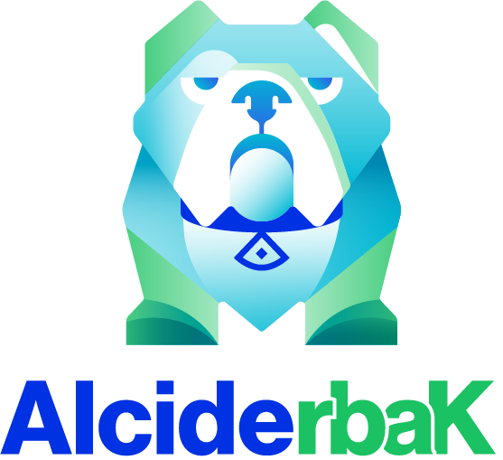
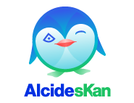
Kubernetes Security Anatomy & the recent CVEs perspective
Gadi Naor, CTO
Alcide Jul 2020

Slide 2
In today’s session
Kubernetes Security Building Blocks
Demos
The Recent Kubernetes CVEs (CVE-2020-10749 & CVE-2020-8555)
Detection & Preventions
Notes:
Convenient for developers while performing operational changes. Audit trails, comments Git is a part of every developer’s toolkit version control, history, peer review, and rollbacks

Slide 3
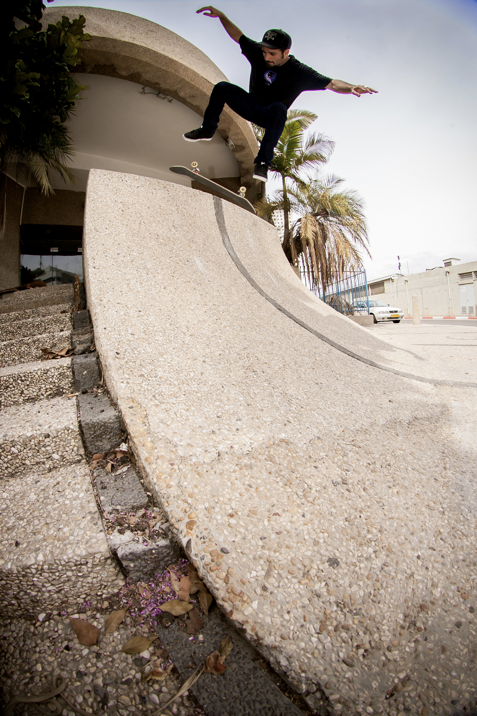
Yours Truly
about# gadi.naor
--from tel_aviv
--enjoy sk8boarding
--kernel-dev @check_point --kernel-dev @altor_networks --kernel-dev @juniper_networks
--cloud-native @alcideio
validate k8s cluster
@alcideio
@gadinaor
Copyright ©2020 Alcide.io, All Rights Reserved

Slide 4
Kubernetes Security Building Blocks
Cloud Account
Identity (Authentication)
RBAC
(Authorization)
Pod
Security Policies
Secrets
Network Policies
Container
Image
Scan
Code Scan
Compute (Nodes)
Container Security Context
Validating Admission
Control
Dynamic Secret
Injection
Image
Signing
Pod Security Context
Control Plane
Services
SAST
Network
Mutating Admission
Control
Pod Identity
Webhook
Image Policy Webhook
Ingress
DAST
Storage
Pod QoS
Cloud + Cluster
Workloads
App Code

Slide 5
Kubernetes Security Building Blocks
Cloud Account
Identity (Authentication)
RBAC
(Authorization)
Pod
Security Policies
Secrets
Network Policies
Container
Image
Scan
Code Scan
Compute (Nodes)
Container Security Context
Validating Admission
Control
Dynamic Secret
Injection
Image
Signing
Pod Security Context
Control Plane
Services
SAST
Network
Mutating Admission
Control
Pod Identity
Webhook
Image Policy Webhook
Ingress
DAST
Storage
Pod QoS
Cloud + Cluster
Workloads
App Code

Slide 6
Kubernetes Security Building Blocks
Cloud Account
Identity (Authentication)
RBAC
(Authorization)
Pod
Security Policies
Secrets
Network Policies
Container
Image
Scan
Code Scan
Compute (Nodes)
Container Security Context
Validating Admission
Control
Dynamic Secret
Injection
Image
Signing
Pod Security Context
Control Plane
Services
SAST
Network
Mutating Admission
Control
Pod Identity
Webhook
Image Policy Webhook
Ingress
DAST
Storage
Pod QoS
Cloud + Cluster
Workloads
App Code

Slide 7
Kubernetes Security Building Blocks
Cloud Account
Identity (Authentication)
RBAC
(Authorization)
Pod
Security Policies
Secrets
Network Policies
Container
Image
Scan
Code Scan
Compute (Nodes)
Container Security Context
Validating Admission
Control
Dynamic Secret
Injection
Image
Signing
Pod Security Context
Control Plane
Services
SAST
Network
Mutating Admission
Control
Pod Identity
Webhook
Image Policy Webhook
Ingress
DAST
Storage
Pod QoS
Cloud + Cluster
Workloads
App Code

Slide 8
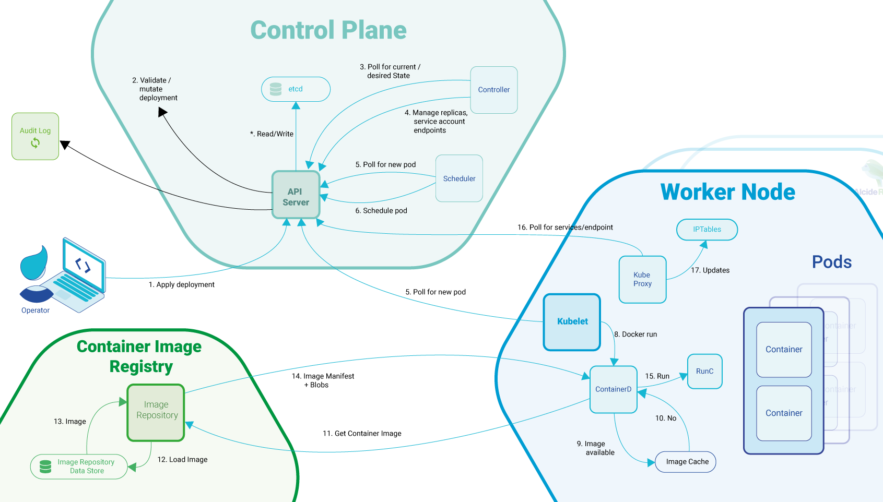
Trust Boundaries

Slide 9
Know Thyself & Know Thy Cluster(s)
Exception Management - how do you manage for the various building blocks those exceptions?
Examples: Exclude namespaces, Exclusion within namespace, Exclusion based on label selector
Multi Cluster- how do you unify the application of security blocks?
Examples: PCI regulated applications, Stage + Prod, Multiple Applications
Multi Cloud - unifying security is very challenging
Examples: Kubernetes Audit Log, Pod Identity, Cloud Account ...
Security Life Cycle - Life span longer/different than cluster lifespan
Examples: Secrets (API Keys, Token,..), User Identity, Certificates, …
“Shift Left” - Integrate Security Tools to your pipelines (CI + CD)
Examples: Source Scan@CI, Image Scan@CI, Helm/YAML Scan@CI, Test Cluster Configuration Scan@CD

Slide 10
Scan Your Clusters

Slide 11
CVEs & Kubernetes
CVE ⇒ Common Vulnerabilities and Exposures
Kubernetes (and Golang) - not immune to bugs nor security bugs
K8S has a vulnerability disclosure process
Bug Bounty program if you feel like hacking for living is your thing
2 Most recent CVEs: CVE-2020-8555 & CVE-2020-10749
Notes:
Convenient for developers while performing operational changes. Audit trails, comments Git is a part of every developer’s toolkit version control, history, peer review, and rollbacks

Slide 12
CVE-2020-10749
Man-In-The-Middle (MiTM) Attack Leverages IPv6 Router Advertisements
Not core k8s vulnerability
Forwarding Plane/CNI specific weakness
CAP_NET_RAW - Sending ICMPv6 messages is a prerequisite for this exploit
Istio is not useful at helping this type of attack vectors
Think zero-trust // if something is not explicitly allowed → it’s denied/blocked
6.0 cvss
Notes:
Convenient for developers while performing operational changes. Audit trails, comments Git is a part of every developer’s toolkit version control, history, peer review, and rollbacks

Slide 13
CVE-2020-10749
Man-In-The-Middle (MiTM) Attack Leverages IPv6 Router Advertisements
Mitigate: → Deny/Block IPv6 malicious traffic → ….Do not run (network) privileged containers → ….Disable OS Kernel features
Fix: → Upgrade vulnerable CNI
Notes:
Convenient for developers while performing operational changes. Audit trails, comments Git is a part of every developer’s toolkit version control, history, peer review, and rollbacks

Slide 14
CVE-2020-8555
Half-Blind Server-Side Request Forgery (SSRF) in kube/cloud-controller-manager
apiVersion: storage.k8s.io/v1
kind: StorageClass
metadata:
name: slow
provisioner: kubernetes.io/glusterfs
parameters:
resturl: "http://127.0.0.1:8081"
clusterid: "630372ccdc720a92c681fb928f27b53f"
restauthenabled: "true"
restuser: "admin"
secretNamespace: "default"
secretName: "heketi-secret"
gidMin: "40000"
gidMax: "50000"
volumetype: "replicate:3"
6.3 cvss
10 cvss
Official CVE Rating
Self Rated @ Managed K8S
Notes:
Convenient for developers while performing operational changes. Audit trails, comments Git is a part of every developer’s toolkit version control, history, peer review, and rollbacks

Slide 15
CVE-2020-8555 // Disclosure Timeline
6th December 2019 : MSRC Bug Bounty case submission
3rd January 2020 : K8s has been informed by a third-party actor about the security issue discovered.
15th January 2020 : K8s team provided with technical and generic report k8s HackerOne bug bounty program.
15th January 2020 : Kubernetes noticed us that the half blind SSRF part + CRLF injection for old releases was being considered as an in-core vulnerability.
15th January 2020 : Bounty Received from MSRC through HackerOne
16th January 2020 : Kubernetes PSC (Product Security Committee) acknowledged the vulnerability and requested us the mid-march embargo due to the numerous distributors involved on this security matter.
11th February 2020 : Bounty received from Google VRP
4th March 2020 : Bounty received from Kubernetes through HackerOne
15th March 2020 : Initial planned public disclosure delayed due to COVID-19 situation
1st June 2020 : Kubernetes + Microsoft Public Disclosure
Official CVE Rating
6.3 cvss
v1.0-1.14
versions prior to v1.15.12, v1.16.9, v1.17.5,
v1.18.0
10 cvss
Self Rated @ Managed K8S
Notes:
Convenient for developers while performing operational changes. Audit trails, comments Git is a part of every developer’s toolkit version control, history, peer review, and rollbacks

Slide 16
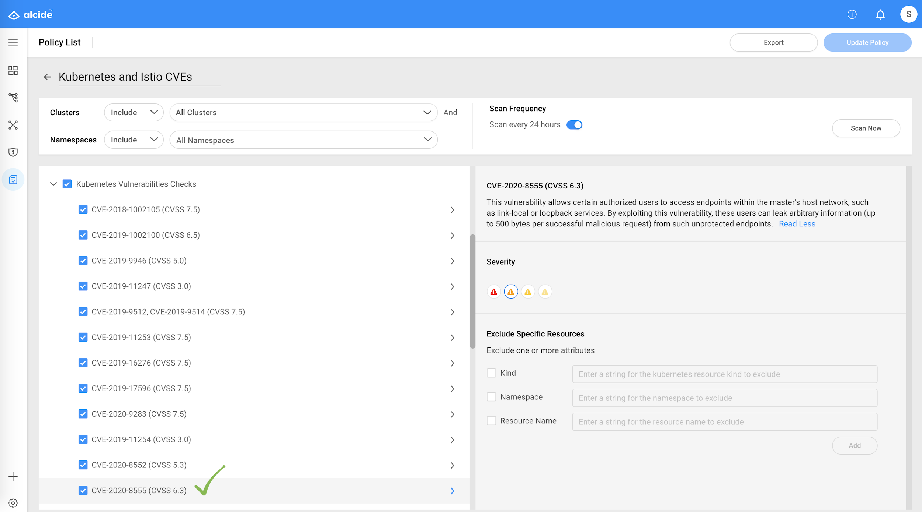
Scan Your Clusters

Slide 17
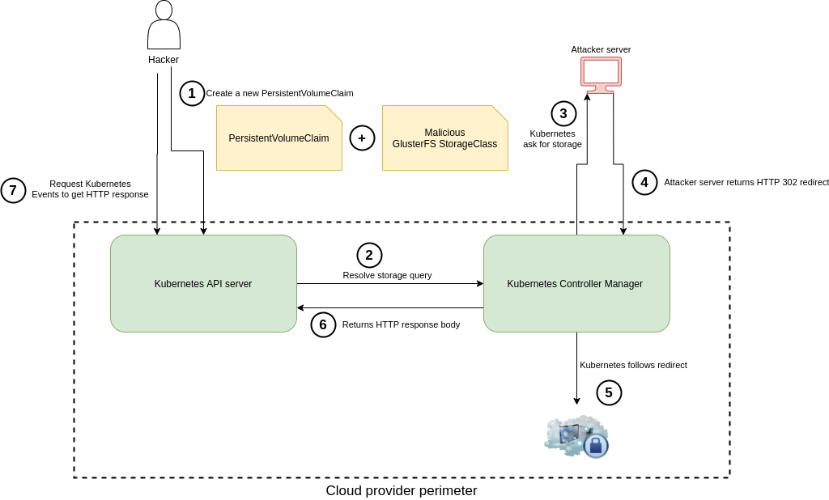
CVE-2020-8555
Half-Blind Server-Side Request Forgery (SSRF) in kube/cloud-controller-manager
Create Malicious StorageClass + Create PVC
kube-apiserver resolve storage query
kube/cloud-controller-manager ask for storage
attacker reply with HTTP redirect (302)
kube/cloud-controller-manager follows redirect
kube/cloud-controller-manager return HTTP response
kubectl get events to read HTTP response
source: https://medium.com/@BreizhZeroDayHunters/when-its-not-only-about-a-kubernetes-cve-8f6b448eafa8
Notes:
Convenient for developers while performing operational changes. Audit trails, comments Git is a part of every developer’s toolkit version control, history, peer review, and rollbacks

Slide 18
Kubernetes Audit Logs - Security Gold Mine
Detect threats using Kubernetes Audit logs
Raw Audit Logs
Analysis & Detection
Exploited vulnerabilities in Kubernetes API server
Stolen credentials Stolen tokens
Compliance based policies
Misconfigured RBAC

Slide 19
Security Issues that Kubernetes Customers Face
Users. Activities. Exposure
Stolen Credentials
The Result: Gaining initial access to cluster
Stolen Token
The result: Performing lateral movement, privilege escalation, data access and data manipulation while evading detection
Misconfigured RBAC
The result: Performing lateral movement, privilege escalation, data access and data manipulation while evading detection
Exploited Vulnerabilities in Kubernetes API Server
The result: Gaining access to privileged and sensitive resources

Slide 20
Security Issues that Kubernetes Customers Face
Users. Activities. Exposure
Exploited Vulnerabilities in Kubernetes API Server
The result: Gaining access to privileged and sensitive resources
Alert on Policy & Compliance Violations
The result: Stay compliant, invoke security playbooks on violations

Slide 21
Real-time Kubernetes Audit Analysis
Automatic and Proactive Audit Analysis
Detect security-related abuse of Kubernetes cluster
Identify anomalous behaviors and suspicious activity patterns
Observing multiple activities with extended context that is not limited to configured rules
Focus compliance investigations on Kubernetes misuses
Looking beyond simple log filtering rules

Slide 22
kAudit Use Cases Examples
Remote Shell Access
Cluster user does: kubectl exec <pod> bash
Selected Audit Events: user’s rules filtering of audit entries
Audit Data Summary: graphical view of Shell & Direct Access
Abnormal User Account Activity
Account credentials reused from different sources in a short period
Detected Anomalies: as anomalous behavior in cluster and of specific user
Audit Data Summary: Audit forensic capabilities
Unauthorized Access
Access denied to k8s resources due to:
Pattern changes (or more events)
Detected Anomalies on specific user/service-account
Can be filtered (focused) on activity of the user/service-account to understand impact

Slide 23
Try Alcide Kubernetes Security
Security Scan Your Cluster - Alcide Advisor (Free) alcide.io/pricing/free-forever
Kubernetes Security Monitoring - Alcide kAudit alcide.io/kaudit-K8s-forensics
Open Tools github.com/alcideio
Tutorials codelab.alcide.io
Copyright ©2020 Alcide.io, All Rights Reserved

Slide 24
THANK YOU!
www.alcide.io
@alcideio
@gadinaor
Copyright ©2020 Alcide.io, All Rights Reserved

