Slide 1
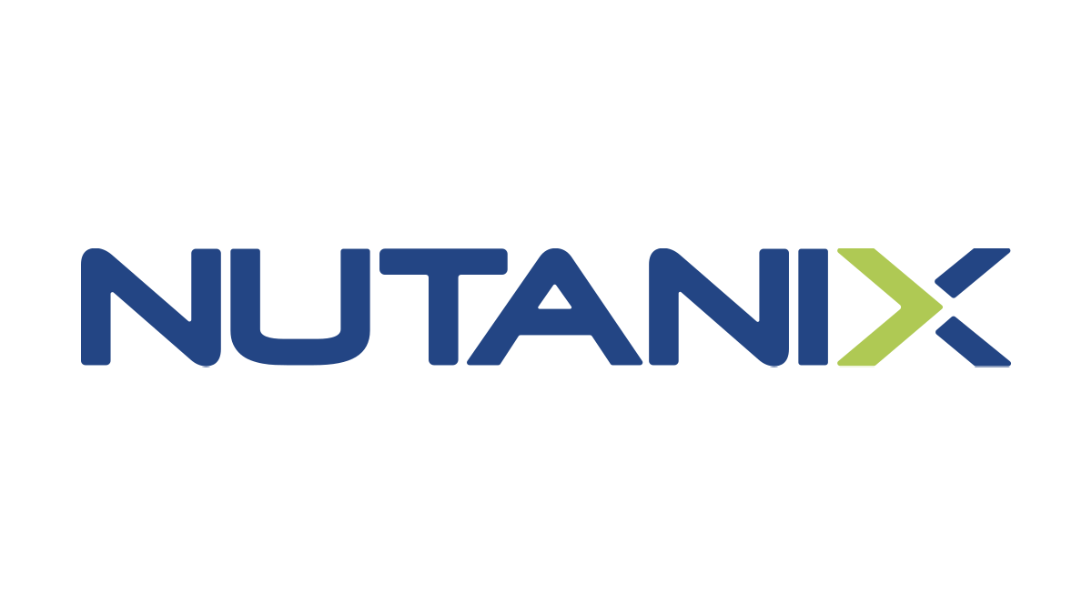
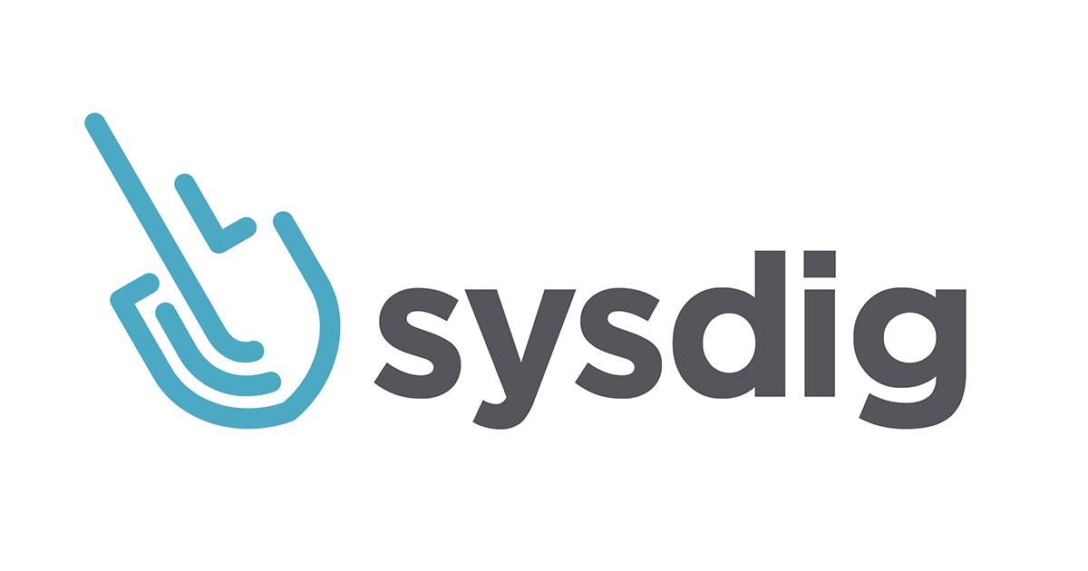
Joint Webinar
Critical DevSecOps Considerations
For Multicloud Kubernetes
September 18th, 2020
PRESENTED BY:

Slide 2
Presenters
Sylvain Huguet
Sr. Product Manager Karbon | Cloud Native Solutions
Loris Digioanni
CTO and Founder

Slide 3
Every Enterprise Is A Software Enterprise
Industrial IOT
Connected Cars
SOFTWARE
Artificial Intelligence
Direct To Consumer

Slide 4
Container Adoption Is Evolving
Lightweight VMs
CI-CD
Cloud Native
Provide a more efficient form of virtualization with smaller images and faster boot time
Make it easy to package application components and run them in different environments
Building block for microservices
Notes:
But not surprisingly, as wonderful as containers and microservices are, they come with a host of new challenges that enterprises must solve in order to unlock these new benefits.
Containers – useful for developers, but the ‘black box’ nature makes it hard to monitor and troubleshoot them in production
Microservices – made up of hundreds of containers that are dynamic and ephemeral are a completely new model for applications. Simply asking “how is my application performing” is now a very hard question to answer.
Multi-cloud – providing consistent security and monitoring practices across multiple clouds – be it private or public – is increasingly a challenge. Without these practices, developers will not actually be able to take advantage of what the platforms have to offer.
In short, Containers have complicated the ability to see, analyze and secure distributed enterprise applications.
We have seen this in a number of customer environments – these are just a couple examples. We’ll cover a few of these in-depth later, but I wanted to give you a sense that these challenges are real and we see them in production in many places.
Let’s talk about how we can solve some of these problems.

Slide 5
It’s A Much More Open World
Istio
Falco
OPA
Network policies
Anchore
Admission Controller
Pod Security Policies
Seccomp Profiles
Calico
Notes:
Heap usage at service level.
JVM heap usage for service X
Talk about service topology
Sophisticated demo

Slide 6
The Stack Is More Complex
Istio
Falco
OPA
Network policies
Anchore
Admission Controller
Pod Security Policies
Seccomp Profiles
Calico
Notes:
Heap usage at service level.
JVM heap usage for service X
Talk about service topology
Sophisticated demo

Slide 7
Cloud instances = Cattle
Notes:
Heap usage at service level.
JVM heap usage for service X
Talk about service topology
Sophisticated demo

Slide 8
Containers = Swarms of locusts
Notes:
Heap usage at service level.
JVM heap usage for service X
Talk about service topology
Sophisticated demo

Slide 9
It’s hard to understand what locusts do.
It’s hard to secure them.
Notes:
Heap usage at service level.
JVM heap usage for service X
Talk about service topology
Sophisticated demo

Slide 10
Notes:
Heap usage at service level.
JVM heap usage for service X
Talk about service topology
Sophisticated demo

Slide 11
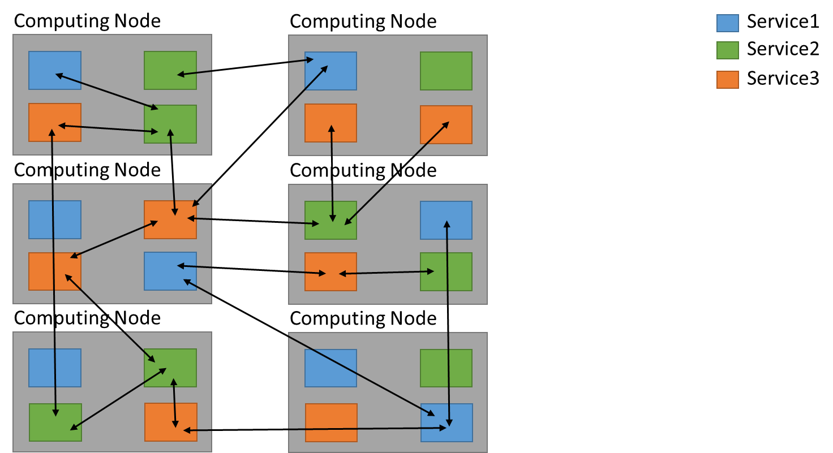
Notes:
Heap usage at service level.
JVM heap usage for service X
Talk about service topology
Sophisticated demo

Slide 12
Legacy tooling can’t help you.
Notes:
Heap usage at service level.
JVM heap usage for service X
Talk about service topology
Sophisticated demo

Slide 13
You can’t secure what you cannot see.
Cloud-native leaves you blind.
Cloud-native security fails without context.
Containers disappear and leave no trail.
Notes:
orgs need to label infra and applications, and leveraging that.
amount of assets, cardinality of labels, whats running where and who its related to
policy configurations (dont associate with IP or domains, instead domains/deployments) vs static model rather be label orchestrator driven

Slide 14
Containers CAN be more secure
Notes:
Heap usage at service level.
JVM heap usage for service X
Talk about service topology
Sophisticated demo

Slide 15
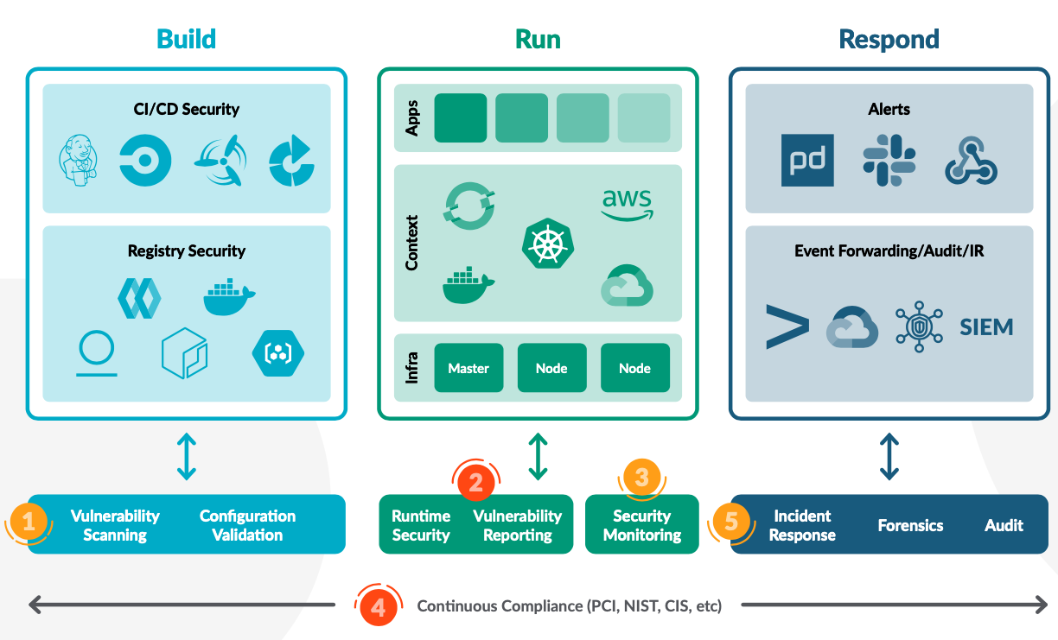
Modern Security
Notes:
You can’t simply secure the top of your stack, you have to secure all of it through and though
Your security posture is as effective as the weakest link in your stack
How secure is your infrastructure? Is it really cloud ready?
And by the way, who manages your infrastructure?

Slide 16
The dreaded ‘Human Error’
can be worse than any swarm of locusts!
Notes:
Because human error can also be an issue, and there is often still human doing a lot of repetitive/boring/error-prone tasks lower down the stack.
So you’ve automated and secure your app, but are your friends in Infra doing the same?

Slide 17
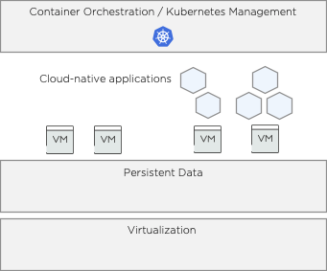
Security Down The Stack
You can make your container platform secure, but is your infrastructure secure?
If your infrastructure isn’t secure, you open yourself to many threat vectors
Down the stack, the “blast radius” gets bigger and bigger
Notes:
So let’s assume every one of you followed all the proven practices related to Cloud Native apps development and deployment.
How much do you trust the infrastructure you’re running on?
How much do you even know this infrastructure?
Did it evolve to follow your new consumption/deployment model, or is it a bunch of legacy 3-tier (storage/network/compute) silos?
What would happen if one of those silos was compromised?

Slide 18
Security Throughout The Cloud Native Journey
Security teams are much closer to DevOps teams than you think. They want:
AUDITABILITY
Automation
Centralized logging
SIMPLE PROCESSES
A microservice does one thing (and one thing only)
NO DISRUPTION
Non-disruptive Kubernetes and node OS upgrades
Needed across the entire stack:
from modern applications to modern infrastructure!
Notes:
Most developers (and ITOps!) that we know and talk to, don’t want to talk to Enterprise Security teams…
But why?
If we take the time to learn their language, Security Teams are actually much closer to the DevOps process/mentality than you would think!
DevOps (or DevSecOps, it’s all the same!) is a process, each team does it, we simply all apply different terms to it.

Slide 19
Security Throughout The Cloud Native Journey
Bring ops, developers, and security practitioners together
We’re all looking for the same thing (we just talk about it differently)
Notes:
Most developers (and ITOps!) that we know and talk to, don’t want to talk to Enterprise Security teams…
But why?
If we take the time to learn their language, Security Teams are actually much closer to the DevOps process/mentality than you would think!
DevOps (or DevSecOps, it’s all the same!) is a process, each team does it, we simply all apply different terms to it.

Slide 20
Security In The Multicloud Era
Is my traditional 3-tier infrastructure able to cope with new cloud-like consumption?
What if infrastructure was an app like any other?
How would *you* go about securing *your* app?
Notes:
If the security of 1x infrastructure supplier (private or public) is an issue, then how about an N x N matrix where you’re now multiplying the number of software stacks/packages that you deploy, by the number of infrastructure providers that you consume infrastructure from?
Why shouldn’t we treat an infrastructure provider like any other app?
So now that we’ve talked about those point, how would *you* go about securing your app?

Slide 21
Thank You
PRESENTED BY:

