Slide 1
Multi Cluster Service Mesh Patterns, Operations, and Extensibility with WebAssembly
Idit Levine
Founder and CEO
@idit_levine
Christian Posta
Global Field CTO
@christianposta

Slide 2
Challenges in Adopting Microservices
Improve velocity of teams building and delivering code
Decentralized implementations vs centralized operations
Connect and include existing systems and investments
Improve security posture
Stay within regulations and compliance
Notes:
Challenges in microservices architecture adoption – desires organizations want

Slide 3
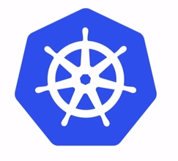
A Solution is many, smaller clusters
High availability
Compliance
Isolation / Autonomy
Scale
Data locality, cost
Public / DMZ / Private networks
Notes:
How to achieve the needs/solve challenges?
Instead of large clusters with tenancy
Consider many small clusters instead

Slide 4
Considerations for multiple clusters
Exact replicas of each other, same fleet?
Separate, non-uniform deployments?
Single operational/administrative control
Segmented by network? Segmented by team?
Independent administration?
Cluster federation? Independent clusters, which services are shared?
Notes:
When you have lots of clusters, you may….

Slide 5
Example: Kubefed
apiVersion: types.kubefed.io/v1beta1
kind: FederatedService
metadata:
name: echo-server
spec:
placement:
clusterSelector:
matchLabels: {}
template:
metadata:
labels:
app: echo-server
spec:
ports:
- name: http
port: 8080
selector:
app: echo-server
Cluster 1
Cluster 0
Kubefed CP
Federate to clusters
Cluster 2
watches
Federated
Resources
https://github.com/kubernetes-sigs/kubefed

Slide 6
Services Need to Communicate with Each Other
Patterns within and outside of Kubernetes
Notes:
Kubernetes the defacto way to build and deploy containerized microservices … but not everything runs in Kubernetes, and not everything will run on premises

Slide 7
Pattern: Flat network across pods
Cluster 1
Cluster 2
Account
Products
User
History

Slide 8
Pattern: Different network, expose all services
Cluster 1
Cluster 2
Account
Products
User
History

Slide 9
Pattern: Different network, controlled gateway
Cluster 1
Cluster 2
Account
Products
User
History

Slide 10
Forces to balance
Security (AuthN/Z, encryption, identity)
Service discovery
Failover / traffic shifting / transparent routing
Observability
Separate networks
Well-defined fault domains
Building for scale

Slide 11
Can you build these patterns just using Kubernetes?

Slide 12
Service Mesh can help

Slide 13
Envoy Proxy is the magic behind service mesh
Envoy Implements the following:
Zone aware, priority/locality load balancing
Circuit breaking, outlier detection
Timeouts, retries, retry budgets
Traffic shadowing
Request racing
Rate limiting
RBAC, TLS origination/termination
Access logging, statistics collection
http://envoyproxy.io
Notes:
Need a way to automate handling of explosive numbers of workloads (microservices)
Placement of workloads AKA deployments
Autoscale, health check, start/stop, rebalance, scale up/down
Building applications for Kubernetes (or any cloud native platform) is fundamentally different
Why Kubernetes won:
* community
Right level of API
Extensible
Declarative configuration model
Foundation of DevOps and Automation model
Adopting microservices to go fast!

Slide 14
Envoy Proxy to do application networking heavy lifting
work load
Account
work load
mTLS
work load
Transparent client-side routing decisions
TLS orig/termination
Circuit breaking
Stats collection
Notes:
Need a way to automate handling of explosive numbers of workloads (microservices)
Placement of workloads AKA deployments
Autoscale, health check, start/stop, rebalance, scale up/down
Building applications for Kubernetes (or any cloud native platform) is fundamentally different
Why Kubernetes won:
* community
Right level of API
Extensible
Declarative configuration model
Foundation of DevOps and Automation model
Adopting microservices to go fast!

Slide 15
Envoy Proxy as backbone for multi-cluster communication federation
Cluster 1
Cluster 2
Account
Products
History
User
User

Slide 16
Other key Envoy Proxy features
Request hedging
Retry Budgets
Load balancing priorities
Locality weighted load balancing
Zone aware routing
Degraded endpoints (fallback)
Aggregated clusters

Slide 17
Multi-Cluster Examples
Service Mesh examples using Envoy Proxy

Slide 18
Three Examples and Considerations
1
Shared Service Mesh Control Plane with Flat Network
2
Shared Service Mesh Control Plane with Separate Networks
3
Separate Service Mesh Control Planes with Separate Networks

Slide 19
1 - Istio shared control plane, flat network
Simplest setup for multi-cluster
No special Envoy routing (though may use zone-aware)
Shared control plane increases the failure domain to multiple clusters
Use simpler, flat networking if possible
No special considerations for identity (identity domain is shared)
Still need to federate telemetry collection
Cluster 1
Cluster 2
Account
Products
History
User
User
Istiod
Notes:
Simplest set up for Istio multi-cluster
No special Envoy routing (though may use zone-aware)
Shared control plane increases the failure domain to multiple clusters
Use flat networking if possible (simpler) but may not have/want that option
No special considerations for identity (identity domain is shared)
Still need to federate telemetry collection

Slide 20
2 - Istio shared control plane, separate networks
Gateway allows communication between networks
Envoy Locality Weighted LB (for the gateway endpoints). Istio calls this “split horizon EDS”.
Shares same failure domain across all clusters
Gateways facilitate communication AND control plane
Slight increase in burden on operator to label networks and gateway endpoints correctly so Istio has that information
Cluster 1
Cluster 2
Account
Products
History
User
User
Istiod
Notes:
Uses a gateway to allow communication between networks
Uses Envoy Locality Weighted LB (for the gateway endpoints). Istio calls this “split horizon EDS”.
Shares same failure domain across all clusters
Use the gateways to facilitate communication AND control plane
Slight increase in burden on operator to label networks and gateway endpoints correctly so Istio has that information

Slide 21
3 - Istio separate control plane, separate networks
Gateway allows communication between networks
Uses Istio ServiceEntry to enable cross-network discovery
Independent control planes
Separate, independent failure domains
Doesn’t solve where trust domains MUST be separate (with federation at the boundaries)
Increased operator burden to maintain service discovery, identity federation, and configuration across meshes
Cluster 1
Cluster 2
Account
Products
History
User
User
Istiod
Istiod
Notes:
Uses a gateway to allow communication between networks
Uses Istio’s ServiceEntry mechanism to enable cross-network discovery
Independent control planes
Separate, independent failure domains
Doesn’t solve where trust domains MUST be separate (with federation at the boundaries)
Increase burden on operator to maintain service discovery, identity federation, and multi-cluster configuration across meshes

Slide 22
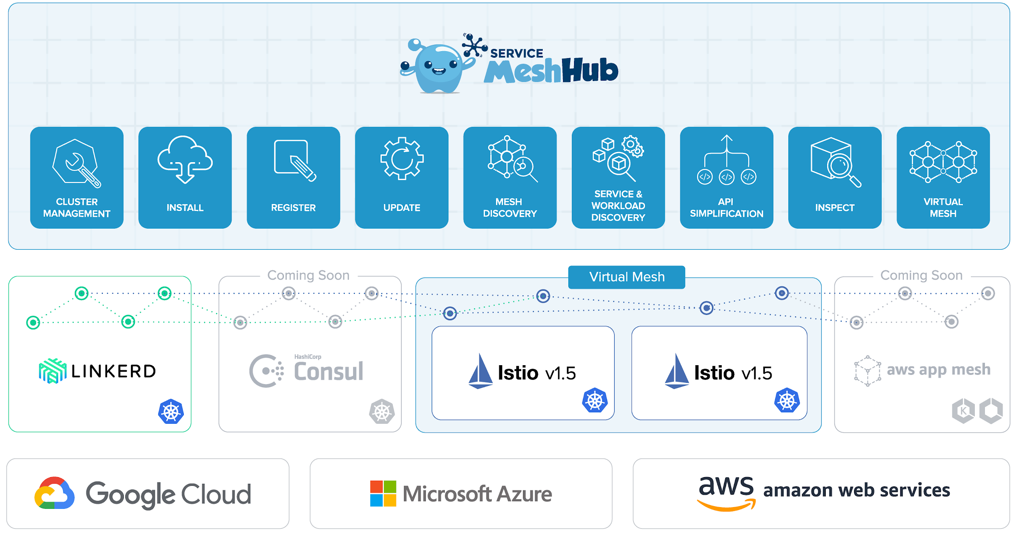
Open Source Service Mesh Hub
Open Source
Install & Configure
Discovery
Unified API
Virtual Mesh
Shared Identity
Developer friendly tooling

Slide 23
Open Source Service Mesh Hub
Cluster 1
Cluster 2
work load
work load
Ingress Gateway
Ingress Gateway
work load
work load
work load
Istiod
Istiod
work load
Management Plane

Slide 24
Demo

Slide 25
Extending the Service Mesh Data Plane with WebAssembly

Slide 26
What is WebAssembly? It’s neither web nor assembly
WebAssembly (abbreviated Wasm) is a binary instruction format for a stack-based virtual machine. Wasm is designed as a portable target for compilation of high-level languages like C/C++/Rust, enabling deployment on the web for client and server applications.
-> No Assembly -> Binary Instruction Format
-> No Web -> WASI
PORTABLE
SECURE
FAST
ANY LANGUAGE

Slide 27
Challenges in customizing Envoy Proxy
Must maintain efficient performance for the data plane
Writing custom filters is difficult and limited to C++
Changes built into Envoy, maintain separate distro
Hard dependencies, cascading failures
Must stop and recompile
EXTERNAL AUTH
RATE LIMITING
gRPC TRANSCODER
CUSTOM
ROUTER
UPSTREAM

Slide 28
WebAssembly in Envoy Proxy
EXTERNAL AUTH
RATE LIMITING
gRPC TRANSCODER
WASM
ROUTER
UPSTREAM

Slide 29
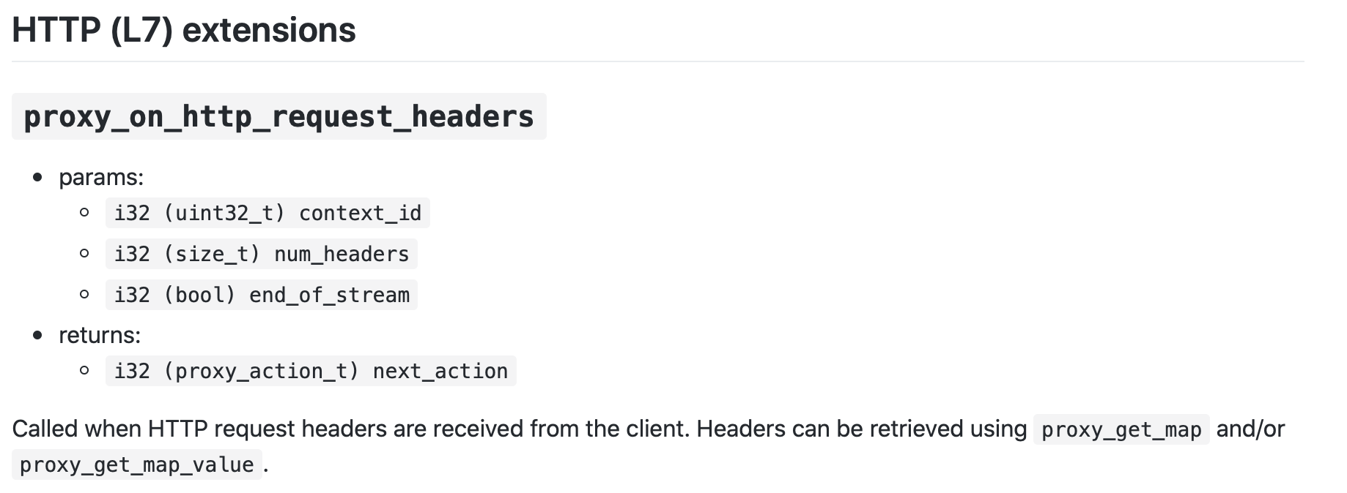
WebAssembly in Envoy Proxy
ABI: Application Binary Interface
EXTERNAL AUTH
Code
RATE LIMITING
ABI
gRPC TRANSCODER
V8
WASM
ROUTER
UPSTREAM

Slide 30
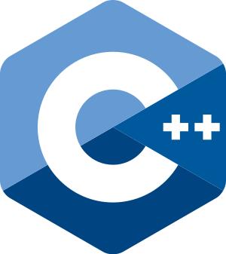
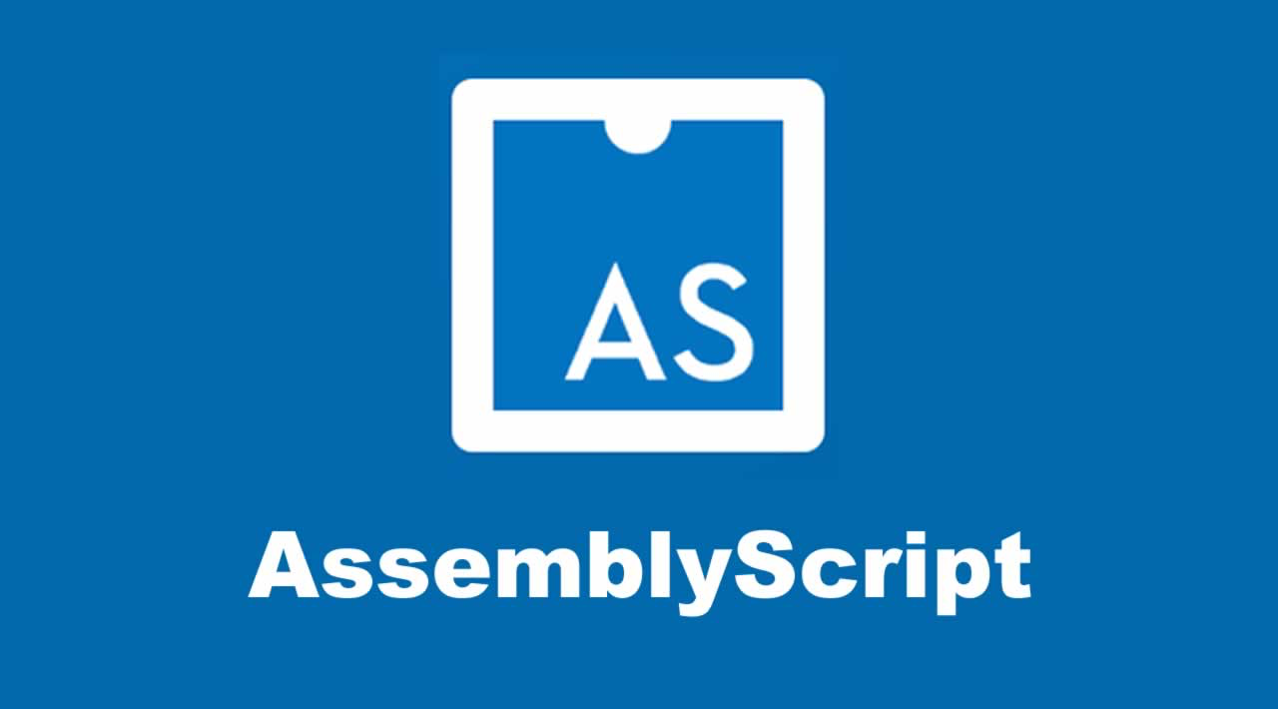
WebAssembly in Envoy Proxy
SDK Includes the following with more coming soon.
EXTERNAL AUTH
Code + SDK
RATE LIMITING
ABI
gRPC TRANSCODER
V8
WASM
ROUTER
UPSTREAM

Slide 31
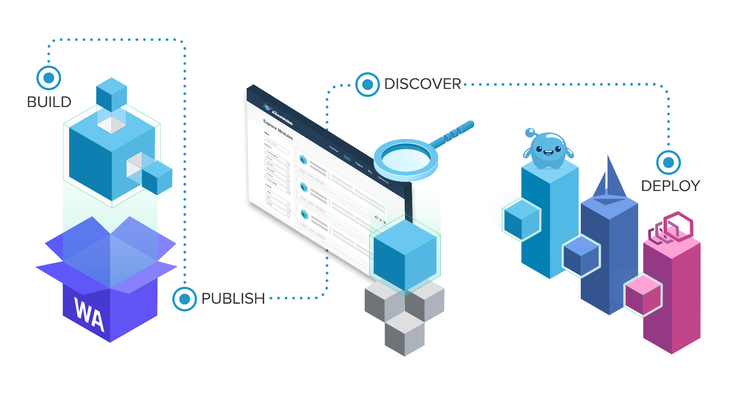
WebAssembly Hub
Developer and operator workflow to build, share, and deploy
Team and user management
Operator uses declarative CRD
Modules are OCI images https://github.com/solo-io/wasm-image-spec

Slide 32
Demo

Slide 33
About Us - We’re Hiring!
solo.io
WebAssembly Hub
webassemblyhub.io
Service Mesh Hub - Community meetings starting June 17th
github.com/solo-io/service-mesh-hub
Join the Community
slack.solo.io

