Slide 1
Getting Started with
Runtime Security using Falco
Loris Degioanni, CTO and founder, Sysdig

Slide 2
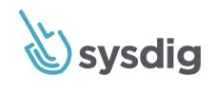
Open by design
Founded by Wireshark co-creator
Contributed Falco to CNCF
Supported open-source sysdig (10M+ downloads)
Ecosystem integration
Cloud-native security and monitoring
Provides visibility and control for secure operations
Loris Degioanni CTO, Founder Sysdig
@lorisdegio
Strong momentum
Customer expansion mirrors cloud-native adoption
Trusted by the largest enterprises

Slide 3
Agenda
Runtime security overview
Comparing runtime security technologies
Falco overview and rules
Demo
History and roadmap

Slide 4
Runtime Security Overview

Slide 5
Why runtime security?
Incident response
Alert on detections right when they happen
Detect malicious behavior
Drift from image scanned
Only present in runtime
Unknown/0-day threats
Forensics
Audit activity and gain knowledge of extent
Compliance with security frameworks from PCI, NIST, SOC

Slide 6
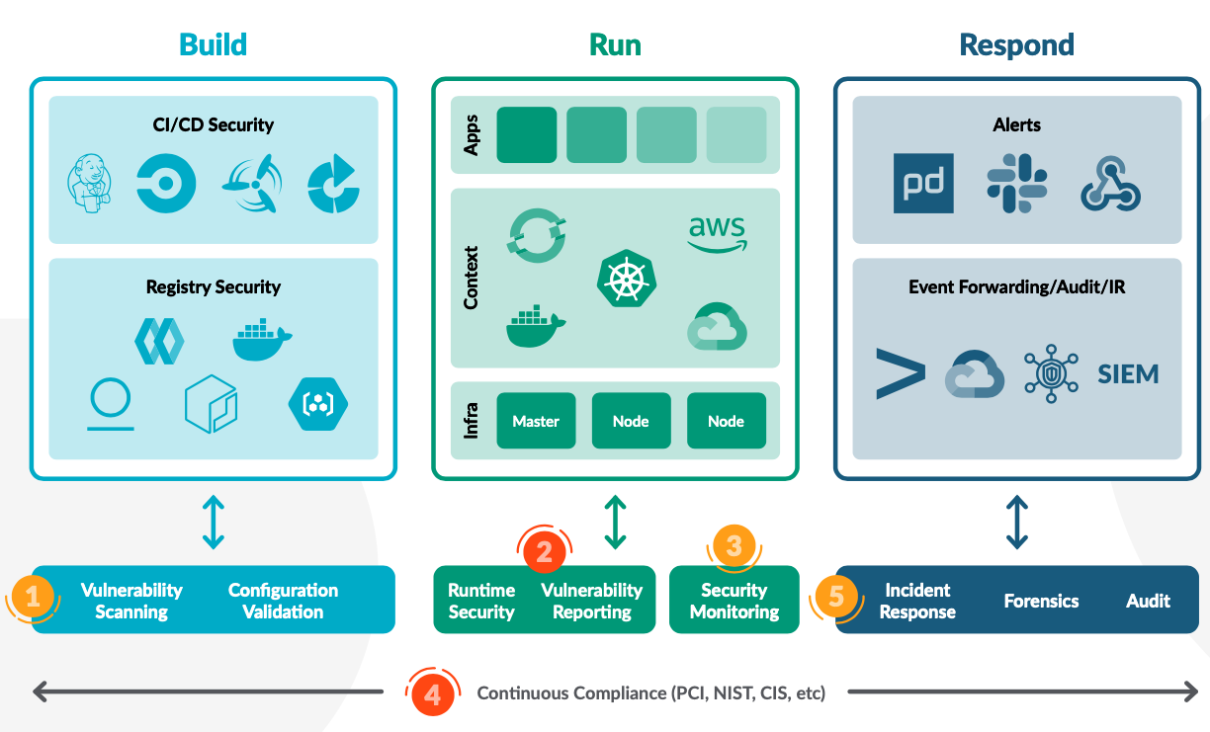
How runtime security fits into the workflow

Slide 7
Comparing Runtime Security Collection Technologies

Slide 8
container
Application
Operating System
Notes:
This technique consists of using an environment variable, LD_PRELOAD, to tell the operating system to load a different version of the libc dynamic library (glibc).

Slide 9
LD_PRELOAD
container
libc
Application
libc
Operating System
Notes:
This technique consists of using an environment variable, LD_PRELOAD, to tell the operating system to load a different version of the libc dynamic library (glibc).

Slide 10
Pros vs Cons: LD_PRELOAD
Can be applied to serverless and non-privileged environments
Not accurate, as it is an out of kernel based instrumentation
Can crash the target process
Limited support (e.g. doesn’t work with Go)
Requires instrumenting every container

Slide 11
ptrace
container
Application
agent
libc
Operating System
Notes:
ptrace is an advanced system call that makes it possible for a process with the right privileges to pause, introspect, modify and control another process. This is the model used in a sidecar instrumentation model. The PTRACE_SYSCALL feature allows a process to stop another one upon the execution of a system call and capture the system call arguments.

Slide 12
Pros vs Cons: ptrace
Accurate
Language and stack independent
Safer than LD_PRELOAD b/c it leverages the Operating System
Inefficient
Requires instrumenting every container

Slide 13
Kernel based instrumentation
Data Collection
Container 1
Docker
Container 2
Containerd
Container 3
CRI-O
Agent
eBPF Program
Host
Kernel

Slide 14
Pros vs Cons: Kernel instrumentation
Greater accuracy
Performance without compromise
Highly scalable (doesn’t need to run in every container)
Limited ability to collect data in serverless environments (Fargate, Lambda)

Slide 15
Enriched Context via Cloud/K8s Metadata instrumentation
HOST
HOST
HOST
Kubernetes
Docker
AWS
Azure
GKE AWS
Applications
HOST
HOST
HOST
HOST
HOST
HOST
HOST
HOST
HOST
SVC 1
SVC 2
SVC 3
SVC 4

Slide 16
Falco: Open-source runtime security engine

Slide 17
What is Falco?
What is Falco?
Runtime security engine
Observability from the kernel
Built on kmod/eBPF
Consumable / Modular
github.com/falcosecurity
Notes:
Falco created by Sysdig, donated to the CNCF
CNCF is part of the Linux foundation, and is responsible for Kubernetes development

Slide 18
Cloud Native Runtime Security
Container-centric Runtime Security
CNCF Incubating Project
Kernel Events as source of truth
Enriched with metadata
Assert against rules at runtime
Alert/Alarm during violation events
Jan 2016 First Commit
Oct 2018 Donated CNCF
Dec 2019 Promoted to Incubation
github.com/falcosecurity

Slide 19
Falco Open Source Ecosystem
Core Principles
Community Driven
End-Users
Vendors
Deeply integrated with Kubernetes and CNCF communities
Decision making in the open
Integrations built and supported by the community
Consumers of Falco and the Falco ecosystem
Contributors to the Falco ecosystem
PCI Compliance, SOC2, HIPAA
Observability, CVEs, Exploits, 0Day events
Sysdig Secure (scale)
SumoLogic
SkyScanner (scale)
PCI Compliance, HIPAA
Kubernetes Audit
Application Integration

Slide 20
Success with
Falco in Production at
Production Environment
Involvement with Open Source
Running Falco in PCI-compliant environment on AWS EC2 / EKS
Every day, Falco protects $100-150M in Shopify transactions
Falco enabled PCI-compliant lift and shift to AWS from data center
Integrated with Falco community and maintainers
Deploys Falco artifacts regularly as released
Presented production use case at KubeCon Europe Virtual keynote (see the replay on CNCF’s YouTube channel)
github.com/falcosecurity

Slide 21
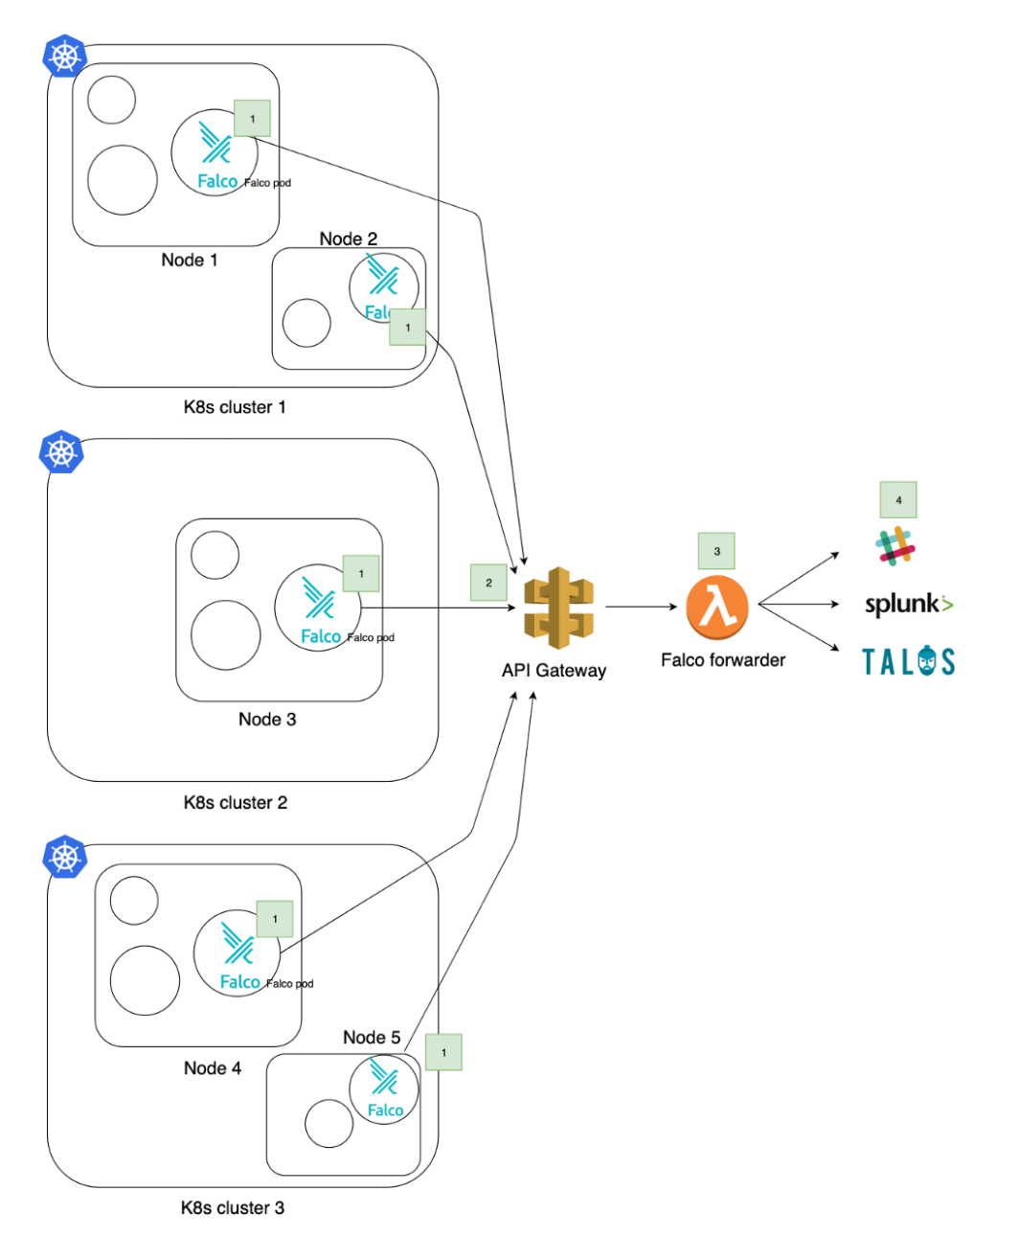
Falco in Production at
Production Environment
High Level Architecture
Running Falco with 2,000+ nodes across 30 clusters powering 160+ services on AWS Lambda
Core requirements: detect malicious activity at scale without hindering performance, integrate with service mapping tools
Read their use case - Medium, 1/29/20 https://medium.com/@SkyscannerEng/kubernetes-security- monitoring-at-scale-with-sysdig-falco-a60cfdb0f67a

Slide 22
Falco Architecture
API Layers
Optimized Performance
Integration Hooks
Input
Output
mTLS
Kernel Events
Container Meta
Kubernetes
Kubernetes Audit
gRPC
Webhook
Syslog
SDKs
Dynamic Rules

Slide 23
Resource Isolation
Resource Isolation
Application
Application
Application binaries
Application libraries
Application binaries
Application libraries
Output
Docker
Docker
Security Rules
System Calls
syscalls / eBPF
Kernel
Notes:
System calls monitored directly using a probe, or using eBPF packets

Slide 24
Node
Node
Pod
Pod
container
container
container
container
Pod
Pod
container
container
container
container
Output
Kubelet
Kubelet
Security Rules
Kubernetes Audit Webhook
Kubernetes Master

Slide 25
Falco Rules

Slide 26
Rule Examples
A shell is run in a container
container.id != host and proc.name = bash
Overwrite system binaries
fd.directory in (/bin, /sbin, /usr/bin, /usr/sbin) and write
Container namespace change
evt.type = setns and not proc.name in (docker, sysdig)
Non-device files written in /dev
(evt.type = create or evt.arg.flags contains O_CREAT) and proc.name != blkid and fd.directory = /dev and fd.name != /dev/null
Process tries to access camera
evt.type = open and fd.name = /dev/video0 and not proc.name in (skype, webex)

Slide 27
Sample Rule: DB spawns a shell
- rule: Database spawns a shell
condition: >
proc.pname in (db_server_binaries) and spawned_process
and not proc.name in (db_server_binaries)
and not postgres_running_wal_e
output: >
Database-related program spawned process other than itself
(user=%user.name program=%proc.cmdline parent=%proc.pname)
source: syscall
desc: >
Database-server program spawned a new process other than itself.
This shouldn't occur and is a follow on from some SQL injection attacks.
priority: WARNING
tags: [process, database]

Slide 28
Lists and Macros
- list: sensitive_file_names
items: [/etc/shadow, /etc/sudoers, /etc/pam.conf, /etc/security/pwquality.conf]
- macro: sensitive_files
condition: >
fd.name startswith /etc and
(fd.name in (sensitive_file_names)
or fd.directory in (/etc/sudoers.d, /etc/pam.d))

Slide 29
Falco MITRE Rule Matrix
Execution | Persistence | Privilege Escalation | Defense Evasion | Credential Access | Discovery | Lateral Movement | Exfiltration
DB program spawned process | Modify Shell Configuration File | Launch Privileged Container | Clear Log Activities | Read sensitive file trusted after startup | Read Shell Configuration File | Launch Privileged Container | System procs network activity
Run shell untrusted | Schedule Cron Jobs | Non sudo setuid | Delete Bash History | Read sensitive file untrusted | Read ssh information | Launch Sensitive Mount Container | Interpreted procs inbound network
Terminal shell in container | Update Package Repository |  |  | Search Private Keys or Passwords | Read sensitive file untrusted | Launch Disallowed Container | Interpreted procs outbound network
Netcat Remote Code Execution in Container | Write below binary dir Write below monitored dir |  |  |  | Contact K8S API Server From Container |  | Unexpected UDP Traffic
 | Write below etc Write below root Write below rpm database |  |  |  | Launch Suspicious Network Tool in Container |  | Launch Suspicious Network Tool in Container
 | Modify binary dirs Mkdir binary dirs |  |  |  | Launch Suspicious Network Tool on Host |  | Launch Suspicious Network Tool on Host
 | User mgmt binaries
 | Create files below dev
 | Launch Package Management Process in Container
 | Remove Bulk Data from Disk Set
 | Create Hidden Files or Directories
 | Setuid or Setgid bit
More info at: https://sysdig.com/blog/mitre-attck-framework-for-container-runtime-security-with-sysdig-falco

Slide 30
Demo

Slide 31
Falco Releases and Roadmap

Slide 32
Falco’s History
CNCF
Graduation
(target)
eBPF
support
CNCF
sandbox
GRPC interface
Poiana project automation
User Level
Capture
2016
2017
2018
2019
2020
2021
CNCF
incubation
Prometheus
integration
Falco
Released
K8s audit logs support

Slide 33
Recently Added Features
Rules Improvements
PSPs, MITRE framework, cryptoming
gRPC input/output interface
Integrations
Prometheus, Slack, ElasticSearch, AWS Lambda
Helm Chart
ptrace instrumentation
https://www.cncf.io/blog/2020/08/17/falco-update-whats-new-in-falco-0-25/

Slide 34
Roadmap
Expand our community by delighting our users
Lowering the barrier
Stability
Ease of deployment
Performance
Integrations
Platform coverage
AWS Fargate

Slide 35
Resources
The Falco project
falco.org
github.com/falcosecurity/falco
Try it yourself
https://falco.org/docs/installation/
Join the community
https://github.com/falcosecurity/community

Slide 36
Questions?

